Slide 1
Chapter 7 语义分析和中间代码产生

Slide 2
Outlines
静态检查和中间语言简介
静态语义检查
中间语言形式
后缀式
图表示法
DAG
抽象语法树
三地址代码
三元式
四元式
间接三元式

Slide 3
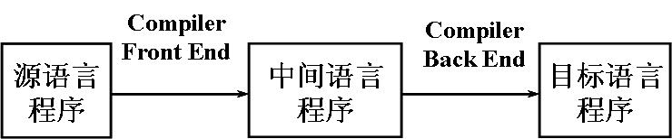
Static checking
词法分析和语法分析之后，编译程序的工作是进行静态语义检查和翻译
借助中间语言进行翻译
便于进行与机器无关的代码优化工作
使编译程序改变目标机更容易
使编译程序的结构在逻辑上更为简单明确
中间
代码
语法
分析器
静态
检查器
中间代码
产生器
优化器

Slide 4
Static checking
1）类型检查。
验证程序中执行的每个操作是否遵守语言的类型系统的过程，编译程序必须报告不符合类型系统的信息。
2）控制流检查。
控制流语句必须使控制转移到合法的地方。例如，在C语言中break语句使控制跳离包括该语句的最小while、for或switch语句。如果不存在包括它的这样的语句，则就报错
3）一致性检查。
在很多场合要求对象只能被定义一次。例如Pascal语言规定同一标识符在一个分程序中只能被说明一次，同一case语句的标号不能相同，枚举类型的元素不能重复出现等等

Slide 5
Static checking
4）相关名字检查。
有时，同一名字必须出现两次或多次。例如，Ada 语言程序中，循环或程序块可以有一个名字，出现在这些结构的开头和结尾，编译程序必须检查这两个地方用的名字是相同的。
5)名字的作用域分析

Slide 6
Intermediate language
常用的中间语言
后缀式表示法
图表示法
DAG
抽象语法树
三地址代码
三元式
四元式
间接三元式

Slide 7
Postfix notation
后缀式表示法又称逆波兰表示法
Lukasiewicz发明的一种表示表达式的方法
把运算量（操作数）写在前面，把算符写在后面
如a+b写成ab+
表达式E的后缀式
若E是一个变量或常量，则E的后缀式是E自身
若E是E₁ op E₂形式的表达式，则E的后缀式为
E₁′ E₂′op
op是任何二元操作符
E₁′ 和E₂′ 分别为E₁ 和E₂的后缀式
若E是(E₁)形式的表达式，则E₁的后缀式就是E的后缀式

Slide 8
Postfix notation
abc+*等价a*(b+c)
(a + b)*(c + d) → ab + cd +*
表达式 x+y≤z ∨ a＞0 ∧ (8+z) ＞3 的逆波兰表示为
表达式﹁A∨﹁（C∨﹁D）的逆波兰表示为

Slide 9
Postfix notation
abc+*等价a*(b+c)
(a + b)*(c + d) → ab + cd +*
表达式 x+y≤z ∨ a＞0 ∧ (8+z) ＞3 的逆波兰表示为
xy+z≤a0＞8z+3＞∧∨
表达式﹁A∨﹁（C∨﹁D）的逆波兰表示为
A﹁CD﹁∨﹁∨

Slide 10
Example
表达式 a ∧ b ∨ c ∧ (b ∨ x=0 ∧ c) 的逆波兰表示为 。
表达式 （A∨B）∧（C∨﹁D∧E）的逆波兰表示为 。

Slide 11
Example
表达式 a ∧ b ∨ c ∧ (b ∨ x=0 ∧ c) 的逆波兰表示为 。
表达式 （A∨B）∧（C∨﹁D∧E）的逆波兰表示为 。
ab∧cbx0=c∧∨∧∨
AB∨CD﹁E∧∨∧

Slide 12
Postfix notation
逆波兰表示法不用括号
只要知道每个算符的目数，对于后缀式，不论从哪一端进行扫描，都能对它进行唯一分解
后缀式的计算
用一个栈实现
一般的计算过程
自左至右扫描后缀式
每碰到运算量就把它推进栈
每碰到k目运算符就把它作用于栈顶的k个项
用运算结果代替这k个项
Notes:
板书简单的栈等

Slide 13
Postfix notation
把表达式翻译成后缀式的语义规则描述
产生式 语义规则
E→E₁opE₂ E.code:= E₁.code || E₂.code ||op
E→ (E₁) E.code:= E₁.code
E→id E.code:=id
E.code表示E后缀形式
op表示任意二元操作符
“||”表示后缀形式的连接

Slide 14
Graph
图表示法
DAG
抽象语法树
描述源程序的自然层次结构
无循环有向图(Directed Acyclic Graph，DAG)
对表达式中的每个子表达式，DAG中都有一个结点
一个内部结点代表一个操作符，它的孩子代表操作数
一个DAG中代表公共子表达式的结点具有多个父结点

Slide 15
DAG
a:=b*(-c)+b*(-c)
assign
assign
a
+
a
+
*
*
*
b
uminus
b
uminus
b
uminus
c
c
c
抽象语法树
DAG
更加紧凑

Slide 16
Abstract Syntax Tree
mknode（op，left，right）
建立一个运算符号结点
标号是op
两个域left和right分别指向左子树和右子树
mkleaf（id，entry）
建立一个标识符结点
标号为id
一个域eutry指向标识符在符号表中的入口
mkleaf（num，ral）
建立一个数结点
标号为num
一个域ral用于存放数的值

Slide 17
Abstract Syntax Tree
产 生 式 语 义 规 则
E→E₁+T E.nptr := mknode( ‘+’, E₁.nptr, T.nptr )
E→E₁-T E.nptr := mknode( ‘-’, E₁.nptr, T.nptr )
E→T E.nptr := T.nptr
T→ (E) T.nptr := E.nptr
T→id T.nptr := mkleaf( id, id.entry )
T→num T.nptr := mkleaf( num, num.val )

Slide 18
Three-address codes
一般形式
x := y op z
三地址代码包含三个地址
两个用来表示操作数
一个用来存放结果
表达式x + y ∗ z翻译成的三地址语句序列是
t₁ := y ∗ z
t₂ := x + t₁

Slide 19
Three-address codes
三地址代码是语法树或DAG的一种线性表示
a := (−b + c∗d ) + c∗d
语法树的代码 DAG的代码
t₁ := −b t₁ := −b
t₂ := c ∗ d t₂ := c ∗ d
t₃ := t₁ + t₂ t₃ := t₁ + t₂
t₄ := c ∗ d t₄ := t₃ + t₂
t₅ := t₃ + t₄ a := t₄
a := t₅
更加简洁
assign
a
+
+
uminus
∗
c
d
b

Slide 20
Three-address codes
赋值语句
x := y op z，x := op y，x := y
无条件转移
goto L
条件转移
if x relop y goto L
过程调用
param x和call p , n
过程返回
return y
索引赋值
x := y[i]和x[i] := y
地址和指针赋值
x := &y，x := ∗y和∗x := y

Slide 21
Quadruples
一个带有四个域的记录结构
这四个域分别称为op, arg1, arg2及result
例： a:=b*-c+b*-c 的四元式

Slide 22
Quadruples
一个带有四个域的记录结构
这四个域分别称为op, arg1, arg2及result
例： a:=b*-c+b*-c 的四元式
op arg1 arg2 result
(0) uminus c T₁
(1) * b T₁ T₂
(2) uminus c T₃
(3) * b T₃ T₄
(4) + T₂ T₄ T₅
(5) := T₅ a

Slide 23
Triples
通过计算临时变量值的语句的位置来引用这个临时变量
例： a:=b*-c+b*-c 的三元式
三个域：op、arg1和arg2
op arg1 arg2
(0) uminus c
(1) * b (0)
(2) uminus c
(3) * b (2)
(4) + (1) (3)
(5) assign a (4)

Slide 24
Triples
三元式中的多目运算符用若干相继的三元式表示
例如，x[i]:=y
op arg1 arg2
(0) [ ] = x i
(1) assign (0) y
又如， x:=y[i]
op arg1 arg2
(0) = [ ] y i
(1) assign x (0)

Slide 25
Indirect triples
三元式表+间接码表
用于中间代码表示
间接码表
一张指示器表
按运算的先后次序列出有关三元式在三元式表中的位置
优点
便于优化
节省空间

Slide 26
Indirect triples
例如，语句
X:=(A+B)*C;
Y:=D↑(A+B)
的间接三元式表示
三元式表
间接代码
(1)
(2)
(3)
(1)
(4)
(5)
 | OP | ARG1 | ARG2
(1) | + | A | B
(2) | * | (1) | C
(3) | = | X | (2)
(4) | ↑ | D | (1)
(5) | = | Y | (4)

Slide 27
Example
例 :
A + B * ( C - D ) + E / ( C - D ) ^N
分别用逆波兰、三元式、四元式表示。

Slide 28
Example
A + B * ( C - D ) + E / ( C - D ) ^N

Slide 29
Example
A + B * ( C - D ) + E / ( C - D ) ^N

Slide 30
Example
表达式 -a+b*c+d+(e*f)/d*e，如果优先级由高到低依次为-、+、*、/，且均为左结合，则其后缀式为 。
如果优先级由高到低依次为-、+、*、$（乘幂），且均为右结合，则表达式2+3-2+2*2*1$2$3-3-2+1的后缀式为 。
如果某表达式的后缀式为ab+cd+*，则其中缀形式的表达式为 。

Slide 31
Example
表达式 -a+b*c+d+(e*f)/d*e，如果优先级由高到低依次为-、+、*、/，且均为左结合，则其后缀式为 。
a-b+cd+ef*+*de*/
如果优先级由高到低依次为-、+、*、$（乘幂），且均为右结合，则表达式2+3-2+2*2*1$2$3-3-2+1的后缀式为 。
232-2++21**2332--1+$$
如果某表达式的后缀式为ab+cd+*，则其中缀形式的表达式为 。
(a+b) * (c+d)

Slide 32
Example
给出下面表达式的后缀式（逆波兰表示）
a*(-b+c)
if(x+y)*z=0 then s:=(a+b)*c else s:=a*b*c
用￥表示if-then-else 运算

Slide 33
Example
给出下面表达式的后缀式（逆波兰表示）
a*(-b+c)
if(x+y)*z=0 then s:=(a+b)*c else s:=a*b*c
用￥表示if-then-else 运算
解：
(1) ab-c+*
(2) xy+z*0=sab+c*:=sab*c*:=￥

Slide 34
第3题
请将表达式-(a+b)*(c+d)-(a+b)分别表示成三元式、间接三元式和四元式序列

Slide 35
第3题
请将表达式-(a+b)*(c+d)-(a+b)分别表示成三元式、间接三元式和四元式序列
解：
三元式 间接三元式
(1) (+ a, b) 间接三元式序列 间接码表
(2) (+ c, d) (1) (+ a, b) (1)
(3) (* (1), (2)) (2) (+ c, d) (2)
(4) (- (3), /) (3) (* (1), (2)) (3)
(5) (+ a, b) (4) (- (3), /) (4)
(6) (- (4), (5)) (5) (- (4), (1)) (1)
(5)
四元式
(1) (+, a, b, t1) (2) (+, c, d, t2)
(3) (*, t1, t2, t3) (4) (-, t3, /, t4)
(5) (+, a, b, t5) (6) (-, t4, t5, t6)

Slide 36
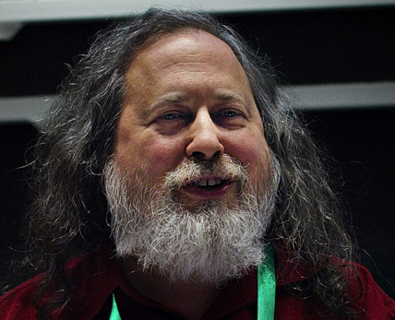

history
Richard Stallman
1971 MIT AI Lab
1985 GNU Manifesto
1985 FSF
1987 GCC
1991 Linux
Chris Lattner
2003 UIUC llvm
2005 Apple Clang

Slide 37
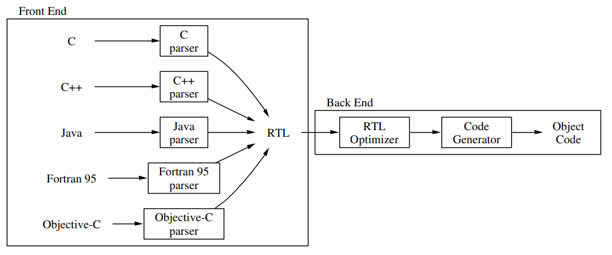
GCC IR
早期GCC架构
函数>RTL
GCC 3.0 函数>语法树>RTL

Slide 38
GCC IR
源语言>语法树>RTL>目标代码
语法树
语言相关
有副作用
结构复杂，一个语句可能有多个基本块
RTL
可以进行一些机器相关优化（寄存器分配、窥孔优化）
无数据结构（无数组、结构体等）
过早引入栈
添加一种IR

Slide 39
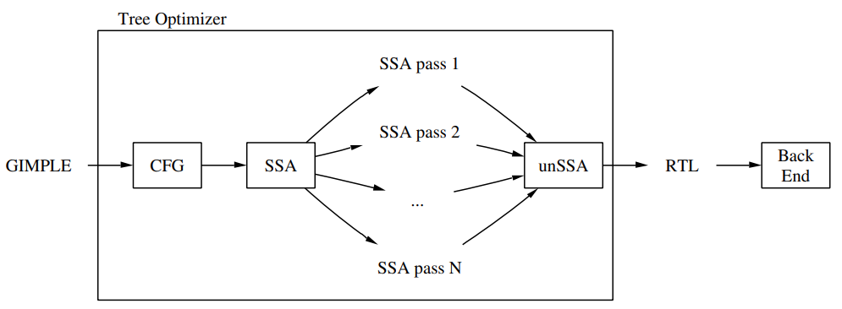
GCC IR
Tree SSA

Slide 40
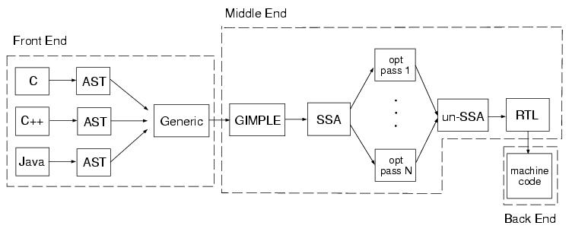
GCC IR
Gimple：主要的中间语言，基于McCat中的Simple

Slide 41
GCC IR
Gimple
三地址代码
有各种类型
有条件语句
有无限循环语句
有无条件跳转语句
有try catch

Slide 42
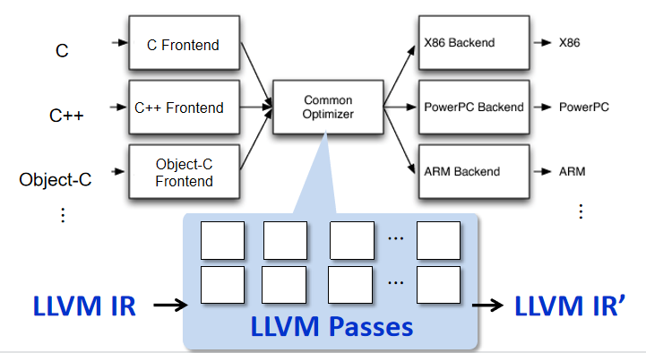
LLVM IR

Slide 43
LLVM IR
LLVM IR
语言无关
寄存器机器
无限寄存器
三地址代码
31个指令
SSA
基本块组成
带类型
控制流

Slide 44
LLVM IR At a Glance
C program language
LLVM IR
Scope: file, function
module, function
Type: bool, char, int, struct{int, char}
i1, i8, i32, {i32, i8}
A statement with multiple expressions
A sequence of instructions each of which is in a form of “x = y op z”.
Data-flow: a sequence of reads/writes on variables
1. load the values of memory addresses (variables) to registers;
2. compute the values in registers;
3. store the values of registers to memory addresses
* each register must be assigned exactly once (SSA)
Control-flow in a function: if, for, while, do while, switch-case,…
A set of basic blocks each of which ends with a conditional jump (or return)

Slide 45
Example
simple.c
simple.ll (simplified)
…
6 @x = common global i32 0, align 4
7 @y = common global i32 0, align 4
11 define i32 @main() #0 {
12 entry:
…
14 %t = alloca i32, align 4
…
16 %call = call i32 (i8*, ...)*
@__isoc99_scanf(…i32* @x,i32* @y)
17 %0 = load i32* @x, align 4
18 %1 = load i32* @y, align 4
19 %sub = sub nsw i32 %0 %1
20 store i32 %sub, i32* %t, align 4
21 %2 = load i32* %t, align 4
22 %cmp = icmp sgt i32 %2, 0
23 br i1 %cmp, label %if.then, label %if.end
24 if.then:
25 %call1 = call i32 … @printf(…
26 br label %if.end
27 if.end:
28 ret i32 0
1
2
3
4
5
6
7
8
9
10
11
#include <stdio.h>
int x, y ;
int main() {
int t ;
scanf(“%d %d”,&x,&y);
t = x – y ;
if (t > 0)
printf(“x > y”) ;
return 0 ;
}
2
4
5
6
7
8
9
$ clang –S –emit-llvm simple.c
10

Slide 46
Contents
LLVM IR Instruction
architecture, static single assignment
Data representation
types, constants, registers, variables
load/store instructions, cast instructions
computational instructions
Control representation
control flow (basic block)
control instructions
How to instrument LLVM IR
* LLVM Language Reference Manual http://llvm.org/docs/LangRef.html
* Mapping High-Level Constructs to LLVM IR http://llvm.lyngvig.org/Articles/Mapping-High-Level-Constructs-to-LLVM-IR

Slide 47
LLVM IR Architecture
RISC-like instruction set
Only 31 op-codes (types of instructions) exist
Most instructions (e.g. computational instructions) are in three-address form: one or two operands, and one result
Load/store architecture
Memory can be accessed via load/store instruction
Computational instructions operate on registers
Infinite and typed virtual registers
It is possible to declare a new register any point (the backend maps virtual registers to physical ones).
A register is declared with a primitive type (boolean, int, float, pointer)

Slide 48
Static Single Assignment (1/2)
In SSA, each variable is assigned exactly once, and every variable is defined before its uses.
Conversion
For each definition, create a new version of the target variable (left-hand side) and replace the target variable with the new variable.
For each use, replace the original referred variable with the versioned variable reaching the use point.
1
2
3
4
5
6
x = y + x ;
y = x + y ;
if (y > 0)
x = y ;
else
x = y + 1 ;
11
12
13
14
15
16
x1 = y0 + x0 ;
y1 = x1 + y0 ;
if (y1 > 0)
x2 = y1 ;
else
x3 = y1 + 1 ;

Slide 49
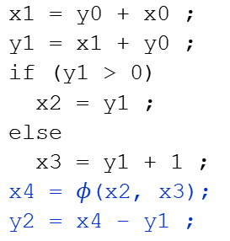
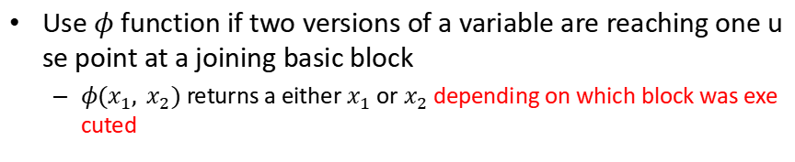
Static Single Assignment (2/2)
Use $φ$ function if two versions of a variable are reaching one use point at a joining basic block
$φ(x_{1}, x_{2})$ returns a either $x_{1}$ or $x_{2}$ depending on which block was executed
1
2
3
4
5
6
7
x = y + x ;
y = x + y ;
if (y > 0)
x = y ;
else
x = y + 1 ;
y = x – y ;
11
12
13
14
15
16
17
18
x1 = y0 + x0 ;
y1 = x1 + y0 ;
if (y1 > 0)
x2 = y1 ;
else
x3 = y1 + 1 ;
x4 = $φ$(x2, x3);
y2 = x4 – y1 ;

Slide 50
Data Representations
Primitive types
Constants
Registers (virtual registers)
Variables
local variables, heap variables, global variables
Load and store instructions
Aggregated types

Slide 51
Primitive Types
Language independent primitive types with predefined sizes
void: void
bool: i1
integers: i[N] where N is 1 to 2²³-1 e.g. i8, i16, i32, i1942652
floating-point types: half (16-bit floating point value) float (32-bit floating point value) double (64-bit floating point value)
Pointer type is a form of <type>* (e.g. i32*, (i32*)*)

Slide 52
Constants
Boolean (i1): true and false
Integer: standard integers including negative numbers
Floating point: decimal notation, exponential notation, or hexadecimal notation (IEEE754 Std.)
Pointer: null is treated as a special value

Slide 53
Registers
Identifier syntax
Named registers: [%][a-zA-Z$._][a-zA-Z$._0-9]*
Unnamed registers: [%][0-9][0-9]*
A register has a function-level scope.
Two registers in different functions may have the same identifier
A register is assigned for a particular type and a value at its first (and the only) definition

Slide 54
Variables
In LLVM, all addressable objects (“lvalues”) are explicitly allocated.
Global variables
Each variable has a global scope symbol that points to the memory address of the object
Variable identifier: [@][a-zA-Z$._][a-zA-Z$._0-9]*
Local variables
The alloca instruction allocates memory in the stack frame.
Deallocated automatically if the function returns.
Heap variables
The malloc function call allocates memory on the heap.
The free function call frees the memory allocated by malloc.

Slide 55
Load and Store Instructions
Load
<result>=load <type>* <ptr>
result: the target register
type: the type of the data (a pointer type)
ptr: the register that has the address of the data
Store
store <type> <value>,<type>* <ptr>
type: the type of the value
value: either a constant or a register that holds the value
ptr: the register that has the address where the data should be stored
Memory
CPU
Address | Var
0
1 | x
…
99 | y
100
Virtual registers
%0
%1
ALU
load
%x
%y
store

Slide 56
Variable Example
1 #include <stdlib.h>
2
3 int g = 0 ;
4
5 int main() {
6 int t = 0;
7 int * p;
8 p=malloc(sizeof(int));
9 free(p);
10 }
1 @g = global i32 0, align 4
…
8 define i32 @main() #0 {
…
%t = alloca i32, align 4
11 store i32 0, i32* %t, align 4
12 %p = alloca i32*, align 8
13 %call = call noalias i8* @malloc(i64 4) #2
14 %0 = bitcast i8* %call to i32*
15 store i32* %0, i32** %p, align 8
16 %1 = load i32** %p, align 8
…
Notes:
#0: attribute groups

Slide 57
Aggregate Types and Function Type
Array: [<# of elements> x <type>]
Single dimensional array ex: [40 x i32], [4 x i8]
Multi dimensional array ex: [3 x [4 x i8]], [12 x [10 x float]]
Structure: type {<a list of types>}
E.g. type{ i32, i32, i32 }, type{ i8, i32 }
Function: <return type> (a list of parameter types)
E.g. i32 (i32), float (i16, i32*)*

Slide 58
Getelementptr Instruction
A memory in an aggregate type variable can be accessed by load/store instruction and getelementptr instruction that obtains the pointer to the element.
Syntax:
<res> = getelementptr <pty>* <ptrval>{,<t> <idx>}*
res: the target register
pty: the register that defines the aggregate type
ptrval: the register that points to the data variable
t: the type of index
idx: the index value

Slide 59
Aggregate Type Example 1
1 struct pair {
2 int first;
3 int second;
4 };
5 int main() {
6 int arr[10];
7 struct pair a;
8 a.first = arr[1];
…
%struct.pair = type{ i32, i32 }
define i32 @main() {
entry:
%arr = alloca [10 x i32]
%a = alloca %struct.pair
%arrayidx = getelementptr
[10 x 32]* %arr,i32 0,i64 1
%0 = load i32* %arrayidx
%first = getelementptr %struct.pair* %a,i32 0,i32 0
%store i32 %0, i32* %first
11
12
13
14
15
16
17
18
19

Slide 60
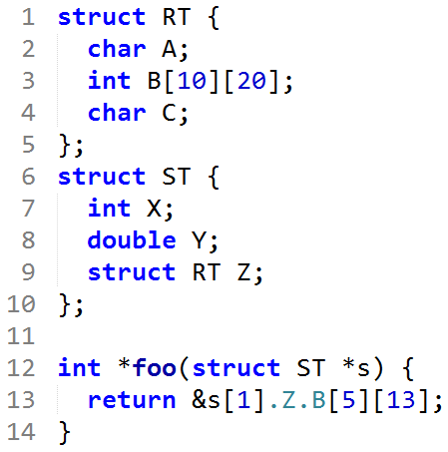
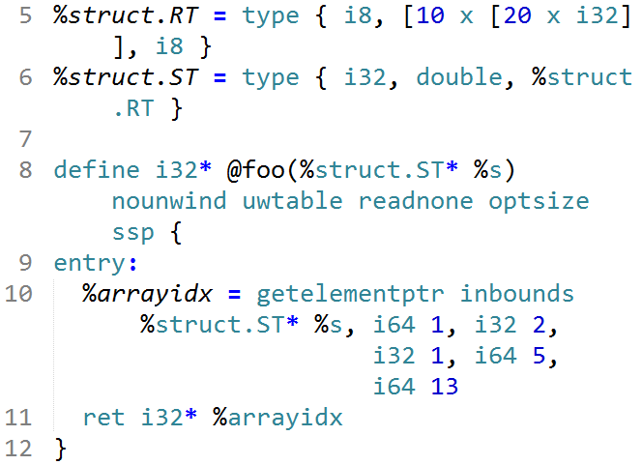
Aggregate Type Example 2

Slide 61
Integer Conversion (1/2)
Truncate
Syntax: <res> = trunc <iN1> <value> to <iN2> where iN1 and iN2 are of integer type, and N1 > N2
Examples
%X = trunc i32 257 to i8 ;%X becomes i8:1
%Y = trunc i32 123 to i1 ;%Y becomes i1:true
%Z = trunc i32 122 to i1 ;%Z becomes i1:false

Slide 62
Integer Conversion (2/2)
Zero extension
<res> = zext <iN1> <value> to <iN2> where iN1 and iN2 are of integer type, and N1 < N2
Fill the remaining bits with zero
Examples
%X = zext i32 257 to i64 ;%X becomes i64:257
%Y = zext i1 true to i32 ;%Y becomes i32:1
Sign extension
<res> = sext <iN1> <value> to <iN2> where iN1 and iN2 are of integer type, and N1 < N2
Fill the remaining bits with the sign bit (the highest order bit) of value
Examples
%X = sext i8 -1 to i16 ;%X becomes i16:65535
%Y = sext i1 true to i32 ;%Y becomes i32:2³²-1

Slide 63
Other Conversions
Float-to-float
fptrunc .. to, fpext .. to
Float-to-integer (vice versa)
fptoui .. to, tptosi .. to, uitofp .. to, sitofp .. to
Pointer-to-integer
ptrtoint .. to, inttoptr .. to
Bitcast
<res> = bitcast <t1> <value> to <t2> where t1 and t2 should be different types and have the same size

Slide 64
Computational Instructions
Binary operations:
Add: add, sub , fsub
Multiplication: mul , fmul
Division: udiv , sdiv , fdiv
Remainder: urem , srem , frem
Bitwise binary operations
shift operations: shl , lshl , ashr
logical operations: and , or , xor

Slide 65
Add Instruction
<res> = add [nuw][nsw] <iN> <op1>, <op2>
nuw (no unsigned wrap): if unsigned overflow occurs, the result value becomes a poison value (undefined)
E.g: add nuw i8 255, i8 1
nsw (no signed wrap): if signed overflow occurs, the result value becomes a poison value
E.g. add nsw i8 127, i8 1

Slide 66
Control Representation
The LLVM front-end constructs the control flow graph (CFG) of every function explicitly in LLVM IR
A function has a set of basic blocks each of which is a sequence of instructions
A function has exactly one entry basic block
Every basic block is ended with exactly one terminator instruction which explicitly specifies its successor basic blocks if there exist.
Terminator instructions: branches (conditional, unconditional), return, unwind, invoke
Due to its simple control flow structure, it is convenient to analyze, transform the target program in LLVM IR

Slide 67
Label, Return, and Unconditional Branch
A label is located at the start of a basic block
Each basic block is addressed as the start label
A label x is referenced as register %x whose type is label
The label of the entry block of a function is “entry”
Return ret <type> <value> | ret void
Unconditional branch br label <dest>
At the end of a basic block, this instruction makes a transition to the basic block starting with label <dest>
E.g: br label %entry

Slide 68
Conditional Branch
<res> = icmp <cmp> <ty> <op1>, <op2>
Returns either true or false (i1) based on comparison of two variables (op1 and op2) of the same type (ty)
cmp: comparison option
eq (equal), ne (not equal), ugt (unsigned greater than), uge (unsigned greater or equal), ult (unsigned less than), ule (unsigned less or equal), sgt (signed greater than), sge (signed greater or equal), slt (signed less than), sle (signed less or equal)
br i1 <cond>, label <thenbb>, label <elsebb>
Causes the current execution to transfer to the basic block <thenbb> if the value of <cond> is true; to the basic block <elsebb> otherwise.
Example:
11 %0 = load i32* %x
12 %1 = load i32* %y
13 %cmp = icmp sgt i32 %0, %1
14 br i1 %cmp, label %if.then, label %if.end
15 if.then:
…
1 if (x > y)
2 return 1 ;
3 return 0 ;

Slide 69
Switch
switch <iN> <value>, label <defaultdest> [<iN> <val>, label <dest> …]
Transfer control flow to one of many possible destinations
If the value is found (val), control flow is transferred to the corresponding destination (dest); or to the default destination (defaultdest)
Examples:
1
2
3
4
5
6
7
8
switch(x) {
case 1:
break ;
case 2:
break ;
default:
break ;
}
11
12
13
14
15
16
17
18
19
20
21
%0 = load i32* %x
switch i32 %0, label %sw.default [
i32 1, label %sw.bb
i32 2, label %sw.bb1]
sw.bb:
br label %sw.epilog
sw.bb1:
br label %sw.epilog
sw.default:
br label %sw.epilog
sw.epilog:
…

Slide 70

PHI ($Φ$) instruction
<res> = phi <t> [ <val_0>, <label_0>], [ <val_1>, <label_1>], …
Return a value val_i of type t such that the basic block executed right before the current one is of label_i
Example
11 %0 = load i32* %x
12 %c = icmp sgt i32 %0 0
13 br i1 %c, label %c.t, %c.f
14 c.t:
15 %1 = load i32* %x
16 br label %c.end
17 c.f:
18 br label %c.end
19 c.end:
20 %cond = phi i32 [%1, %c.t], [0, %c.f]
21 store i32 %cond, i32* %y
1 y = (x > 0) ? x : 0 ;

Slide 71
Function Call
<res> = call <t> [<fnty>*] <fnptrval>(<fn args>)
t: the type of the call return value
fnty: the signature of the pointer to the target function (optional)
fnptrval: an LLVM value containing a pointer to a target function
fn args: argument list whose types match the function signature
Examples:
11 @.str = [3 x i8] c”%d\00”
12 %0 = load i32* %x
13 %call = call i32 @abs(i32 %0)
14 %call1 = call i32 (i8*, ...)* @printf(i8* getelementptr ([3 x i8]* @.str, i32 0, i32 0), i32 %call)
1 printf(“%d”, abs(x));

Slide 72
Unaddressed Issues
Many options/attributes of instructions
Vector data type (SIMD style)
Exception handling
Object-oriented programming specific features
Concurrency issues
Memory model, synchronization, atomic instructions
* http://llvm.org/docs/LangRef.html

Slide 73
参考资料
gcc与clang/llvm比较
https://www.alibabacloud.com/blog/gcc-vs--clangllvm-an-in-depth-comparison-of-cc%2B%2B-compilers_595309
https://stackoverflow.com/questions/40799696/how-is-gcc-ir-different-from-llvm-ir
https://blog.csdn.net/m0_37477061/article/details/85993447
Architecture of llvm
http://www.aosabook.org/en/llvm.html

Slide 74
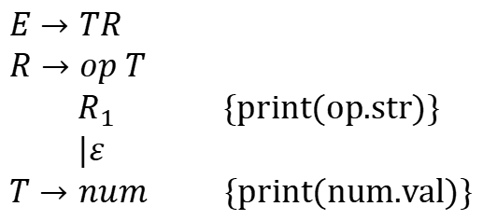
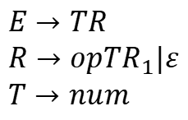
语法制导的翻译方案
Syntax-Directed Translation scheme SDT
产生式中嵌入了程序片段
中缀表达式转后缀表达式
$$E→TR$$
$$R→op T$$
$R_{1}$ {print(op.str)}
$|ε$
$T→num$ {print(num.val)}
$$E→TR$$
$$R→opTR_{1}|ε$$
$$T→num$$

Slide 75

说明语句
语法
$D→T id ; D | ε$
$T→BC$
$B→int|float$
$C→ε|[num]C$
语义
变量名
变量类型 type
变量地址 offset / 变量大小 width

Slide 76
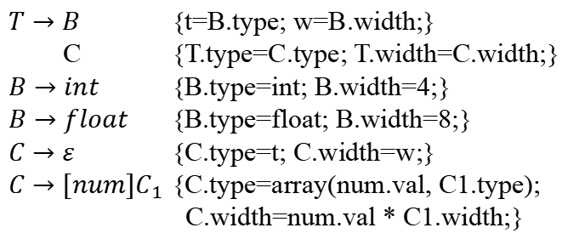
说明语句
类型
$T→B$ {t=B.type; w=B.width;}
C {T.type=C.type; T.width=C.width;}
$B→int$ {B.type=int; B.width=4;}
$B→float$ {B.type=float; B.width=8;}
$C→ε$ {C.type=t; C.width=w;}
$C→[num]C_{1}$ {C.type=array(num.val, C1.type);
C.width=num.val * C1.width;}

Slide 77
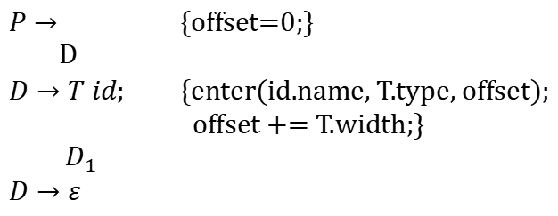
说明语句
变量
$P→$ {offset=0;}
D
$D→T id;$ {enter(id.name, T.type, offset);
offset += T.width;}
$D_{1}$
$D→ε$

Slide 78

算术表达式
语法
$S→id=E$
$E→E_{1}+E_{2}$
$E→E_{1}∗E_{2}$
$E→−E_{1}$
$E→(E_{1})$
$E→id$
三地址代码
addr1 = addr2 + addr 3
get( var )
new temp()

Slide 79
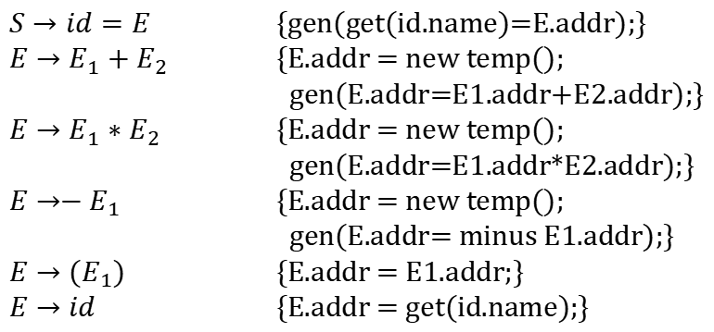
算术表达式
增量翻译
$S→id=E$ {gen(get(id.name)=E.addr);}
$E→E_{1}+E_{2}$ {E.addr = new temp();
gen(E.addr=E1.addr+E2.addr);}
$E→E_{1}∗E_{2}$ {E.addr = new temp();
gen(E.addr=E1.addr*E2.addr);}
$E→−E_{1}$ {E.addr = new temp();
gen(E.addr= minus E1.addr);}
$E→(E_{1})$ {E.addr = E1.addr;}
$E→id$ {E.addr = get(id.name);}

Slide 80
其他内容
布尔表达式
控制流
类型检查
等等……

