Slide 1
1. Background
In 2003
Energy markets have been established
such as PJM in USA, Nord Pool and EPEX Spot in EU,
JEPX in Japan
Supply-demand balance will be kept
based on mainly energy markets, whose player is aggregator.
A large amount of photovoltaic power generation equipment and storage batteries will be introduced [1].
Does the storage battery continue to be introduced?
What is a reasonable strategy of aggregator?
Purpose
We analyze a profit of each aggregator with respect to a penetration level of storage batteries.
[1] T.Masuta, et al., IEEE Transactions on smart grid, vol.3,no.3, pp.1253-1262, 2012.
Notes:
Energy markets have been established such as PJM in USA, Nord Pool, EPEX Spot in EU and JEPX in JAPAN．
In near future，supply-demand balance will be kept mainly based on an energy markets, whose player is aggregator.
Furthermore, it is expected that，a large amount of photovoltaic power generation equipment and storage batteries will be introduced.
In this situation, We would like to know answers of the following questions.
Does the storage battery continue to be introduced?
What is a reasonable strategy of aggregator?
So, we analyze a profit of each aggregator with respect to a penetration level of storage batteries.

Slide 2








2.1 Day-ahead Multiperiod Energy Markets
ISO
Price [Yen/kWh]
Energy Markets
Sell
Time[h]
Buy
Energy [kWh]
Energy [kWh]
Energy [kWh]
0
Time[h]
Time[h]
Time[h]
Agg.#1
Agg.#2
Agg.#n
Prosumption energy schedule on the following day is bought and sell based on clearing price.
Notes:
We focus on the day-ahead multiperiod energy markets.
Players of the markets are aggregators.
Each aggregator has resources.
An Operator of the markets is ISO.
In this markets, prosumption energy schedule on the following day is bought and sell based on clearing price.

Slide 3
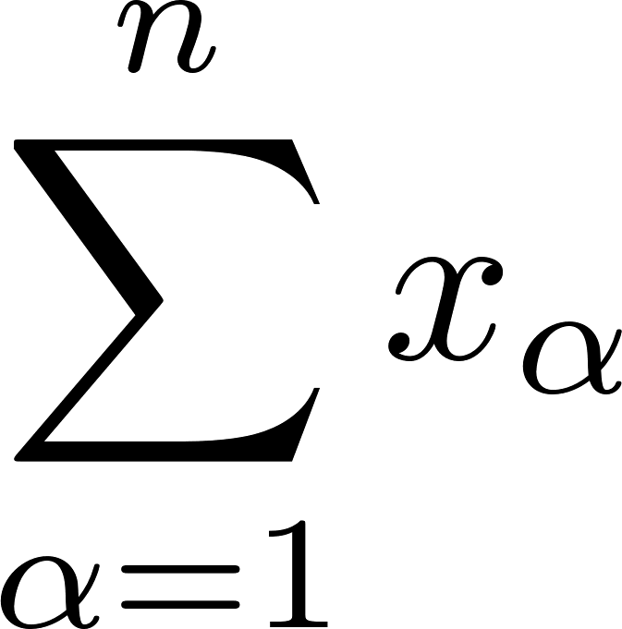
Decision process of clearing price & prosumption energy schedule
Step2
ISO
Total Energy for all aggregators [kWh]
Price [Yen/kWh]
0
Energy Markets
Sell
Time[h]
Time[h]
Energy [kWh]
Buy
0
Step1
Time[h]
Bid function (JEPX in Japan)
Spot #1
Spot #2
Spot #8
Energy [kWh]
Energy [kWh]
0
Energy [kWh]
0
0
Price [Yen/kWh]
Price [Yen/kWh]
Price [Yen/kWh]
Agg.#1
Aggregator must produce and consume energy so as to follow the schedule.
Notes:
I explain about decision process of clearing price and prosumption energy schedule.
Step1, each aggregator presents bid function.
Bid function possesses relationship between price and prosumption energy aggregator want to buy or sell.
Step2, based on bid function, ISO find clearing price and appropriate prosumption enrgy for each aggrigator such that total prosumption energy for all aggregators is 0.
which means keeping supply-demand balance.
This is decision process.
In the day of interest, Aggregator must produce and consume energy following the profile.

Slide 4

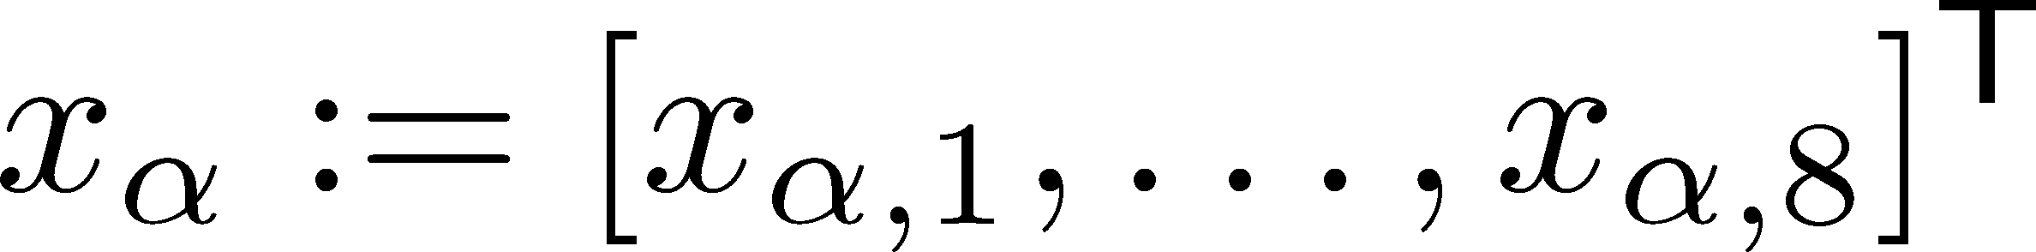

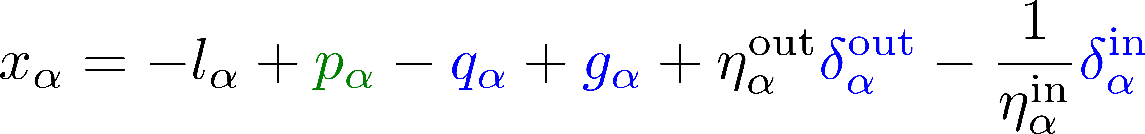








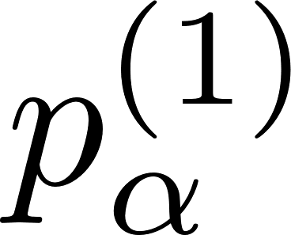
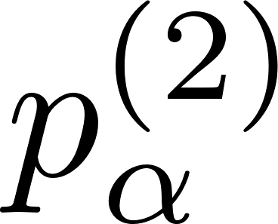
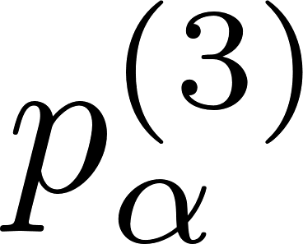
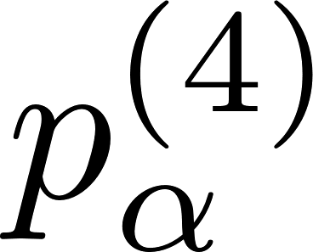
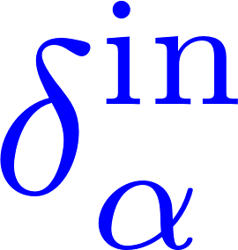

2.2 Proposed Aggregator Model [2]
Agg.#
Prosumption profile for the th aggregator
given
Prosumption
Load
PV
Suppression
Thermal
plant
C/D power
Time[h]
Time[h]
Time[h]
Time[h]
Time[h]
Time[h]
: Load of consumer
: Generating power of PV equipment
: PV suppression
given
: generating power of
the thermal power plant
: C/D power of storage batteries
Time[h]
Time[h]
Time[h]
Time[h]
Notes:
Next, I explain about aggregator model proposed in this reference.
Please focus on aggregator No.$\alpha$.
Aggregator possesses consumer, PV equipment, thermal power plant, and storage battery.
By using these resources, Aggregator create the prosumption profile $x_\alpha$.
which can be described as like this.
If there are eight spots a day, then dimension of $x_\alpha$ is eight.
\green{These symbols correspond to load of consumer,...., and C/D power of storage batteries}
In order to consider uncertainty of PV prediction, we treat with PV as scenarios.
For example, we prepare scenario no.1 to no.4.
●
Even if any PV scenario arises on the day of interest, we would like to realize the prosumption profile as one pattern.
To this end, It is need to absorb the uncertainty using the other resources.
If PV scenario no.1 arises, then aggregator operates resources like this.
If PV scenario no.2 arises, then aggregator choses this motion.
As a result, the prosumption profile will never change.

Slide 5

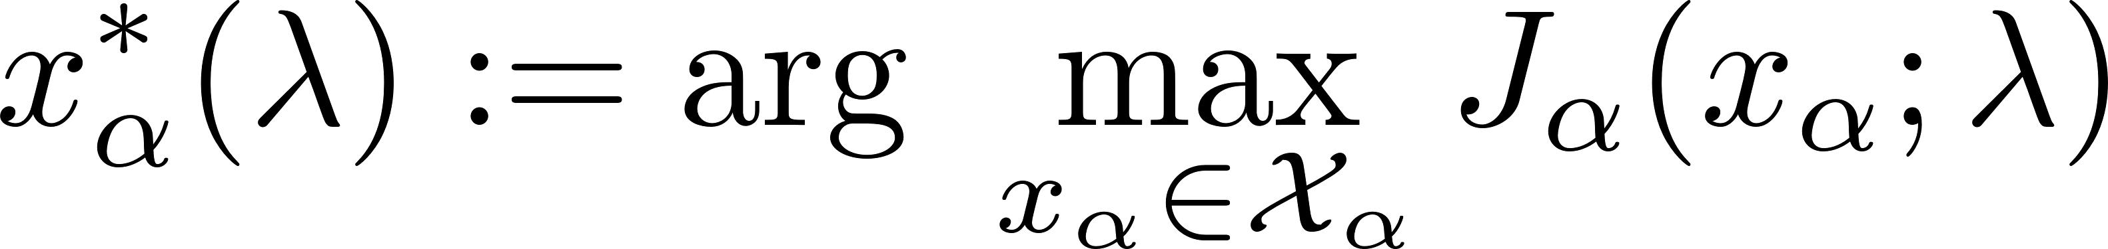
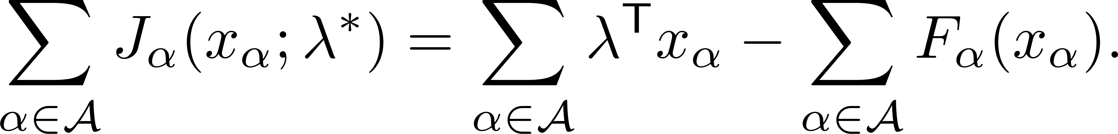
2.3 Multiperiod Energy Markets Model
Task for Aggregator
Given price ,
,where
Income
Cost
Task for ISO
Under keeping the supply-demand balance,
ISO aims to maximize the social profit
Notes:
This statement shows a task for aggregator
Given price profile $\lambda$, aggregator would like to find the optimal prosumption profile such that this object function is maximized.
This term indicates income from the market, this term represents cost to create the prosumption profile.
On the other hand, this statement shows a task for ISO.．
Under keeping the supply-demand balance, ISO aims to maximize the social profit．
which corresponds to sum of the profits of all aggregators.

Slide 6
Agg.#1
PV: 8 [GW]
Agg.#2
PV: 9 [GW]

Slide 7
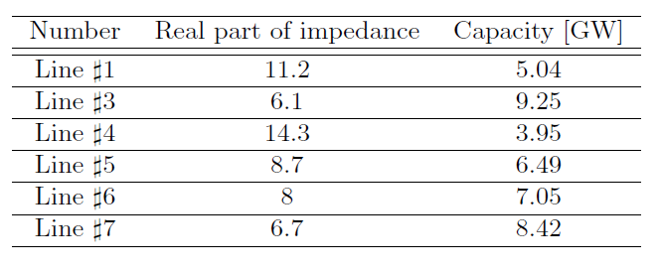
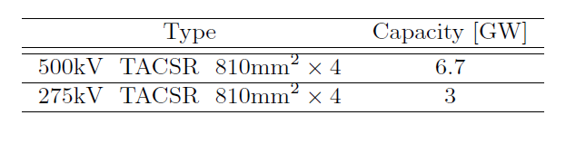
Transmission capacity

