Slide 1
Part 2: Designing Research Questions

Slide 2
Krathwahl’s Model of the Chain of Reasoning in Quantitative Studies
Notes:
Talk about going up and down the rings (even if you have a research design in mind, you need to be able to back up and think about the question independent of the design)
Similarly with the OLS model – need to be able to say what would be wrong with it (related: need to make sure the more complicated design is necessary!)

Slide 3
Krathwahl’s Model of the Chain of Reasoning in Quantitative Studies
Conclusions from previous research studies
Explanation, rationale, theory, or point of view
Questions, Hypotheses, predictions, models
Design or structure of the study
Gathering data, analysis, conclusions…

Slide 4
Krathwahl’s Model of the Chain of Reasoning in Quantitative Studies
Conclusions from previous research studies
Explanation, rationale, theory, or point of view
Questions, Hypotheses, predictions, models
Design or structure of the study
Gathering data, analysis, conclusions…

Slide 5
Krathwahl’s Model of the Chain of Reasoning in Quantitative Studies
Conclusions from previous research studies
Explanation, rationale, theory, or point of view
Questions, Hypotheses, predictions, models
Design or structure of the study
Gathering data, analysis, conclusions…

Slide 6
Krathwahl’s Model of the Chain of Reasoning in Quantitative Studies
Conclusions from previous research studies
Explanation, rationale, theory, or point of view
Questions, Hypotheses, predictions, models
Design or structure of the study
Gathering data, analysis, conclusions…
Measures
RQ’s
Operationalizations

Slide 7
Designing Research Questions
“Your first step should be to articulate a set of specific research questions. Good design flows from clear goals… Well crafted research questions guide the systematic planning of research. Formulating your questions precisely enables you to design a study with a good chance of answering them.”
From By Design: Planning Research on Higher Education, by Light, Singer, and Willett (1990)

Slide 8
Why are research questions so important?
Research questions:
Identify the target population
Identify the outcome variables
Identify the key predictors
Determine whether a descriptive, relational, or (quasi)experimental study is most appropriate
Raise challenges for measurement and data collection
Determine every facet of research design
From By Design: Planning Research on Higher Education, by Light, Singer, and Willett (1990)

Slide 9
Pull up your list of questions
“Now comes the hard part: Get Specific.”
Write out one research questions based on your brainstorming. Try to pick one that has a causal element to it
Causal Research: Identifies impacts and effects of an identifiable thing
Descriptive Research: Documents the state of something or describes processes
Focus on the concepts you have identified. We will talk about how to operationalize and measure these concepts next.

Slide 10
Example Research Questions
How does higher education performance funding affect degree productivity?
Does public school for young children increase maternal labor supply?
Does public spending crowd out/in private donations?
Notes:
Is it one research question, or should it be broken up into multiple ones?
Is it general enough?
Is it causal? Does the proposed causation make sense? (note: this step is ONLY because of the nature of this class – everything else we have talked about could apply to different types of question)

Slide 11
Designing research questions
“Now comes the hard part: Get specific. Examine every outcome on your list. Define it. Refine that definition. Think about how you would measure it. Do the same for every predictor. Identify the target population of greatest interest. Should it include anyone else? Be as precise as you can – the clearer, the better.”
From By Design: Planning Research on Higher Education, by Light, Singer, and Willett (1990)

Slide 12
Conceptualization and Operationalization
Operationalization: The process of specifying the measures that will indicate the value of cases on a variable
Indicator: The question or other operation used to indicate the value of cases on a variable
From Investigating the Social World: The Process and Practice of Research, by Schutt (2012)

Slide 13
Example Research Questions
How does higher education performance funding affect degree productivity?
Does public school for young children increase maternal labor supply?
Does public spending crowd out/in private donations?

Slide 14
What concepts need to be defined?
How does higher education performance funding affect degree productivity?
Does public school for young children increase maternal labor supply?
Does public spending crowd out/in private donations?

Slide 15
What concepts need to be defined?
How does higher education performance funding affect degree productivity?
Does public school for young children increase maternal labor supply?
Does public spending crowd out/in private donations?

Slide 16
What concepts need to be defined?
How does higher education performance funding affect degree productivity?
Does public school for young children increase maternal labor supply?
Does public spending crowd out/in private donations?

Slide 17
What concepts need to be defined?
How does higher education performance funding affect degree productivity?
Does public school for young children increase maternal labor supply?
Does public spending crowd out/in private donations?

Slide 18
Conceptualization and Operationalization
Conceptualization and Operationalization of Social Control
Concept | Definition | Types | Possible Operational Indicators
Social Control | The normative aspect of social life | Law Etiquette Customs Bureaucracy Psychiatric Treatment | Legal rules; punishments; police stops Handbooks Gossip; aphorisms Official conduct rules; promotion procedures Rules for dangerousness; competency hearings
From Investigating the Social World: The Process and Practice of Research, by Schutt (2012)

Slide 19
What concepts need to be defined?
How does higher education performance funding affect degree productivity?

Slide 20
What concepts need to be defined?
How does higher education performance funding affect degree productivity?
Washington Student Achievement Initiative for community colleges

Slide 21
What concepts need to be defined?
How does higher education performance funding affect degree productivity?
Washington Student Achievement Initiative for community colleges
Retention rates
Certificates awarded
Associate’s degrees awarded

Slide 22
What concepts need to be defined?
How does higher education performance funding affect degree productivity?
Washington Student Achievement Initiative for community colleges
Retention rates
Certificates awarded
Associate’s degrees awarded
Next you would consider how to measure these things – sometimes it is straightforward, sometimes it is not

Slide 23
Does public spending crowd out/in private donations?
Concepts

Slide 24
Does public spending crowd out/in private donations?
Concepts
Operational Indicators
Government grants
Private donations to charity

Slide 25
Does public spending crowd out/in private donations?
Concepts
Operational Indicators
Government grants
Private donations to charity
IRS return documentation for 501(c)(3) revenue reported as direct and indirect public support
Measures
IRS return documentation for 501(c)(3) revenue reported as Government grants and program service revenue

Slide 26
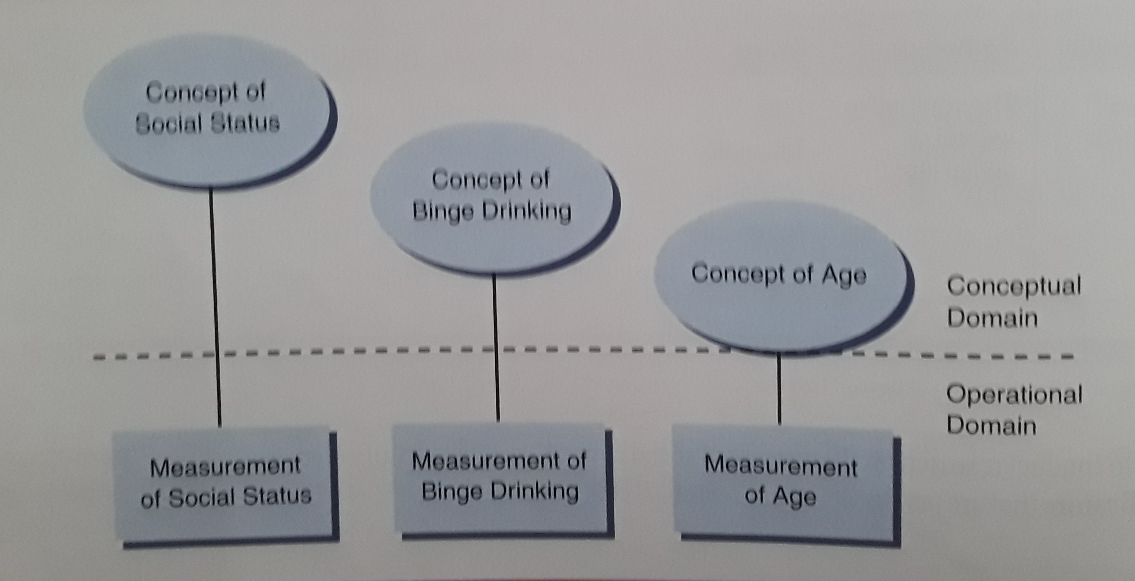
Varying Distances Between Concepts & Measures
From Investigating the Social World: The Process and Practice of Research, by Schutt (2012)

Slide 27
Defining Concepts
Take 5 minutes to:
Underline the concepts in your research question that need to be defined
Define them
List some potential operational indicators
List some potential measures for those indicators (in theory, does not have to be known data yet)

Slide 28
Translating to an OLS model
How would you write your research question as an OLS model? What are the independent and dependent variables of interest?

Slide 29
Translating to an OLS model
How would you write your research question as an OLS model? What are the independent and dependent variables of interest?
Example: Does public school for young children increase maternal labor supply?

Slide 30
Translating to an OLS model
How would you write your research question as an OLS model? What are the independent and dependent variables of interest?
Example: Does public school for young children increase women’s labor supply?

Slide 31
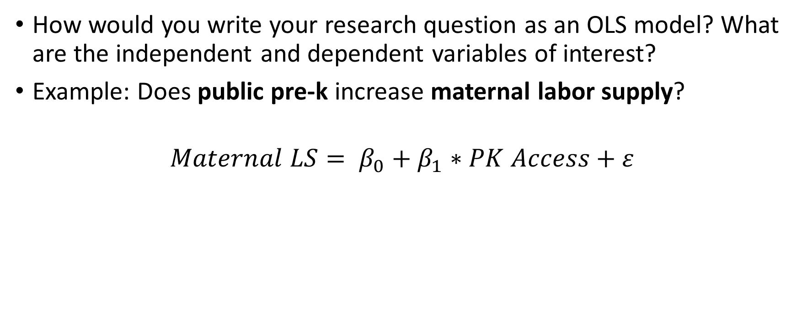
Translating to an OLS model
How would you write your research question as an OLS model? What are the independent and dependent variables of interest?
Example: Does public pre-k increase maternal labor supply?
$$Maternal LS= β_{0}+β_{1}∗PK Access+ε$$

Slide 32
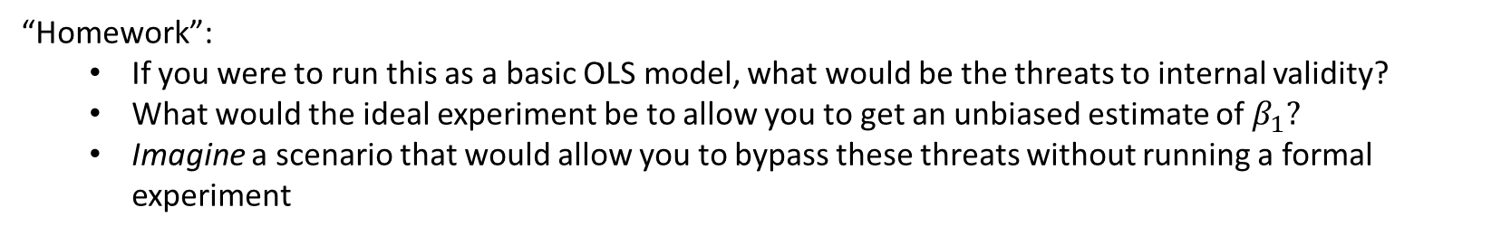
Translating to an OLS model
How would you write your research question as an OLS model? What are the independent and dependent variables of interest?
Example: Does public pre-k increase maternal labor supply?
$$Maternal LS= β_{0}+β_{1}∗PK Access+ε$$
“Homework”:
If you were to run this as a basic OLS model, what would be the threats to internal validity?
What would the ideal experiment be to allow you to get an unbiased estimate of $β_{1}?$
Imagine a scenario that would allow you to bypass these threats without running a formal experiment

