Slide 1
Quant 2
TA Section 1/11/19

Slide 2
Agenda
Housekeeping
Breaking down the regression equation
Stata refresher & intro to regression in Stata

Slide 3

$$Y_{i}=β_{0}+β_{1}X_{i}+u_{i}$$

Slide 4
$$Y_{i}=β_{0}+β_{1}X_{i}+u_{i}$$
Notation | Meaning | Examples
Y | Dependent Variable | Test Scores, Wages
X | Independent Variable/Covariate/Explanatory Variable/Regressor | School Spending, Education Level

Slide 5
$$Y_{i}=β_{0}+β_{1}X_{i}+u_{i}$$
Notation | Meaning | Examples
Y | Dependent Variable | Test Scores, Wages
X | Independent Variable/Covariate/Explanatory Variable/Regressor | School Spending, Education Level
i | Indexes the level of measurement or unit of analysis | School, Individual

Slide 6
$$Y_{i}=β_{0}+β_{1}X_{i}+u_{i}$$
Notation | Meaning | Examples
Y | Dependent Variable | Test Scores, Wages
X | Independent Variable/Covariate/Explanatory Variable/Regressor | School Spending, Education Level
i | Indexes the level of measurement or unit of analysis | School, Individual
This tells us that Y and X can vary for each observation

Slide 7

$$Y_{i}=β_{0}+β_{1}X_{i}+u_{i}$$
$$f( )$$
Notation | Meaning | Examples
Y | Dependent Variable | Test Scores, Wages
X | Independent Variable/Covariate/Explanatory Variable/Regressor | School Spending, Education Level
i | Indexes the level of measurement or unit of analysis | School, Individual

Slide 8
$$Y_{i}=β_{0}+β_{1}X_{i}+u_{i}$$
Y is a function of X
We will define the function using the full regression equation
$$f( )$$
Notation | Meaning | Examples
Y | Dependent Variable | Test Scores, Wages
X | Independent Variable/Covariate/Explanatory Variable/Regressor | School Spending, Education Level
i | Indexes the level of measurement or unit of analysis | School, Individual

Slide 9
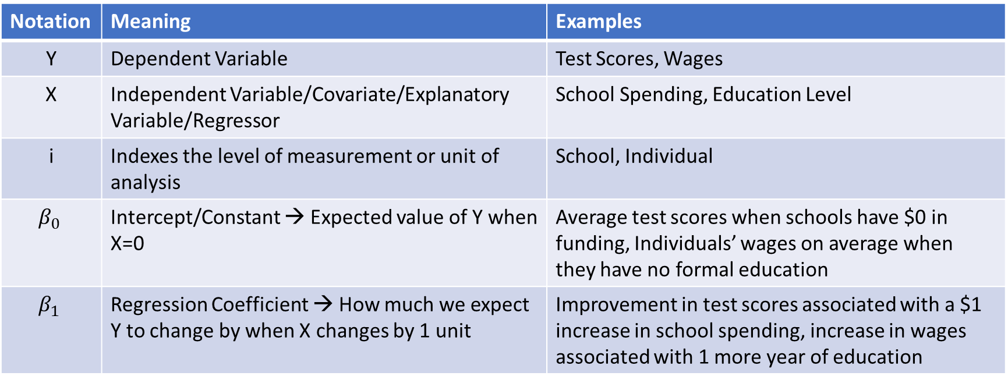
$$Y_{i}=β_{0}+β_{1}X_{i}+u_{i}$$
Notation | Meaning | Examples
Y | Dependent Variable | Test Scores, Wages
X | Independent Variable/Covariate/Explanatory Variable/Regressor | School Spending, Education Level
i | Indexes the level of measurement or unit of analysis | School, Individual
$$β_{0}$$ | Intercept/Constant → Expected value of Y when X=0 | Average test scores when schools have $0 in funding, Individuals’ wages on average when they have no formal education
$$β_{1}$$ | Regression Coefficient → How much we expect Y to change by when X changes by 1 unit | Improvement in test scores associated with a $1 increase in school spending, increase in wages associated with 1 more year of education

Slide 10
$$Y_{i}=β_{0}+β_{1}X_{i}+u_{i}$$
Since these are not indexed by i, we know that they are constant values
Notation | Meaning | Examples
Y | Dependent Variable | Test Scores, Wages
X | Independent Variable/Covariate/Explanatory Variable/Regressor | School Spending, Education Level
i | Indexes the level of measurement or unit of analysis | School, Individual
$$β_{0}$$ | Intercept/Constant → Expected value of Y when X=0 | Average test scores when schools have $0 in funding, Individuals’ wages on average when they have no formal education
$$β_{1}$$ | Regression Coefficient → How much we expect Y to change by when X changes by 1 unit | Improvement in test scores associated with a $1 increase in school spending, increase in wages associated with 1 more year of education

Slide 11
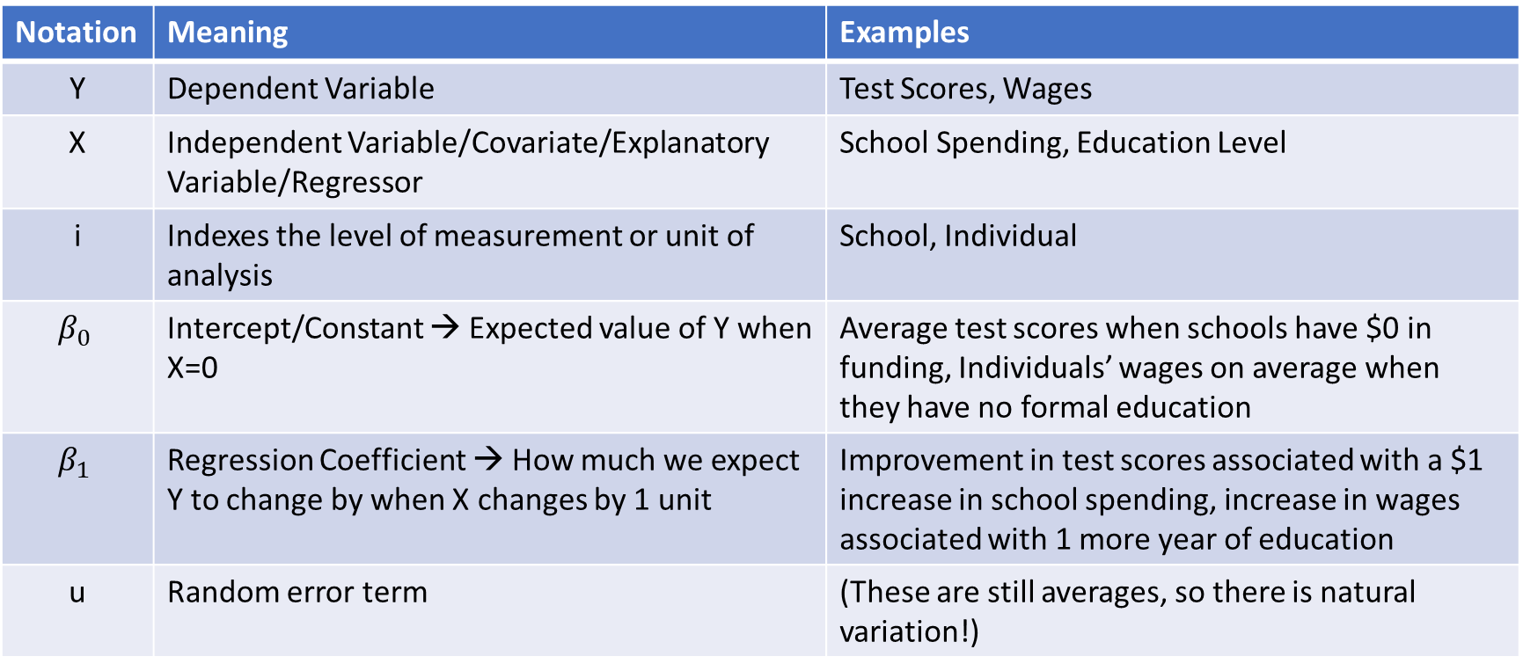
$$Y_{i}=β_{0}+β_{1}X_{i}+u_{i}$$
Notation | Meaning | Examples
Y | Dependent Variable | Test Scores, Wages
X | Independent Variable/Covariate/Explanatory Variable/Regressor | School Spending, Education Level
i | Indexes the level of measurement or unit of analysis | School, Individual
$$β_{0}$$ | Intercept/Constant → Expected value of Y when X=0 | Average test scores when schools have $0 in funding, Individuals’ wages on average when they have no formal education
$$β_{1}$$ | Regression Coefficient → How much we expect Y to change by when X changes by 1 unit | Improvement in test scores associated with a $1 increase in school spending, increase in wages associated with 1 more year of education
u | Random error term | (These are still averages, so there is natural variation!)

Slide 12

$$\hat{Y_{i}}=\hat{β_{0}}+\hat{β_{1}}X_{i}$$
Alternatively, the estimated equation uses “hats” to indicate what is an estimate (and does not include an error term)

Slide 13
$$\hat{Y_{i}}=\hat{β_{0}}+\hat{β_{1}}X_{i}$$
Alternatively, the estimated equation uses “hats” to indicate what is an estimate (and does not include an error term)

Slide 14

$$Y_{i}=β_{0}+β_{1}X_{i}+u_{i}$$
IMPORTANT (and confusing)!
This notation is NOT Universal!
Notation | Meaning | Examples
Y | Dependent Variable | Test Scores, Wages
X | Independent Variable/Covariate/Explanatory Variable/Regressor | School Spending, Education Level
i | Indexes the level of measurement or unit of analysis | School, Individual
$$β_{0}$$ | Intercept/Constant → Expected value of Y when X=0 | Average test scores when schools have $0 in funding, Individuals’ wages on average when they have no formal education
$$β_{1}$$ | Regression Coefficient → How much we expect Y to change by when X changes by 1 unit | Improvement in test scores associated with a $1 increase in school spending, increase in wages associated with 1 more year of education
u | Random error term | (These are still averages, so there is natural variation!)

Slide 15
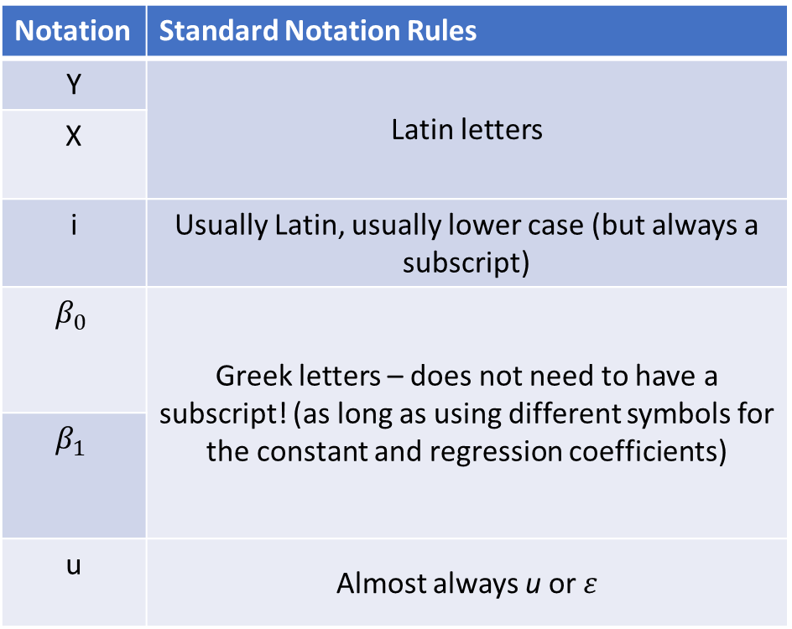
$$Y_{i}=β_{0}+β_{1}X_{i}+u_{i}$$
IMPORTANT (and confusing)!
This notation is NOT Universal!
Notation | Standard Notation Rules
Y | Latin letters
X
i | Usually Latin, usually lower case (but always a subscript)
$$β_{0}$$ | Greek letters – does not need to have a subscript! (as long as using different symbols for the constant and regression coefficients)
$$β_{1}$$
u | Almost always u or $ε$

Slide 16
Carnoy & Loeb (2002)

Slide 17
Cook et. al. (+ Guryan) (2014) – BAM Program
Sometimes authors will use different Greek letters instead of numeric subscripts

Slide 18
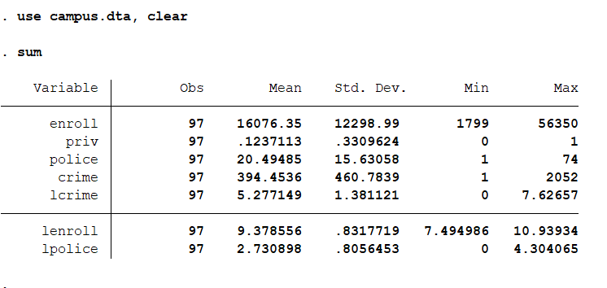
Stata: Crime on College Campuses

Slide 19
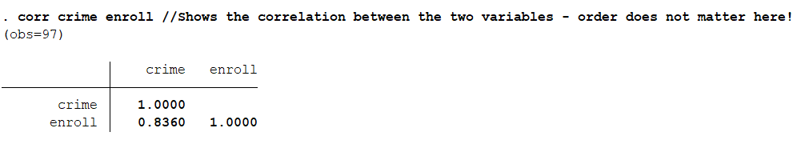
Stata: Crime on College Campuses

Slide 20
Stata: Crime on College Campuses

Slide 21
Stata: Crime on College Campuses

Slide 22
Stata: Crime on College Campuses
What do you think is the equation of the line?

Slide 23
Stata: Crime on College Campuses
What do you think is the equation of the line?
If you extend the line, what would crime be if enrollment = 0?

Slide 24
Stata: Crime on College Campuses
What do you think is the equation of the line?
Is this a meaningful intercept?

Slide 25
Stata: Crime on College Campuses
What do you think is the equation of the line?
How would you estimate the slope of the line?

Slide 26
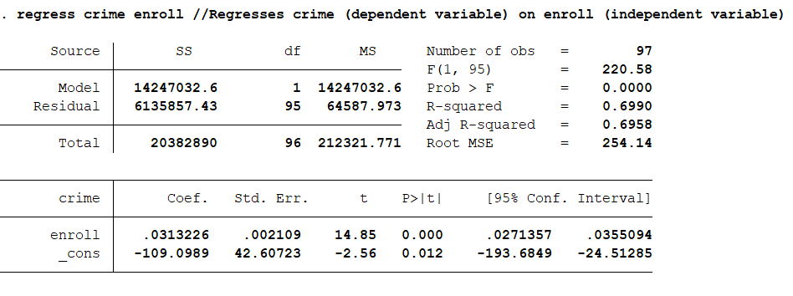
Stata: Crime on College Campuses

Slide 27
Stata: Crime on College Campuses
Observations

Slide 28

Stata: Crime on College Campuses
Intercept ($\hat{β_{0})}$

Slide 29
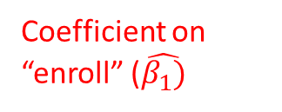
Stata: Crime on College Campuses
Coefficient on “enroll” ($\hat{β_{1})}$

Slide 30
Stata: Crime on College Campuses
T-stat and p-value testing hypothesis that coef=0

Slide 31
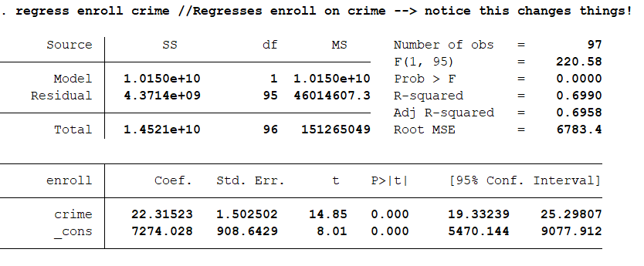
Stata: Crime on College Campuses
Switching the x and y variables, we get the same t-stat on the coefficient → this should be a good reminder that a significant relationship does not inherently mean the relationship is causal!

