Slide 1
Quant 2 Section
1/28/2019

Slide 2
Pset 2 Skills
Where to start
Copying output
Exploring Data
Using conditionals
Regression
Variance and Error Terms
Heteroskedasticity
Omitted variables bias
Transforming Variables
Heterogeneous Effects

Slide 3
Getting Started

Slide 4
Use help command

Slide 5
Google it

Slide 6
Ask your classmates or students who have taken the class

Slide 7
Copying Output

Slide 8
Copy & Paste
From your completed log file or the output window, highlight the output you want
Copy and Paste into a word doc
Highlight the text again in the word doc and change the font to Courier New size 9
Adjust spacing, if necessary

Slide 9
Screenshot
From your log or the output window, use your snipping tool (windows) or Shift-Command-4 (Mac) to take a screenshot just of the output you need to copy

Slide 10
Exploring the Data

Slide 11
Using Conditionals

Slide 12
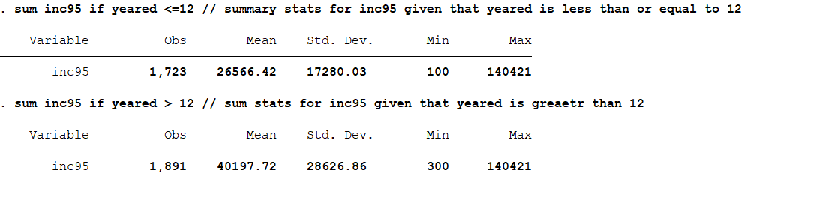
Using Conditionals

Slide 13
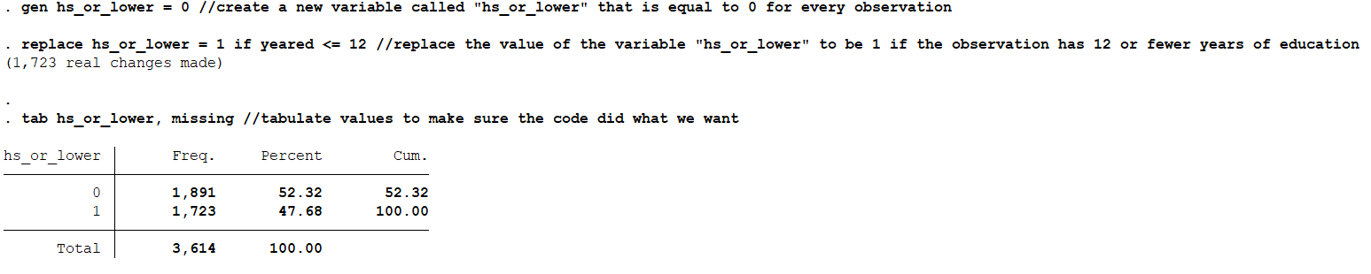
Using Conditionals

Slide 14
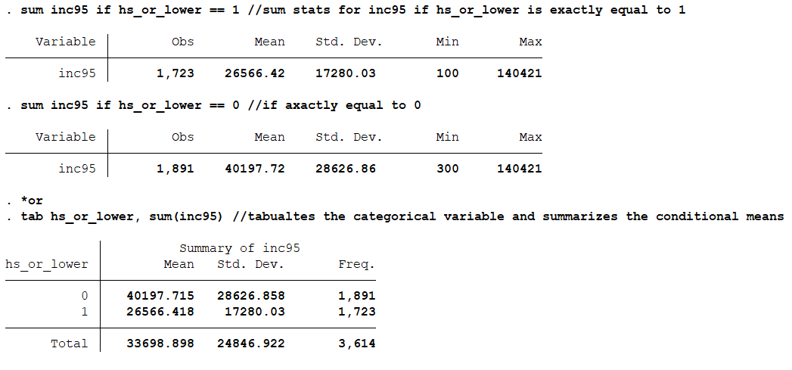
Using Conditionals

Slide 15
Regression & Variance

Slide 16
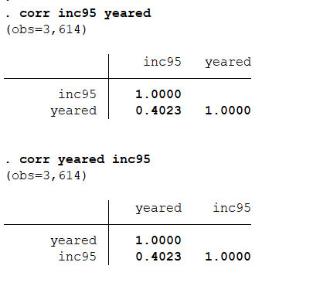
Regression

Slide 17
Regression

Slide 18
Regression
What do you think the equation of the regression line is?
Notes:
Write the equation on the board

Slide 19
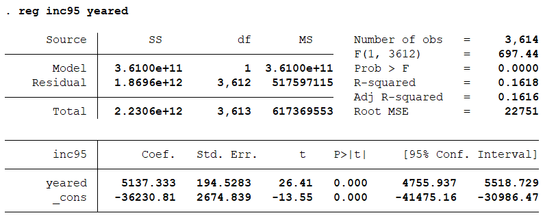
Regression
Notes:
Write on the board for the next questions:

Slide 20
Regression
How many observations?

Slide 21
Regression
How would you write the equation for this line?

Slide 22
Regression
What is the standard error for the coefficient on yeared?

Slide 23
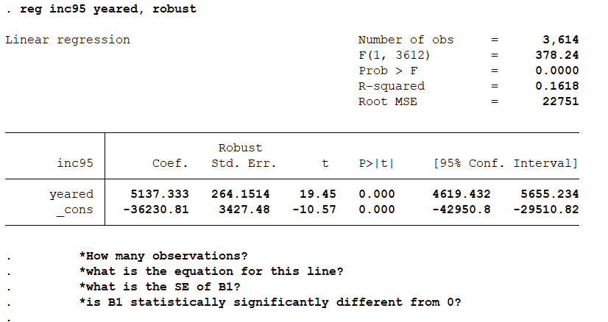
Regression
Notes:
Add a second column on the board

Slide 24
Regression
What is the null hypothesis that this p-value is meant to test?

Slide 25
Regression
This one?

Slide 26
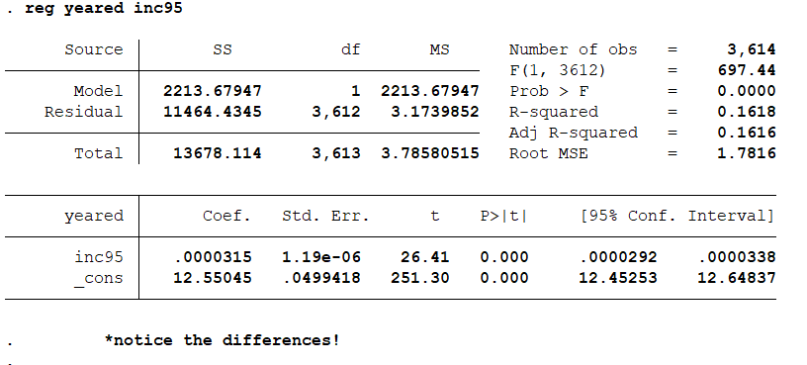
Regression

Slide 27
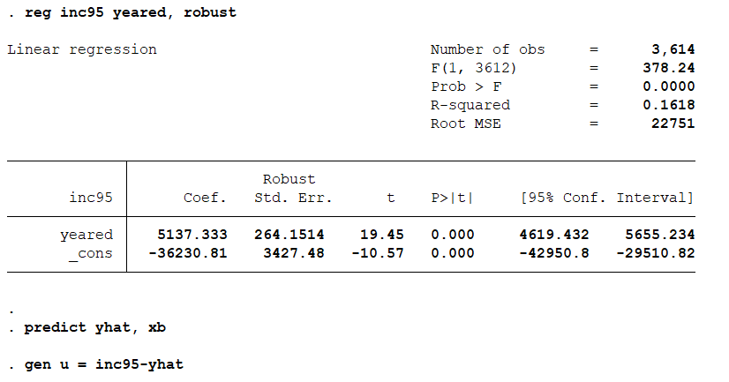
Errors & Variance
Notes:
Show in data browser what this does

Slide 28

Errors & Variance

Slide 29
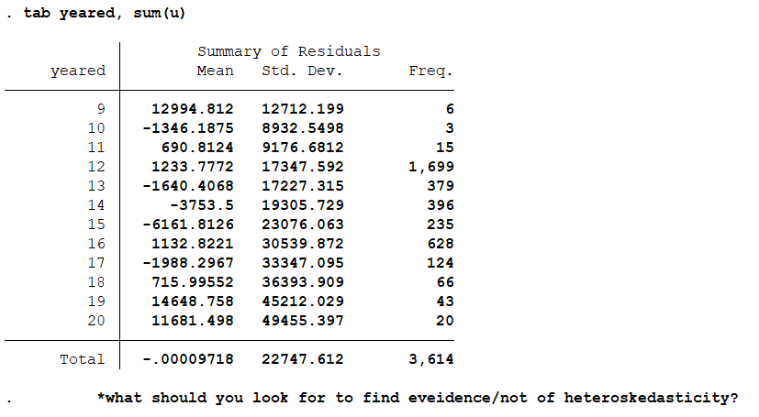
Errors & Variance
Notes:
Show in stata: sum u if yeared==9

Slide 30
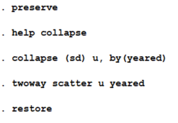
Errors & Variance

Slide 31
Omitted Variables Bias

Slide 32
Notes:
Example – x=yeared y=inc95
How would you draw a line through these points?

Slide 34
Notes:
Black dots are men, blue dots are women. Do you still think this is the relationship between x and y? What’s another way to think about drawing regression lines?

Slide 35
Notes:
Notice that in this totally stylized example, the slope of the line is about the same, but the intercept is different for women. i.e. women probably just make less than men, but they still get a payoff for additional years of education, AND they tend to get more education on average than men

Slide 36
Notes:
Imagine if we just controlled for the intercept difference. Now we are effectively controlling for being a woman, and the slope of the line now matches the actual relationship between years of ed and income, net gender

Slide 37
Omitted Variables Bias
X Y
Notes:
There is some true causal effect of x on y

Slide 38
Omitted Variables Bias
X Y
Z
Notes:
There is also some variable Z that has independent effects on both X and Y

Slide 39
Omitted Variables Bias
Education Income
Female
Notes:
There is also some variable Z that has independent effects on both X and Y

Slide 40
Omitted Variables Bias
+
Education Income
Female
Notes:
There is also some variable Z that has independent effects on both X and Y

Slide 41
Omitted Variables Bias
+
Education Income
Female
+
-
Notes:
There is also some variable Z that has independent effects on both X and Y

Slide 42
Omitted Variables Bias
+
Education Income
Female
+
-
Direction of Bias = (+)*(-) = (-)
i.e. Negative bias will make the relationship look more negative than it is (this does not mean it will necessarily make it look negative overall!)
Notes:
There is also some variable Z that has independent effects on both X and Y

Slide 43
Omitted Variables Bias
+
Education Income
AFQT
How would you map the relationships between years of education, income, and AFQT scores? Would you expect bias if you omit AFQT from the model? What direction would the bias be?
Notes:
Draw on board

Slide 44
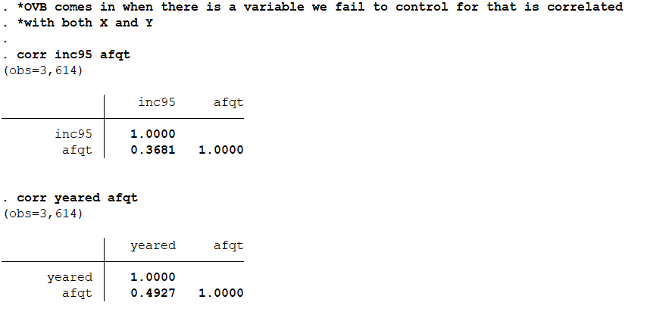
Omitted Variables Bias

Slide 45
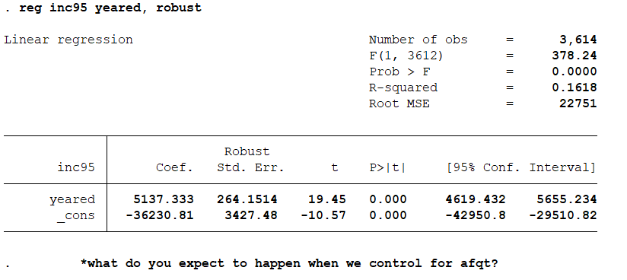
Omitted Variables Bias

Slide 46
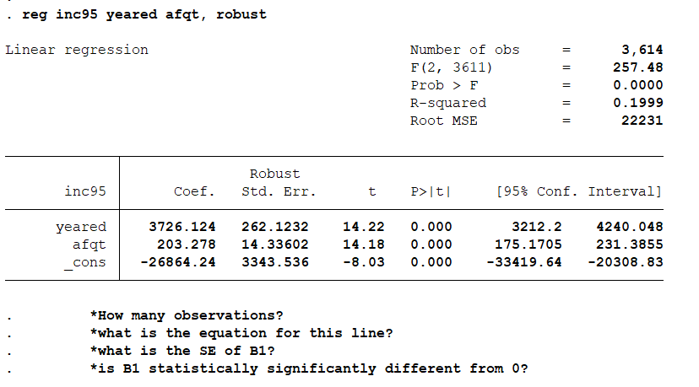
Omitted Variables Bias

Slide 47
Transforming Variables

Slide 48
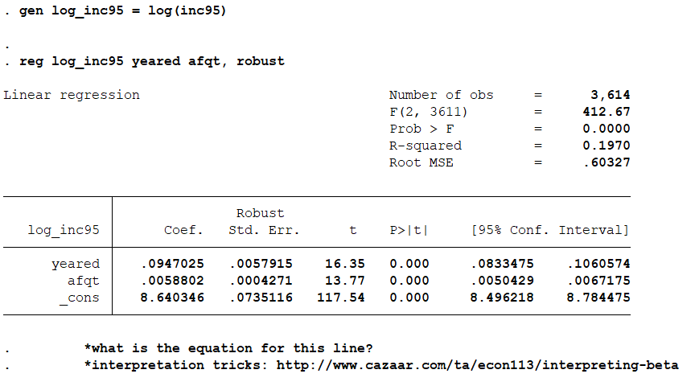
Transformations
Notes:
If we increase years of education by y, we expect income to increase by 9.5%

Slide 49
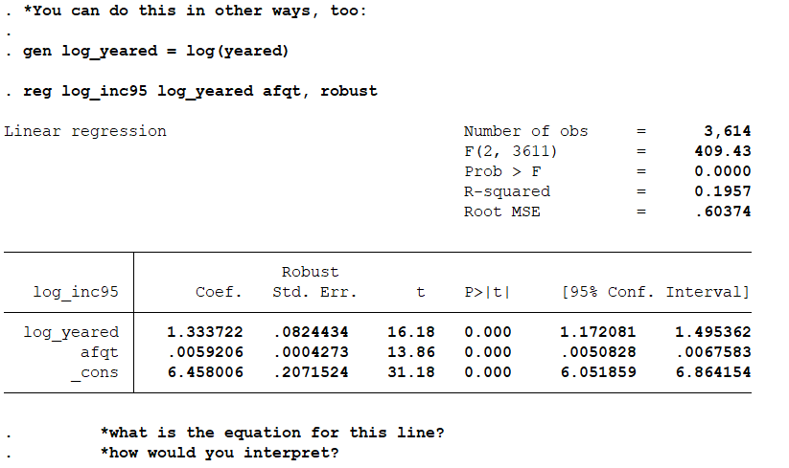
Transformations
Notes:
If you increase years of education by 1%, we expect income to change by 1.33%

Slide 50
Transformations
Be careful about “percent” and “percentage points”!
When could you interpret using a 1 percentage point change in X?
Notes:
If you increase years of education by 1%, we expect income to change by 1.33%

Slide 51
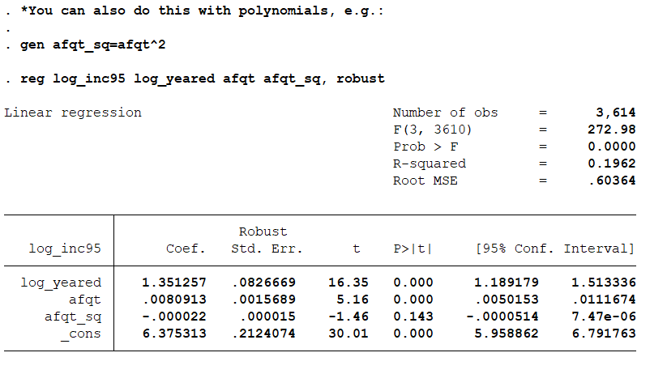
Transformations

