Slide 1
Section, Week 5
2/4/2019

Slide 2
Agenda
Interpreting Multivariate Regression Output
+ Testing Alternative Hypotheses
Functional Forms
Categorical Dummy Variables/Collinearity
Polynomials
Heteroskedasticity, Revisited

Slide 3
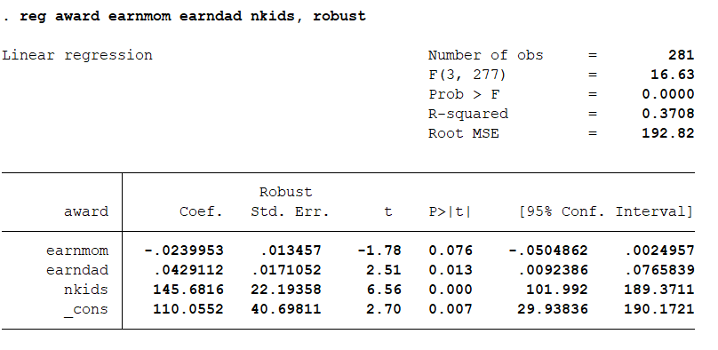
Interpreting Output

Slide 4
Interpreting Output
What is the equation of this line?

Slide 5
Interpreting Output
Interpret the coefficients (in real words)

Slide 6
Interpreting Output
What are the null and alternative hypotheses of the coefficients on earnmom, earndad, and nkids?

Slide 7
Interpreting Output
What are the null and alternative hypotheses of the coefficients on earnmom, earndad, and nkids?
Do we reject them?
At what level of significance?

Slide 8
Interpreting Output
What would be the award amount if no parent earns anything and there are no kids?
Is this a useful constant term?

Slide 9
Interpreting Output
What would be the award amount if mom makes $1,000 and dad makes $6,000, and they have 2 kids?

Slide 10
Interpreting Output
Why do the coefficients for earnmom and earndad go in opposite directions?
What are the 95% confidence intervals of each?

Slide 11
Testing other hypotheses
Do mom and dad have the same income burden?
What null hypothesis could you test?

Slide 12
Testing other hypotheses
Do mom and dad have the same income burden?
What null hypothesis could you test?
What could you conclude from the confidence intervals?

Slide 13
Testing other hypotheses
Do mom and dad have the same income burden?
What null hypothesis could you test?
What could you conclude from the confidence intervals?

Slide 14
Functional Forms
What can you do if you have an interval X variable, but you do not think the effects of X on Y are constant/linear?

Slide 15
Functional Forms
What can you do if you have an interval X variable, but you do not think the effects of X on Y are constant/linear?
Log-transformations

Slide 16
Functional Forms
What can you do if you have an interval X variable, but you do not think the effects of X on Y are constant/linear?
Log-transformations
Polynomial transformations

Slide 17
Functional Forms
What can you do if you have an interval X variable, but you do not think the effects of X on Y are constant/linear?
Log-transformations
Polynomial transformations
Treat as categorical dummy variables

Slide 18
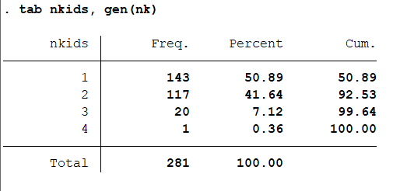
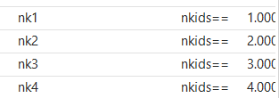
Categorical Dummy Variables
Now we have 4 categorical variables. nk1 = 1 if nkids==1 and 0 if nkids!=1

Slide 19
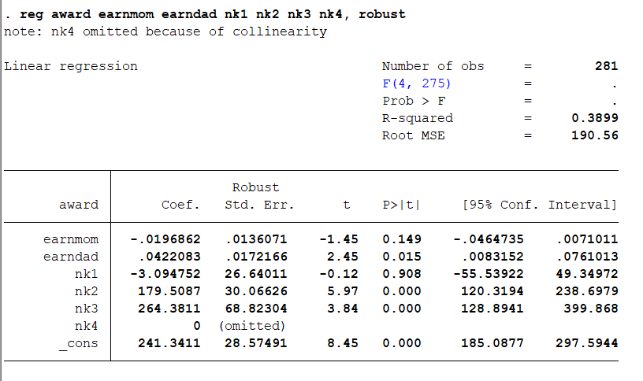
Categorical Dummy Variables
Why did the model drop nk4?

Slide 20
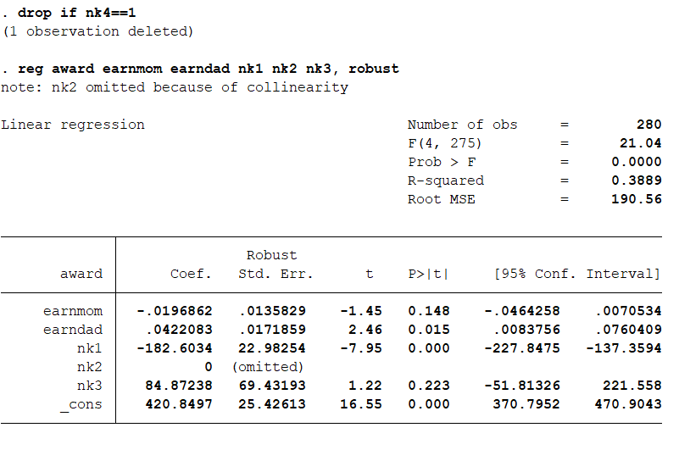
Categorical Dummy Variables
I dropped the observation with 4 kids.
Why does the model drop nk2?

Slide 21
Categorical Dummy Variables
I dropped the observation with 4 kids.
Why does the model drop nk2?
To avoid perfect collinearity!

Slide 22
Collinearity
Y

Slide 23
Collinearity
Explained by X
X
Y
W
Explained by W

Slide 24
Collinearity
Explained by X
X
Y
Cannot attribute to either X or W
W
Explained by W

Slide 25
Collinearity
X
Y
W

Slide 26
Collinearity
X
Y
W
Cannot attribute to either X or W

Slide 27
Categorical Dummy Variables
Our dummy variables for number of kids are perfectly collinear.

Slide 28
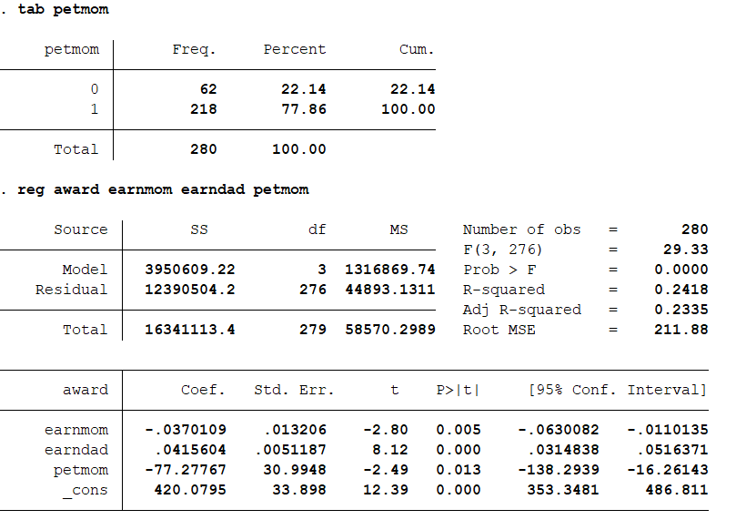
Categorical Dummy Variables
Simpler example: A single Dummy Variable

Slide 29
Categorical Dummy Variables
What does the coefficient on petmom tell you? What is the comparison group?

Slide 30
Categorical Dummy Variables
What does the coefficient on nk1 tell you? What is the comparison?
What about on nk3?

Slide 31
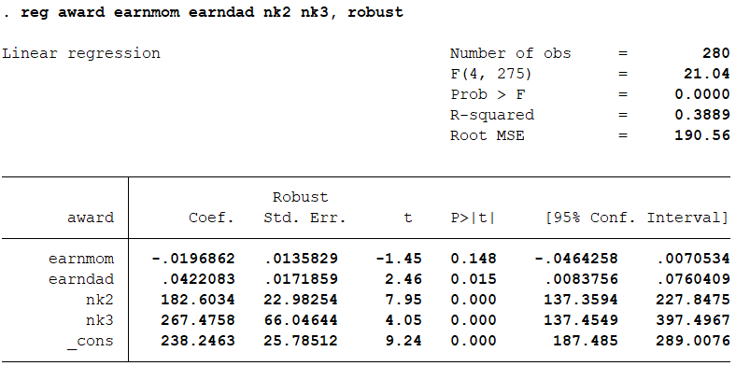
Categorical Dummy Variables
You can pick the comparison group by choosing which one to omit

Slide 32
Categorical Dummy Variables
What is the equation of this line?

Slide 33
Categorical Dummy Variables
What would be the award amount if mom makes $1,000 and dad makes $6,000, and they have 1 kid?

Slide 34
Categorical Dummy Variables
What would be the award amount if mom makes $1,000 and dad makes $6,000, and they have 2 kids?

Slide 35
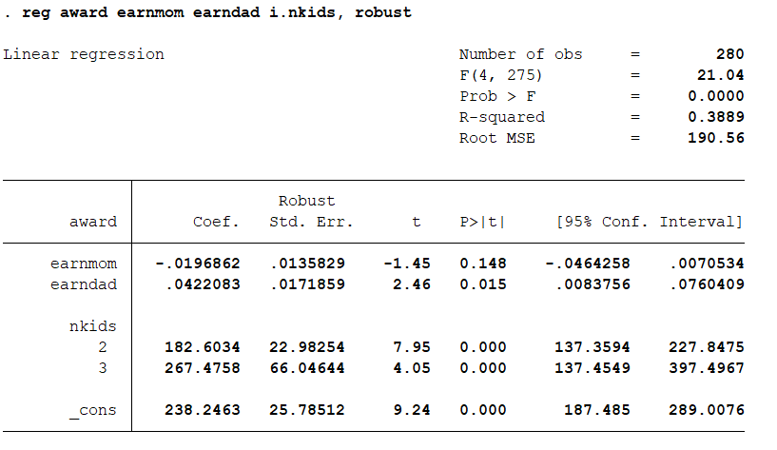
Other Code

Slide 36
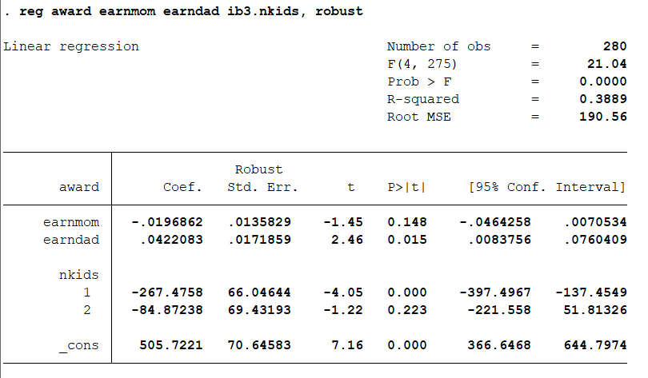
Other Code

Slide 37
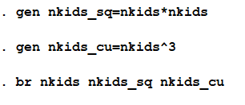
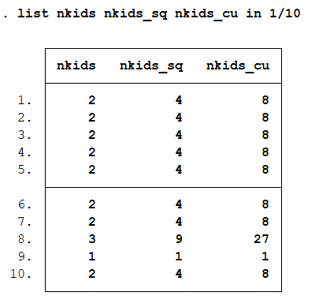
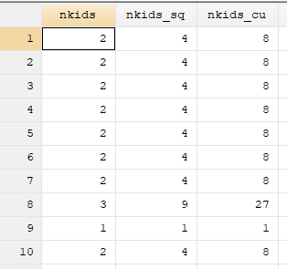
Interpreting Polynomials

Slide 38
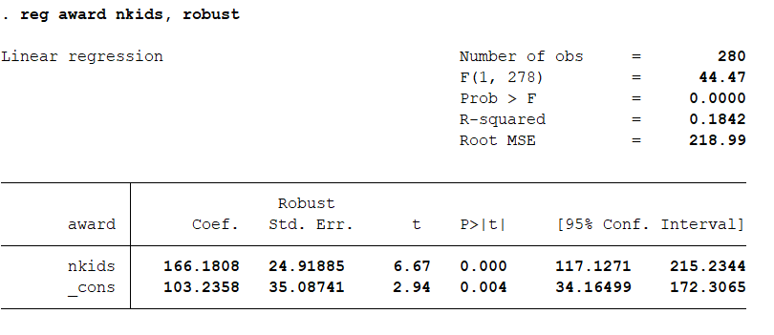
Interpreting Polynomials
What is the average award when there is:
1 kid?
2 kids?
3 kids?

Slide 39
Interpreting Polynomials
What is the average award when there is:
1 kid?
2 kids?
3 kids?

Slide 40
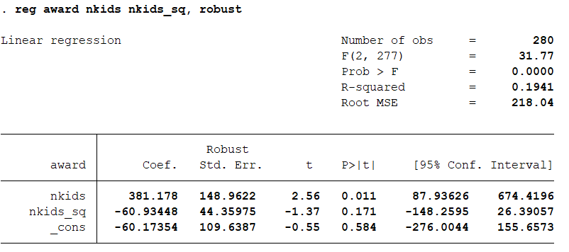
Interpreting Polynomials
What is the average award when there is:
1 kid?
2 kids?
3 kids?

Slide 41
Interpreting Polynomials
What is the average award when there is:
1 kid?
2 kids?
3 kids?

Slide 42
Functional Forms

Slide 43
Heteroskedasticity, revisited
Child support payments may be more variable when family income is high than when it is low
i.e. errors may be heteroskedastic
When we had a categorical variable, Look at standard deviation for each category
Income is continuous, so have to get more creative:
Collapse to quintiles
Predict errors and look at the scatter plot

Slide 44
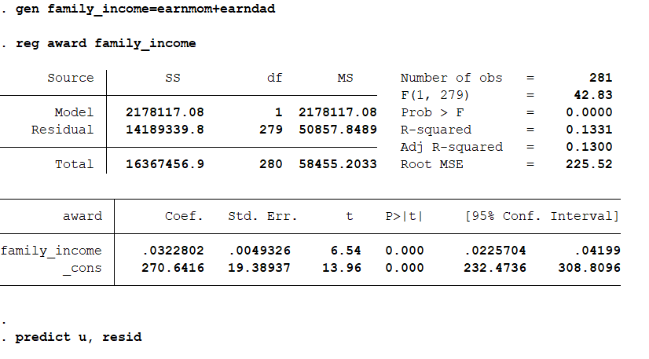
Heteroskedasticity

Slide 45
Heteroskedasticity
Scatter u family_income

Slide 46
Heteroskedasticity
Does this look
Heteroskedastic?

Slide 47
Heteroskedasticity
**One line of code**
twoway
(scatter u family_income)
(lfit u family_income)
(lfit u family_income if u>0)
(lfit u family_income if u<0)

Slide 48
Heteroskedasticity
What would
Homoskedasticity
Look like?

Slide 49
Heteroskedasticity
Does it matter
that I didn’t use
robust SE’s in
this exercise?

