Slide 1
Quant 2
Section, Week 9
3/4/2019

Slide 2
Agenda
Fixed Effects
Example: non-panel data
Notation
Example: panel data

Slide 3
Education & Earnings
What is the effect of education on earnings?

Slide 4
Education & Earnings
What is the effect of education on earnings?
Years of School Salary (thousands)

Slide 5
Education & Earnings
What is the effect of education on earnings?
Data:
N=9
Measured at the individual level

Slide 6

Education & Earnings
What is the effect of education on earnings?
$${Salary}_{i}=β_{0}+β_{1}{Ed}_{i}+u_{i}$$
ID | Education | Salary (K)
1 | 12 | 35
2 | 14 | 40
3 | 16 | 45
4 | 10 | 25
5 | 12 | 30
6 | 14 | 35
7 | 16 | 50
8 | 18 | 55
9 | 20 | 60

Slide 7
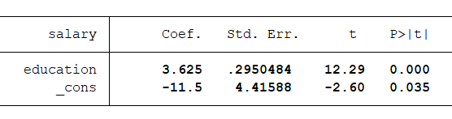
Education & Earnings
What is the effect of education on earnings?
$${Salary}_{i}=β_{0}+β_{1}{Ed}_{i}+u_{i}$$
ID | Education | Salary (K)
1 | 12 | 35
2 | 14 | 40
3 | 16 | 45
4 | 10 | 25
5 | 12 | 30
6 | 14 | 35
7 | 16 | 50
8 | 18 | 55
9 | 20 | 60

Slide 8
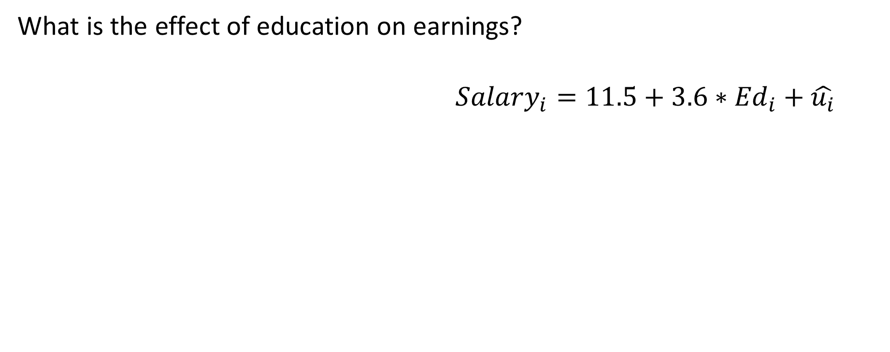
Education & Earnings
What is the effect of education on earnings?
$${Salary}_{i}=11.5+3.6∗{Ed}_{i}+\hat{u_{i}}$$
ID | Education | Salary (K)
1 | 12 | 35
2 | 14 | 40
3 | 16 | 45
4 | 10 | 25
5 | 12 | 30
6 | 14 | 35
7 | 16 | 50
8 | 18 | 55
9 | 20 | 60

Slide 9
Education & Earnings

Slide 10
Education & Earnings
Why might
this be
biased?

Slide 11
Education & Earnings
What is the effect of education on earnings?
ID | Education | Salary (K) | Region
1 | 12 | 35 | MW
2 | 14 | 40 | MW
3 | 16 | 45 | MW
4 | 10 | 25 | S
5 | 12 | 30 | S
6 | 14 | 35 | S
7 | 16 | 50 | N
8 | 18 | 55 | N
9 | 20 | 60 | N

Slide 12
Education & Earnings
What is the effect of education on earnings?
ID | Education | Salary (K) | Region
1 | 12 | 35 | MW
2 | 14 | 40 | MW
3 | 16 | 45 | MW
4 | 10 | 25 | S
5 | 12 | 30 | S
6 | 14 | 35 | S
7 | 16 | 50 | N
8 | 18 | 55 | N
9 | 20 | 60 | N

Slide 13
Education & Earnings
What is the effect of education on earnings?
ID | Education | Salary (K) | Region
1 | 12 | 35 | MW
2 | 14 | 40 | MW
3 | 16 | 45 | MW
4 | 10 | 25 | S
5 | 12 | 30 | S
6 | 14 | 35 | S
7 | 16 | 50 | N
8 | 18 | 55 | N
9 | 20 | 60 | N

Slide 14
Education & Earnings
What is the effect of education on earnings?
ID | Education | Salary (K) | Region
1 | 12 | 35 | MW
2 | 14 | 40 | MW
3 | 16 | 45 | MW
4 | 10 | 25 | S
5 | 12 | 30 | S
6 | 14 | 35 | S
7 | 16 | 50 | N
8 | 18 | 55 | N
9 | 20 | 60 | N

Slide 15
Education & Earnings
Is region causing omitted variables bias?
ID | Education | Salary (K) | Region
1 | 12 | 35 | MW
2 | 14 | 40 | MW
3 | 16 | 45 | MW
4 | 10 | 25 | S
5 | 12 | 30 | S
6 | 14 | 35 | S
7 | 16 | 50 | N
8 | 18 | 55 | N
9 | 20 | 60 | N
Education
Salary
Region

Slide 16
Education & Earnings
What direction will the bias be in?
ID | Education | Salary (K) | Region
1 | 12 | 35 | MW
2 | 14 | 40 | MW
3 | 16 | 45 | MW
4 | 10 | 25 | S
5 | 12 | 30 | S
6 | 14 | 35 | S
7 | 16 | 50 | N
8 | 18 | 55 | N
9 | 20 | 60 | N
Education
Salary
Region

Slide 20
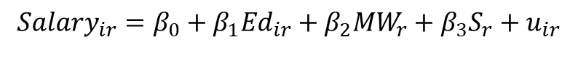
Education & Earnings
What is the effect of education on earnings?
ID | Education | Salary (K) | Region
1 | 12 | 35 | MW
2 | 14 | 40 | MW
3 | 16 | 45 | MW
4 | 10 | 25 | S
5 | 12 | 30 | S
6 | 14 | 35 | S
7 | 16 | 50 | N
8 | 18 | 55 | N
9 | 20 | 60 | N
$${Salary}_{ir}=β_{0}+β_{1}{Ed}_{ir}+β_{2}{MW}_{r}+β_{3}S_{r}+u_{ir}$$

Slide 21
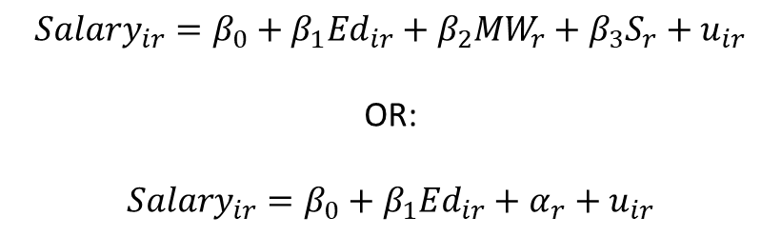
Education & Earnings
What is the effect of education on earnings?
ID | Education | Salary (K) | Region
1 | 12 | 35 | MW
2 | 14 | 40 | MW
3 | 16 | 45 | MW
4 | 10 | 25 | S
5 | 12 | 30 | S
6 | 14 | 35 | S
7 | 16 | 50 | N
8 | 18 | 55 | N
9 | 20 | 60 | N
$${Salary}_{ir}=β_{0}+β_{1}{Ed}_{ir}+β_{2}{MW}_{r}+β_{3}S_{r}+u_{ir}$$
OR:
$${Salary}_{ir}=β_{0}+β_{1}{Ed}_{ir}+α_{r}+u_{ir}$$

Slide 22
Education & Earnings
What is the effect of education on earnings?
ID | Education | Salary (K) | Region
1 | 12 | 35 | MW
2 | 14 | 40 | MW
3 | 16 | 45 | MW
4 | 10 | 25 | S
5 | 12 | 30 | S
6 | 14 | 35 | S
7 | 16 | 50 | N
8 | 18 | 55 | N
9 | 20 | 60 | N
$${Salary}_{ir}=β_{0}+β_{1}{Ed}_{ir}+β_{2}{MW}_{r}+β_{3}S_{r}+u_{ir}$$
OR:
$${Salary}_{ir}=β_{0}+β_{1}{Ed}_{ir}+α_{r}+u_{ir}$$

Slide 23
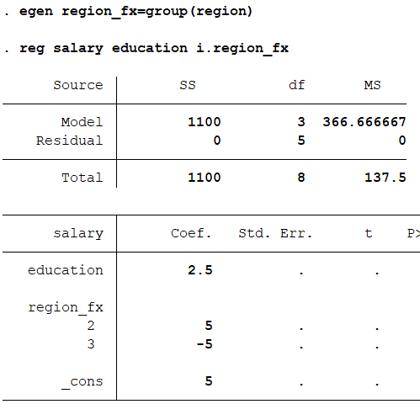
Education & Earnings
What is the effect of education on earnings?
ID | Education | Salary (K) | Region
1 | 12 | 35 | MW
2 | 14 | 40 | MW
3 | 16 | 45 | MW
4 | 10 | 25 | S
5 | 12 | 30 | S
6 | 14 | 35 | S
7 | 16 | 50 | N
8 | 18 | 55 | N
9 | 20 | 60 | N

Slide 24
Education & Earnings
What is the effect of education on earnings?
ID | Education | Salary (K) | Region
1 | 12 | 35 | MW
2 | 14 | 40 | MW
3 | 16 | 45 | MW
4 | 10 | 25 | S
5 | 12 | 30 | S
6 | 14 | 35 | S
7 | 16 | 50 | N
8 | 18 | 55 | N
9 | 20 | 60 | N

Slide 25
Education & Earnings - Demeaning
What is the effect of education on earnings?
ID | Education | Salary (K) | Region
1 | 12 | 35 | MW
2 | 14 | 40 | MW
3 | 16 | 45 | MW
4 | 10 | 25 | S
5 | 12 | 30 | S
6 | 14 | 35 | S
7 | 16 | 50 | N
8 | 18 | 55 | N
9 | 20 | 60 | N
Avg Ed = 14, Avg Salary = 40
Avg Ed = 12, Avg Salary = 30
Avg Ed = 18, Avg Salary = 55

Slide 26
Education & Earnings - Demeaning
What is the effect of education on earnings?
ID | Education | Salary (K) | Region
1 | 12=14 = -2 | 35 – 40 = -5 | MW
2 | 14 | 40 | MW
3 | 16 | 45 | MW
4 | 10 | 25 | S
5 | 12 | 30 | S
6 | 14 | 35 | S
7 | 16 | 50 | N
8 | 18 | 55 | N
9 | 20 | 60 | N
Avg Ed = 14, Avg Salary = 40
Avg Ed = 12, Avg Salary = 30
Avg Ed = 18, Avg Salary = 55

Slide 27
Education & Earnings - Demeaning
What is the effect of education on earnings?
ID | DM Ed | DM Sal | Region
1 | -2 | -5 | MW
2 | 0 | 0 | MW
3 | 2 | 5 | MW
4 | -2 | -5 | S
5 | 0 | 0 | S
6 | 2 | 5 | S
7 | -2 | -5 | N
8 | 0 | 0 | N
9 | 2 | 5 | N

Slide 28
Education & Earnings - Demeaning
What is the effect of education on earnings?
Fixed Effects is running a
regression on THESE values
ID | DM Ed | DM Sal | Region
1 | -2 | -5 | MW
2 | 0 | 0 | MW
3 | 2 | 5 | MW
4 | -2 | -5 | S
5 | 0 | 0 | S
6 | 2 | 5 | S
7 | -2 | -5 | N
8 | 0 | 0 | N
9 | 2 | 5 | N

Slide 29
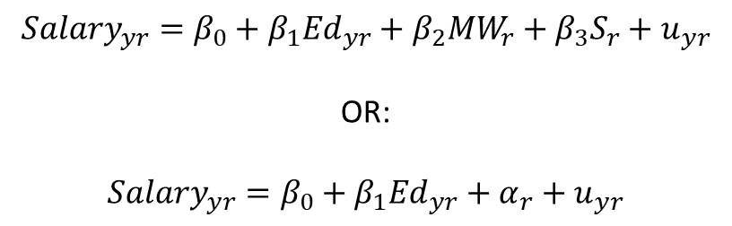
Education & Earnings – Panel Data
What is the effect of education on earnings?
Year | Education | Salary (K) | Region
1990 | 12 | 35 | MW
2000 | 14 | 40 | MW
2010 | 16 | 45 | MW
1990 | 10 | 25 | S
2000 | 12 | 30 | S
2010 | 14 | 35 | S
1990 | 16 | 50 | N
2000 | 18 | 55 | N
2010 | 20 | 60 | N
$${Salary}_{yr}=β_{0}+β_{1}{Ed}_{yr}+β_{2}{MW}_{r}+β_{3}S_{r}+u_{yr}$$
OR:
$${Salary}_{yr}=β_{0}+β_{1}{Ed}_{yr}+α_{r}+u_{yr}$$

Slide 30
Education & Earnings – Panel Data
What is the effect of education on earnings?
Year | Education | Salary (K) | Region
1990 | 12 | 35 | MW
2000 | 14 | 40 | MW
2010 | 16 | 45 | MW
1990 | 10 | 25 | S
2000 | 12 | 30 | S
2010 | 14 | 35 | S
1990 | 16 | 50 | N
2000 | 18 | 55 | N
2010 | 20 | 60 | N
$${Salary}_{yr}=β_{0}+β_{1}{Ed}_{yr}+β_{2}{MW}_{r}+β_{3}S_{r}+u_{yr}$$
OR:
$${Salary}_{yr}=β_{0}+β_{1}{Ed}_{yr}+α_{r}+u_{yr}$$
Only the subscripts change – we haven’t done anything with the time variable yet!

Slide 31
Panel data
Allows us to consider using a fixed effects approach because we observe the same entity at multiple time points.

Slide 32
Fixed Effect Regression
Produces a causal estimate so long as omitted variables that might bias results are fixed over time within the entity.
Time varying factors can still create bias if they drive changes in X and changes in Y
Relies on the subsample of data for which there is an observed changed in X over time
Can limit external validity: What if the subsample of data that generates the estimate is very different from the subsample that does not? Would the results found in one subsample generalize to the other?
Average GPA: 3.79 Average GPA: 3.05 Average GPA: 2.25

