Slide 1
Remaining Useful Life Prediction using Commercial Modular Aero-Propulsion System Simulation (C-MAPSS) dataset
Gregory Lim
^{13/3/2022}

Slide 2
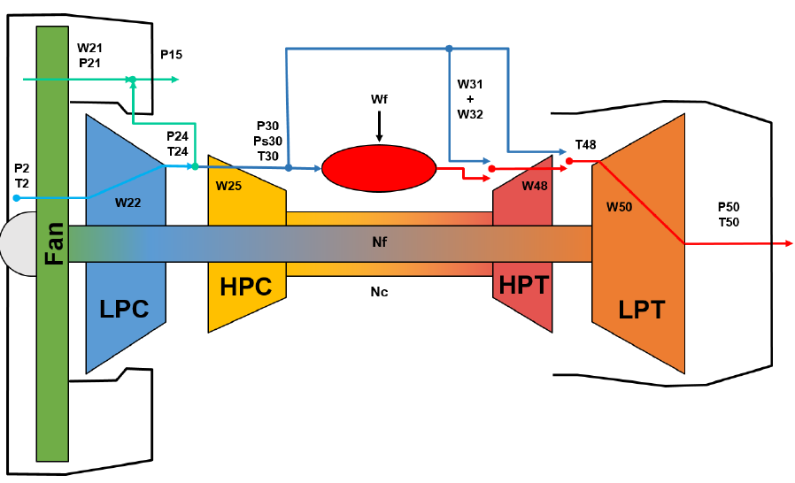
Objective
Remaining useful life (RUL) is an estimation of the leftover time or cycles that an industrial system can operate before failure. The objective of this analysis is to develop a data-driven model to predict the RUL of a fleet of aircraft engines operating under conditions of high variability in the flight envelope and multiple failure modes. Each unit of the fleet has unknown and different initial health conditions and experiences types of slowly developing faults that initiate at some time during the flight history.^{1,2}
Schematic representation of the CMAPSS model as depicted in the CMAPSS documentation
¹ Manuel Arias Chao, Chetan Kulkarni 2, Kai Goebel 3 and Olga Fink. “PHM Society Data Challenge 2021”. [Online] https://data.phmsociety.org/wp-content/uploads/sites/9/2021/08/2021_Data_Challenge.pdf
² Manuel Arias Chao, Chetan Kulkarni 2, Kai Goebel 3 and Olga Fink, “Aircraft Engine Run-to-Failure Dataset under Real Flight Conditions for Prognostics and Diagnostics”. Data 2021, 6, 5. https://doi.org/10.3390/data6010005

Slide 3
Dataset
Turbofan Engine Degradation Simulation Data Set-2
Source: https://ti.arc.nasa.gov/tech/dash/groups/pcoe/prognostic-data-repository/#turbofan-2
Citation: M. Chao, C.Kulkarni, K. Goebel and O. Fink (2021). "Aircraft Engine Run-to-Failure Dataset under real flight conditions", NASA Ames Prognostics Data Repository (http://ti.arc.nasa.gov/project/prognostic-data-repository), NASA Ames Research Center, Moffett Field, CA
Description: The generation of data-driven prognostics models requires the availability of datasets with run-to-failure trajectories. In order to contribute to the development of these methods, the dataset provides a new realistic dataset of run-to- failure trajectories for a small fleet of aircraft engines under realistic flight conditions. The damage propagation modelling used for the generation of this synthetic dataset builds on the modelling strategy from previous work . The dataset was generated with the Commercial Modular Aero-Propulsion System Simulation (C-MAPSS) dynamical model. The data set is been provided by the Prognostics CoE at NASA Ames in collaboration with ETH Zurich and PARC.
Files:
N-CAMPSS_DS01-005.h5
N-CAMPSS_DS02-006.h5
N-CAMPSS_DS03-012.h5
N-CAMPSS_DS04.h5
N-CAMPSS_DS05.h5
N-CAMPSS_DS06.h5
N-CAMPSS_DS07.h5
N-CAMPSS_DS08a-009.h5
N-CAMPSS_DS08c-008.h5
N-CAMPSS_DS08d-010.h5
N-CMAPSS_Example_data_loading_and_exploration.ipynb
Run_to_Failure_Simulation_Under_Real_Flight_Conditions_Dataset.pdf
Dataset used in this analysis (2.8 GB)
Brief reference on dataset loading and description
Detailed description on dataset and C-MAPSS simulation environment

Slide 4
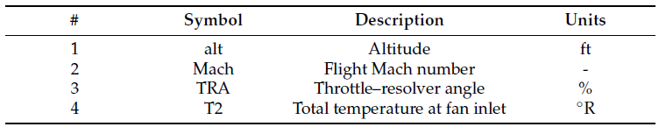
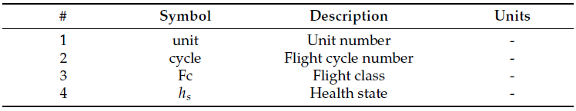
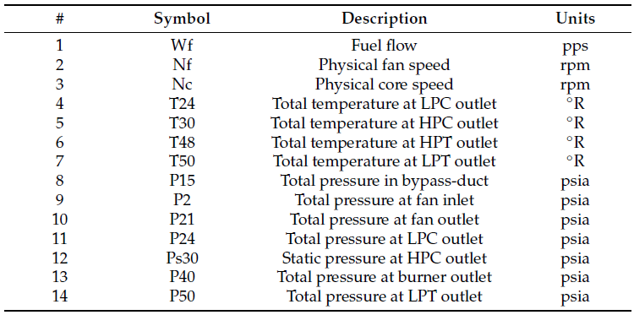
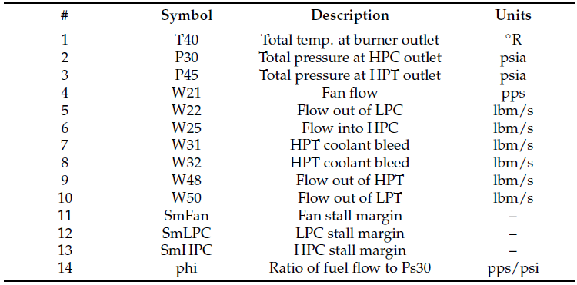
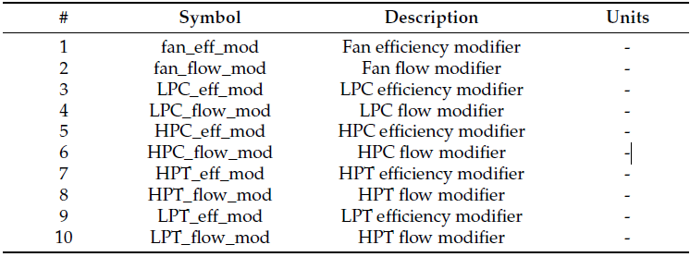
Dataset
N-CAMPSS_DS01-005.h5 dataset contains 10 units, 3 varying flight classes with 1 failure mode affecting the efficiency of the high pressure turbine (HPT) . The dataset contains 7,641,868 records captured during a simulated run-to-failure degradation trajectories based on 46 variables and 1 derived variable (RUL). The first 4,906,646 records relating to first six units (#1-6) are used for development while the remaining 2,735,232 records relating to the remaining 4 units (#7-10) are retained for testing purposes.
Scenario descriptors
Auxiliary data
Flight classes | Flight length (h)
1 | 1 – 3
2 | 3 – 5
3 | >5
Measurements
Virtual sensors
Model health parameters

Slide 5
Data pre-processing
Treat RUL as a regressive problem by predicting RUL (target variable) using all other features such as sensor descriptors, measurements, virtual sensors, model health parameters and auxiliary data
Analysis is performed primarily using Python libraries such as Pandas, Numpy, Matplotlib and Scikit-Learn
The following actions are applied on the dataset after exploratory data analysis:
# | Observation | Action
1 | No null values in dataset | Do nothing
2 | Variables fan_eff_mod, fan_flow_mod, LPC_eff_mod, LPC_flow_mod, HPC_eff_mod, HPC_flow_mod, HPT_flow_mod, LPT_eff_mod, LPT_flow_mod contains all zeroes | Remove these variables from dataset
3 | Variable cycle is used to derive RUL. Strong negative correlation is observed in correlation matrix (see image in the next slide) | Remove cycle and retain RUL as target variable for prediction
4 | Variable unit is a categorical ID variable. Similar unit values do not exist in both development and test dataset. | Remove unit variable
5 | Variables Fc and hs are categorical variables while the remaining variables are continuous | Do nothing. To be handled in data pipeline during training
6 | Dataset possess temporal properties | Engineer additional lag features using target variable RUL (i.e. RUL_lag1, RUL_lag3, RUL_lag5)

Slide 6
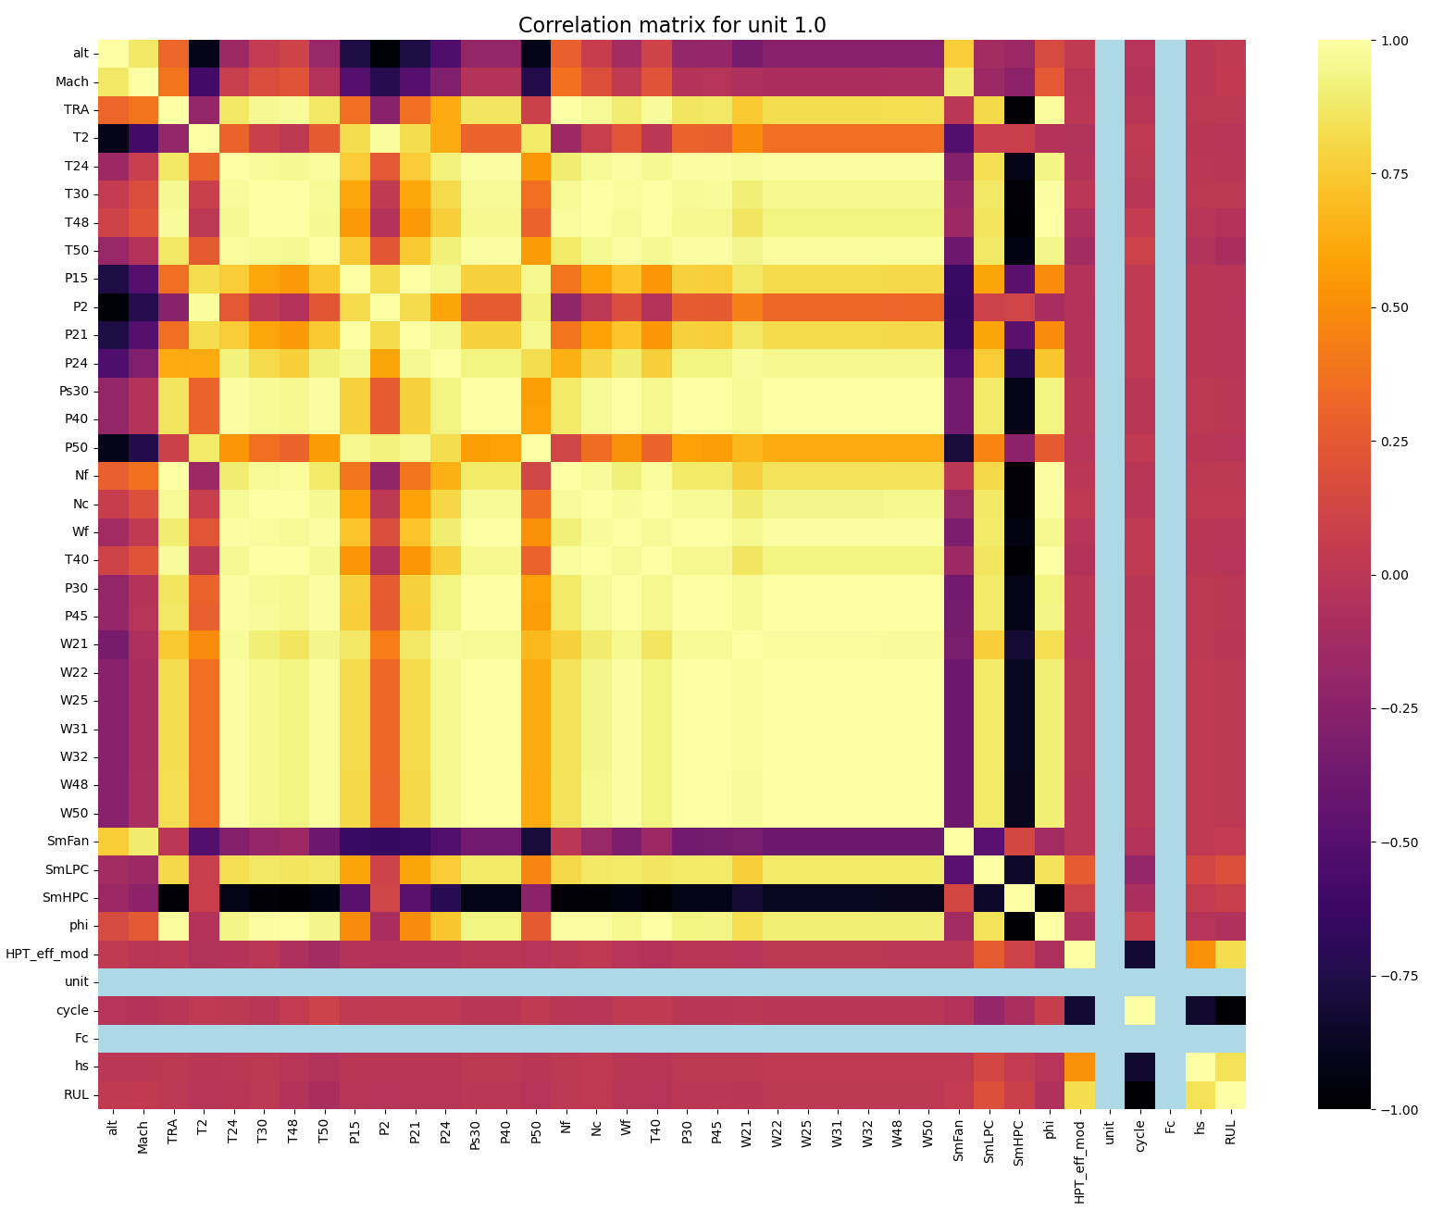
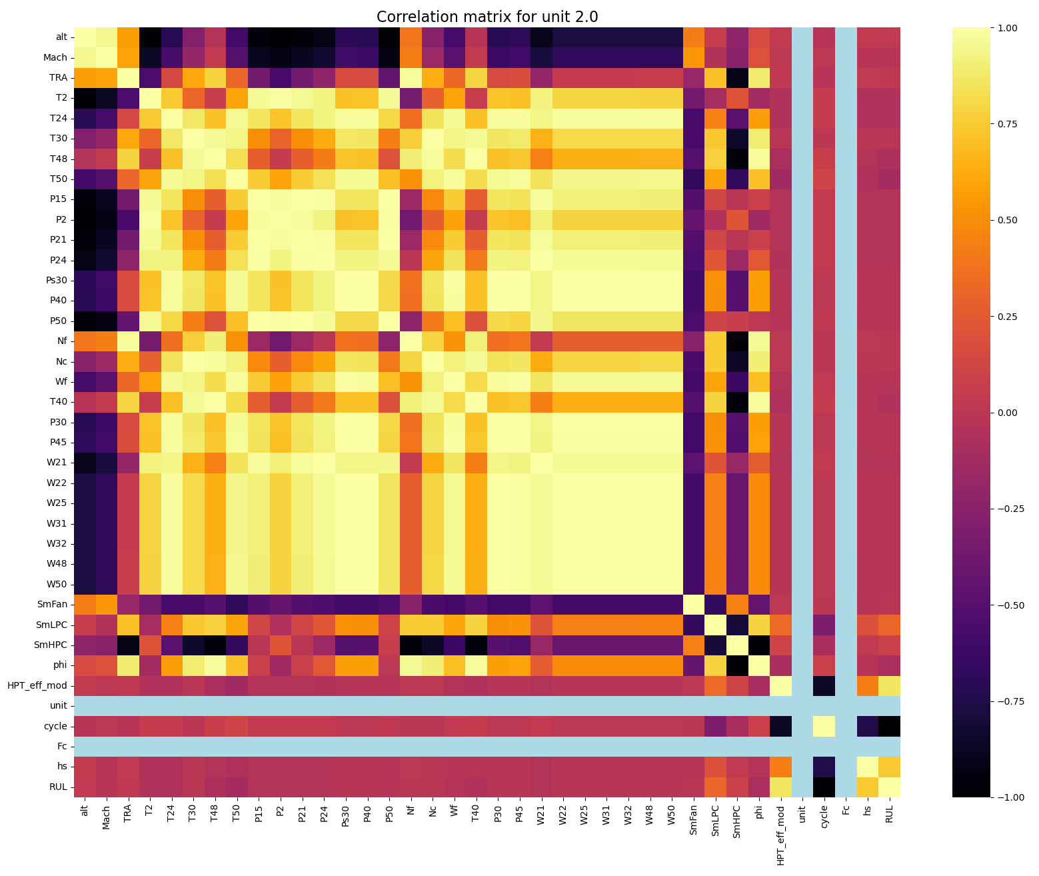
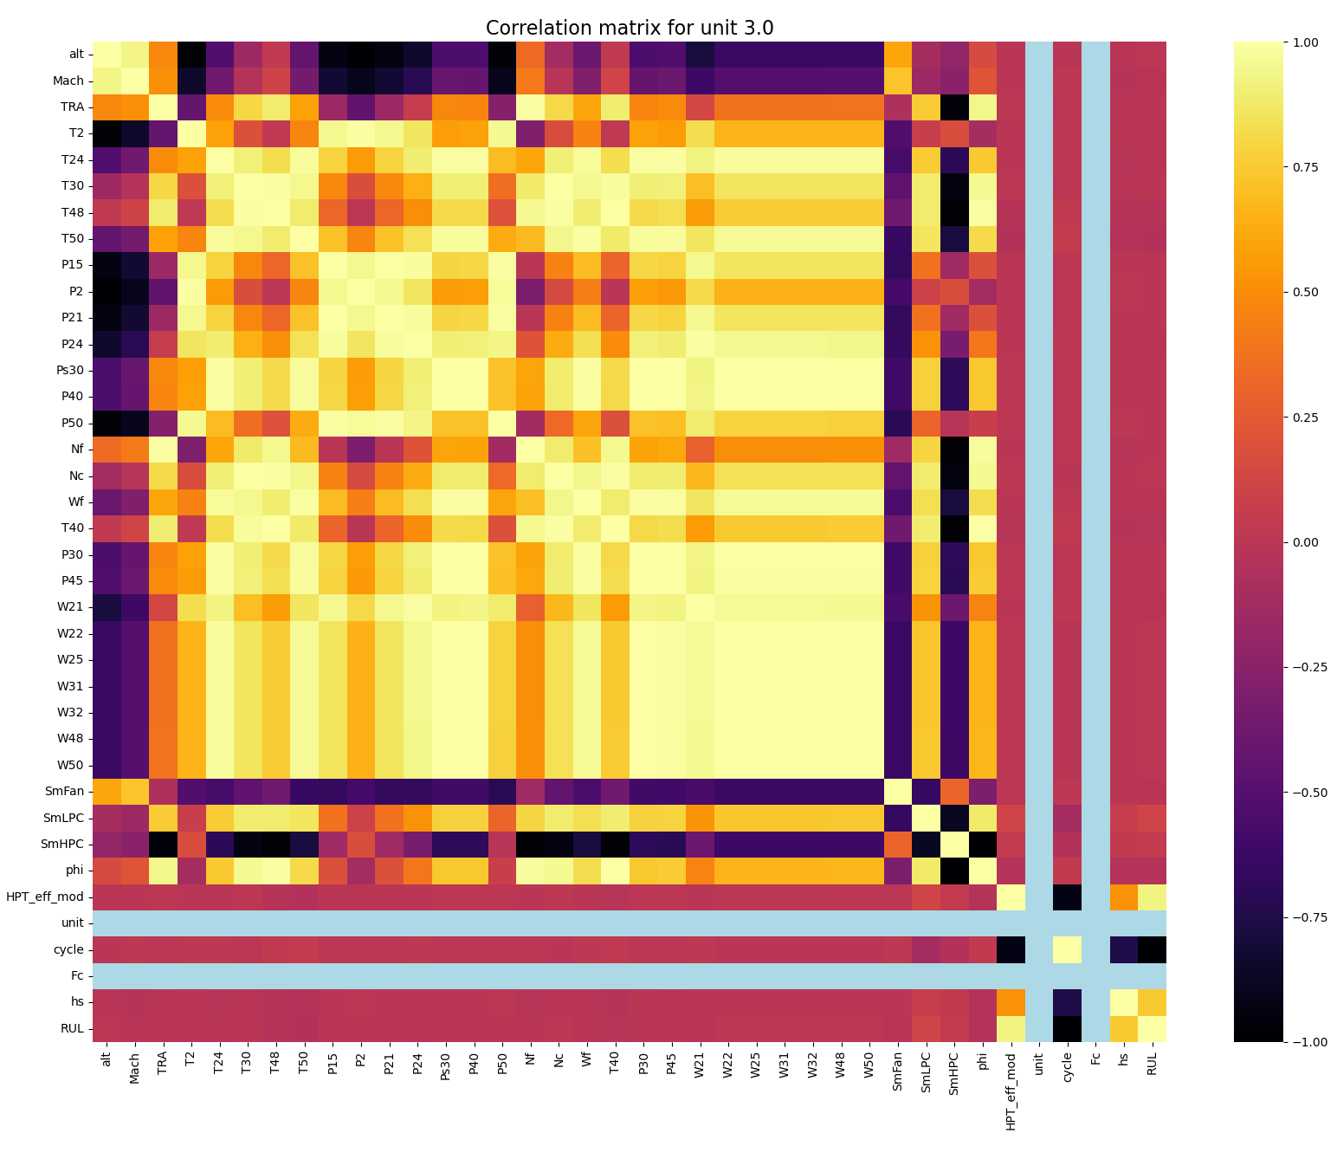



Data pre-processing
Relatively similar correlation is observed across all 6 units in the development dataset
RUL is negatively correlated with cycle which is removed during model training
HPT_eff_mod and hs are highly and positively correlated with RUL, hence must be retained for model training

Slide 7
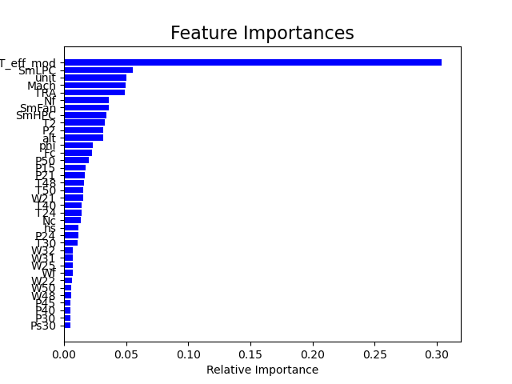
Data pre-processing
Evaluation on the importance of features on RUL is computed using Random Forests algorithm
HPT_eff_mod is shown to have the largest effect on RUL
Large number of variables has little effect on RUL
Principal component analysis can be included in data pipeline to create new uncorrelated variables that successively maximizes variance

Slide 8
Model training
Remove necessary features
(see slide 4 #2-4)
Training data (80%, randomly shuffled)
Train dataset
(units #1-6)
Categorical data
One hot encoding
Original dataset split
Data cleaning
Feature engineering
Training-validation split
Data union
Continuous data
Standardization
Principal component analysis
Add lag features (see slide 4 #6)
Retain 90% of components
Validation data (20%, randomly shuffled)
Test dataset (units #7-10)
XGBoost regression
Visualization
Prediction
Evaluation
Randomized 5-fold cross validation
Random forest regression
Model inference on test dataset
Using root mean squared error (RMSE)
Using negated mean squared error as scoring metric
Ridge regression
Construct one of the three models
The data pipeline is illustrated as shown in the diagram above beginning with original dataset train/test splitting and ending with data visualization
Three models namely XGBoost regressor, Random Forest regressor and Ridge regressor, are constructed and evaluated individually
Mean squared error is used as an accuracy-based metric to aggregate errors in RUL estimation

Slide 9
Model training
Models | Hyperparameters | Range
XGBoost regressor | n_estimators max_depth Subsample colsample_bytree | [100] randint(1, 2) uniform(0.25, 0.75) uniform(0.25, 0.75)
Random forest regressor | n_estimators min_samples_leaf max_features max_depth min_samples_split | randint(1e1, 1e2) randint(1e0, 2e0) ['auto’] randint(1e0, 4e0) randint(2e0, 4e0)
Ridge regressor | alpha | uniform(0.1, 10.0)
Regression models are randomized 5-fold cross-validated at 3 iterations
Hyperparameters are tuned within the distribution range as shown in the table above
Note that distribution range and number of iterations are selected heuristically in consideration of computational time

Slide 10
Results
Model validation after training
Models | Root mean squared error |  | Computation time (secs)
Models | Without lag features | With lag features | Without lag features | With lag features
XGBoost regressor | 0.7770 | 0.9917 | 685.1646 | 309.2234
Random forest regressor | 0.7502 | 0.9889 | 1041.7169 | 1029.1359
Ridge regressor | 0.7488 | 0.9918 | 71.7706 | 68.2248
Model inference on test data
Models | Root mean squared error
Models | Without lag features | With lag features
XGBoost regressor | 16.8314 | 3.6441
Random forest regressor | 16.9422 | 3.7512
Ridge regressor | 16.5576 | 3.3004
Three models achieve relatively similar performance based on RMSE scoring
Addition of lag features significantly improve prediction accuracy for all three models (see diagrams in slide 11-13)
In terms of RMSE and computation time cost, ridge regression appears to offer the best performance within the current experimental boundary

Slide 11
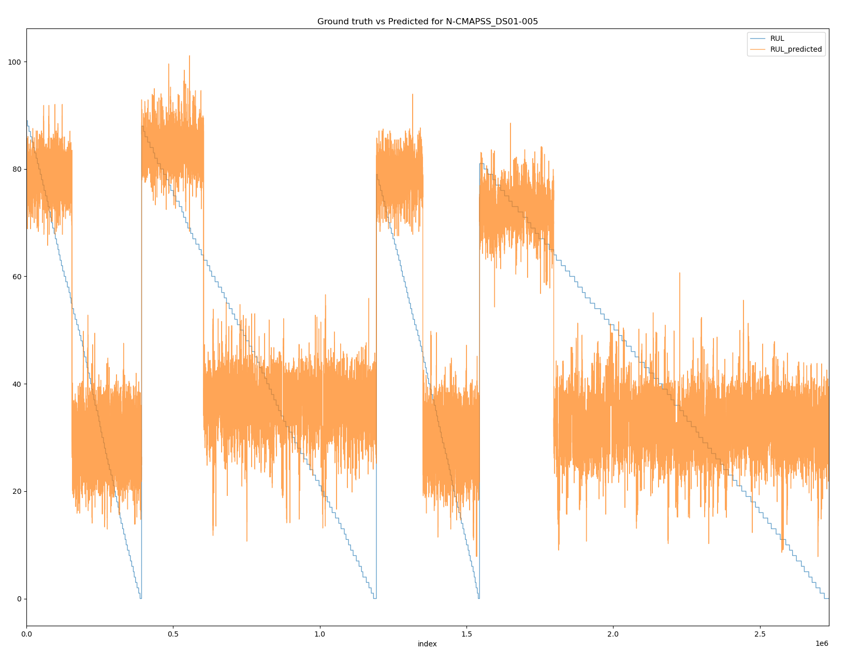
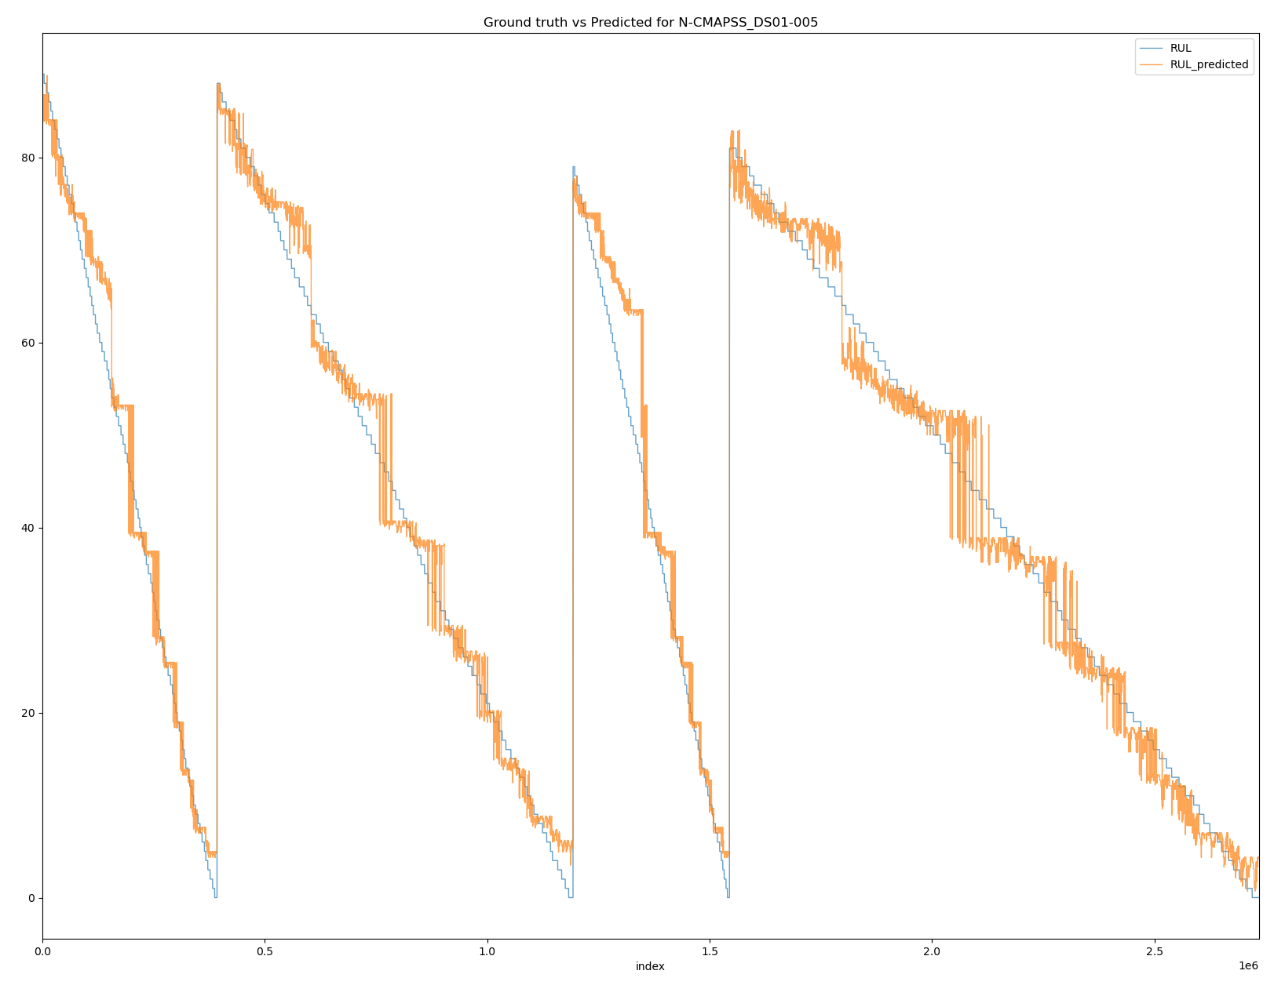
Results
XGBoost regression
Without lag features
With lag features
RMSE: 16.8314
RMSE: 3.6441

Slide 12
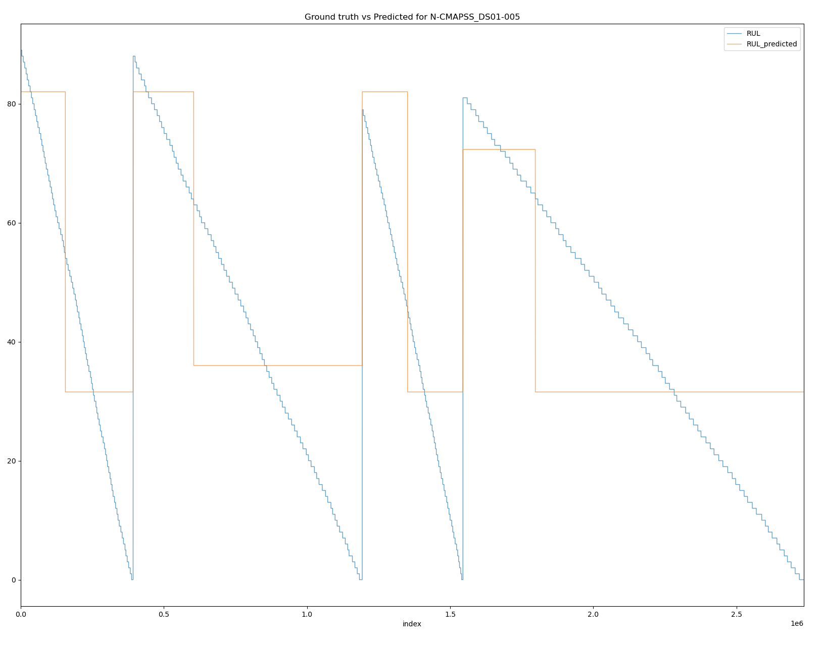
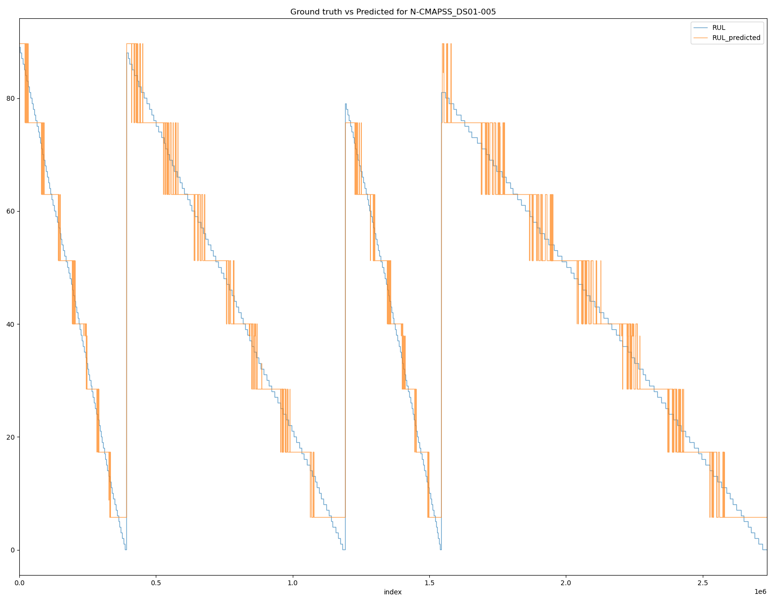
Results
Random forest regression
Without lag features
With lag features
RMSE: 16.9422
RMSE: 3.7512

Slide 13
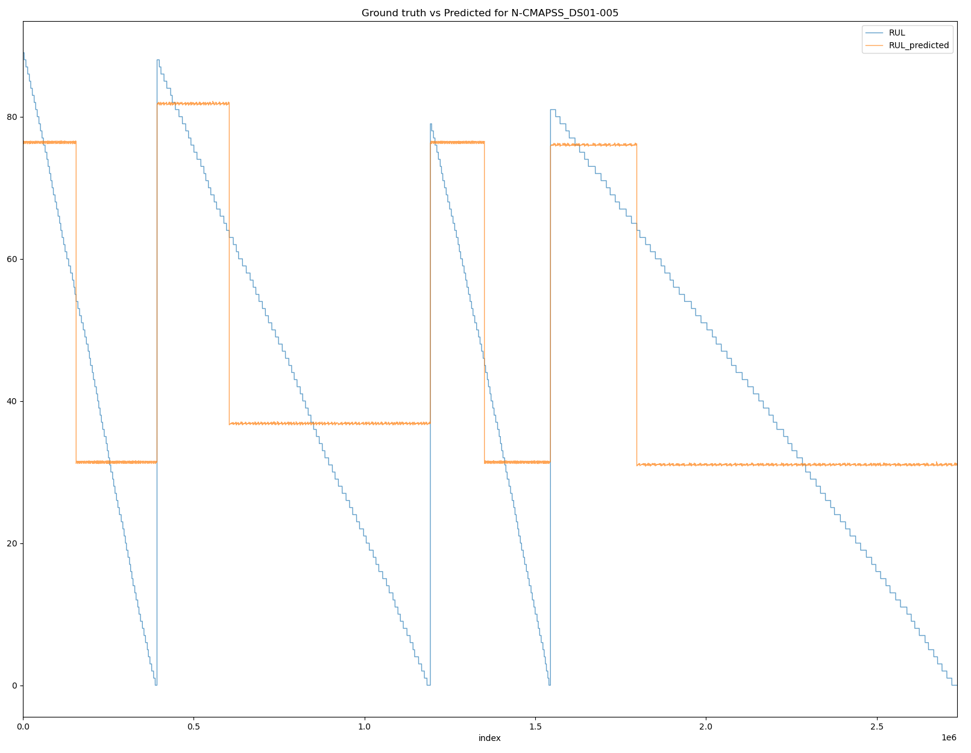
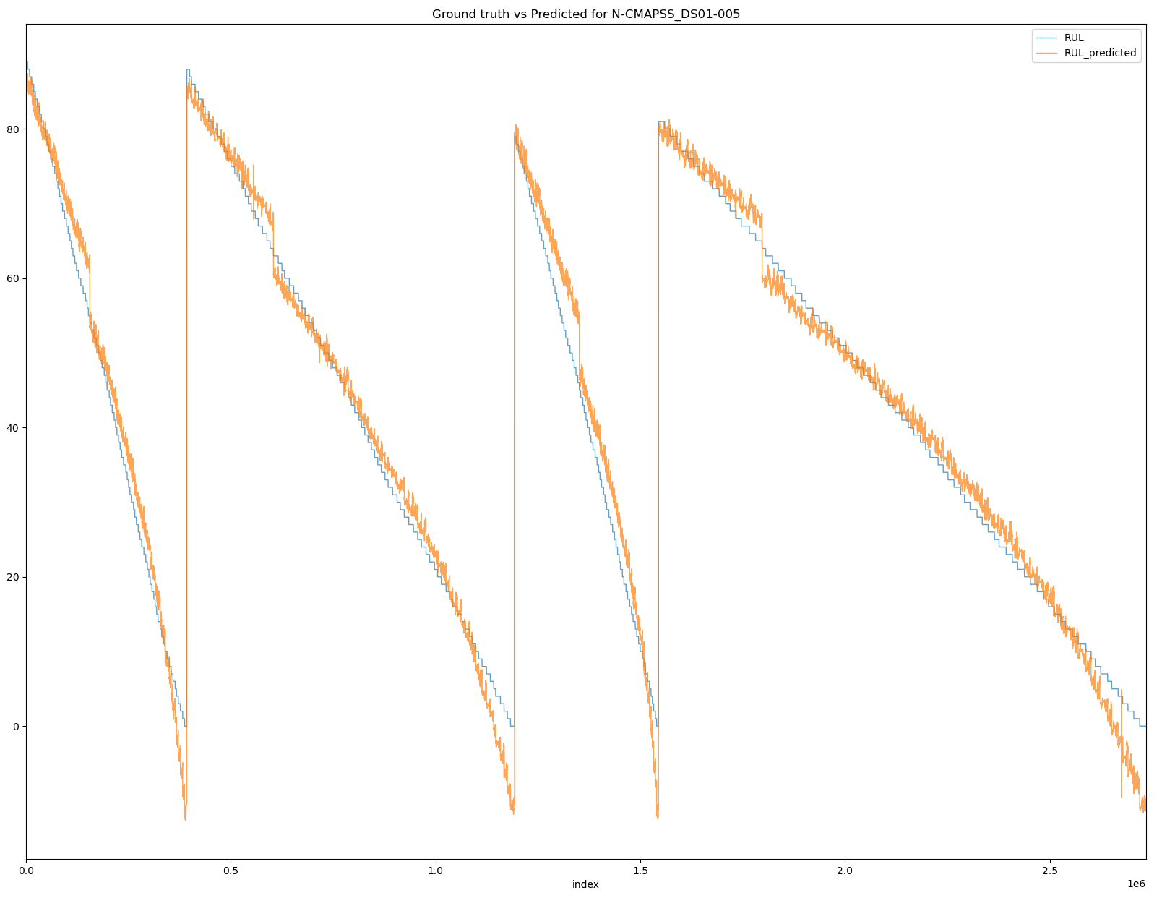
Results
Ridge regression
Without lag features
With lag features
RMSE: 16.5576
RMSE: 3.3004

Slide 14
Results
Ridge regression (with lag features) on test dataset
Data files | Root mean squared error
N-CAMPSS_DS01-005.h5 (Model is trained using development dataset from this file) | 3.3004
N-CAMPSS_DS02-006.h5 | 6.1840
N-CAMPSS_DS03-012.h5 | 5.6094
N-CAMPSS_DS04.h5 | 8.7607
N-CAMPSS_DS05.h5 | 8.9196
N-CAMPSS_DS06.h5 | 10.9219
N-CAMPSS_DS07.h5 | 8.2998
Ridge regression trained with lag features is used to infer test dataset from the remaining data files
RMSE results are tabulated as shown in the table above and the diagrams are shown in slide 15-17
Results seem to suggest that the model trained using a dataset (N-CAMPSS_DS01-005.h5) is able to generalize well on other test data involving different units and failure modes

Slide 15
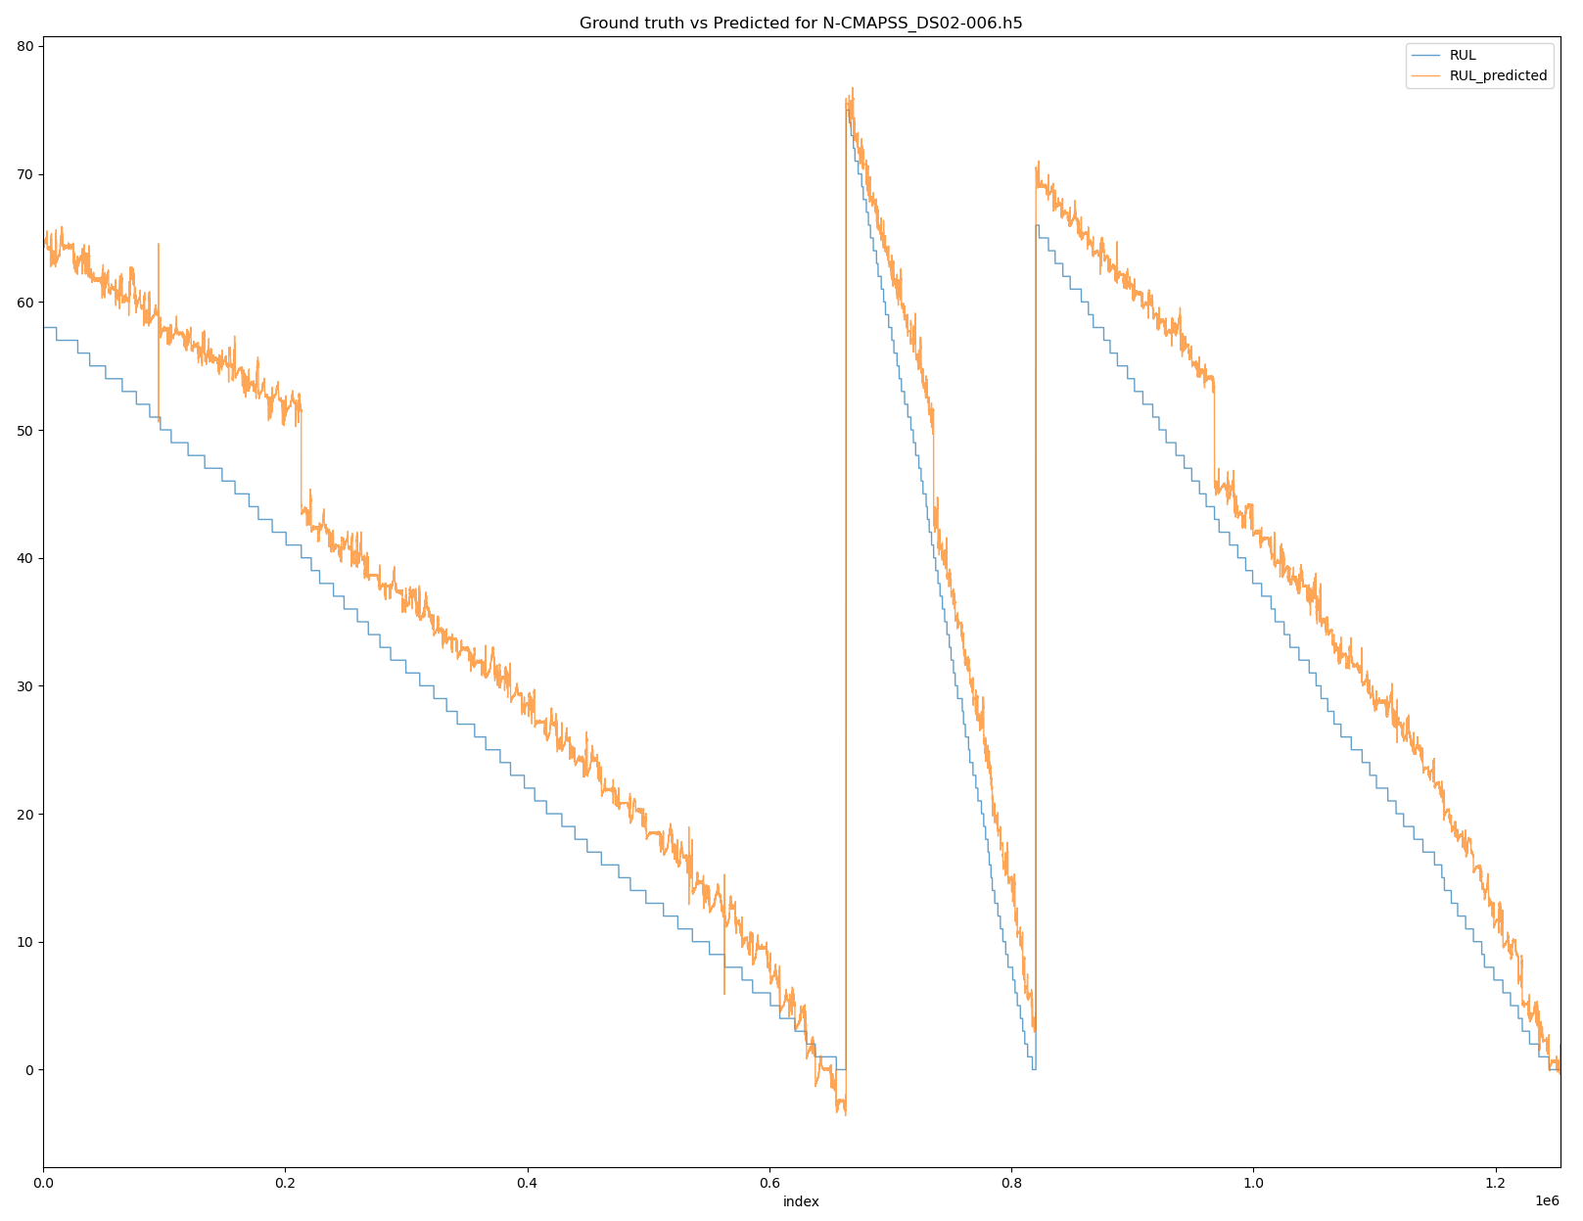
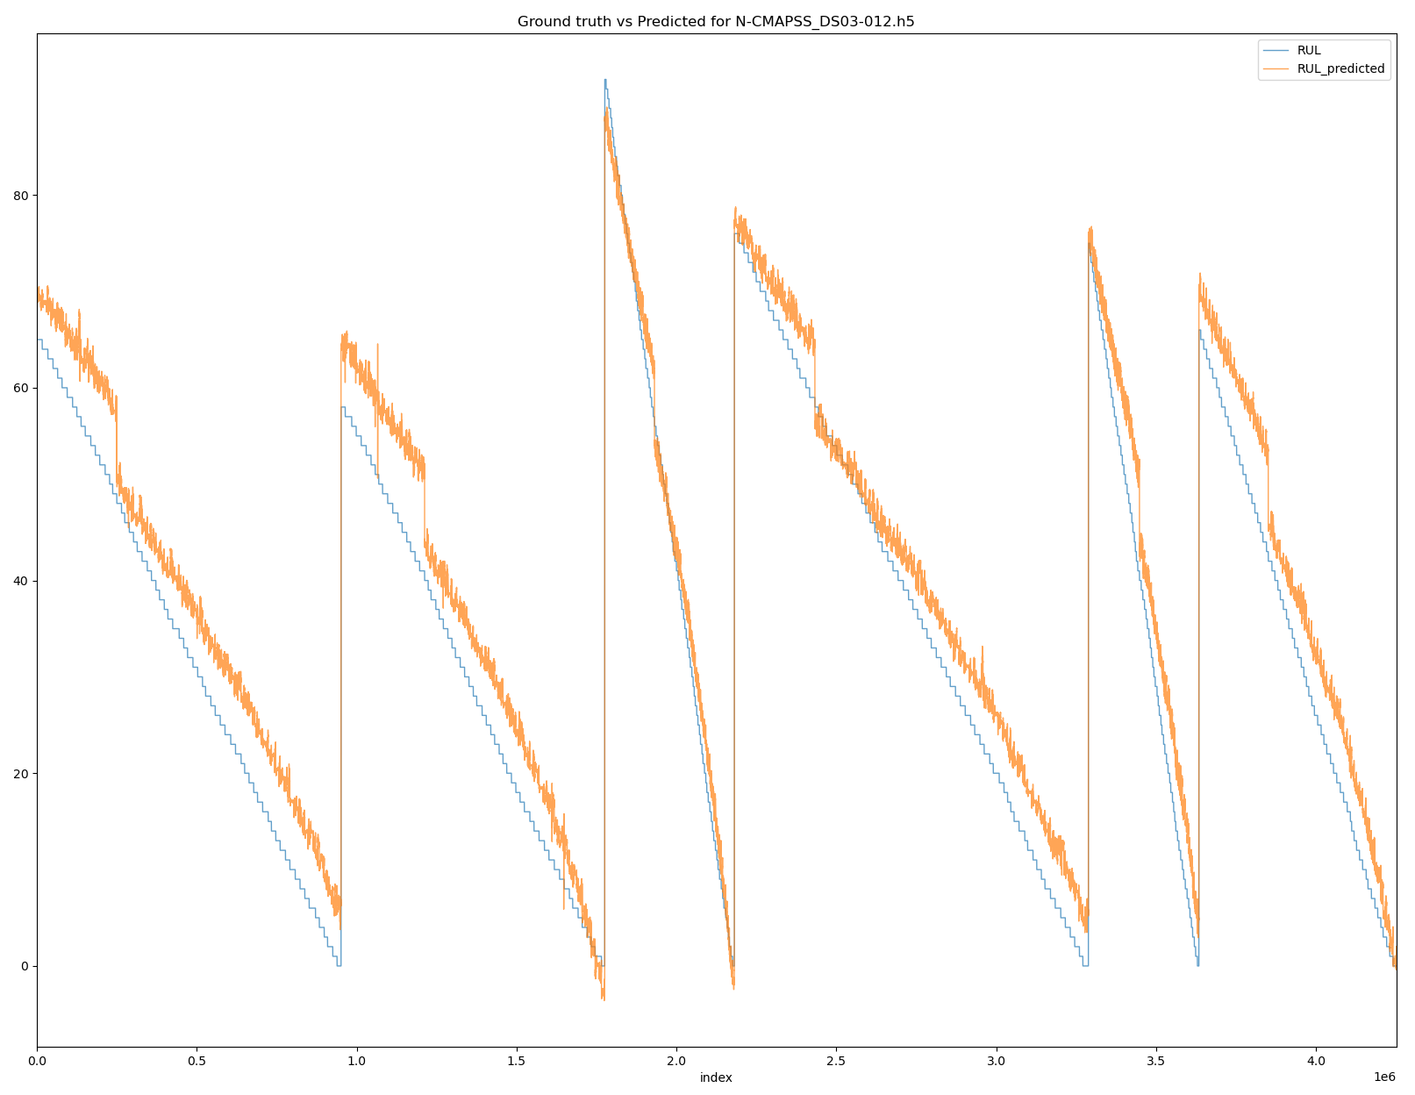
Results
Ridge regression model (with lag features) trained on N-CAMPSS_DS01-005.h5 performing inference on test dataset from:
N-CAMPSS_DS02-006.h5
N-CAMPSS_DS03-012.h5
RMSE: 6.1840
RMSE: 5.6094

Slide 16
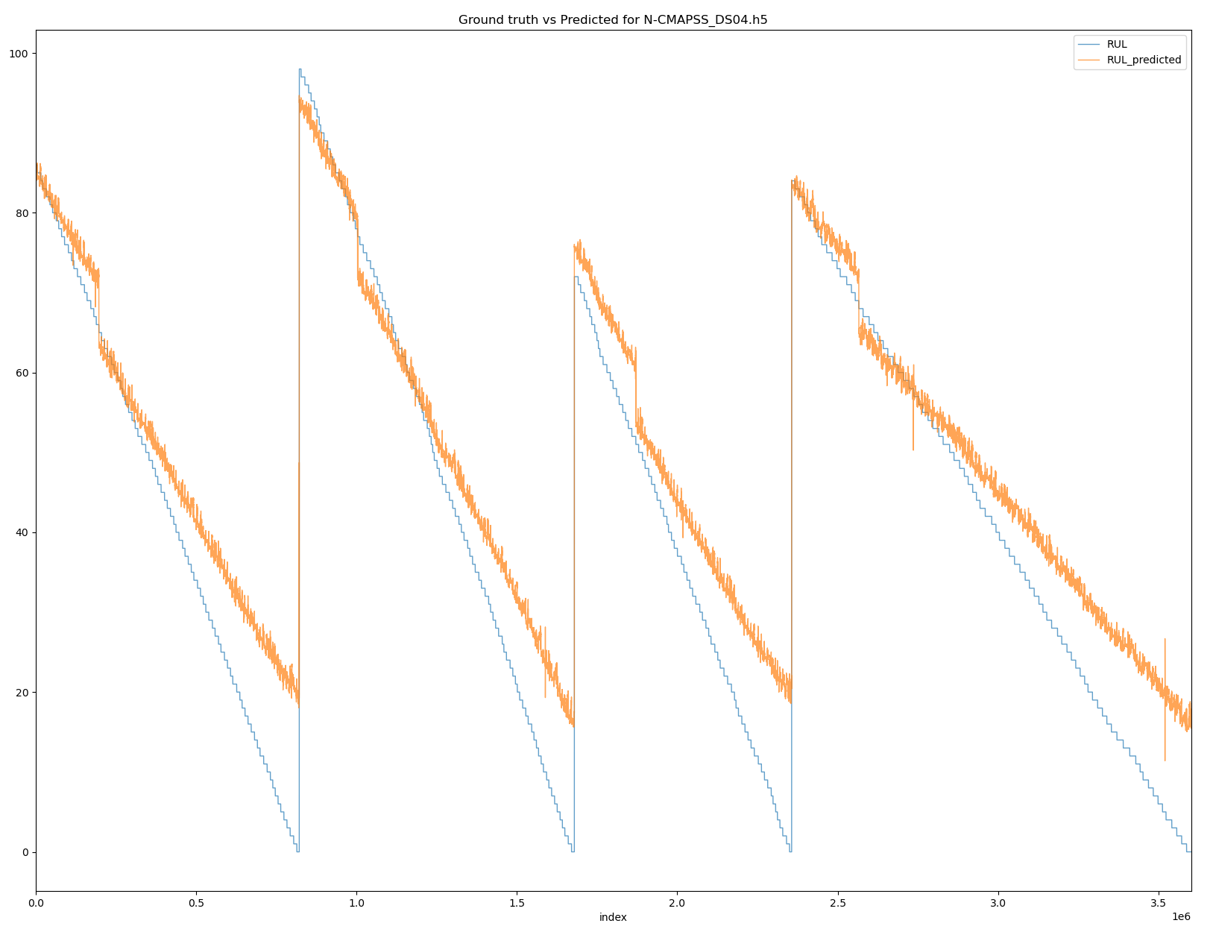
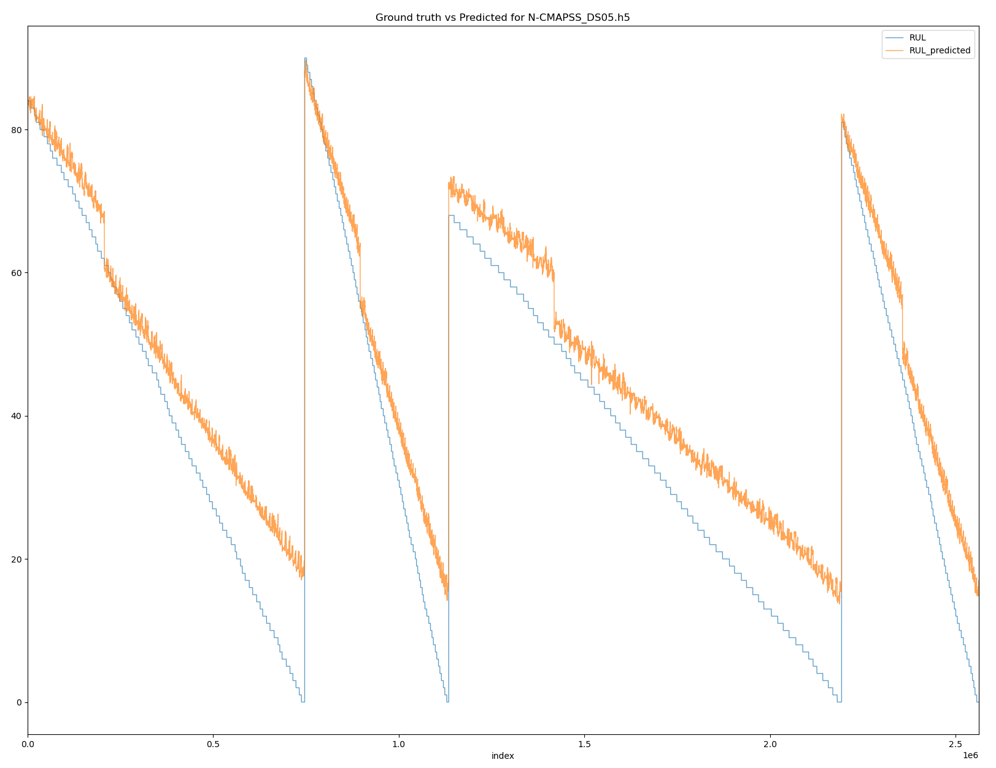
Results
Ridge regression model (with lag features) trained on N-CAMPSS_DS01-005.h5 performing inference on test dataset from:
N-CAMPSS_DS04.h5
N-CAMPSS_DS05.h5
RMSE: 8.7607
RMSE: 8.9196

Slide 17
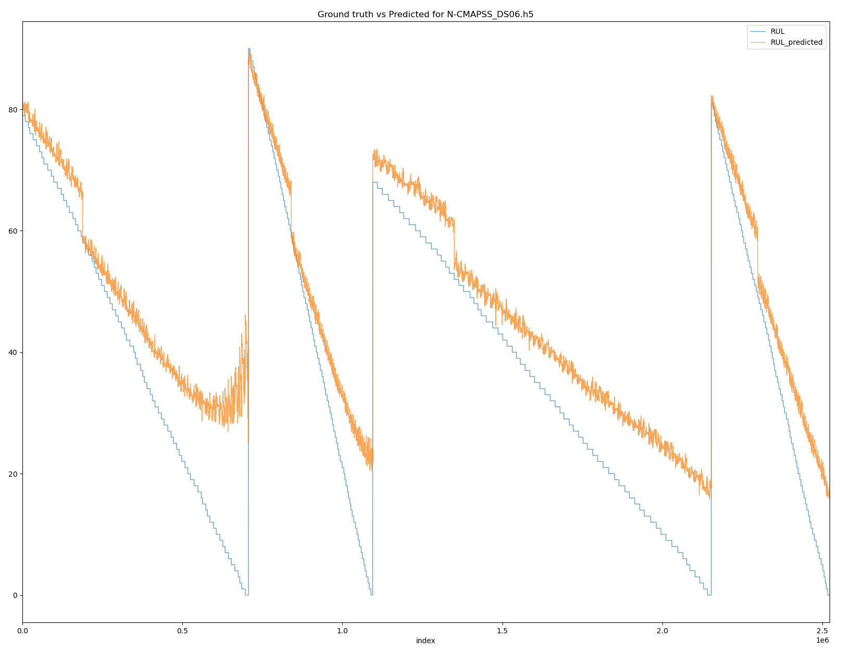
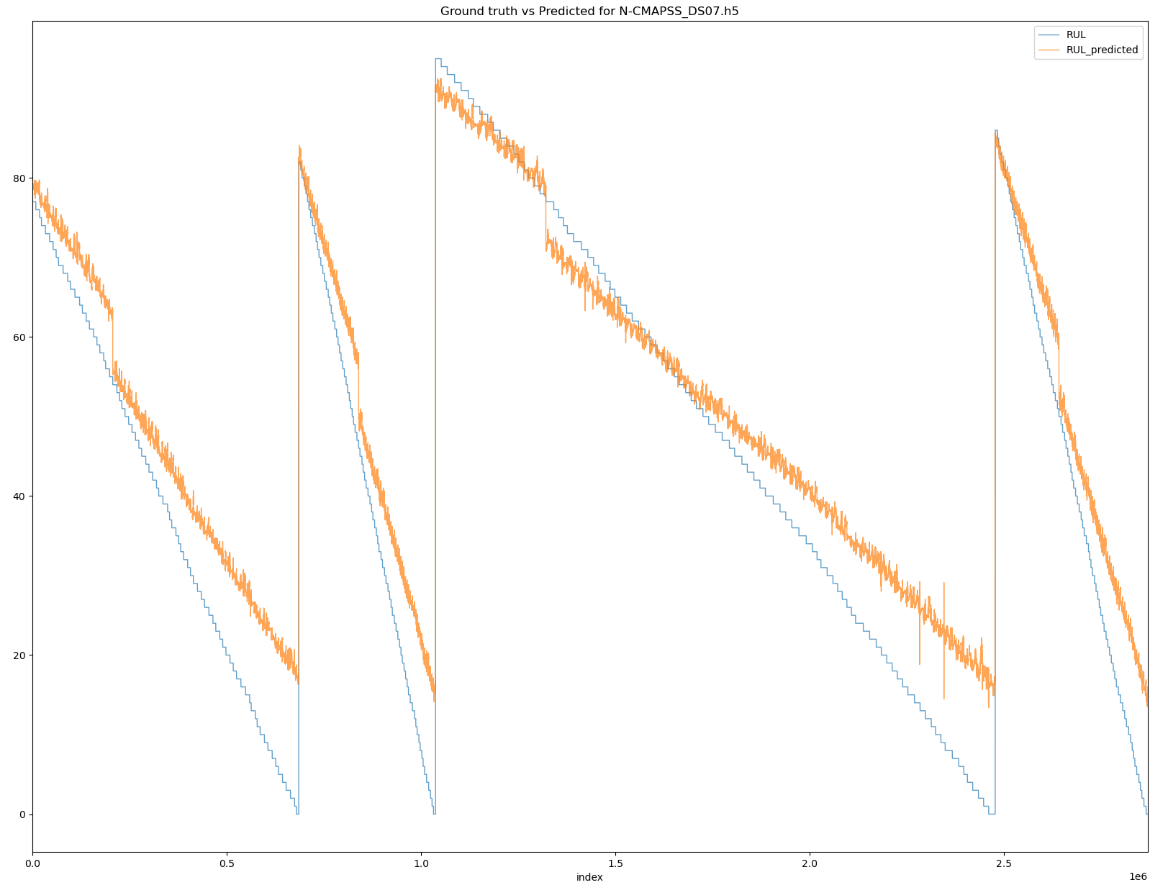
Results
Ridge regression model (with lag features) trained on N-CAMPSS_DS01-005.h5 performing inference on test dataset from:
N-CAMPSS_DS06.h5
N-CAMPSS_DS07.h5
RMSE: 10.9219
RMSE: 8.2998

Slide 18
Potential exploration
Include more datasets (e.g. N-CAMPSS_DS02-006.h5, N-CAMPSS_DS03-012.h5, etc) for modelling to achieve a model that incorporates various failure modes
Explore data pre-processing techniques for noise filtering such as Kalman filtering and gaussian kernel smoothing
RUL prediction is modelled based on a similarity model which requires data degradation from healthy state to failure (run-to-failure). Modelling based on survival model (only data from similar machines during failure exist) and degradation model (when a threshold of a condition indicates failure) can be explored
Consider modelling using convolutional neural network (CNN) + long short term memory network (LSTM) to leverage upon the spatial-temporal properties of CMAPSS dataset

