Slide 1
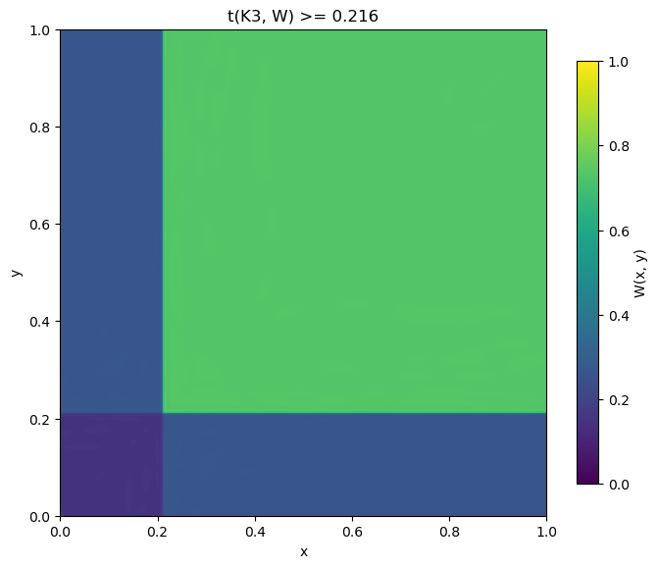
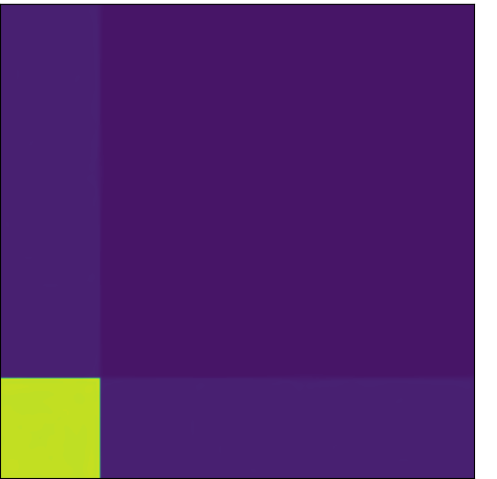
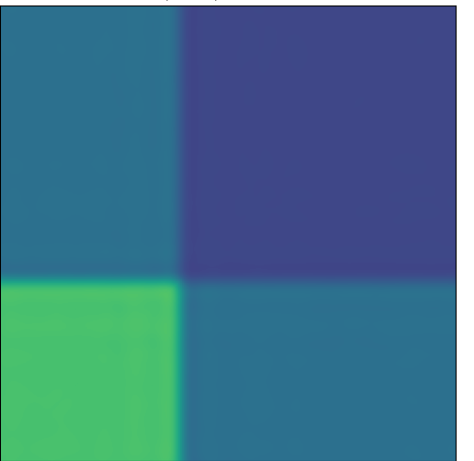
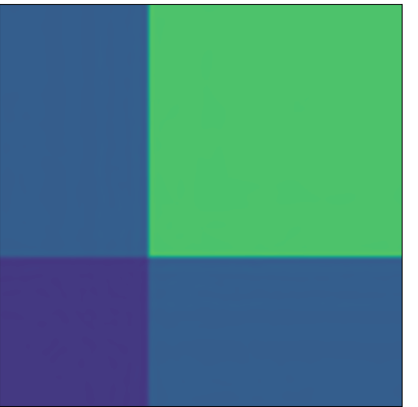
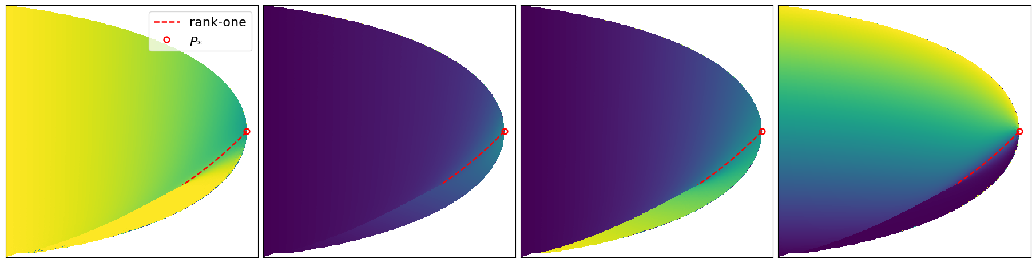
(a) (p, r) = (0.05, 0.2)
(b) (p, r) = (0.1, 0.4)
(c) (p, r) = (0.1, 0.5)
(d) (p, r) = (0.1, 0.6)
1.0
1.0
1.0
1.0
1.0
0.8
0.6
y
y
y
y
W(x,y)
0.4
0.2
0.0
x
1.0
0.0
x
1.0
0.0
x
1.0
0.0
x
1.0
0.0
(a) Larger within-block density
(b) Smaller within-block density
(c) Cross-block density
(d) Weight of the denser block
1.0
1.0
1.0
1.0
1.0
0.8
0.6
r
r
r
r
Parameter
0.4
0.2
0.0
p
0.12
0.0
p
0.12
0.0
p
0.12
0.0
p
0.12
0.0

Slide 2
1.0
1.0
1.0
1.0
1.0
0.8
0.6
y
y
y
y
W(x,y)
0.4
0.2
0.0
x
1.0
0.0
x
1.0
0.0
x
1.0
0.0
x
1.0
0.0
1.0
1.0
1.0
1.0
1.0
0.8
0.6
r
r
r
r
Parameter
discontinuity
0.4
0.2
0.0
p
0.12
0.0
p
0.12
0.0
p
0.12
0.0
p
0.12
0.0

