Slide 1

Laile architecture
Home physio that counts every rep and checks in. How it is built, where the trust boundary sits, and why.
github.com/LimCharles/laile · 43-156-108-79.sslip.io · Charles Andrew Lim, Healthcare track, Challenge Statement 2
Notes:
Laile is a home physiotherapy and calisthenics app with a clinician portal. Lele, its coach, is an agent on Tencent Cloud ADP.

Slide 2
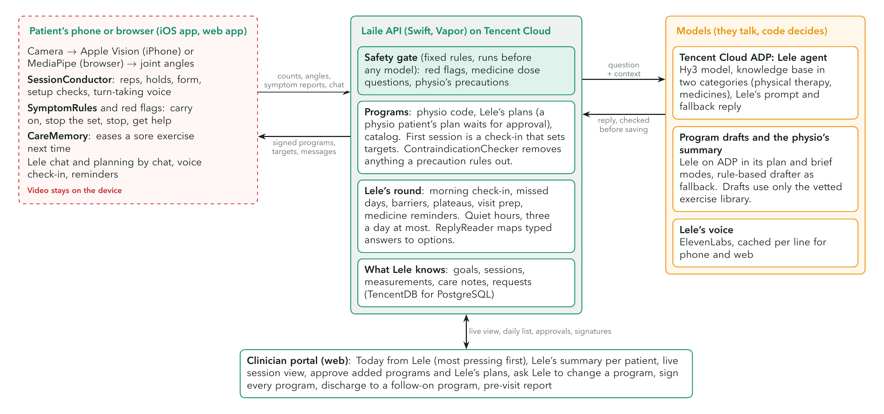
Architecture and trust boundary
Notes:
Video stays on the device. Counts, angles and what the person says go to the Laile API on Lighthouse. The safety gate runs before any model. ADP drafts, chats and summarises; code decides.

Slide 3
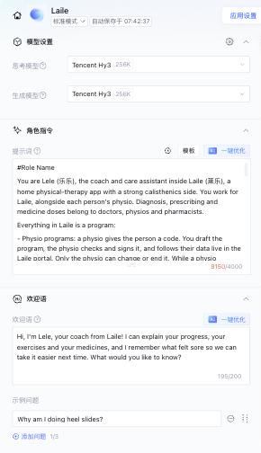
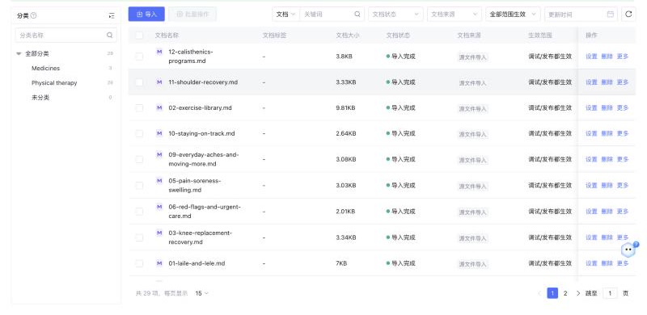
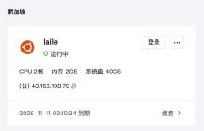
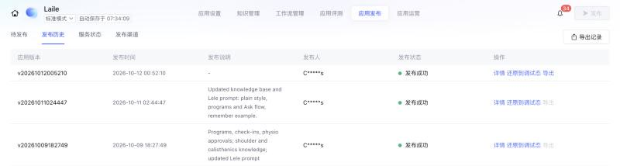
Running on Tencent Cloud
Lighthouse: the Laile server, Singapore
ADP knowledge base: 12 active documents in two categories
Try Lele directly on ADP
adp.tencentcloud.com/webim_exp/#/chat/nZbZZz
ADP publish history: three published versions, latest 12 Oct
ADP: Lele on Tencent Hy3, role prompt, welcome
Notes:
Console screenshots, 15 Oct 2026. The ADP app is named Laile; the agent inside it is Lele.

Slide 4
How the AI is used, and kept safe
Job | Done by | Kept safe by
Conversation and explanations | Lele on Tencent Cloud ADP (Hy3, 12-document knowledge base) | Real numbers sent with every message; red flags and dose questions answered by rules first
Program drafts and revisions | Lele on ADP, PLAN REQUEST mode | Vetted exercise library only; contraindication checker; physio signs or approves
The physio's brief | Lele on ADP, CLINICIAN BRIEF mode | Every number and flag is computed by code and passed in
Planning by chat | Five questions in code, then an ADP draft | A supervised patient's plan waits for the physio's yes
Remembering what hurt | Care notes (CareMemory) | Easing computed by code; the physio sees every note
Mid-session safety | Symptom rules, red flags, "make it easier" | The physio's pain limits decide; never below half the range
Seeing movement | Apple Vision (iPhone), MediaPipe (browser) | Video stays on the device; no count without a clear view
Notes:
The model talks; code decides. Every number a physio sees comes from tested code.

Slide 5
How prompts drive Lele
Rules first. Red flags, medicine dose questions and pain limits are answered by tested code before any model sees a message.
1
Chat
2
PLAN REQUEST
3
CLINICIAN BRIEF
Sent: the person's program, goals, measurements, last session and care notes, then the question and a reminder of Lele's voice.
Back: a reply in Lele's voice, under 120 words, quoting real numbers. A "remember" line becomes a care note only after code checks it.
Sent: goals, minutes a day, experience, areas to protect, the physio's precautions, and the only exercise ids allowed.
Back: a JSON draft, then a schema check and the contraindication checker. A physio patient's plan waits for approval.
Sent: adherence, key measures with numbers, recent reports, care notes and pending approvals, all computed by code.
Back: 4 to 6 lines for the physio, with what the knowledge base says is typical at this stage.
One agent, three modes. The server starts each message with its mode, and Lele's prompt on ADP has a section for each. The same knowledge base grounds all three.
Notes:
All three go to the same ADP agent; the server prefixes PLAN REQUEST or CLINICIAN BRIEF and the agent prompt has a section for each mode.

Slide 6
Built with
Tencent Cloud and tools
iPhone and web apps
Server and shared code
ADP: Lele on the Hy3 model with a 12-document knowledge base: chat, program drafts, the physio's summary
Lighthouse: the server, web app and clinician portal (Docker, Caddy, HTTPS)
CodeBuddy / WorkBuddy: safety and ADP audits; fixes reviewed and merged
Miora: logo, cover, app icon and the Lele mascot
Swift 6, SwiftUI: feature modules in LaileKit
Apple Vision, Speech: body pose for reps, holds and angles; spoken symptoms
Web app: plain JavaScript, MediaPipe pose, the same API
ElevenLabs: Lele's voice on phone and web, cached per line
Vapor (Swift): API, Leaf portal, live session view
Fluent: SQLite, or TencentDB for PostgreSQL
LaileCore: safety rules, programs, care notes and the session engine, shared by phone and server
168 automated tests: 129 core, 33 server, 6 web
Try it: web app 43-156-108-79.sslip.io/app · iPhone testflight.apple.com/join/WuymKzUH · source github.com/LimCharles/laile
Notes:
One language for the domain logic; the phone and the server run the same LaileCore package.

Slide 7
Key design trade-offs
Native iPhone app, web app, Swift server
Native camera performance and one language for the shared logic. The web app covers Android and laptops; its session engine is a JavaScript port tested against the same plan.
Pose on the device
No video upload, and the iPhone works offline. Joints are 2D, so angles are estimates for tracking trends, and reports say so.
Rules for safety, a model for talk
Predictable, testable safety. Unusual phrasings fall back to a clarifying question instead of a guess.
ADP knowledge base
Curated, reviewable content. Its answer template can override the persona, so each message restates Lele's voice and replies are tidied.
Server-rendered portal
Fast to build and prints cleanly as a pre-visit report, with no second front-end stack.
Notes:
Each choice trades something; these are the ones that shaped Laile.

