Slide 1
EXECUTIVE BRIEFING & SYSTEM ARCHITECTURE
CBVH IT Helpdesk System
Operational Workflow, Multi-Tier Branch Governance & System Architecture
📱 Mobile Telegram Mini App
INSTANT MOBILE ACCESS
Zero installation for bank staff. Enables 1-tap incident submission, compressed photo attachments, and real-time chat with IT directly inside Telegram.
🛡️ 2-Tier Branch Governance
STRICT FINANCIAL CONTROL
Branch Dept HOD validates local equipment need, followed by Head Office IT HOD validation before any hardware or budget is committed.
⏱️ SLA & Customer Confirmation
CLOSED-LOOP QUALITY
Technicians cannot close tickets unilaterally. Employees verify the fix and rate service quality with a 48-hour safety auto-close rule.

Slide 2
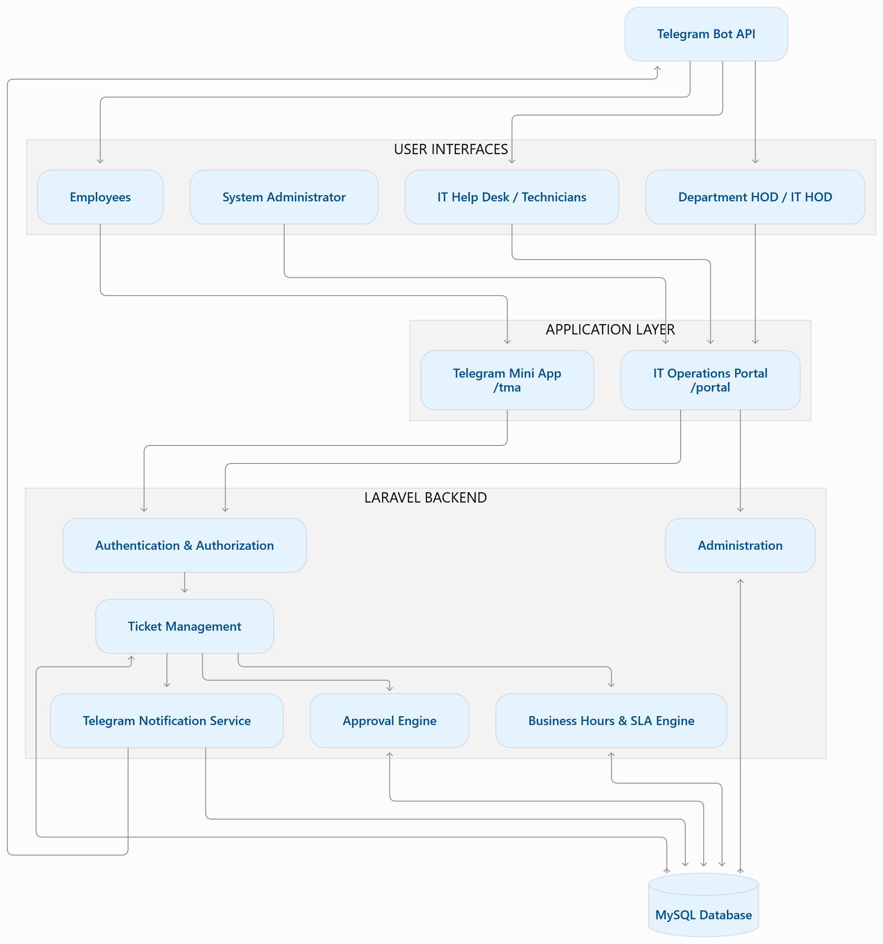
SYSTEM ARCHITECTURE & INTEGRATION
Dual-Channel System Architecture
1. User Interfaces Layer
DUAL USER TOUCHPOINTS
• Requesters & Branch HODs use the Telegram Mini App (/tma) on smartphones with zero app store install.
• IT Technicians, IT HOD, and System Admins use the Web Management Portal (/portal) on desktop.
2. Core Backend & Business Logic Layer
LARAVEL 12 ENGINE & RULES
• Authentication & Session Isolation: Strict guard separation prevents mobile users from accessing admin routes.
• Ticket Management & 2-Tier Approval Engine routes requests by branch and department.
• SLA Engine: Pauses clocks during non-business hours and national holidays.
3. Notification & Database Layer
AUTOMATED PUSH & AUDIT TRAIL
• Telegram Bot API: Delivers instant push alerts when tickets are created, approved, replied, or resolved.
• Enterprise Relational Database: Full relational integrity tracking all tickets, notes, and asset handovers.
Cheang Bak Van Hong (CBVH) Jewelry & Financial Operations • IT Helpdesk System Architecture • Confidential

Slide 3
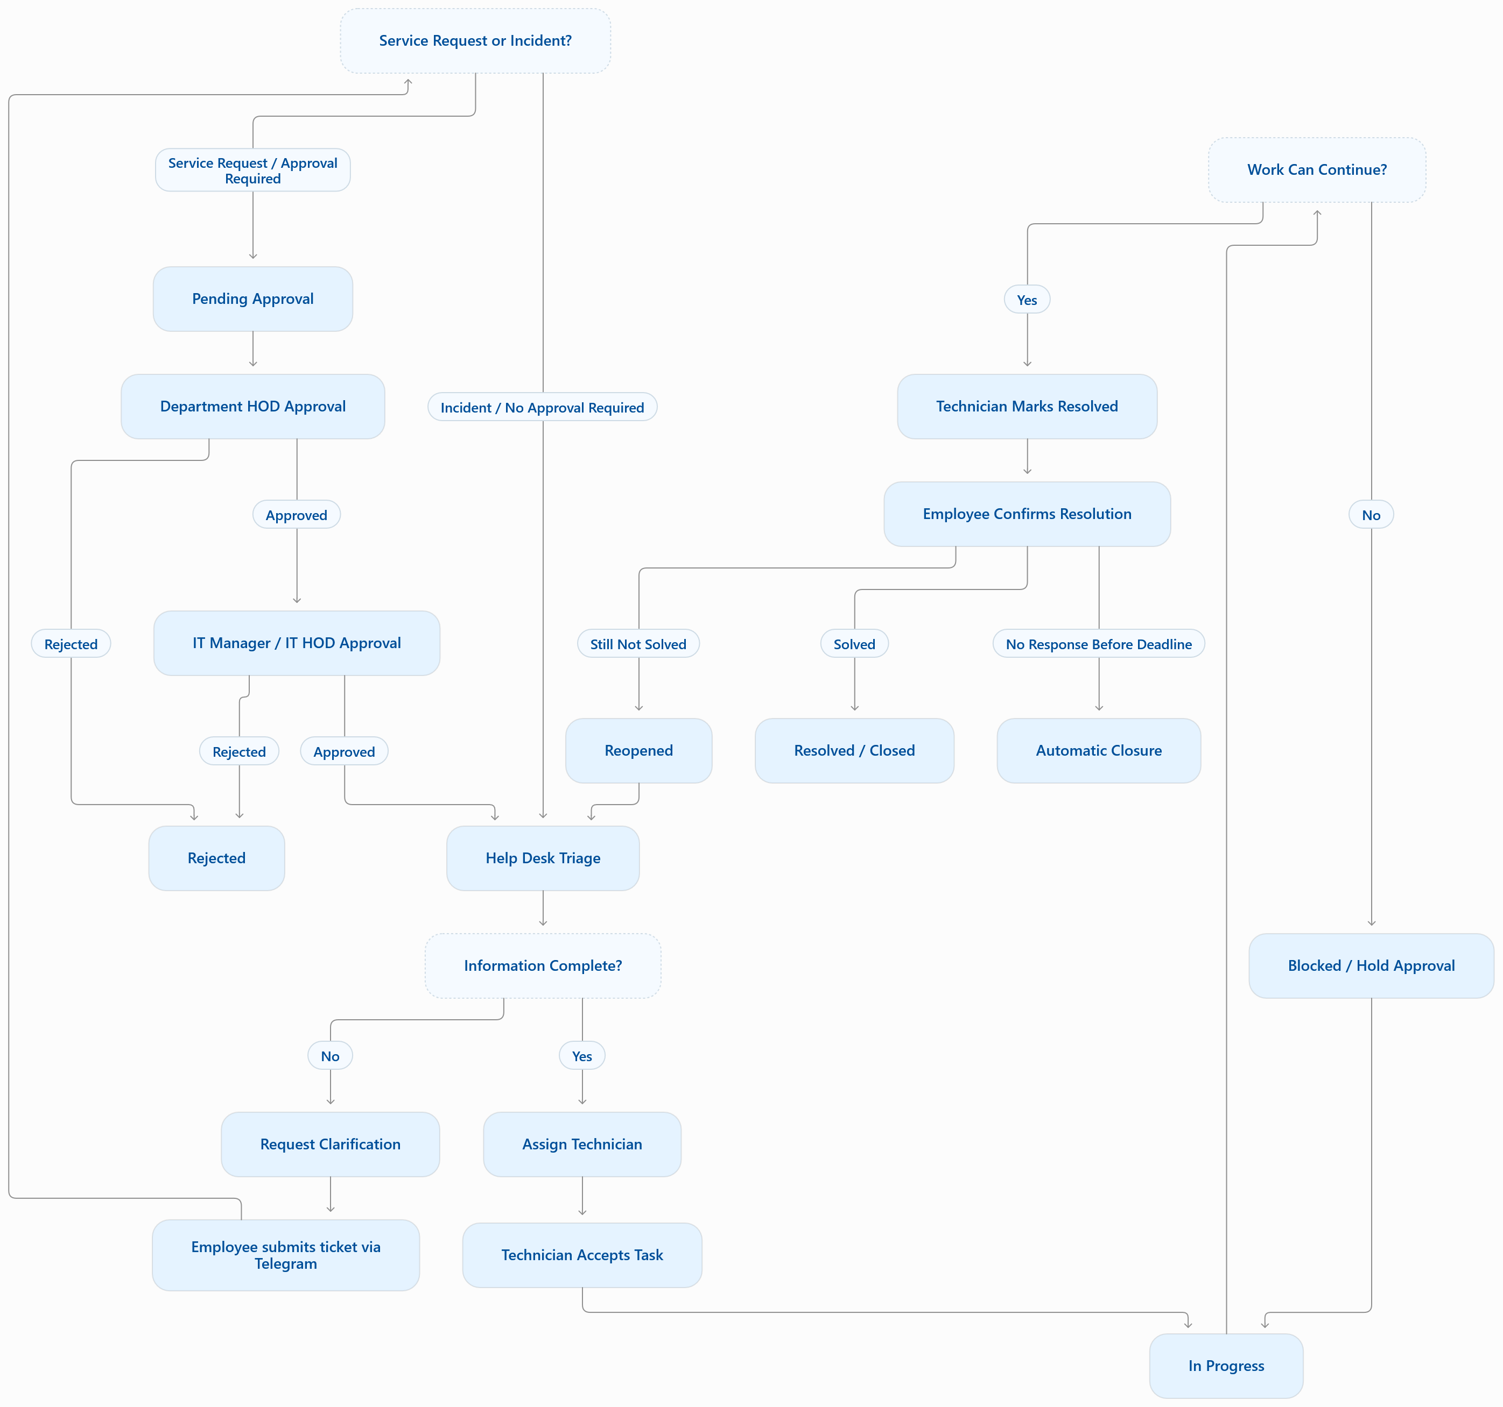
PROCESS FLOWCHART & WORKFLOW
End-to-End Ticket Lifecycle & Decision Rules
Decision 1: Incident vs Service Request
• Incident (Break/Fix): Printer error, network offline, POS crash &rarr; Bypasses approvals directly into the IT Triage Queue.
• Service Request (New Asset/Access): Laptop, email setup &rarr; Routes to 2-tier approval.
Decision 2: Help Desk Triage & Assignment
• If details are incomplete: IT triggers 'Request Clarification' loop back to the employee.
• If complete: Assigned to technician; moves to 'In Progress' with active SLA countdown.
Decision 3: Execution & Blocked Status
• If parts or external vendor support are needed, ticket status shifts to 'Blocked / Hold'.
• Once resolved, technician submits resolution notes and marks 'Resolved'.
Decision 4: Employee Confirmation Loop
• Employee tests fix: 'Solved' closes ticket & collects 1–5 star CSAT rating.
• 'Still Not Solved' reopens ticket instantly to IT. 48h auto-closure prevents stale queues.
Cheang Bak Van Hong (CBVH) Jewelry & Financial Operations • IT Helpdesk System Architecture • Confidential

Slide 4
FINANCIAL & ASSET CONTROL
Branch-Aware 2-Tier Approval Governance
TIER 1: BRANCH DEPARTMENT HOD
Local Branch Need Verification
• Purpose: Verifies the requester genuinely requires the asset or permission for their daily branch operational duties.
• Branch Matching: Approver must hold the HOD role AND match both the requester's Department AND Branch (e.g. Battambang Sales HOD approves a Battambang salesperson).
• Smart Auto-Skip Fallback: If a branch does not have a designated HOD for that department, the system automatically skips directly to Central IT HOD without stalling.
• Mobile Approval Cockpit: HOD receives instant Telegram push alert with 1-tap Approve / Reject buttons.
TIER 2: HEAD OFFICE CENTRAL IT HOD
Central Feasibility & Policy Check
• Purpose: Ensures IT budget compliance, cybersecurity standards, software licensing rules, and hardware inventory availability.
• Head Office Authority: Remains strictly centralized at Head Office (Phnom Penh) for the entire bank network.
• Final Authorization: Once approved by IT HOD, the ticket is dispatched to the technician pool for physical deployment or system configuration.
• Complete Audit Trail: Timestamps, approver ID, and approval notes permanently recorded for compliance audits.
Executive Takeaway: Eliminates 'shadow IT' spending and establishes strict governance while allowing regional branches to operate without delays.
Cheang Bak Van Hong (CBVH) Jewelry & Financial Operations • IT Helpdesk System Architecture • Confidential

Slide 5
SERVICE LEVEL MANAGEMENT
Quality Assurance: Closed-Loop Customer Confirmation
1. Technician Resolves
MANDATORY DOCUMENTATION
• Technician finishes repair or configuration.
• Required to enter detailed resolution notes explaining what was fixed.
• Sets status to 'Pending Confirmation'.
2. Telegram Push Alert
INSTANT USER VERIFICATION
• System immediately fires a Telegram webhook notification to the employee.
• Alerts requester to test the device or service and confirm resolution.
3. Confirm & CSAT Rating
VERIFIABLE SERVICE QUALITY
• If Solved: Employee taps 'Confirm' and submits 1–5 star rating with feedback.
• If Still Broken: 1-tap 'Reopen' returns ticket to IT queue with high priority.
4. 48-Hour Safety Net
PREVENTING STALE QUEUES
• If the requester forgets to confirm, an automated timer closes the ticket after 48 hours.
• Keeps active queues accurate while ensuring user had ample time to test.
Key Differentiator: Unlike legacy helpdesks where technicians close tickets unilaterally, our system puts final verification in the hands of the bank employee.
Cheang Bak Van Hong (CBVH) Jewelry & Financial Operations • IT Helpdesk System Architecture • Confidential

Slide 6
EXECUTIVE VALUE SUMMARY
Business Impact & Leadership Return on Investment (ROI)
OPERATIONAL METRIC | PREVIOUS MANUAL PROCESS | CBVH IT HELPDESK SYSTEM (NEW)
Ticket Tracking & Logging | Lost in private Telegram DMs, verbal phone calls, and unrecorded physical requests. | 100% digital audit trail with employee ID, branch, category, and exact timestamps.
Provincial Branch Oversight | No visibility into issues at Battambang or Siem Reap branches until escalation. | Real-time branch tagging (HQ-PP, BT-PP, BTB-01, VH-SR) with instant management reporting.
Asset & Expense Approvals | Manual paper sign-off sheets causing days of procurement and setup delays. | Automated 2-Tier digital approval: Branch Dept HOD &rarr; Central IT HOD directly in Telegram.
Software & User Licensing | $30–$80 per technician per month on cloud platforms (Jira / ServiceNow / Zendesk). | $0 extra subscription cost. Fully self-hosted on CBVH private infrastructure with zero per-seat fees.
Executive Conclusion: The CBVH IT Helpdesk System delivers complete operational governance, fast mobile access, and measurable service quality across all bank branches.
Cheang Bak Van Hong (CBVH) Jewelry & Financial Operations • IT Helpdesk System Architecture • Confidential

