Slide 1
Introduction to Optimization in Deep Learning
(Sejong RCV 임근택)

Slide 2
Convex Optimization?

Slide 3
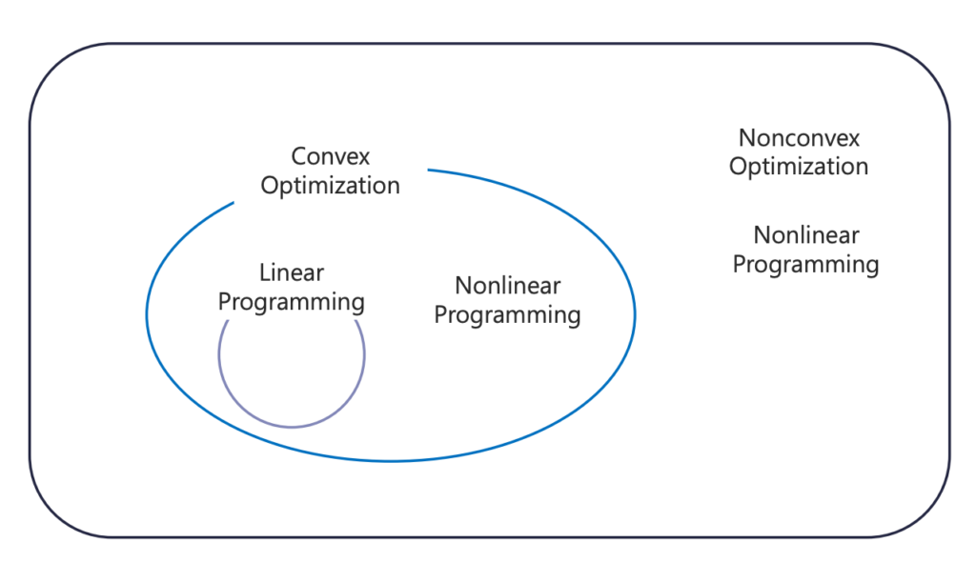
Optimization Problems

Slide 4
Convex Sets & Function

Slide 5


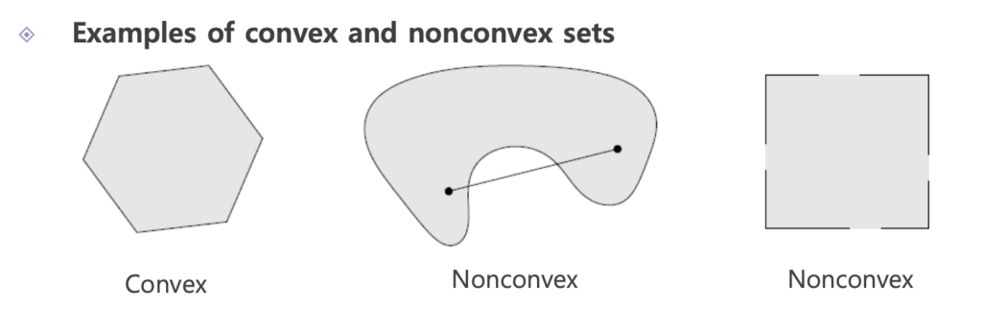
Convex Set
Affine Set :
Convex Set :

Slide 6
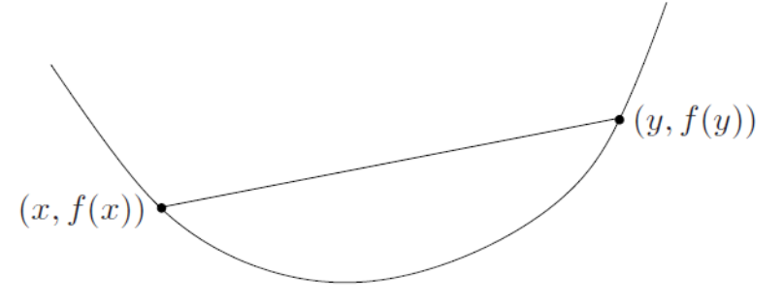
Convex Function
Convex Function :

Slide 7
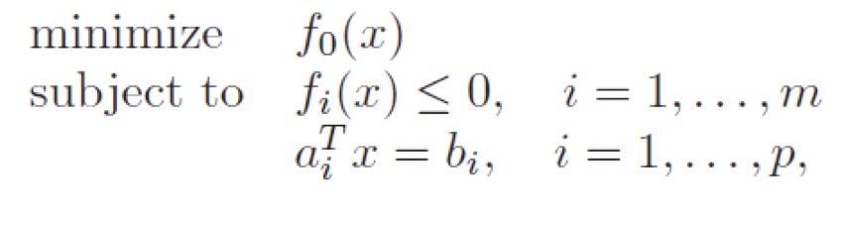
Convex Optimization
The objective function must be convex
The inequality constraint function must be convex
The equality constraint function must be affine
The feasible set of a convex optimization problem is convex

Slide 8



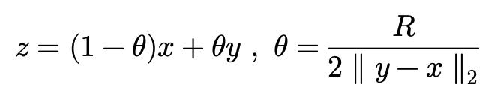




Global optimal = local optimal
Suppose that x is locally optimal point and x is feasible
$$x$$
$$R$$
$$y$$
Suppose that x is not globally optimal there is a feasible point y such that
Consider the point z given by
By Convexity of the function we can have

Slide 9
Unconstrained Convex Optimization

Slide 10

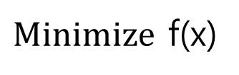
Unconstrained Convex Optimization
$Minimize$ f(x)

Slide 11





Example : Least Square
Vector Differentiation

Slide 12
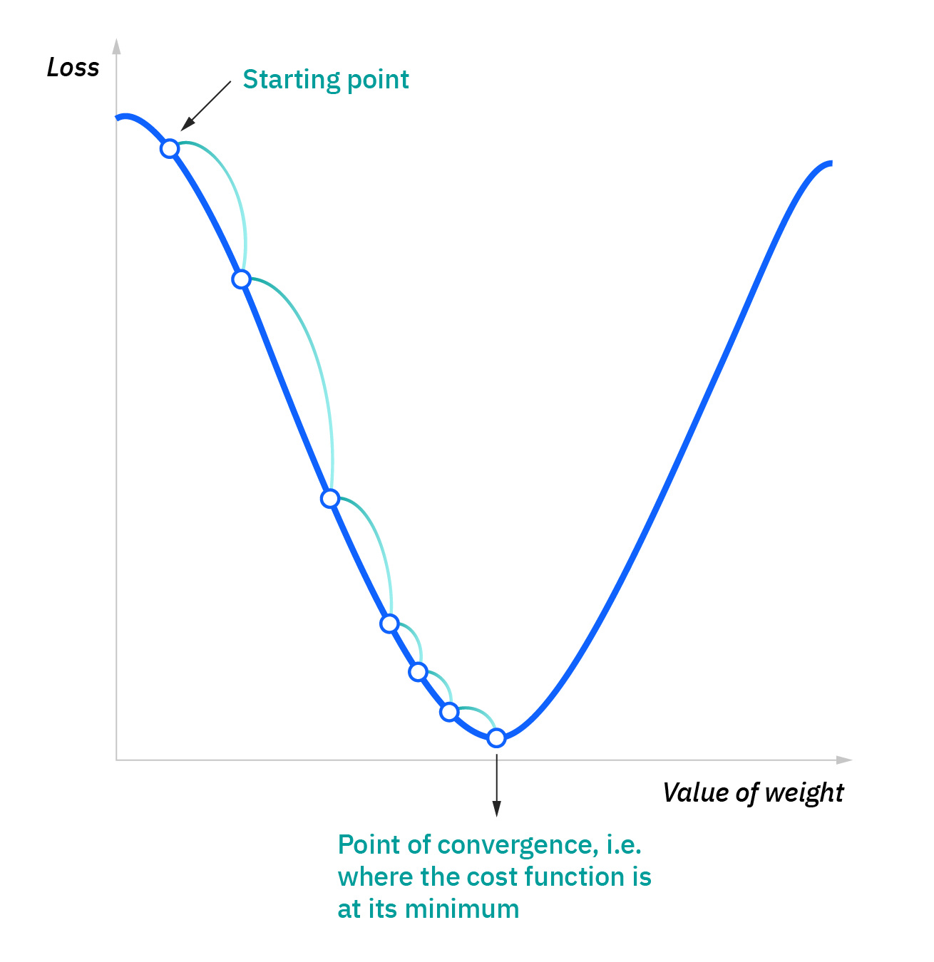
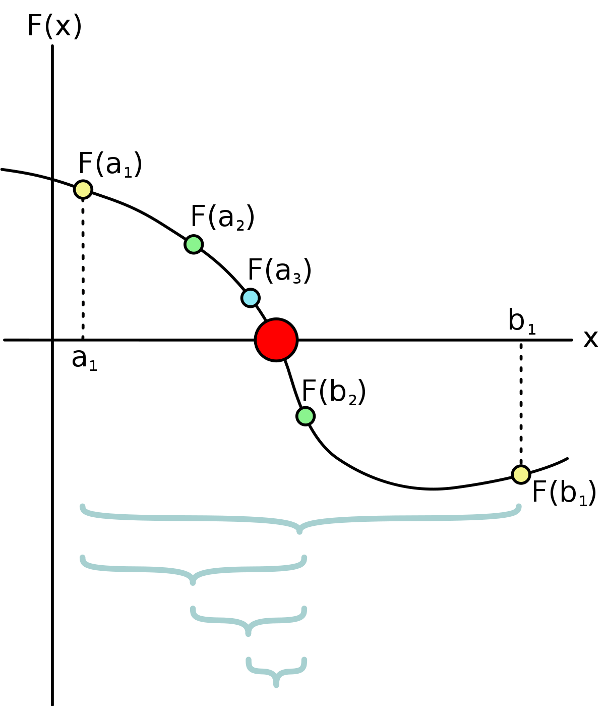
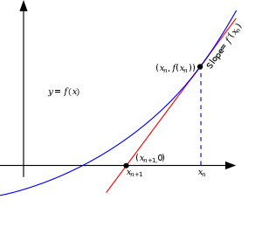
Unconstrained Convex Optimization (Numerical)
Bisection method
Newton’s method
Gradient Descent
To calculate roots of gradient, the exact solution may not be calculated.
So, sometimes we use numerical approach

Slide 13
Constrained Convex Optimization

Slide 14
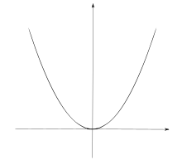
Constrained Convex Optimization
Unconstrained
Constrained

Slide 15
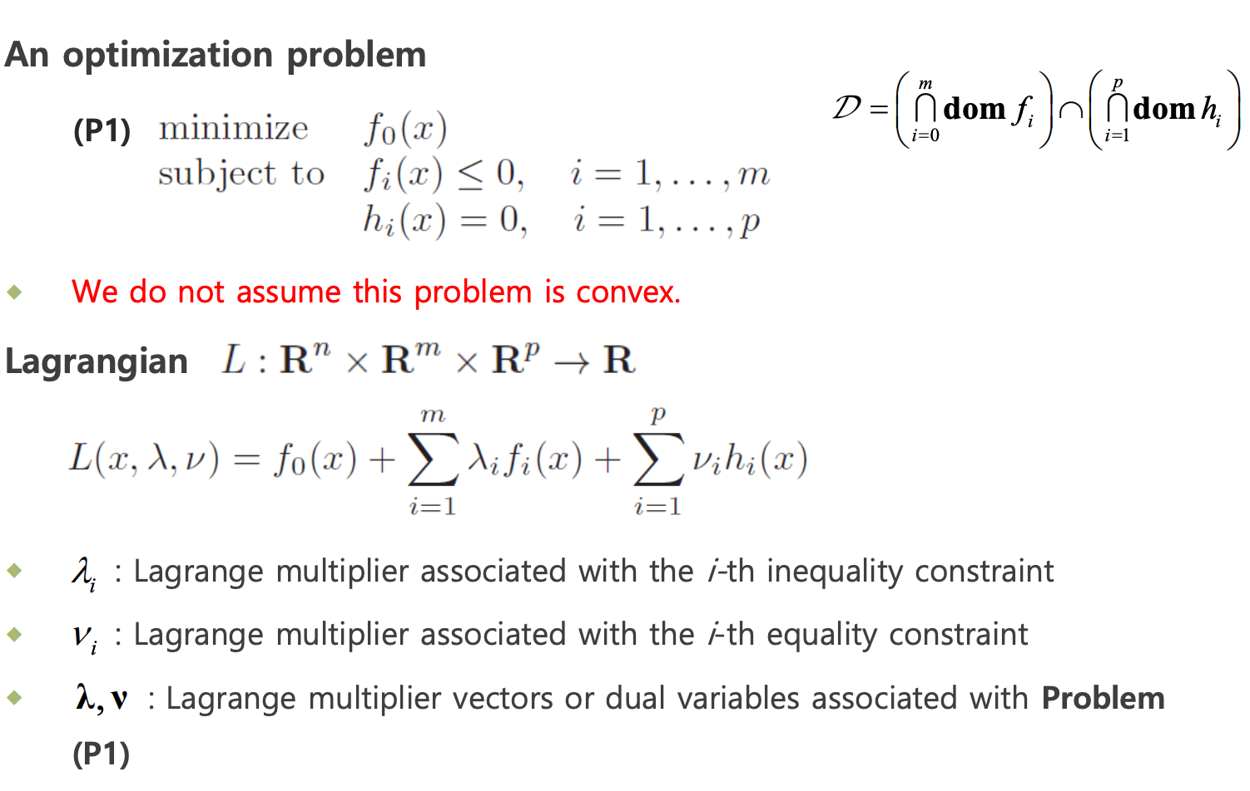
Lagrange multiplier

Slide 16
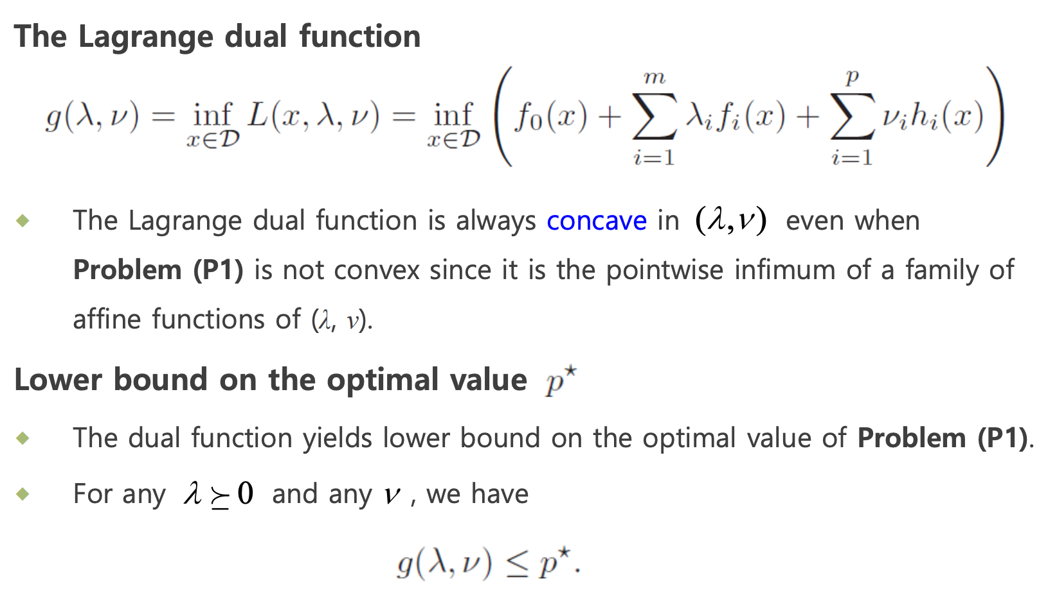
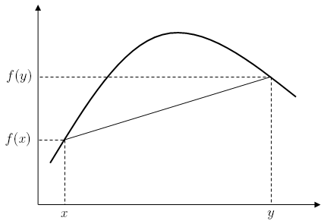
Lagrange Dual Function
Concave function

Slide 17
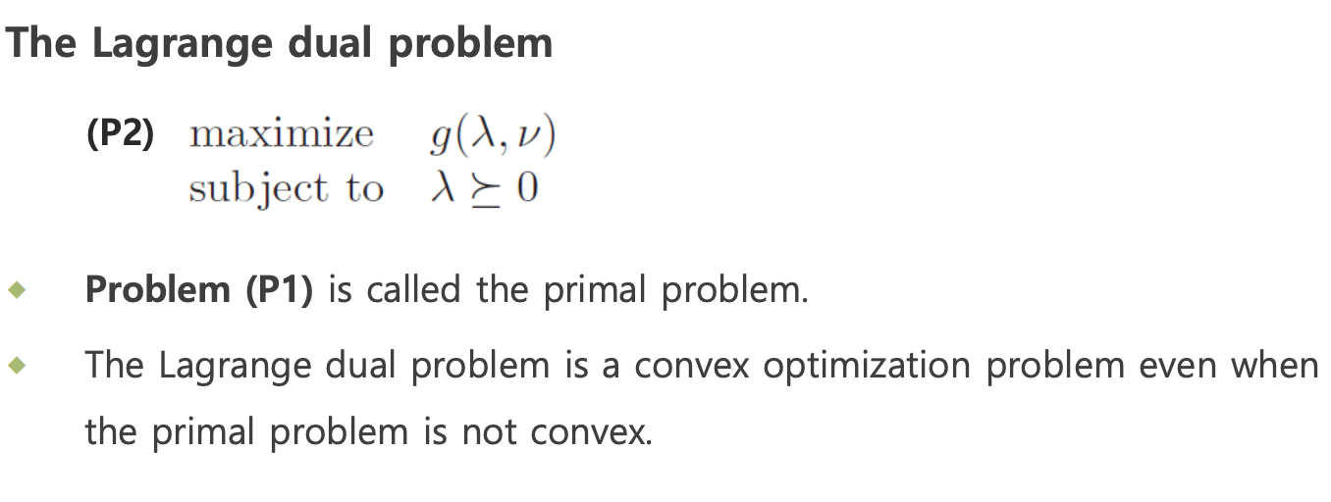
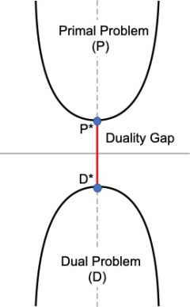
Lagrange Dual Problem
Duality Gap

Slide 18
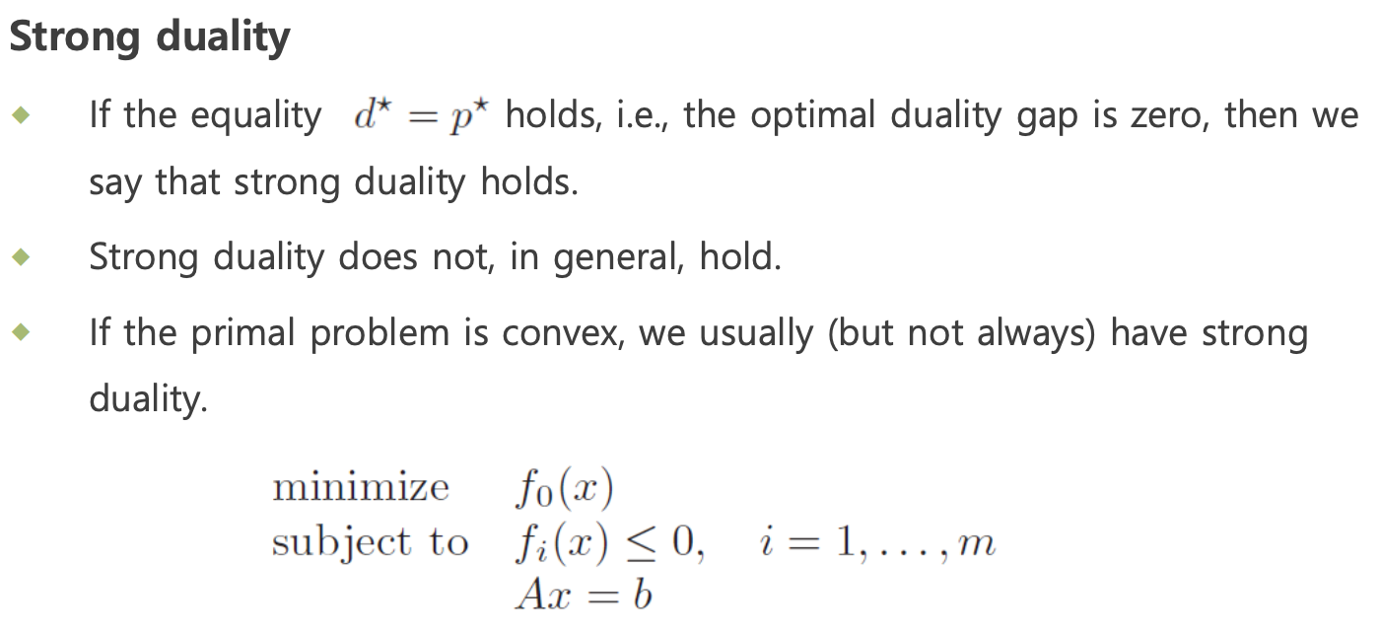
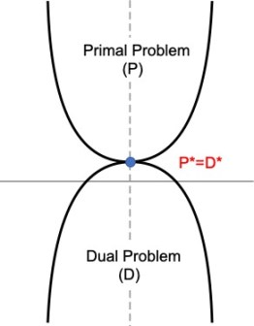
Strong Duality
Strong duality

Slide 19
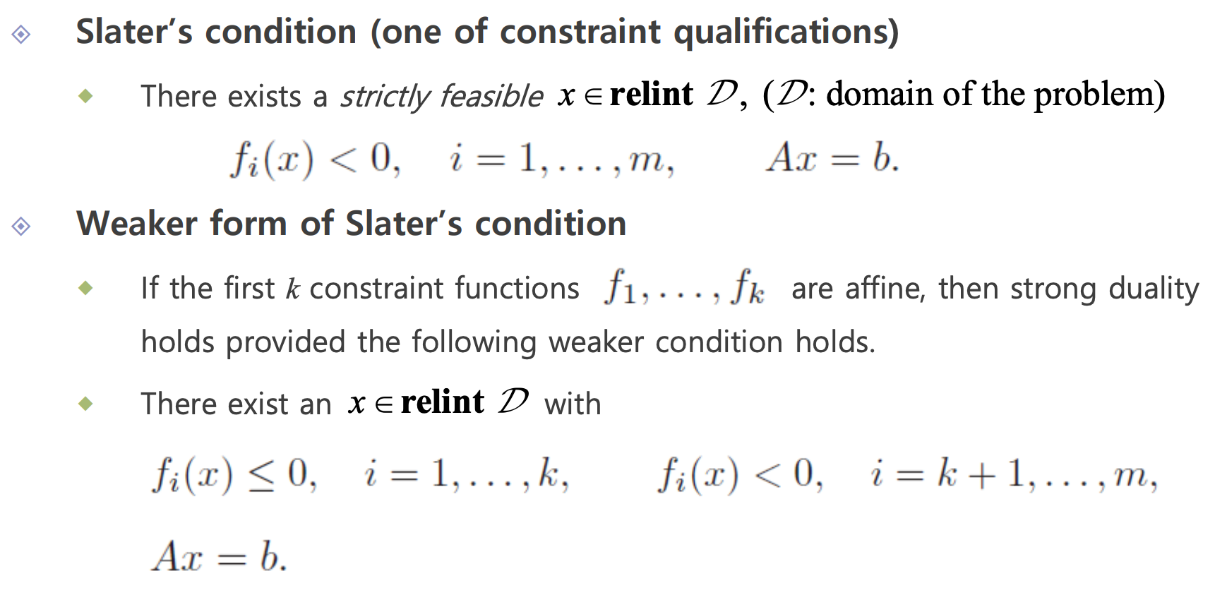
Slater’s condition
Strong duality

Slide 20
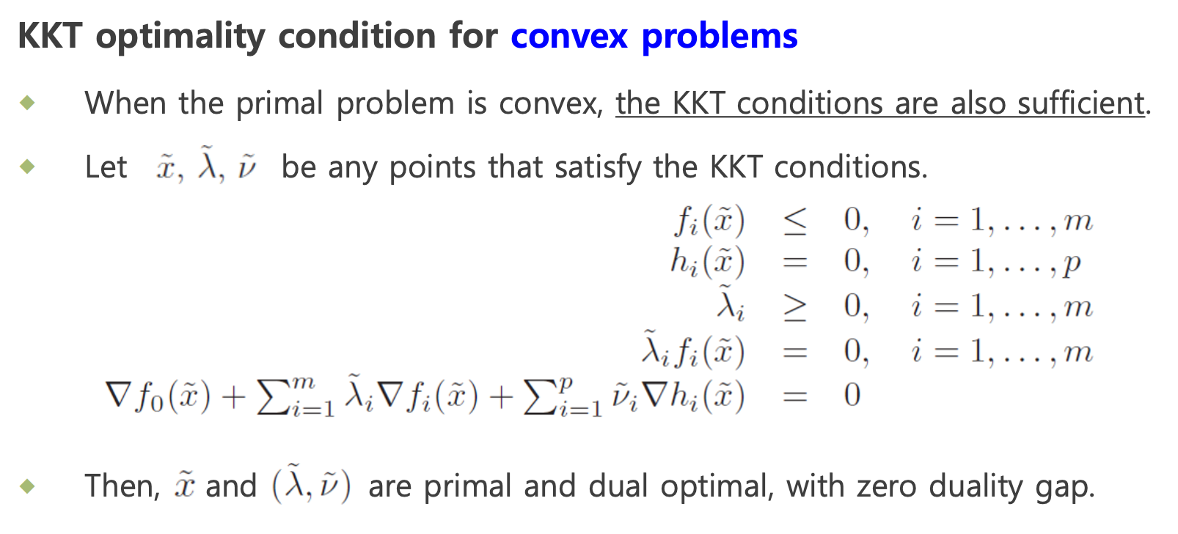
Karush-Kuhn-Tucker condition(KKT condition)

Slide 21
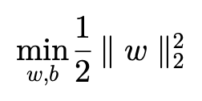
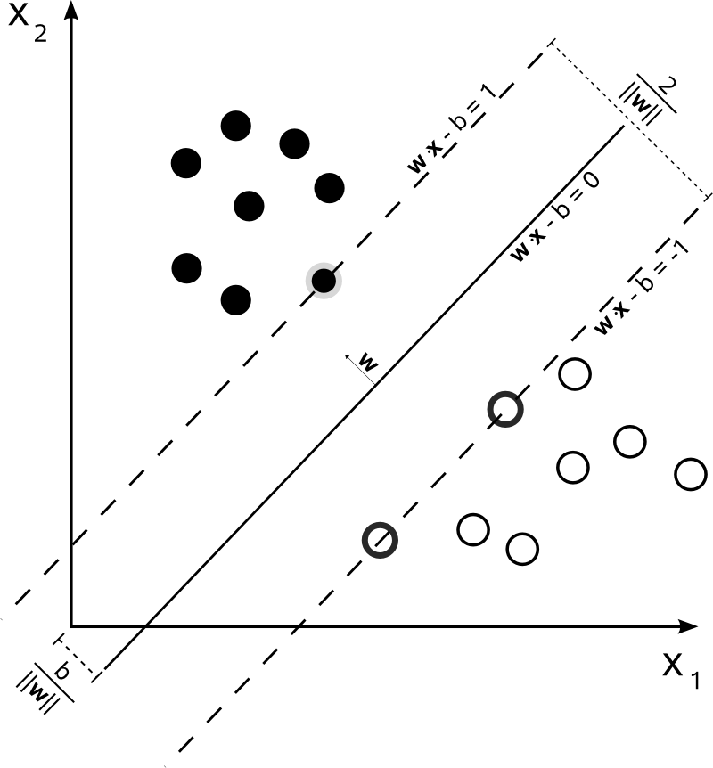

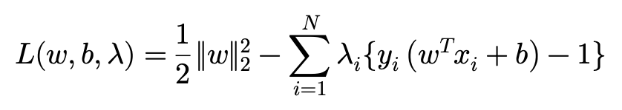
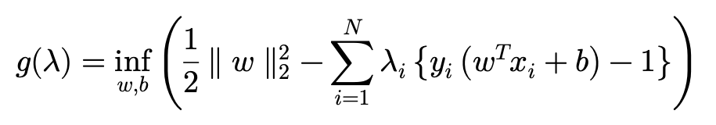
Example : Support Vector Machine(SVM)
Derive Dual Function

Slide 22
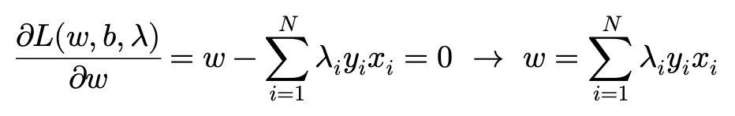
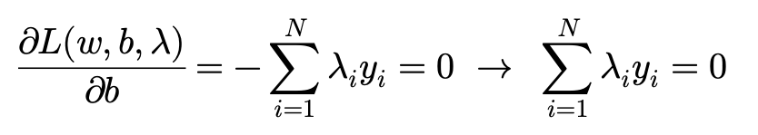
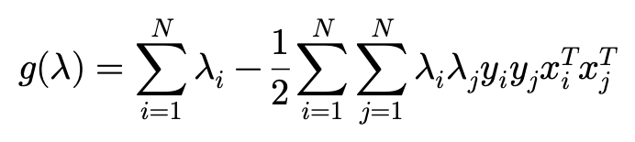
Example : Support Vector Machine (Dual Function)
Substitute

Slide 23
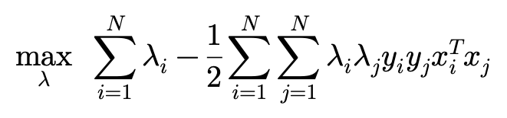
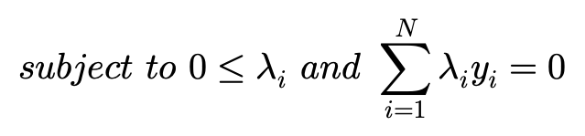
Example : Support Vector Machine (Dual Problem)

Slide 24
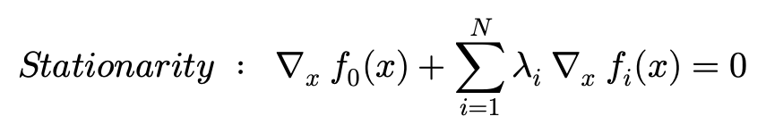


Example : Support Vector Machine (KKT condition)

Slide 25
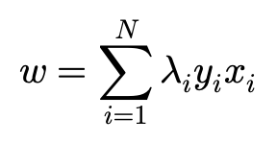
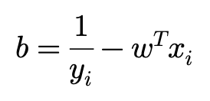
Example : Support Vector Machine (KKT condition)

Slide 26
Gradient Descent

Slide 27
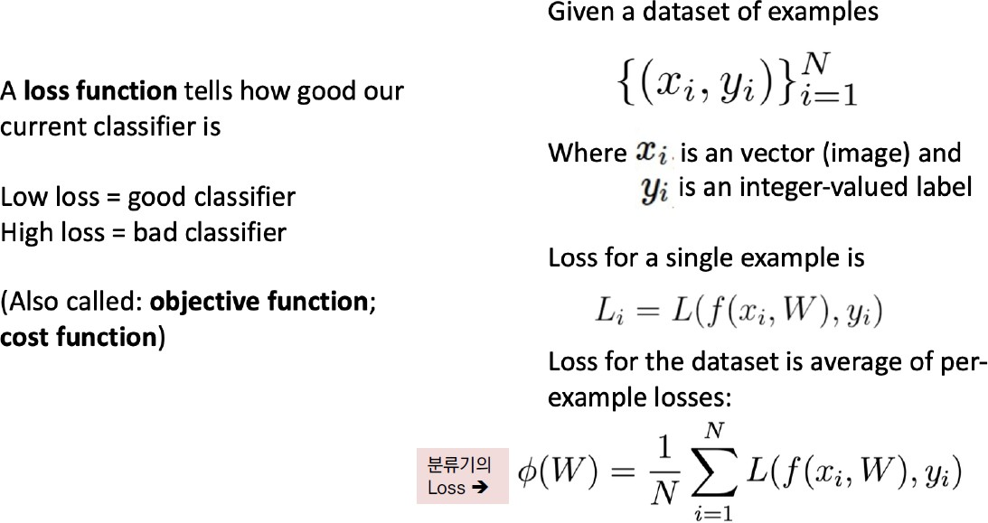
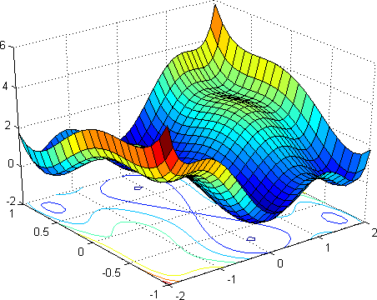
Loss function

Slide 28
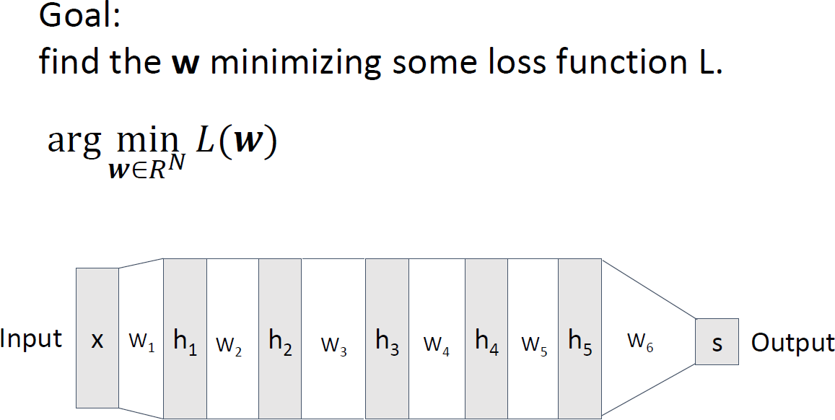
Gradient Descent

Slide 29
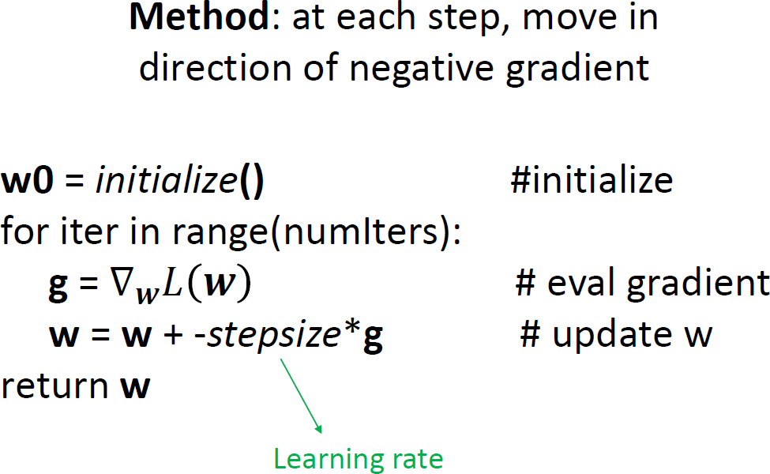
Gradient Descent

Slide 30
Convergence Analysis of Gradient Descent

Slide 31


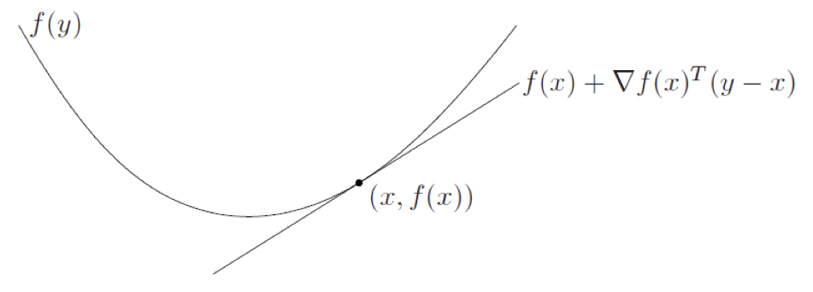
Differentiable Convex Function
First-order condition
Second-order condition

Slide 32
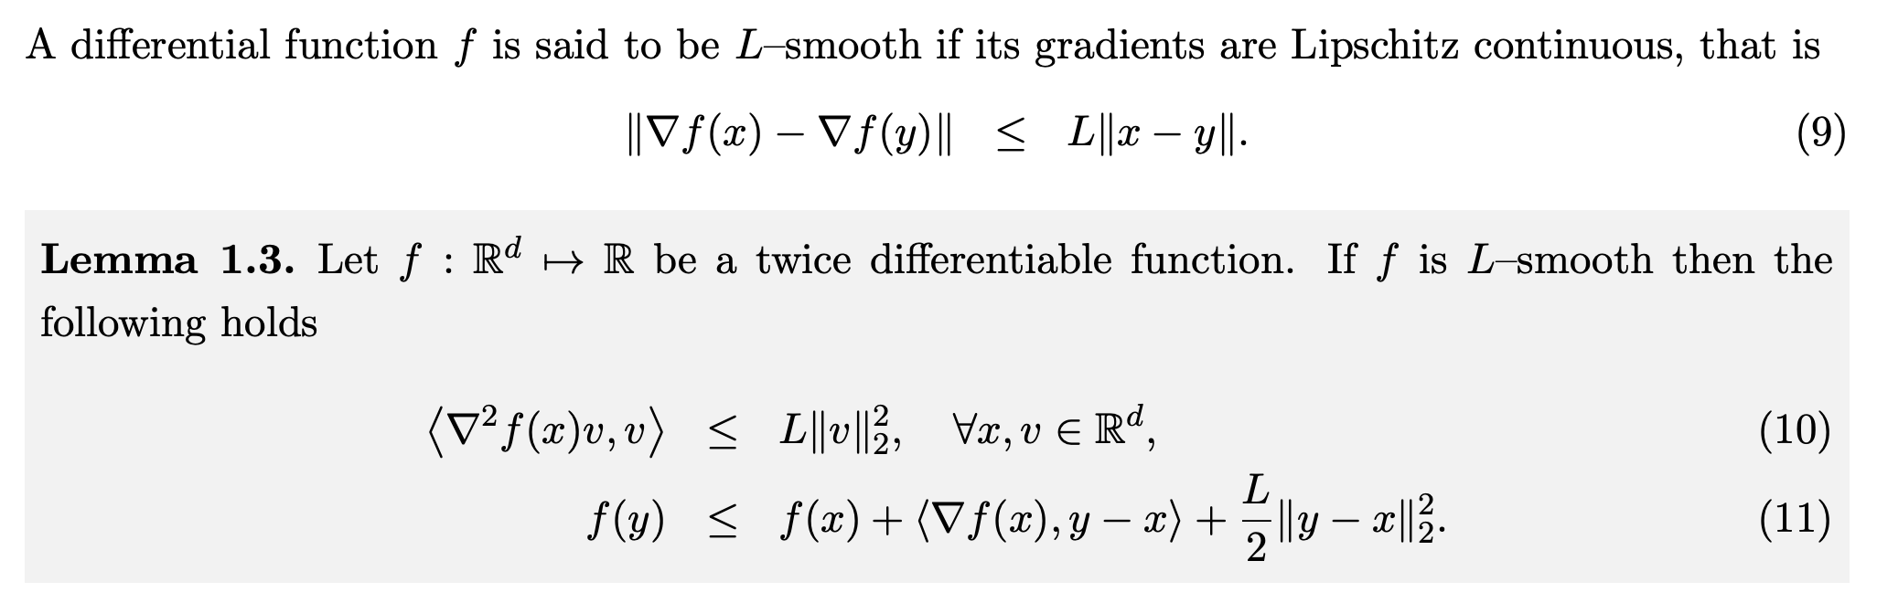
L-Smootheness

Slide 33
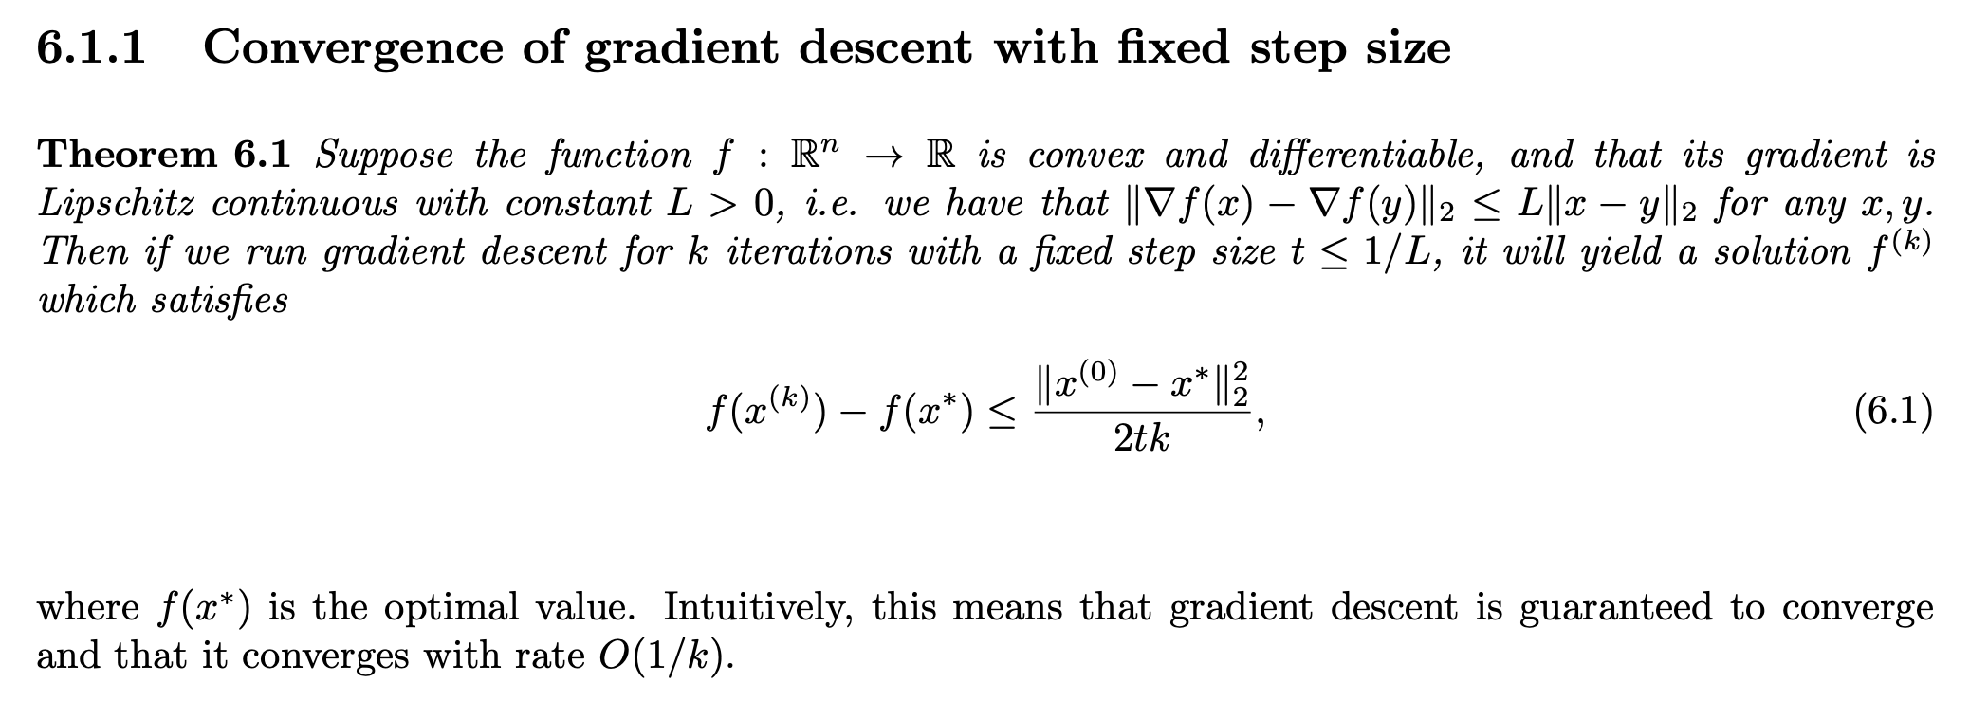
Convergence for convex and smooth functions

Slide 34
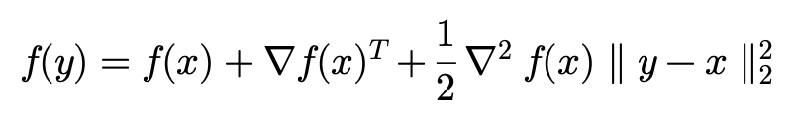
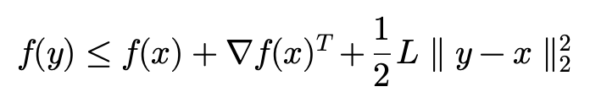
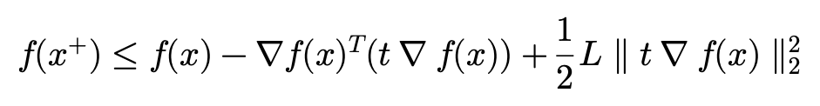
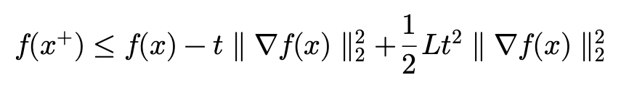
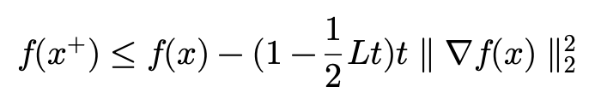
Convergence for convex and smooth functions

Slide 35
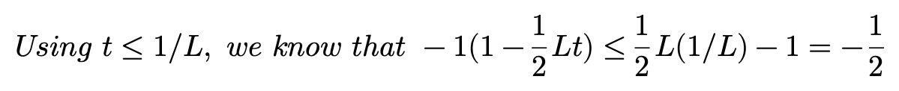
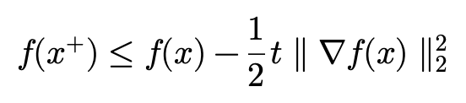


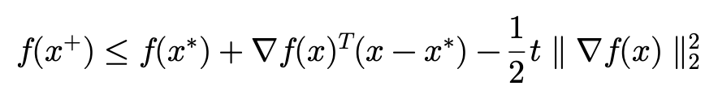
Convergence for convex and smooth functions

Slide 36
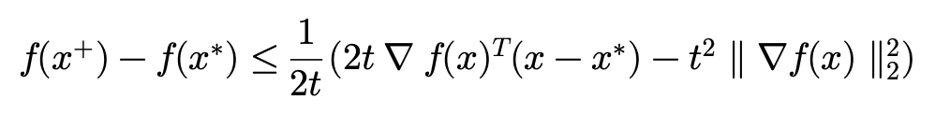
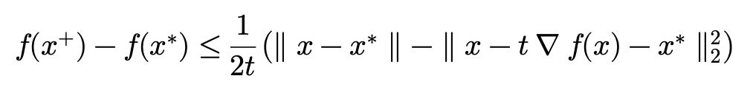
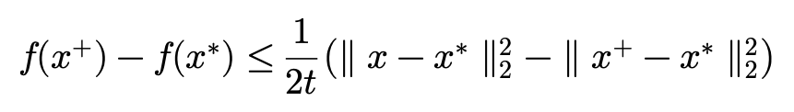
Convergence for convex and smooth functions

Slide 37
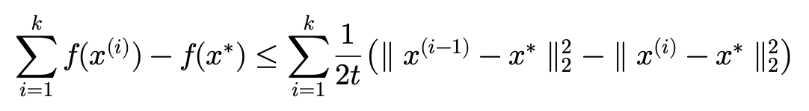



Convergence for convex and smooth functions
QED

Slide 38
Advanced Gradient Descent

Slide 39

Challenges of Gradient Descent in Non-Convex
Choosing a proper learning rate can be difficult
The same learning rate applies to all parameter update
It is difficult to avoid getting trapped in their numerous local minima, saddle point
Saddle Point

Slide 40

Overview of GD algorithms

Slide 41



Momentum

Slide 42


Nesterov Momentum

Slide 43




AdaGrad
Large update of a parameter -> small learning rate
Small update of a parameter -> large learning rate

Slide 44


RMSprop

Slide 45






Adam

Slide 46
Machine learning is just Mathematics

