Slide 1


Introduction to Backpropagation
Sejong RCV – 임근택
Sejong RCV

Slide 2
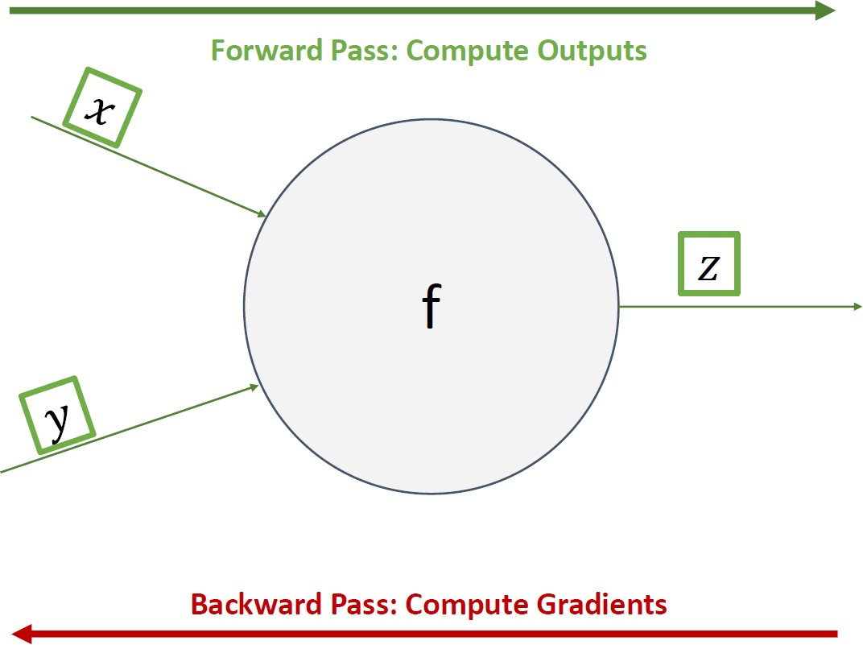
Forward Pass / Backward Pass
Sejong RCV

Slide 3
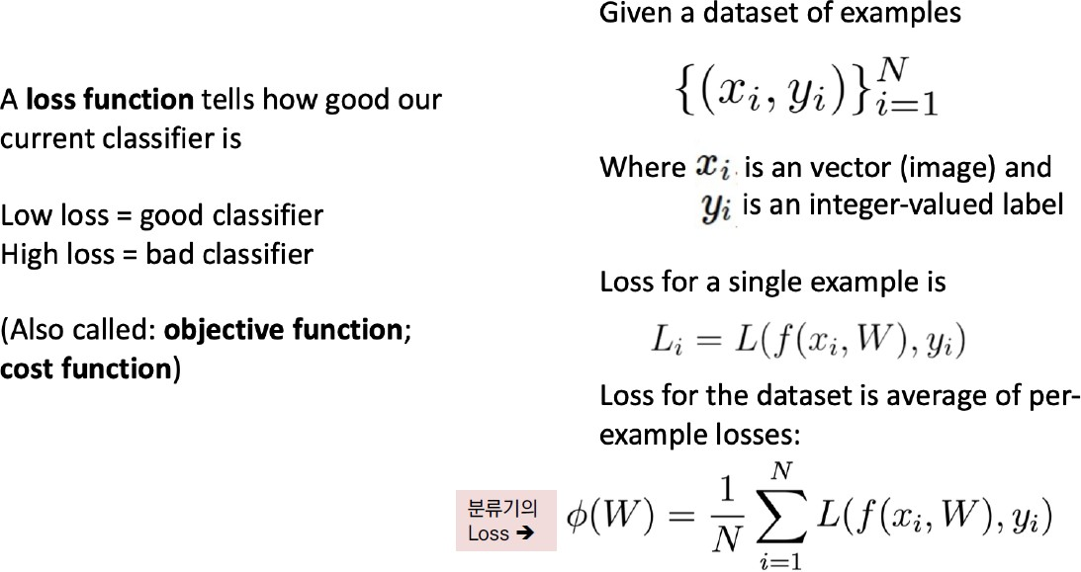
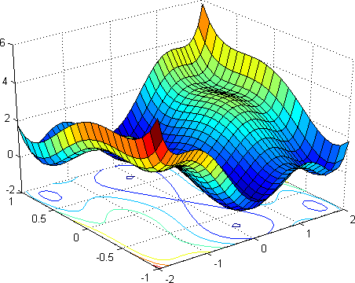
Loss function
Sejong RCV

Slide 4
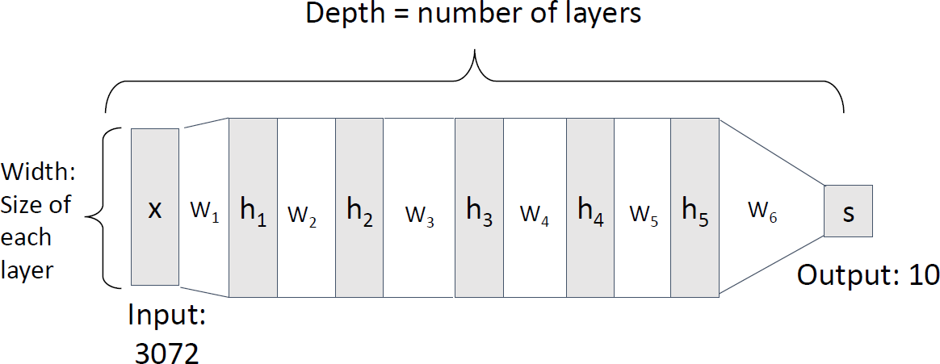
Deep Neural Network
Sejong RCV

Slide 5
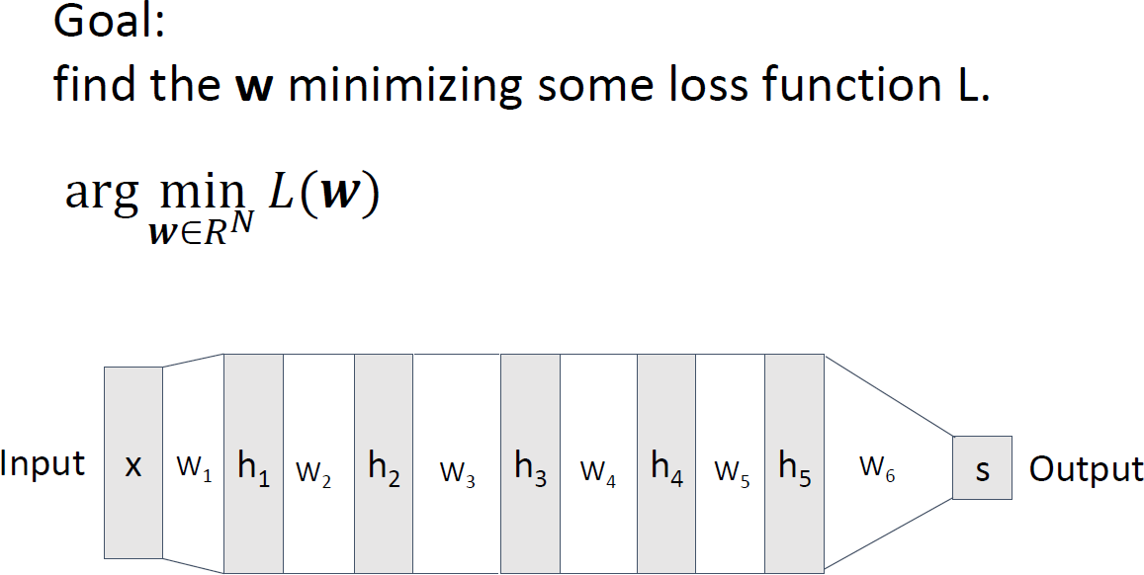
Gradient Descent
Sejong RCV

Slide 6
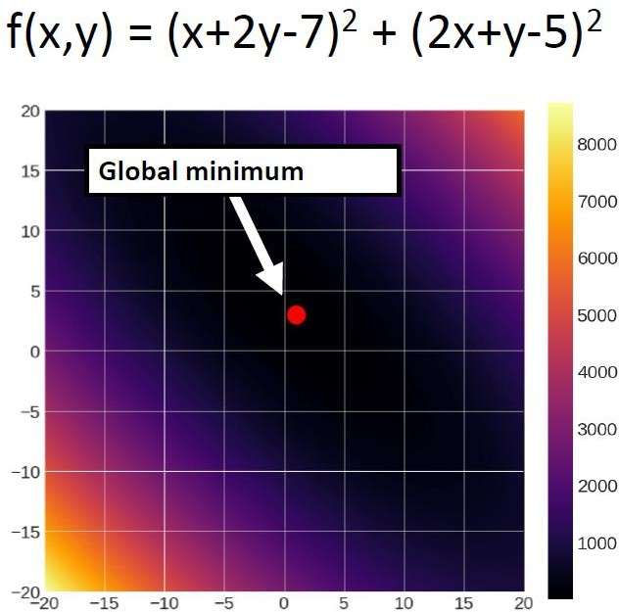
Gradient Descent
Sejong RCV

Slide 7
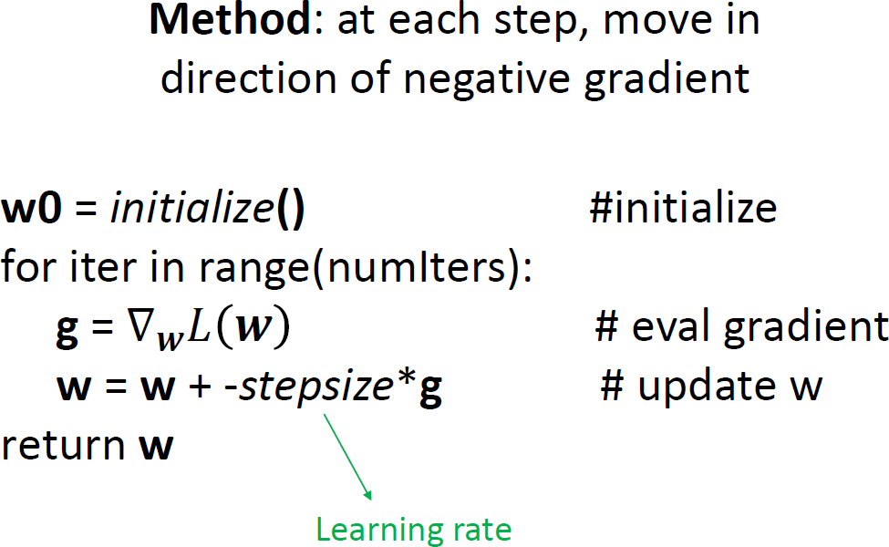
Gradient Descent
Sejong RCV

Slide 8
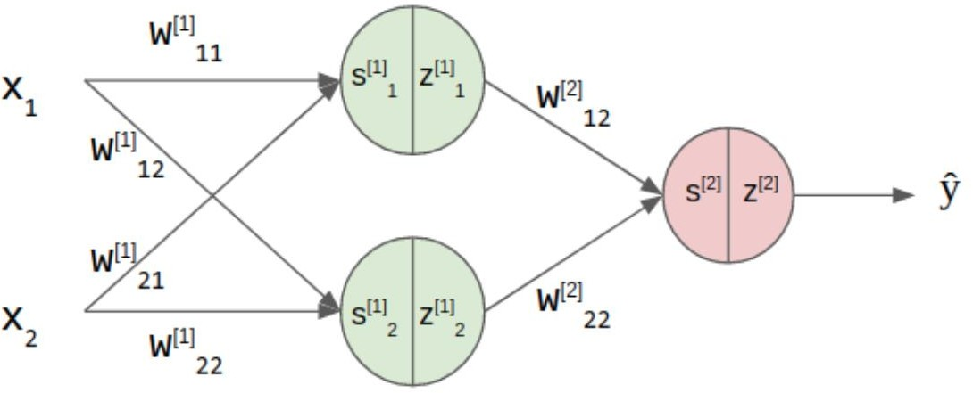
Backward Pass (Backpropagation)
Sejong RCV

Slide 9



Sejong RCV
Backward Pass (Backpropagation)
Learnable Parameters
Then, How to calculate gradient on each layer ?

Slide 10
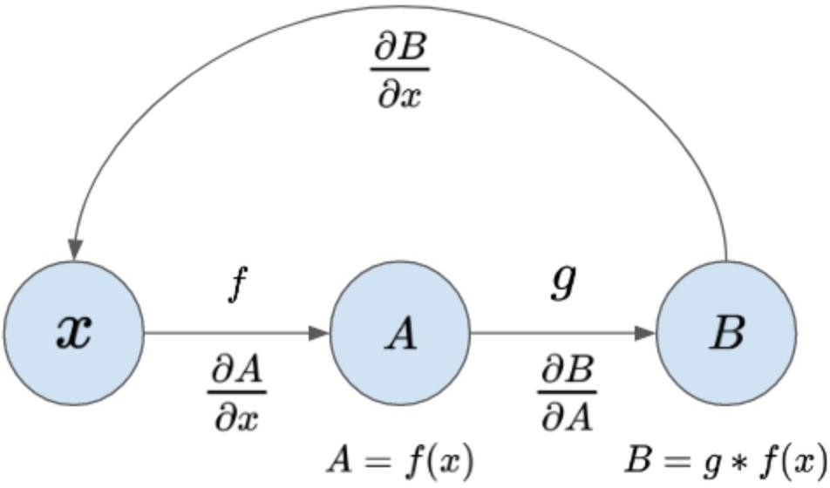
Sejong RCV
Backward Pass (Backpropagation)
Let’s calculate gradient using chain rule !

Slide 11



Sejong RCV
Backward Pass (Backpropagation)
Let’s calculate gradient using chain rule !

Slide 12


Sejong RCV
Backward Pass (Backpropagation)
Let’s calculate gradient using chain rule !

Slide 13


Sejong RCV
Backward Pass (Backpropagation)
Let’s calculate gradient using chain rule !

Slide 14


Sejong RCV
Backward Pass (Backpropagation)
Let’s calculate gradient using chain rule !

Slide 15
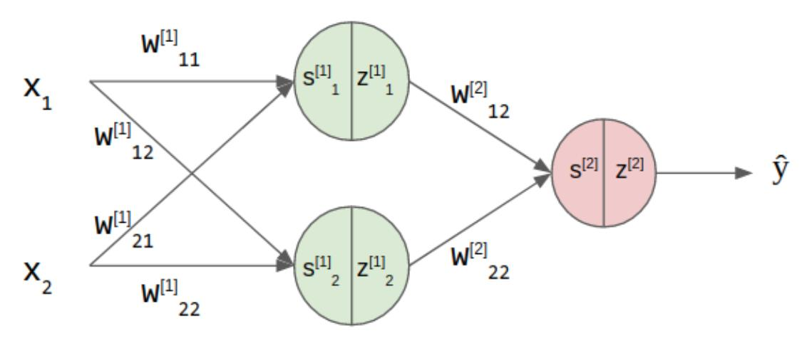


Sejong RCV
Backward Pass (Backpropagation)
Let’s calculate gradient using chain rule !

Slide 16


Sejong RCV
Backward Pass (Backpropagation)
Let’s calculate gradient using chain rule !

