Slide 1
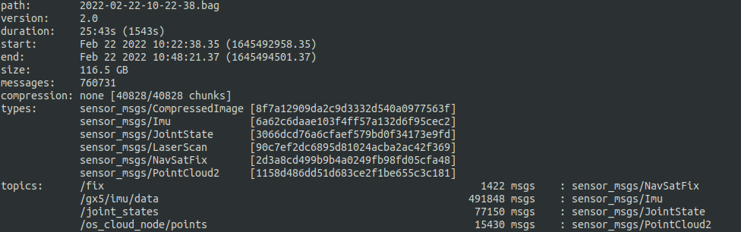

Slide 2
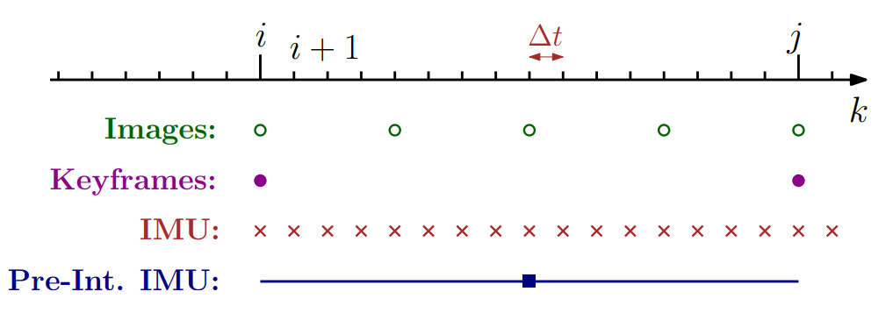
(or 3D point cloud) →

Slide 3
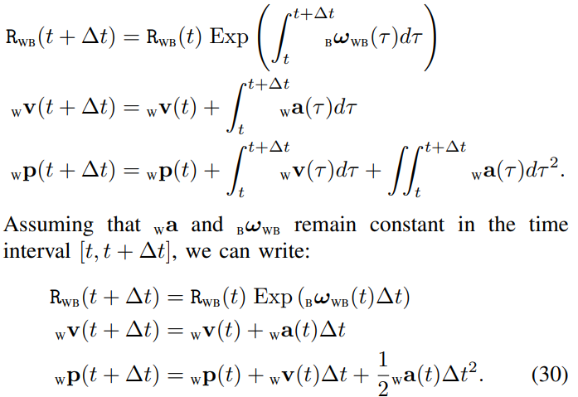


Two problems on the use of the IMU sensor with a LiDAR or vision sensor
Issue 1. The Hz of the IMU should be fast enough
Issue 2. On the factor graph optimization,
it leads to the generation of too many factors
Unfortunately, hundreds of factors are added!
On the discrete-time system,
$∆t$ should be small for the accuracy
Solution: Preintegration of IMU measurements
The hundreds of IMU factors are abstracted
as a single factor via preintegration

Slide 4
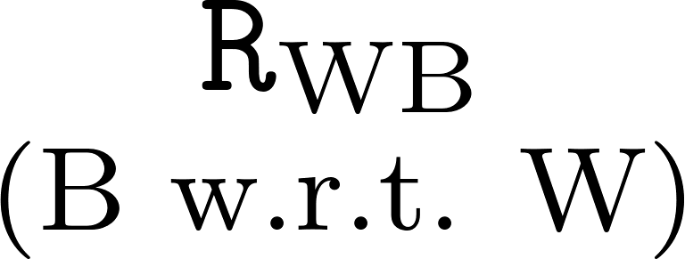











Z
Y
X
Actual acceleration (Want to know)
Actual states (Want to know)
Measurements by IMU (w/ biases and noises)

Slide 5
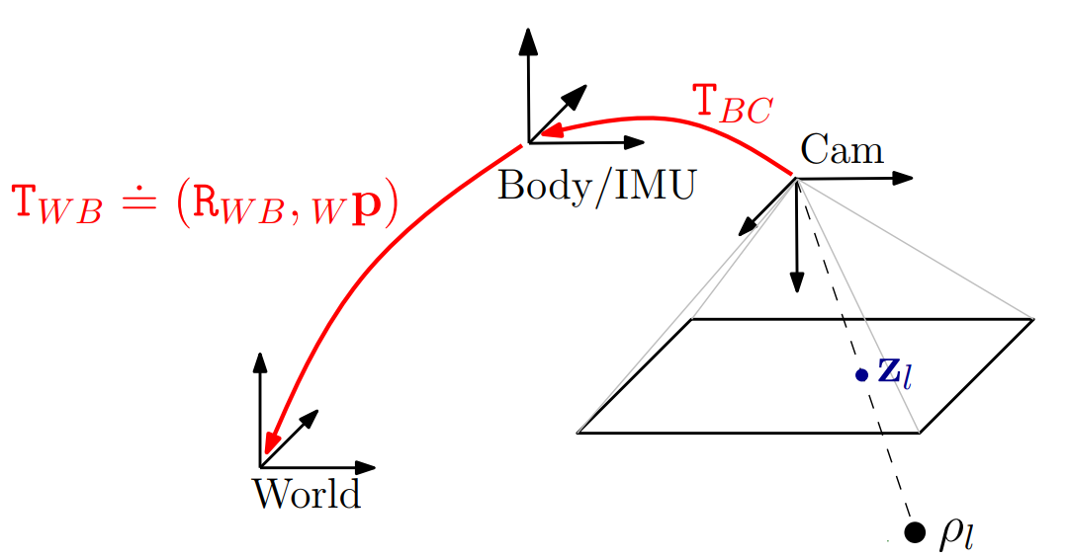
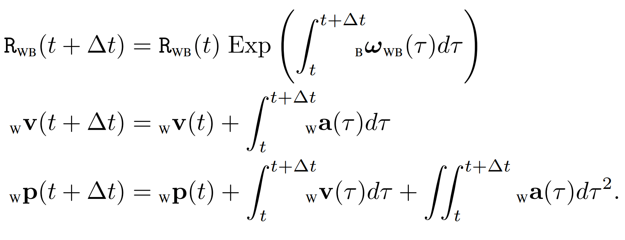
Actual states (Want to know)
Measurements by IMU (w/ biases and noises)
Continuous-time system
↓
Discrete-time system

Slide 6
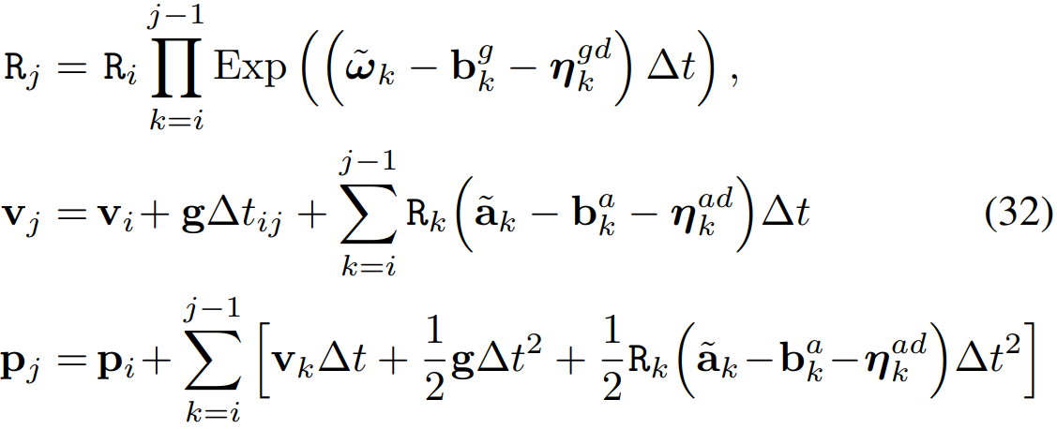
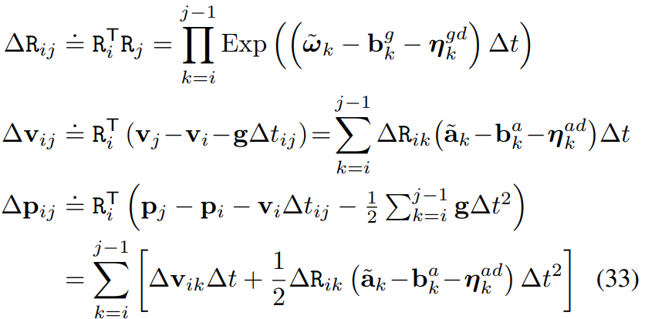

Slide 7

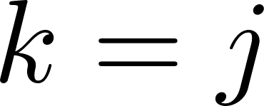




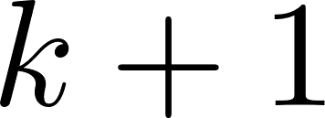
Y
Z
X

Slide 8

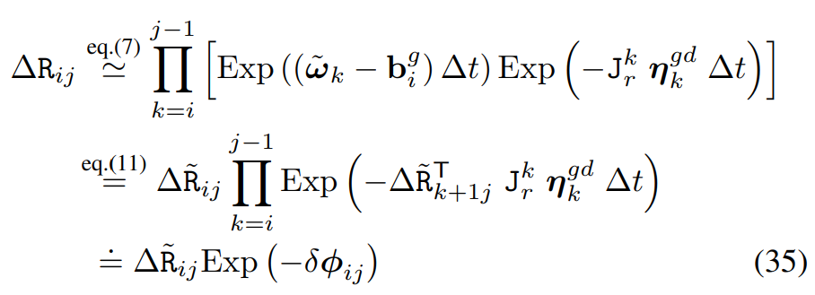



Assume
Repeat

Slide 9





a) From the preintegrated rotation measurements:
b) The higher-order noise term is negligible:

Slide 10
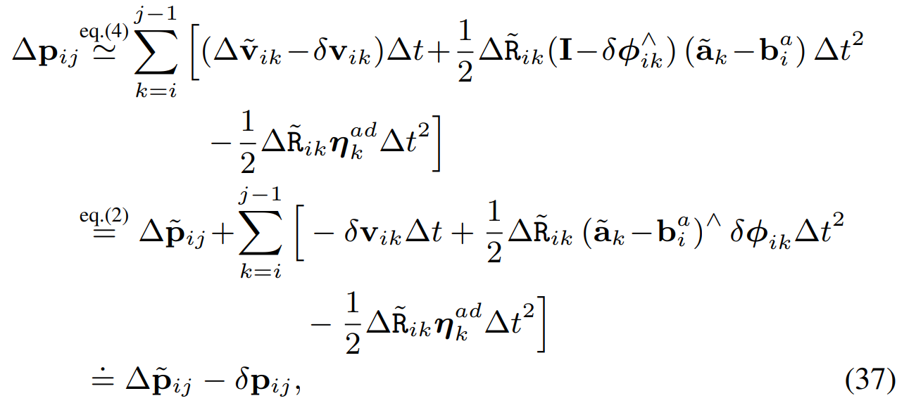
From (36)
From (35)

Slide 11


Slide 12
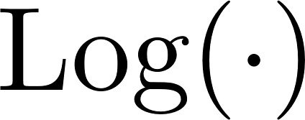








Gaussian distribution

Slide 13
