Slide 2
4m 3m 2m 1m

Slide 3
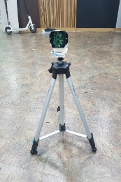
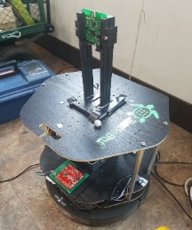
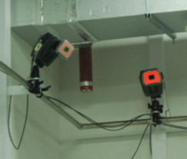
UWB anchor
UWB tag
UWB distance receiving thread
Concatenating
and
saving thread
Motion capture camera
Global position receiving thread

Slide 4
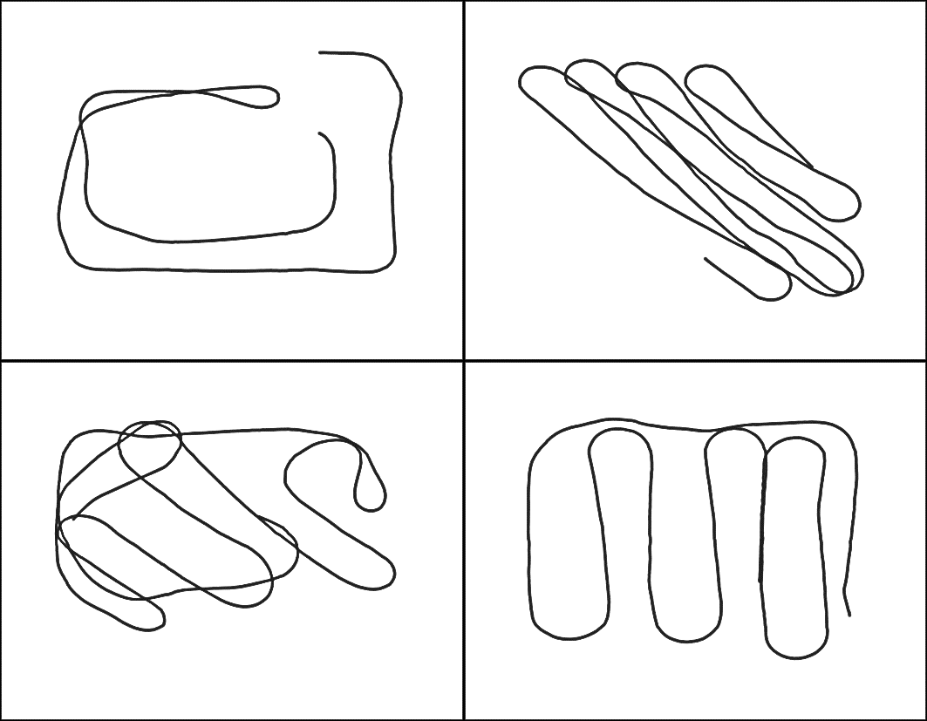

Slide 5
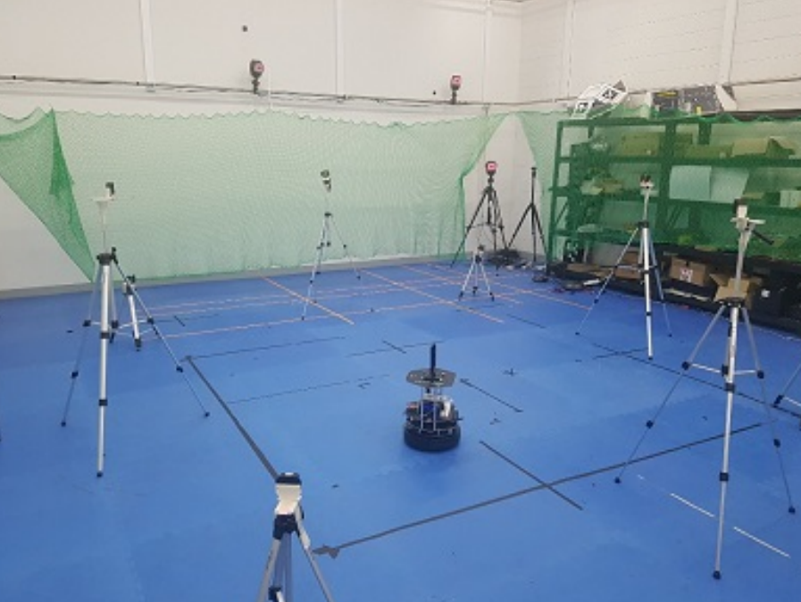
Anchor Node(AN)
Tag Node(TN)

Slide 6


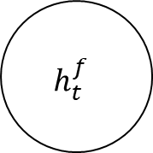
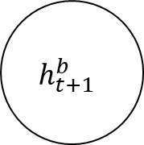

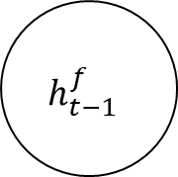
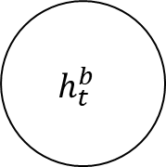

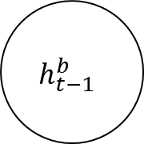

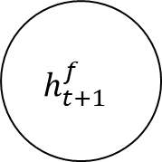

$$y_{t−1}$$
$$y_{t}$$
$$y_{t+1}$$
Outputs
$$h_{t−1}^{b}$$
$$h_{t}^{b}$$
$$h_{t+1}^{b}$$
Backward Layer
$$h_{t−1}^{f}$$
$$h_{t}^{f}$$
$$h_{t+1}^{f}$$
Forward Layer
$$x_{t−1}$$
$$x_{t}$$
$$x_{t+1}$$
Inputs

