Slide 1



.
$$\overset{⃖}{LSTM}$$
$$\overset{⃖}{LSTM}$$
.
$$(x_{t−4}, y_{t−4},{ z}_{t−4})$$
C
C
.
$$\vec{LSTM}$$
.
$$\vec{LSTM}$$
.
.
.
}
$$\overset{⃖}{LSTM}$$
$$\overset{⃖}{LSTM}$$
}
C
C
$$(x_{t−3}, y_{t−3},{ z}_{t−3})$$
.
$$\vec{LSTM}$$
$$\vec{LSTM}$$
t
.
.
.
.
.
.
.
.
}
.
.
.
.
.
.
.
$$\overset{⃖}{LSTM}$$
$$\overset{⃖}{LSTM}$$
C
C
$$(x_{t}, y_{t},{ z}_{t})$$
$$\vec{LSTM}$$
.
$$\vec{LSTM}$$
Residual
Attention
Bi-LSTM
Fully-connected
Layer

Slide 2
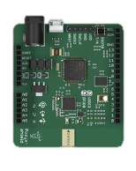
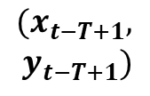






{
( )
$$(x_{t−T+1},$$
$$y_{t−T+1})$$
.
$$t−T+1$$
Bi-LSTM
Bi-LSTM
Bi-LSTM
.
.
[1024x2, $T$]
[512x2, $T$]
.
[256x2, $T$]
.
.
.
.
.
1024
}
2
( )
$$t$$
$$(x_{t}, y_{t})$$
.

