Slide 1
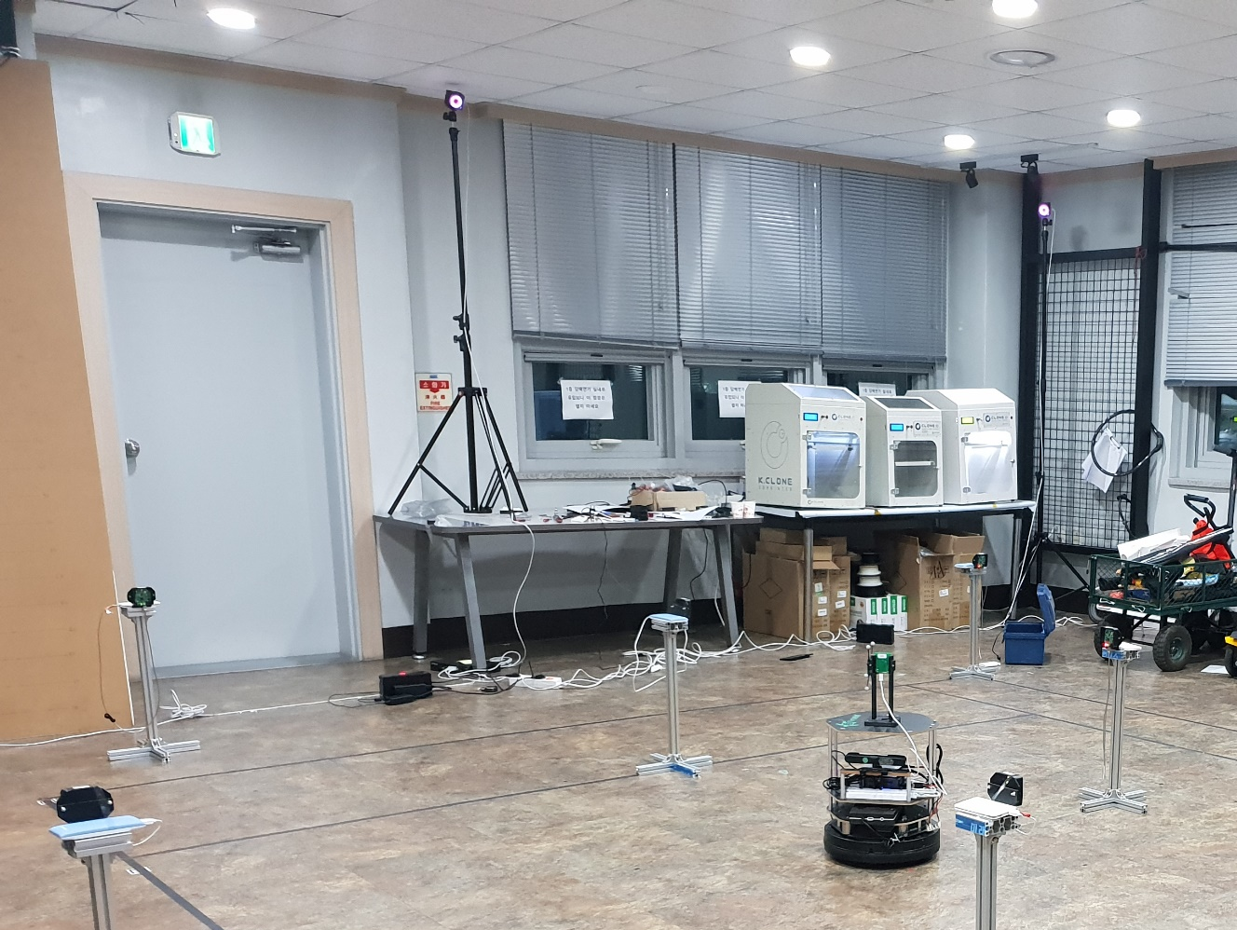
Motion capture camera
Tag node (TN)
Anchor node (AN)

