Slide 1
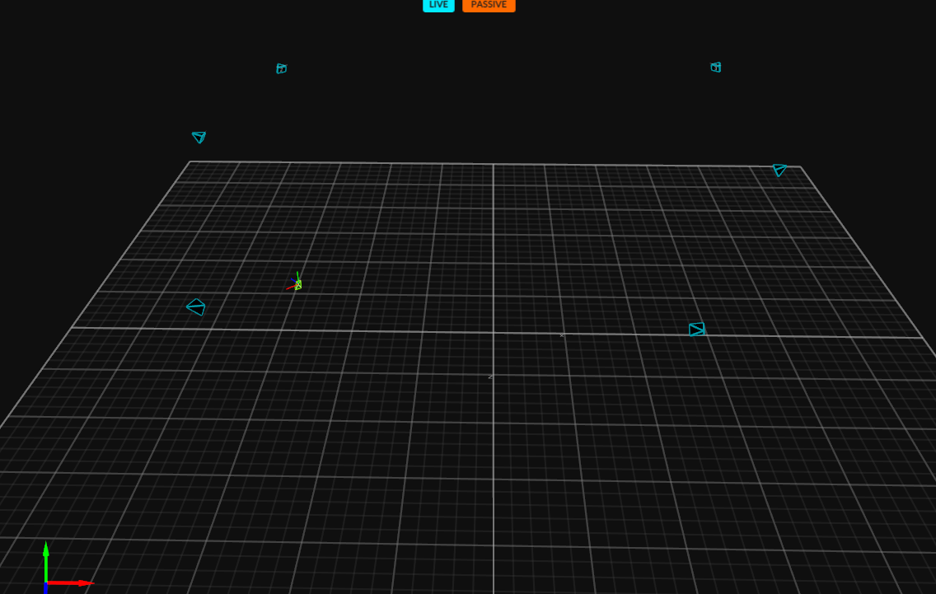
Ground truth
measured by motion capture

