Slide 2
4m 3m 2m 1m

Slide 3
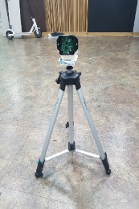
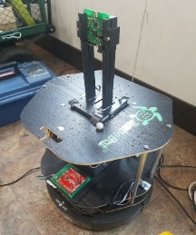
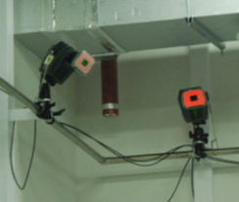
UWB anchor
UWB tag
UWB distance receiving thread
Concatenating
and
saving thread
Motion capture camera
Global position receiving thread

