Slide 1
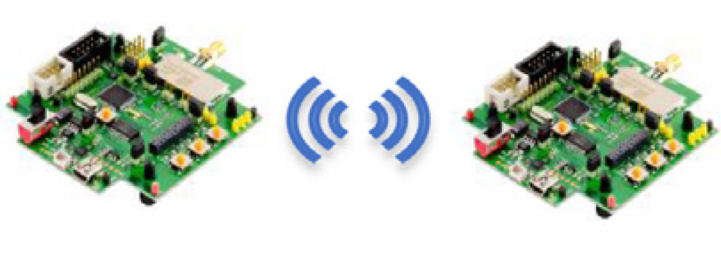
Pre-processing
Filtering
State vector/
Covariance
Initialization
Y
Range measurements
Sensor
Calibration
Initial
State?
N
Outlier
Rejection
State
Prediction
State
Correction
Estimate position
Range measurements
Attention-based LSTM Architecture
Estimate position
Notes:
Until now, other presenter explain about SLAM, especially RO-SLAM, and basic deep learning architecture. I’ll explain our attention based LSTM architecture.
As I mentioned before, procedure of traditional RO SLAM has several steps as shown this figure. Commonly, RO SLAM needs calibration before filtering, and then, range measurement undergoes outlier rejection / prediction / and correction processes. So, what we gonna do is that we’ll replace this traditional method with

Slide 2
.
}
.
.
C
C
}
C
C
.
.
.
.
Robot’s
position
t
.
.
.
.
.
.
.
.
.
.
.
.
Bi-LSTM
.
}
.
Attention
Layer
C
C
Fully-connected
Layer
C
Concatenation

