Slide 1
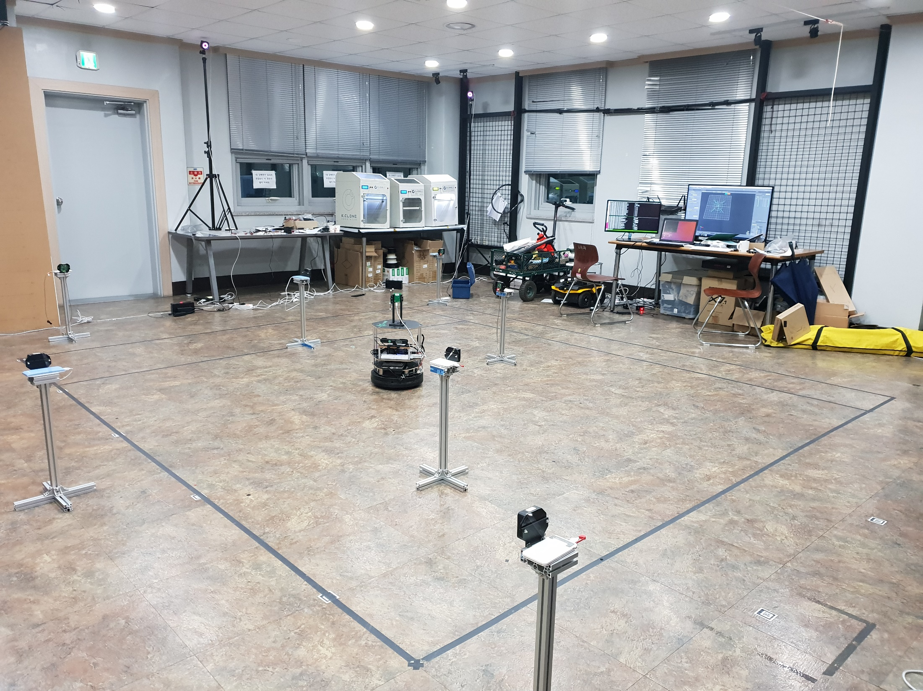
Motion capture camera
Anchor node (AN)
Tag node (TN)

