Slide 1
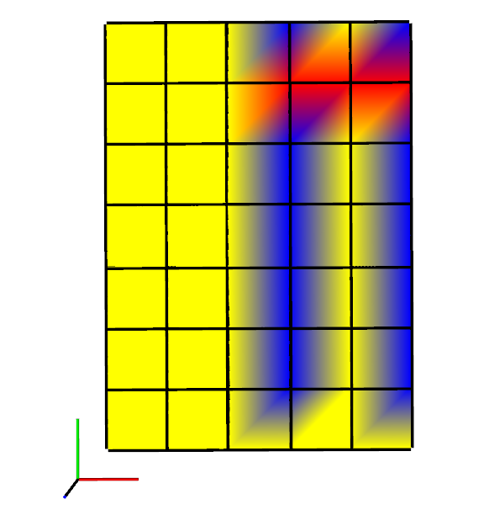
0
When
x_size = 1.2
y_size = 1.6
resolution = 0.2

