Slide 1
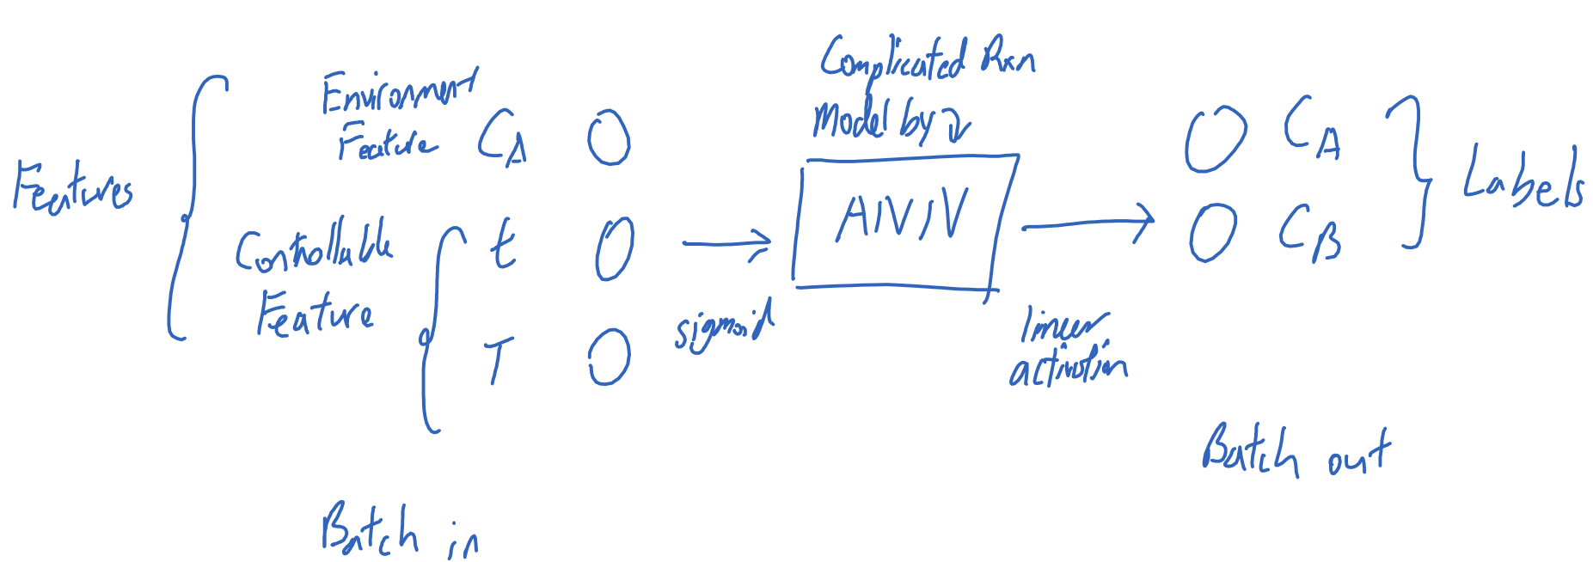
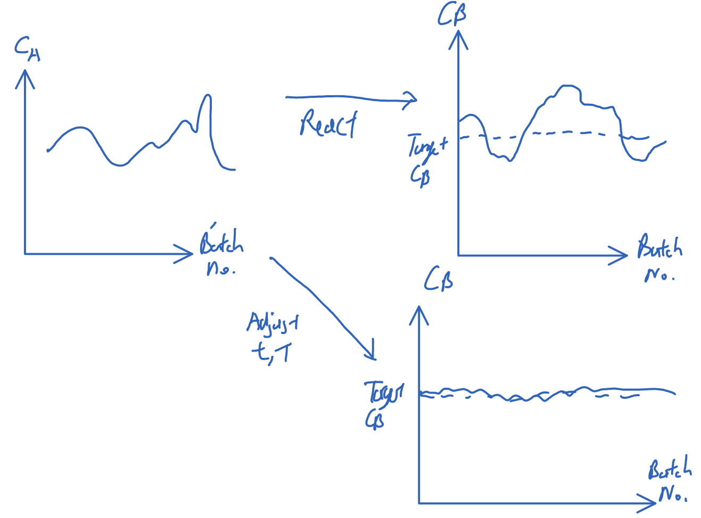

Slide 2
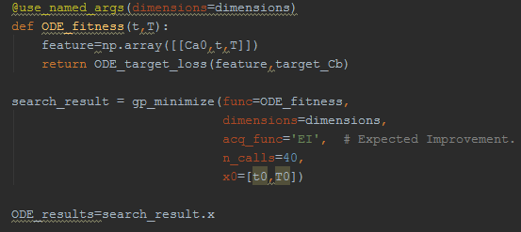
Need model in order to search for optimal t, T for given input Ca
Good results, Target Cb=8
Bad results, Target Cb=4

