Slide 1





THE PROPOSED SOLUTION
BursaIQ
One workspace. A hybrid AI workforce. Governed intelligence.
BursaIQ combines Microsoft AI services with self-hosted open-source models, specialist AI workers, trusted knowledge and human oversight.
HYBRID AI
AI WORKFORCE
GOVERNED KNOWLEDGE
HUMAN CONTROL
Microsoft services and local open-source models in one workspace
Specialist agents for knowledge, analysis and delivery
Trusted internal sources and reusable intelligence
Verification, approvals and audit-ready delivery
08 / 19

Slide 2


06 · THE PROPOSED EXPERIENCE
BursaIQ: The Product Experience
BursaIQ presents one governed AI workforce powered by two complementary model paths.
01
Hybrid model choice
01
My Workforce
02
Intelligence Exchange
Select Microsoft or local open-source AI according to the work, policy and operating context.
AI missions and specialist workers
Approved insights and reuse
02
One AI workforce experience
03
AI Assistant
04
Ask Bursa
Users work with specialist agents without managing separate tools or model interfaces.
Everyday support and insight
Trusted internal knowledge
03
Trusted knowledge and evidence
Verification Centre
Administration
Answers and deliverables remain grounded in approved knowledge and traceable sources.
05
06
Human review and approval
Models, access and governance
04
Human oversight and reuse
People review important outputs before the organisation publishes or reuses them.
Microsoft providers support connected enterprise experiences; self-hosted models provide local control and choice.
Proposed architecture: a shared BursaIQ governance layer across Microsoft AI services and self-hosted open-source models, with one experience for users and reviewers.
BursaIQ · Prompt-a-thon 2026
09 / 19

Slide 3
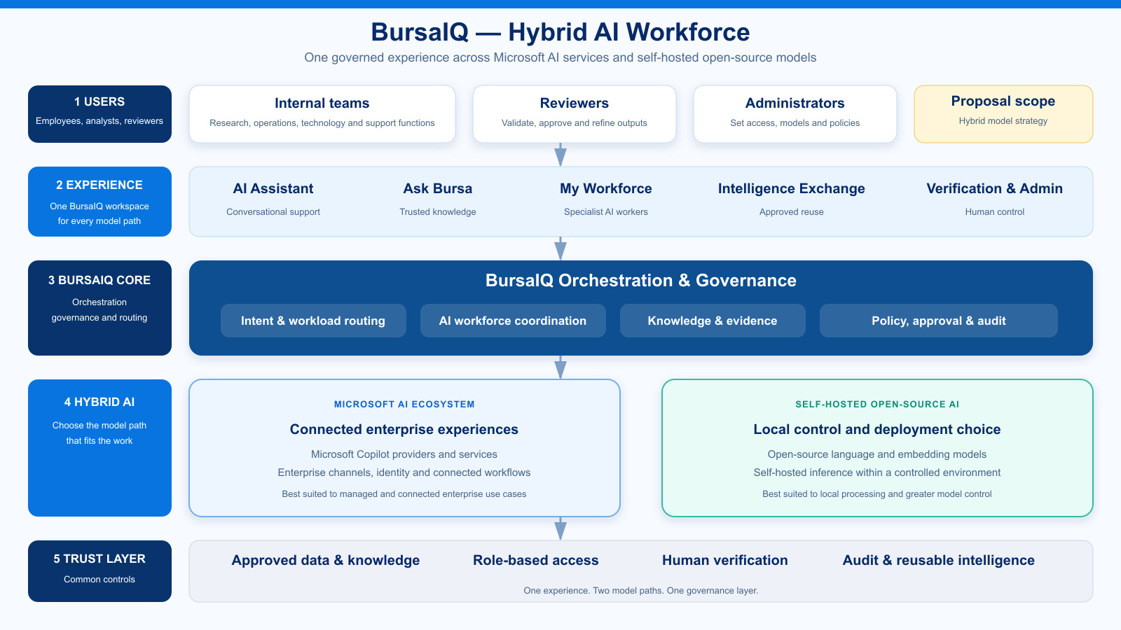
10 / 19

Slide 4








10 · THE HYBRID EXPERIENCE
One platform. Two model paths. One governance layer.
BursaIQ gives users a consistent AI workforce experience while the organisation chooses the right provider for each context.
WORKFORCE
KNOWLEDGE
MISSIONS
INTELLIGENCE
KNOWLEDGE
INTELLIGENCE
My Workforce
Intelligence Exchange
Ask Bursa
Coordinate specialist AI workers across Microsoft and local model paths.
Publish approved insights and reuse them with clear provenance.
Answer internal questions from trusted knowledge and access controls.
ASSISTANT
GOVERNANCE
MODEL CHOICE
GOVERNANCE
GOVERNANCE
AI Assistant
Verification Centre
Administration
Support everyday work through the model path that best fits the request.
Keep people responsible for review, refinement and approval.
Set model availability, access policies and approved knowledge.
Microsoft services provide connected enterprise experiences; self-hosted open-source AI models provide local control. BursaIQ applies the same governance across both.
BursaIQ · Prompt-a-thon 2026
13 / 19

Slide 5

12 · THE HYBRID MODEL
BursaIQ combines provider choice with consistent control
Microsoft AI services and self-hosted open-source models operate as complementary options inside one governed workspace.
Microsoft AI Services
Self-hosted Open Source
BursaIQ Governance
Best fit
✓
Connected enterprise experiences
✓
Local and controlled processing
✓
Routes work by context and policy
Deployment choice
✓
Managed Microsoft ecosystem
✓
Bursa-controlled environment
✓
One consistent user experience
Knowledge
✓
Approved enterprise sources
✓
Approved local sources
✓
Common source and evidence controls
Oversight
✓
Enterprise identity and channels
✓
Local model and data control
✓
Human review and audit
Continuity
✓
Configured Microsoft availability
✓
Independent local model option
✓
Visible provider status and choice
Strategic role
✓
Connected cloud capability
✓
Control over selected workloads
✓
A shared governance layer across both paths
The proposal supports a hybrid model strategy without splitting the user experience or governance model.
BursaIQ · Prompt-a-thon 2026
15 / 19

