Slide 1

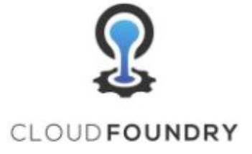
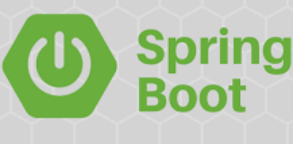
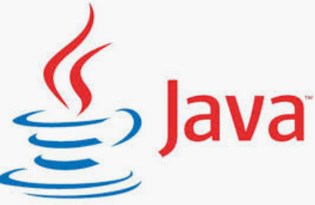

Microservices deployment with pivotal cloud foundry
ARVIND
#1
Monitoring
Deployment
Scaling
-- #greenlearner --

Slide 2
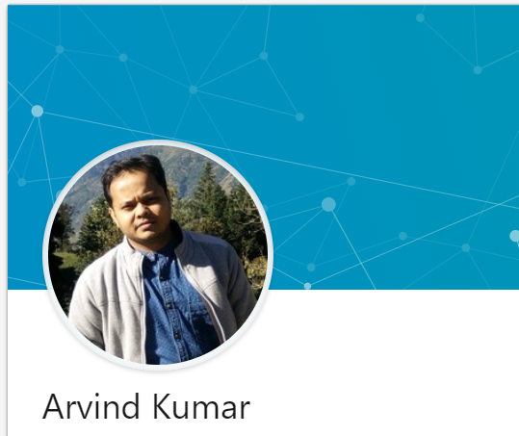
About me
Senior software developer
7 years
Working on
Passion
Facebook – https://www.facebook.com/greenlearner
LinkedIn - https://www.linkedin.com/in/arvind-kumar-108a4b2b/

Slide 3
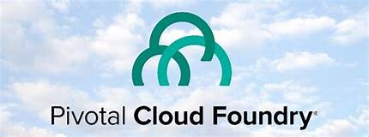
Introduction
ARVIND
#2
MICROSERVICES
AND
CLOUD FOUNDRY
-- #greenlearner --

Slide 4
What is cloud foundry??
Cloud Foundry is an open source, multi-cloud application platform as a service (PaaS) governed by the Cloud Foundry Foundation.
The software was originally developed by VMware and then transferred to Pivotal Software, a joint venture by EMC, VMware and General Electric.
Cloud Foundry is promoted for continuous delivery. It supports the
full application development lifecycle,
from initial development through all testing stages to deployment.
Cloud platforms let anyone deploy network apps or services and make them available to the world in a few minutes.

Slide 5
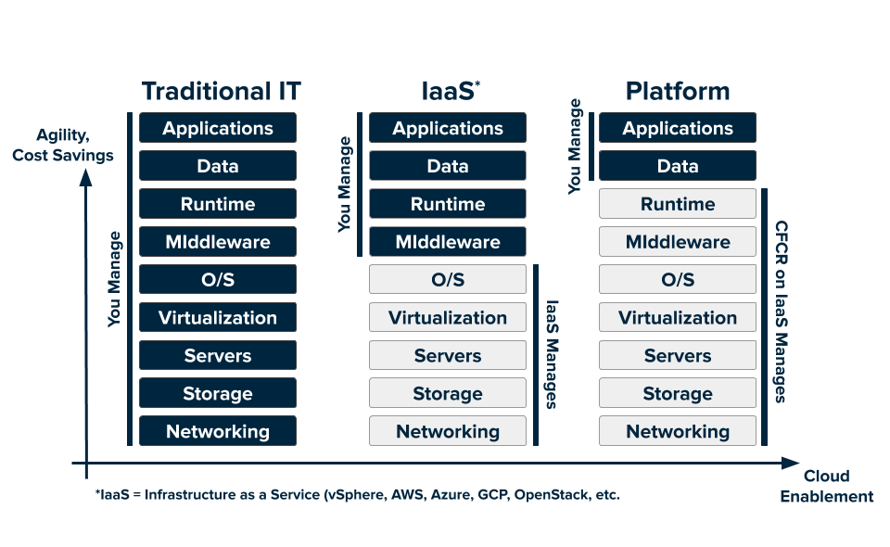
Cloud services

Slide 6
What is Pivotal Cloud Foundry??
Pivotal Inc. is the company behind development and support for cloud foundry

Slide 7
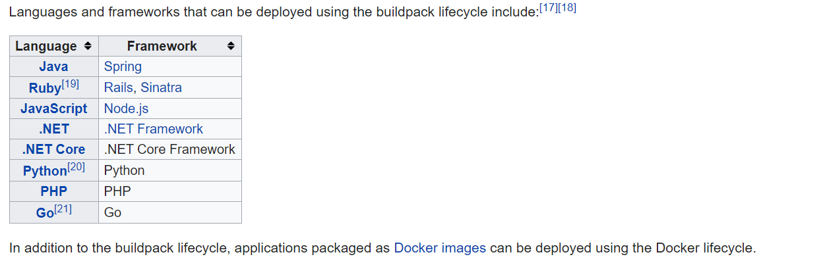
Supported languages/frameworks

Slide 8
Why PCF??
Easy and quick deployment
No worry about which cloud is in the backend
Migration among different cloud providers like aws, gcp, azure

Slide 9
Microservices deployment with pivotal cloud foundry
ARVIND
#2
pcf
ENVIRONMENT SETUP
GETTING READY
-- #greenlearner --

Slide 10
ENVIRONMENT SETUP PCF CLI installation
ARVIND
#3
MICROSERVICES
AND
CLOUD FOUNDRY
-- #greenlearner --

Slide 11
Steps to perform
CF cli installation
Registration
ORG/SPACE

Slide 12
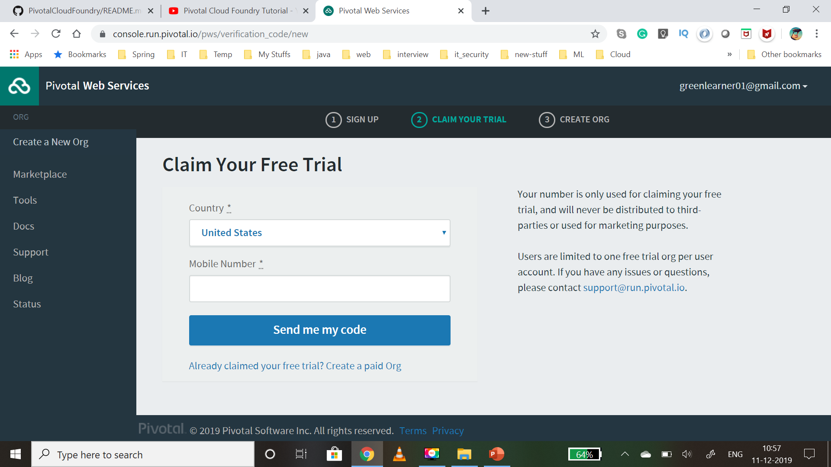

Slide 13
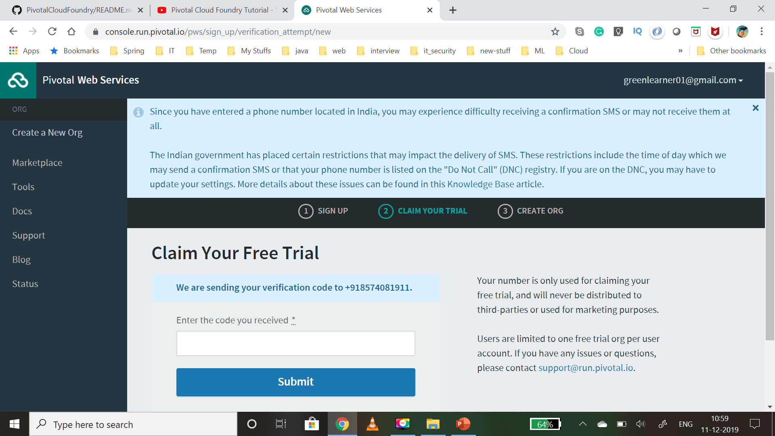

Slide 14
ORG
An org is a development account that an individual or multiple collaborators can own and use.
All collaborators access an org with user accounts, which have roles such as
Org Manager,
Org Auditor, and
Org Billing Manager.
Collaborators in an org share a resource quota plan, apps, services availability, and custom domains.
By default, an org has the status of active.
An admin can set the status of an org to suspended for various reasons such as failure to provide payment or misuse.
When an org is suspended, users cannot perform certain activities within the org, such as push apps, modify spaces, or bind services.

Slide 15
SPACE
A space provides users with access to a shared location for app development, deployment, and maintenance.
An org can contain multiple spaces
Every app, service, and route is scoped to a space
Org managers can set quotas on the following for a space:
Usage of paid services
Number of app instances
Number of service keys
Number of routes
Number of reserved route ports
Memory used across the space
Memory used by a single app instances

Slide 16
Deploying first application to PCF using CLI
ARVIND
#4
MICROSERVICES
AND
CLOUD FOUNDRY
-- #greenlearner --

Slide 17
Steps to perform
Open cf cli
Login
Get the .jar which is to be pushed
Push the app

Slide 18
Sample application to be pushed/deployed
DOCTOR’s PORTAL
/doctors [GET]
/patients [GET]
/diseases [GET]
/doctors [POST]
/patients [POST]
/diseases [POST]

Slide 19
Microservices deployment with pivotal cloud foundry
ARVIND
#4
pcf
What is Buildpack?
-- #greenlearner --

Slide 20
buildpack
Buildpacks provide framework and runtime support for apps.
Buildpacks typically examine your apps to determine what dependencies to download and how to configure the apps to communicate with bound services.
https://docs.cloudfoundry.org/buildpacks/

Slide 21
Microservices deployment with pivotal cloud foundry
ARVIND
#5
pcf
Deploying application using manifest
-- #greenlearner --

Slide 22
Manifest.yml
Manifests provide consistency and reproducibility, and can help you automate deploying apps.
Both manifests and command line options allow you to override the default attribute values of cf push.
These attributes include things like number of instances, disk space limit, and memory limit.
Command line options override manifests.
https://docs.cloudfoundry.org/devguide/deploy-apps/manifest.html

Slide 23
references
https://www.cloudfoundry.org/the-foundry/pivotal-cloud-foundry/
https://pivotal.io/why-pivotal
https://docs.pivotal.io/pivotalcf/2-3/concepts/overview.html
https://en.wikipedia.org/wiki/Cloud_Foundry
https://docs.pivotal.io/
https://pivotal.io/platform/pcf-tutorials/getting-started-with-pivotal-cloud-foundry
https://pivotal.io/platform/pcf-tutorials/getting-started-with-pivotal-cloud-foundry/next-steps

