Slide 1
ehs tools
A lifecycle workflow automation tool

Slide 2

What Drove us...
In the Oil and Gas Industry, there are multitude of studies & risk assessment workshops; e.g., HAZOP, HAZID, SIL, Construction Risk Assessment (CRA).
For each stage of the project, there could be easily 100’s to 1000’s of actions generated, which needs to be tracked, signed off and reported on, often on a very tight schedule.
A typical process requires an action sheet to be printed out, passed around for responses and then comes the approval sign-off. Current “paper” process is time-consuming, labor and resource-intensive, involving multiple parties from different organizations
This process becomes more complicated when the approvers are from different organizations or different geographical locations. Painful when the “paper action close out sheets” get held up by certain discipline and are just tedious to trace.
This approach is prone to mismanagement ; e.g., losing track of actions, and tracking high risk , high priority items; Fragmented excel sheets capturing various discipline responses; lack of alerts to parties holding up approval; Unable to produce timely reporting just to name a few
We have a solution ; an operational improvement tool , our ehs tools to bring about a big step change in the way you would traditional approach this problem

Slide 3
ehs tools - Your Engineered workflow solution
Where are we today ?
Where we could be?
What’s Our Value?
Paper/ email based
Improving Productivity;
Your Digital Transformation Journey
Automation
What the challenges faced with current process
Why Automate using our ehs tools?
Key Advantages
Immense cost benefit
Reduced resources in tracking and producing reports
Significant savings in time i.e. starting the close out process and subsequently allowing the system to track, report and alert users
Robust system for auditing purposes
Required additional personnel manpower to issue action individually and track actions to completion
Fragmented responses in multiple excel sheets
Malformed reporting & Inability to track items to completion
Extended schedule for closing out 100’s or 1000’s of action
High risk of project overruns if actions are not managed satisfactorily, we have proven track record to manage close outs efficiently and in time
WFH becomes the norm, tedious to administer and follow up on who's holding the action
In an era where productivity is digitization, organizations need to automate
3

Slide 4
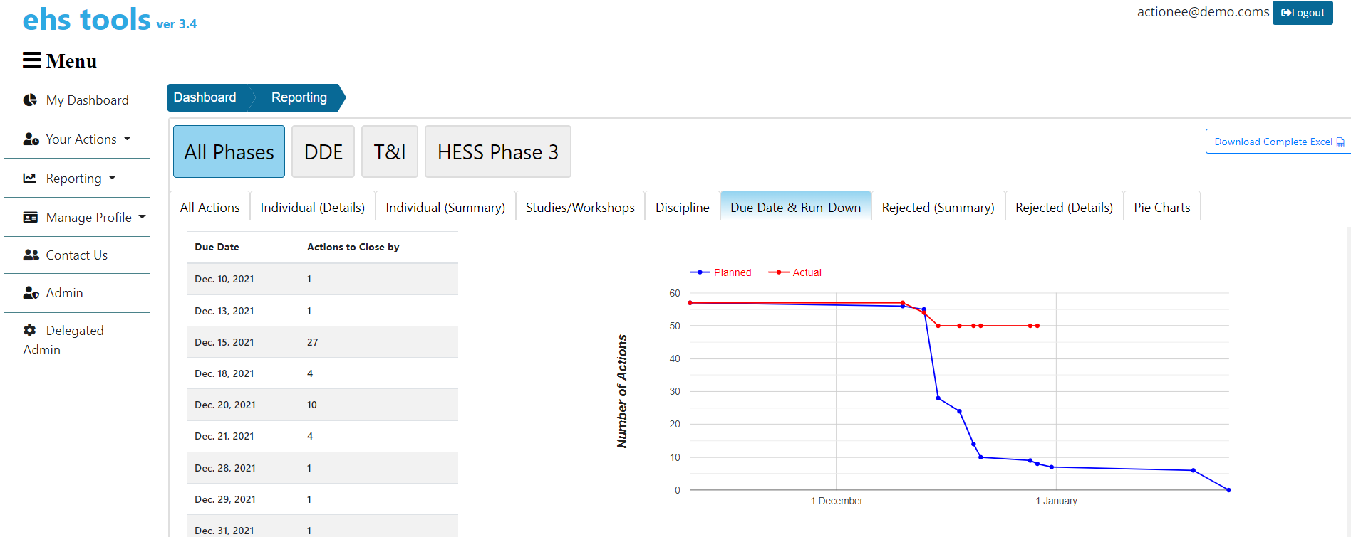
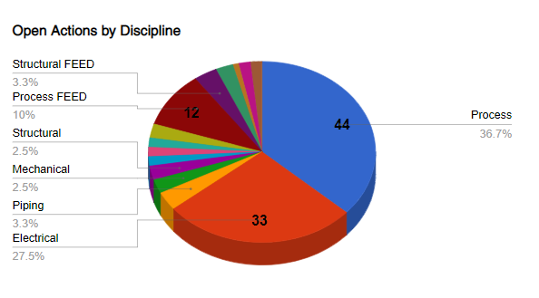
Your Risk Management Tool
Out of the box solution; Hit the ground running from Day 1, Intelligent Workflow Routing using Data-Science Tools
Shorten your Engineering Lifecycle . As these actions are on the critical path, its vital these action are worked on immediately , tracked , reminded and closed out in record time
Your Risk Management DNA; we assimilate your risk matrix, your templates into our solutions. Priority setting by Due Dates or even Risk
ehs
tools
Flexibility Routing, We provide for routing based on your requirements , multiple approvals, re-delegation, withdrawals, across organizations and borders.
Your Dashboard & email Reminders ; We have an intuitive dashboard that tracks , reminds and alerts you on pending actions.
Tracking & PMT Reporting. A multitude of reporting tools . Business intelligence to drive your productivity

Slide 5
ehs tools Workflow
Input Data
Upload Actions, Routing Tables, Risk Matrix, in Excel Format
Responds and Approve
Actionee receives Notification on Actions via Email
Tracking and Reporting
Intuitive Dashboard for Tracking of Actions Status
Live Status Update
Generate Close Out Report
Generate various Reports for different Reporting Requirement
Generate Digitally Signed pdf Close-out Sheets individually or in bulk
Upload preferred Closeout Sheet Template in PDF Format
Approvers receive Notification via Email and approves or rejects
Actionee responds with evidence (attachments)
The Narrative
Actions, Routing Tables, Risk Matrix and Templates are loaded, and your team can hit the ground running in a day. Priority setting are done via due dates or even risk values. Emails reminders are immediately sent to those who hold the actions .These Emails reminder are flexible , basically configurable and are set based on organization requirements.
Actions are then worked on with ease, Actionees responds with evidence or attachment, and we allow all attachment types. These could be P&ID or Layouts, Safety drawings, etc. 3 clicks away to submission with a simplified e-Signature step. Actions can all also be withdrawn at any point during the life of an open action
Next approvers are alerted via email reminders that they have actions in their que. They can view responses and evidences and decide to approve or reject with an e-Signature. Rejection can also be accompanied by redline markup, docs and attachment
Easy reporting for you and your PMT team. We have an Intuitive Dashboards ; Run-Down curves, multitude of other pie charts and tabular reporting for your weekly status updates in your EPCIC meetings.

Slide 6
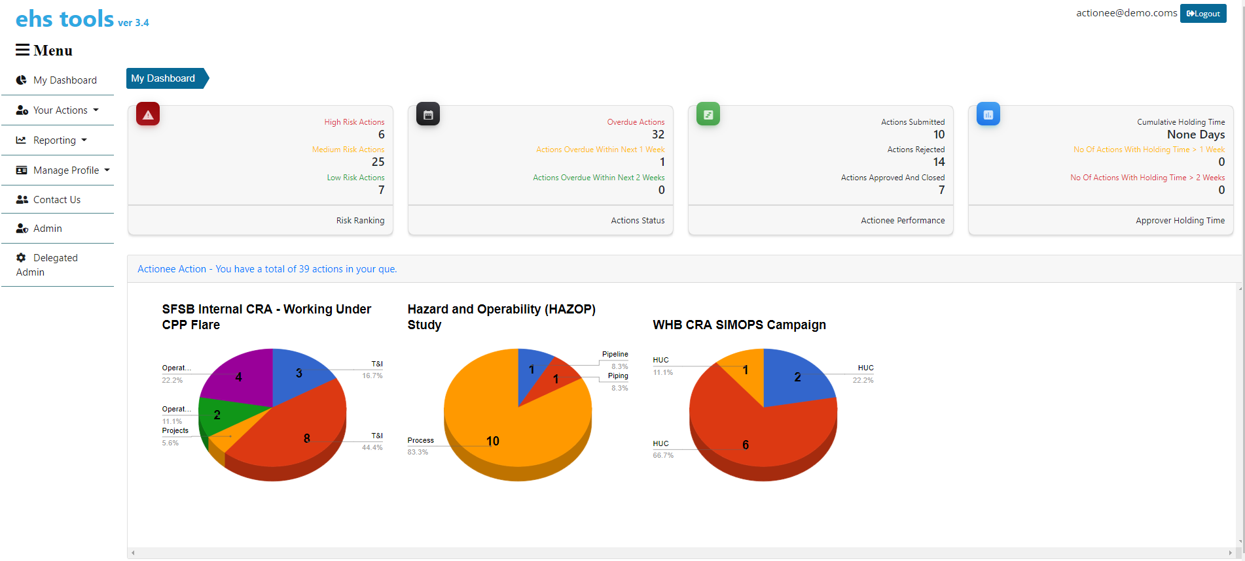
Dashboard and Performance Monitoring
Status of actions sorted based on risk ranking and due date priority
Performance monitoring of actionee and approver
Clear illustration of actions and studies to be actioned on
Intuitive and user friendly dashboard page

Slide 7
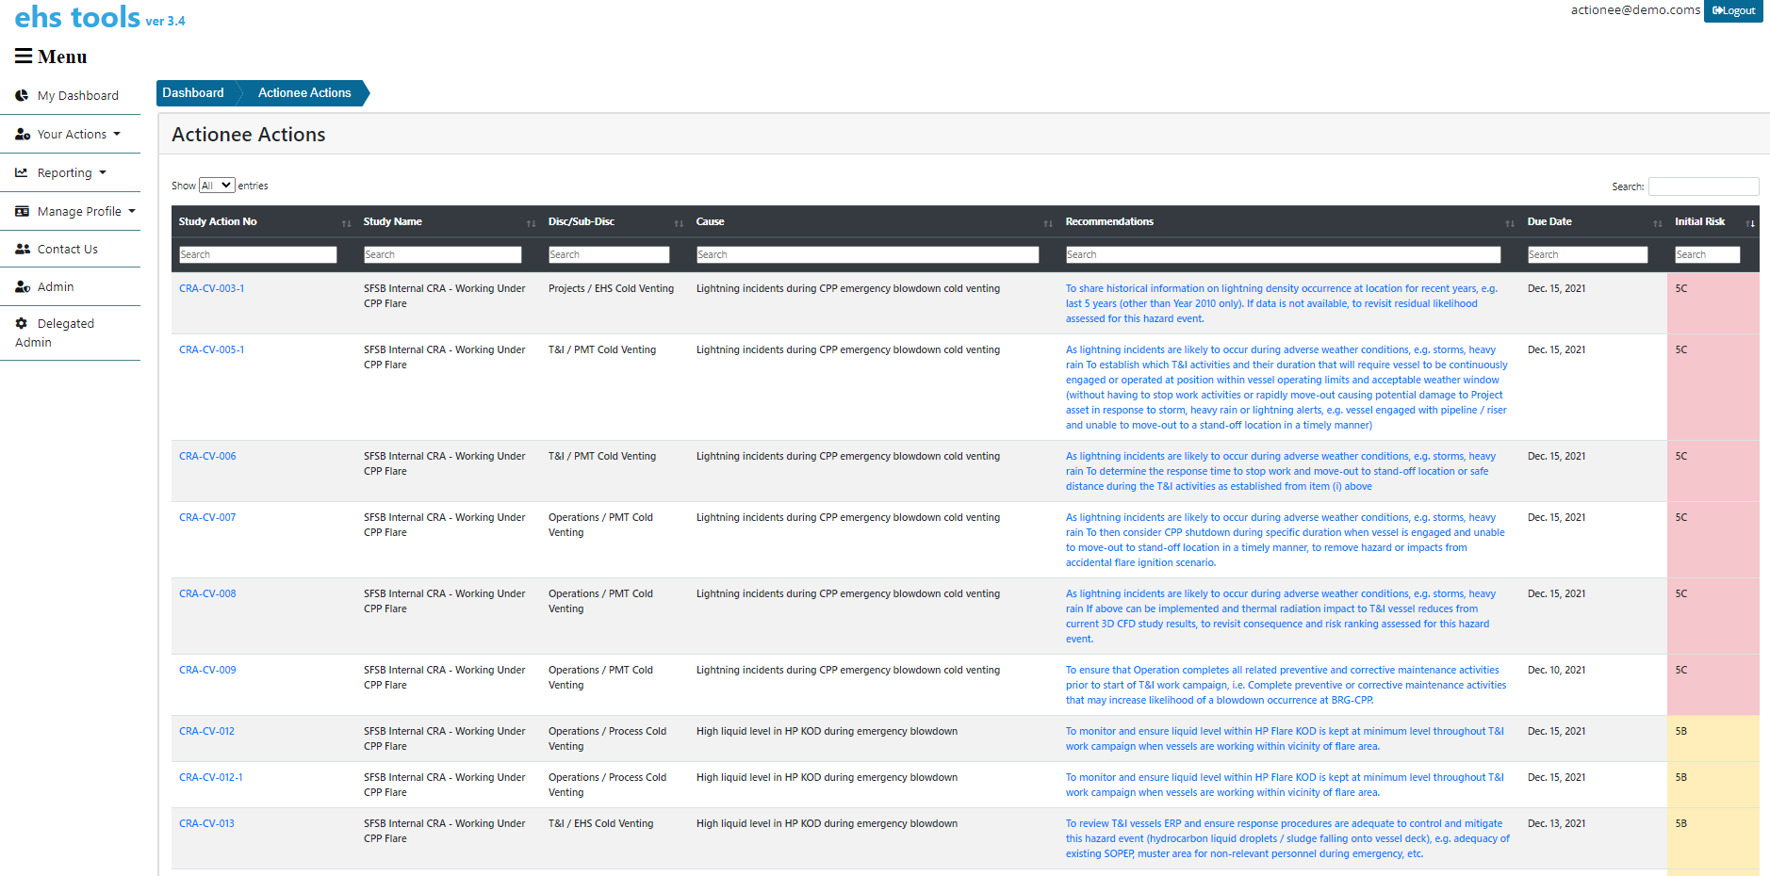
Actionee List
Summarised List of Actions and Recommendations in a single page with enhanced filtering function. Sort by dates, risk, numbers or filter by keywords
Automated risk ranking and display based on organisation Risk Matrix.

Slide 8
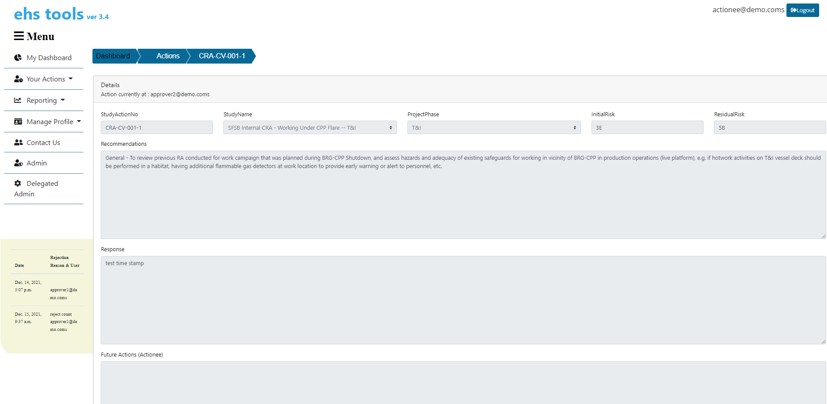
Action Items (Actionee) - Detailed
Detailed View of Actions and Recommendations
Rejection Comments from Approvers will be shown

Slide 9
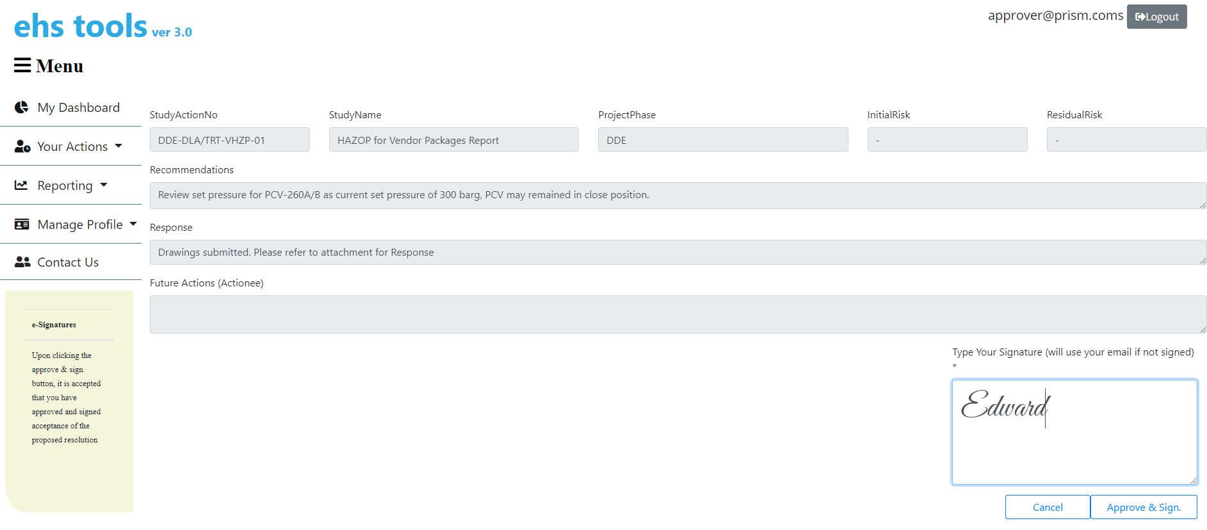
Action Items (Approver) - Approving

Slide 10
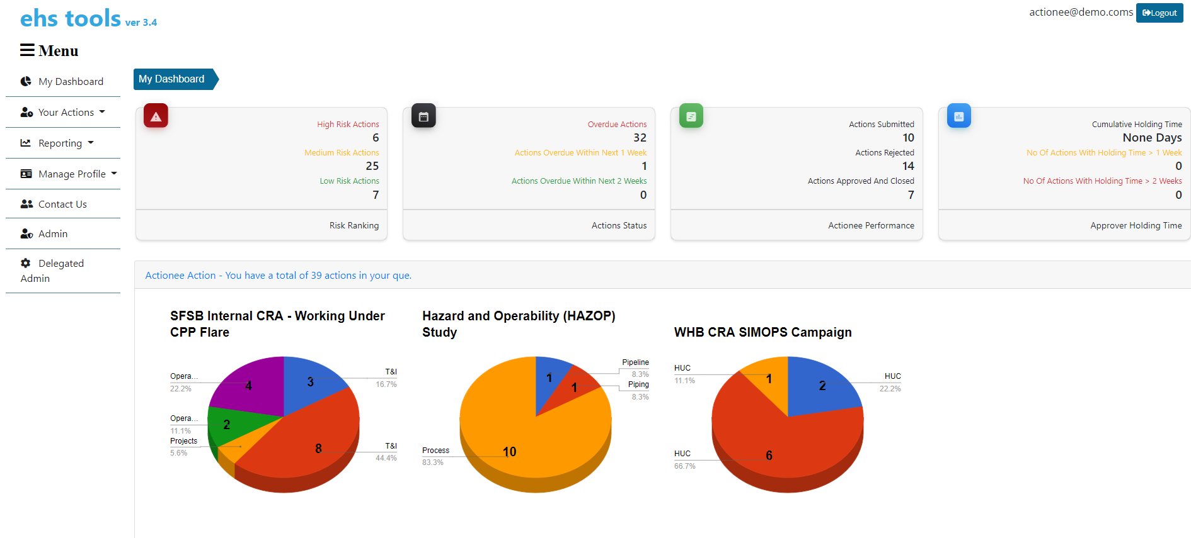
Intuitive Individual & Organisation Dashboards
You Have Actions…
And we have a system that tracks every single EPCIC actions ; Both Yours and the Organizations. We have designed it to accept your workshop RA (HAZOP, HAZID, Construction Risk Assessment-CRA, etc.). Emails are sent when an action arrives in your Que.
We provide for granular and intuitive reporting. We have an array of reporting via tabular format, pie charts and run downs engineering curves
This easy reporting is tailored for your PMT team; its an enabler for them at the weekly EPCIC meetings. No stone unturned as all actions are precisely known where they reside., In addition Excel downloads are available for each slice of reporting ;
These dashboards are segmentized based on Phases , throughout your lifecycle you have several Phases – Engineering , Construction, Installation & HUC. These actions can be segmentized based on Phases

Slide 11
Reporting
Wide Range of Reporting / Dashboard for Various Needs – viewed by Project Phases

Slide 12
Technology Stack and Licensing
Cloud Base
Framework
Backup
Licensing
Amazon Web Services (AWS)
Secure https login using your email id
Django, python REACT, data-science
Frequent backups of data and application
Unlimited Users
Monthly subscription software as a service or
Purchase with yearly maintenance
We use AWS in Singapore and offer monthly Software as a Service based subscription
The framework enables quick access to MySQL databases and fast rendering of HTML
Backup are configured twice a day

Slide 13
Our Client List
PRISM (Process Risk Integrity and Safety Management) GROUP is an established, independent third party consultant with a team of highly qualified, specialist in process risk integrity and safety management. We provide services for clients in many sectors, including Oil and Gas, Marines, and even Food & Beverages industries.
https://www.prism-ta.com/about-us/
https://greatventures.prism-ehstools.com/
Our Clients for ehs tools are
Sapura Energy
Hess Malaysia
PRW Engineering Malaysia ( Perunding Ranhill Worley )

Slide 14
Thank you
For more information, please contact
sales@prism-ehstools.awsapps.com
+601123806573

