Slide 1

CSE430: SOFTWARE TESTING AND QUALITY ASSURANCE
SESSION: SUMMER 2026
SECTION: 01
PROJECT NAME: CAR SHOP MANAGEMENT SYSTEM
PROGRAMMING LANGUAGE: JAVA
SUBMITTED TO:
SHARTAZ SAJID NAHID
LECTURER
DEPARTMENT OF COMPUTER SCIENCE AND ENGINEERING
SUBMITTED BY:
TEAM NAME: STACK UNDERFLOW
SUJOY KARMAKAR--------2023-3-60-514
SHAHRIAR AREFIN--------2023-3-60-517
MD. SADMAN--------------2023-2-60-304
RUDBATUNNESA----------2021-3-60-006
LIMA PRODHAN-----------2021-3-60-180

Slide 2
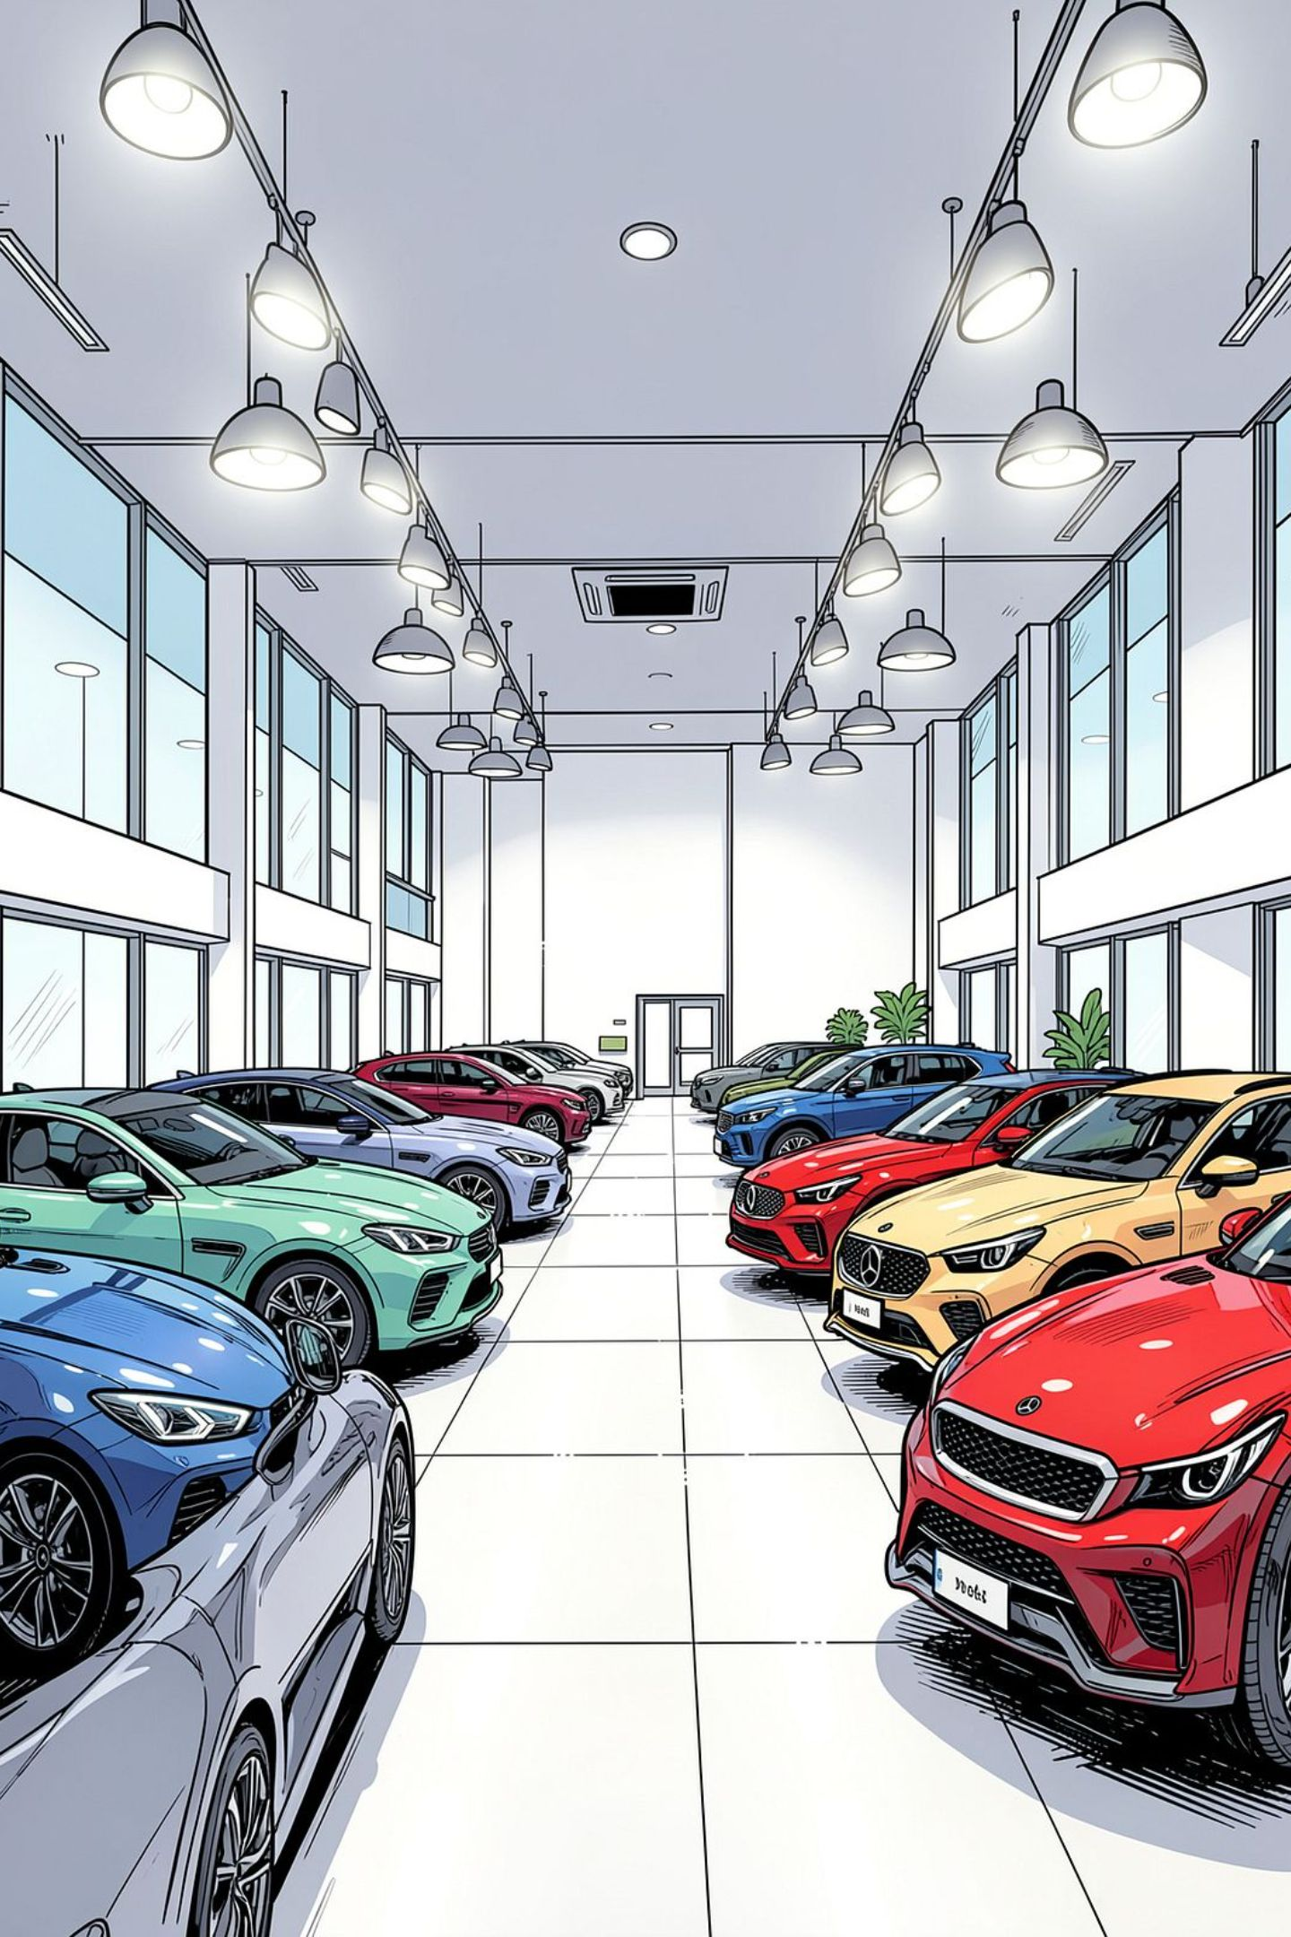
Car Shop Management System
Testing & Quality Assurance Overview

Slide 3
Project Overview
Application Type
Core Functions
A comprehensive GUI-based desktop application built with Java and features a user-friendly interface.
Inventory management, customer tracking, and purchase history.
Key Feature
Seamless integration of car inventory with customer relationship management.

Slide 4
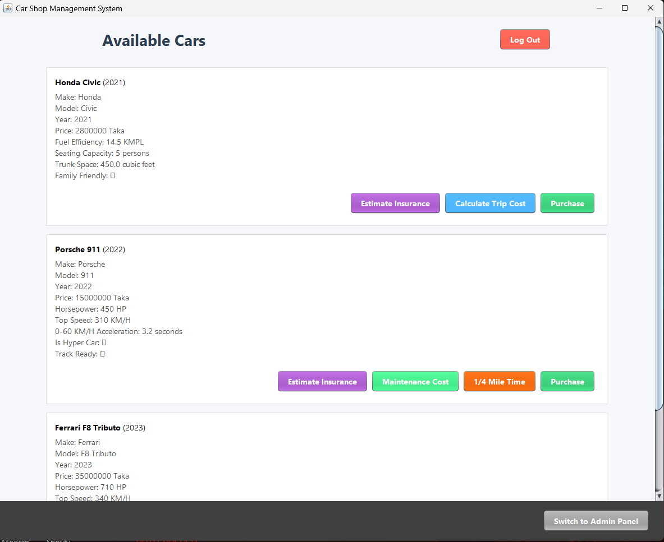

Slide 5
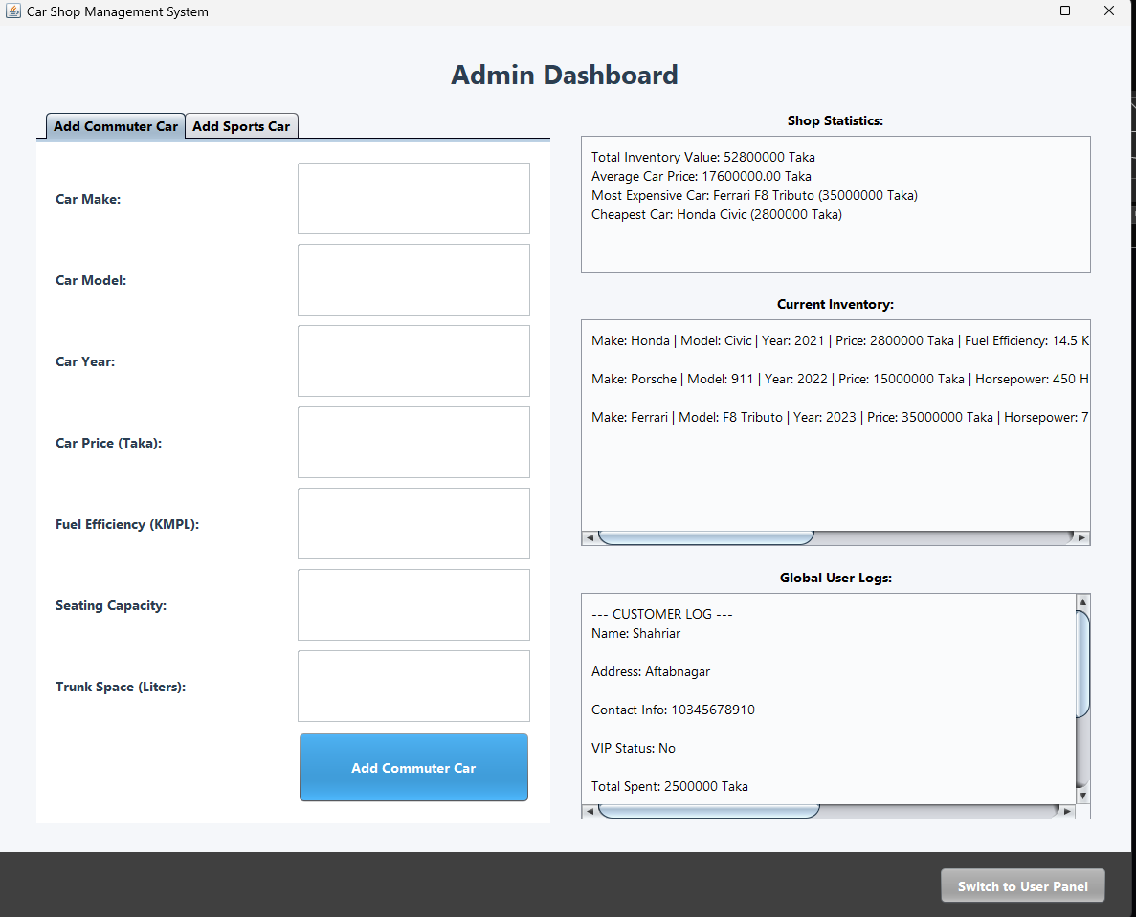

Slide 6
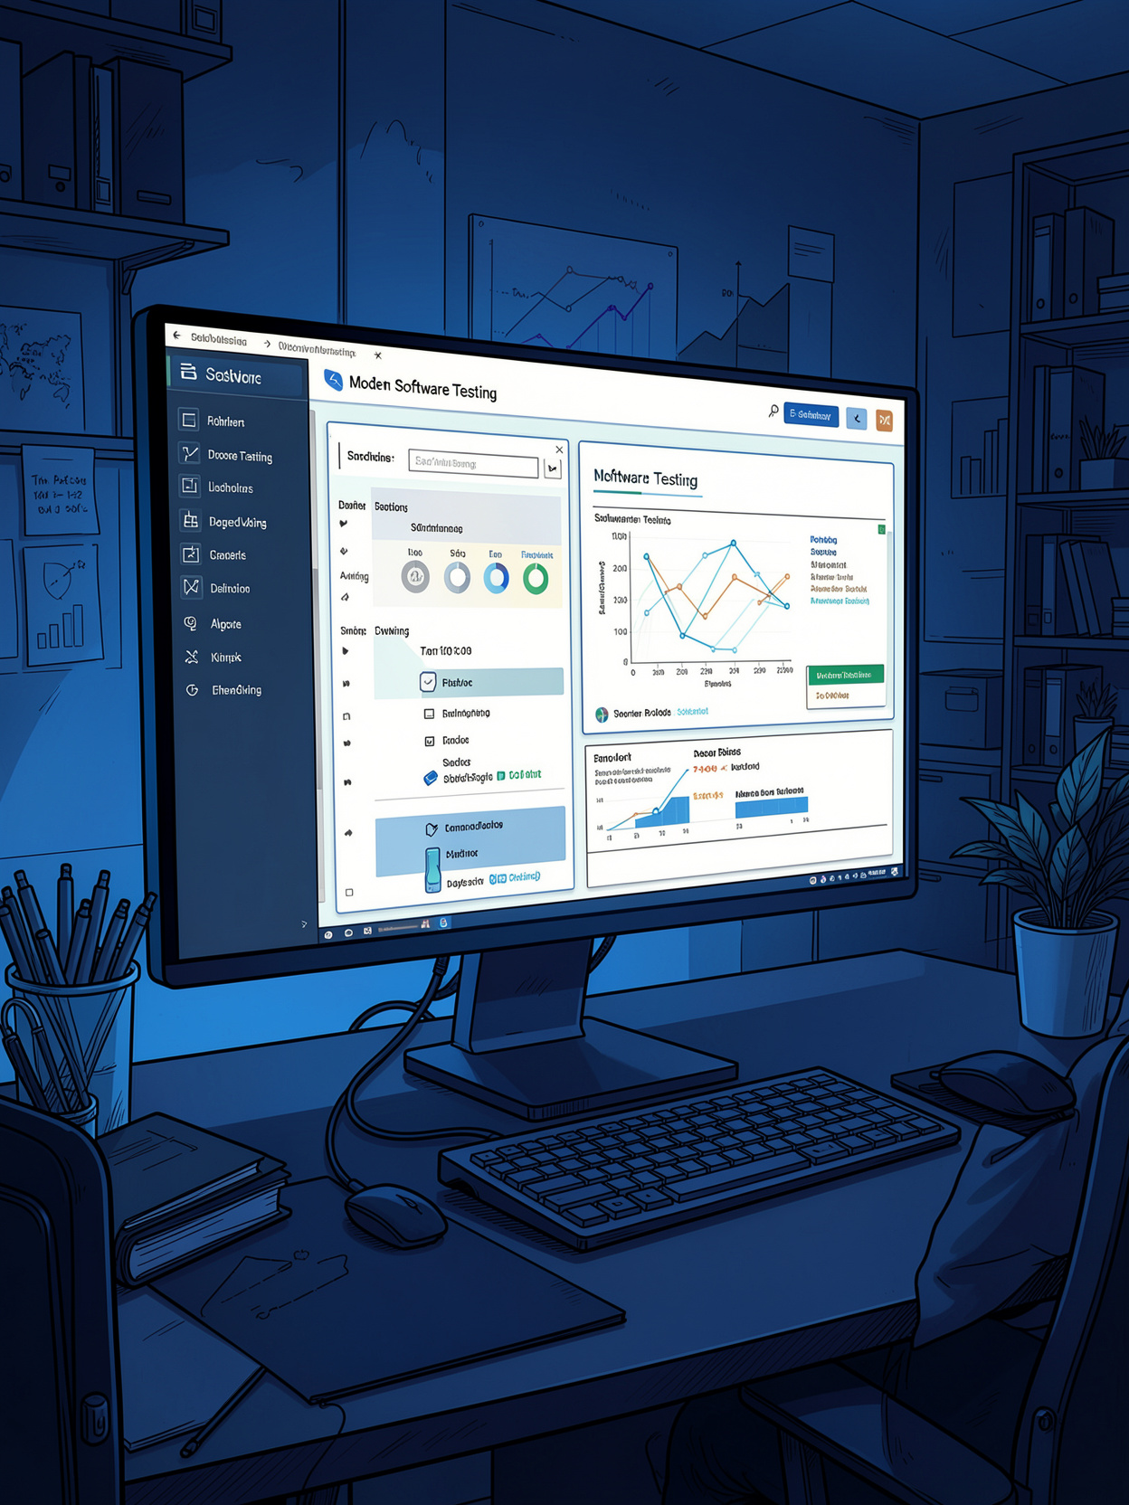
Testing Strategy
An overview of the frameworks, methodologies, and coverage goals guiding quality assurance for the Car Shop Management System.

Slide 7
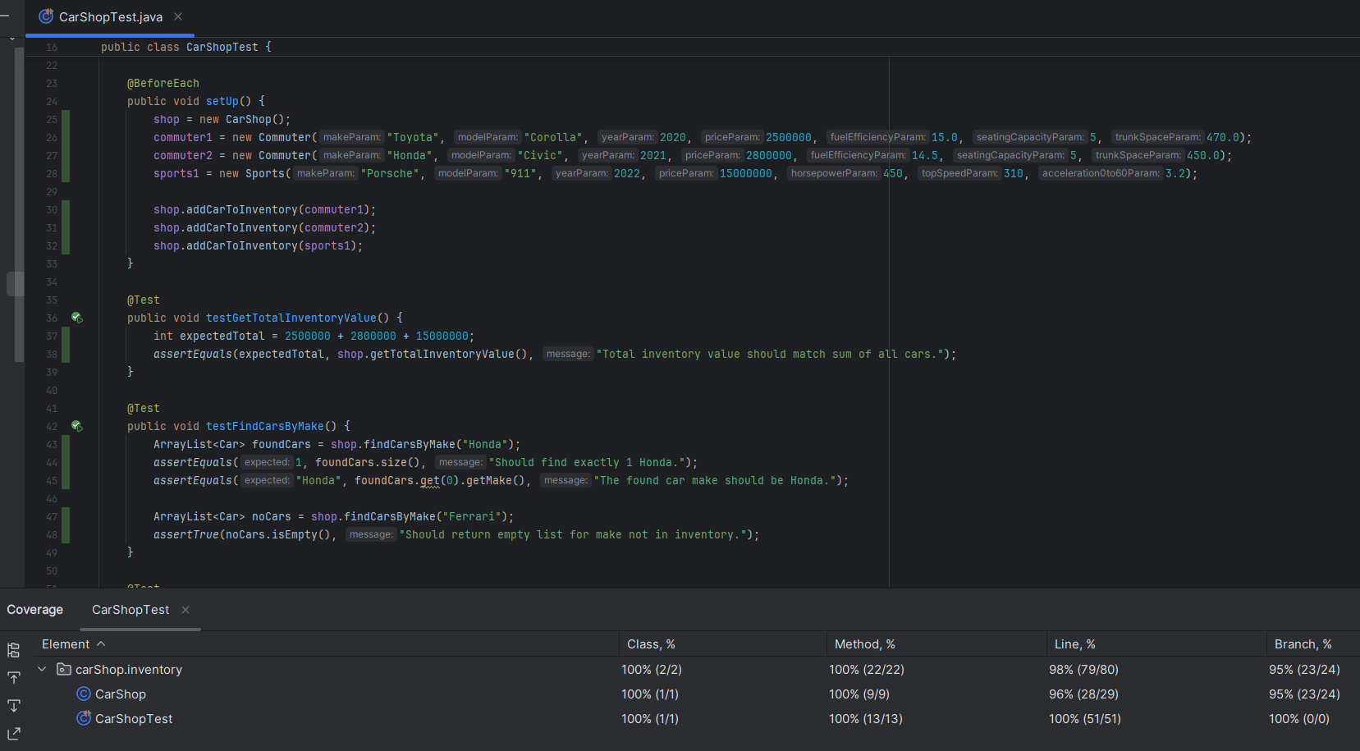
Testing Framework & Approach
Framework
JUnit 4 serves as the backbone for all automated testing across the system.
Testing Methodology
Unit Testing: To test individual methods in isolation
Parameterized Testing: To run tests multiple times with different inputs.

Slide 8
Inventory Management Testing
(CarShopTest)
Focus: Core inventory management logic
Core Operations
Search Mechanisms
Validation & Exception Handling
Validates add, remove, and filter vehicle operations across the full inventory lifecycle.
Tests for finding the most expensive, cheapest, and vehicles searched by make.
Covers invalid operations such as negative prices and out-of-bounds inputs.

Slide 9
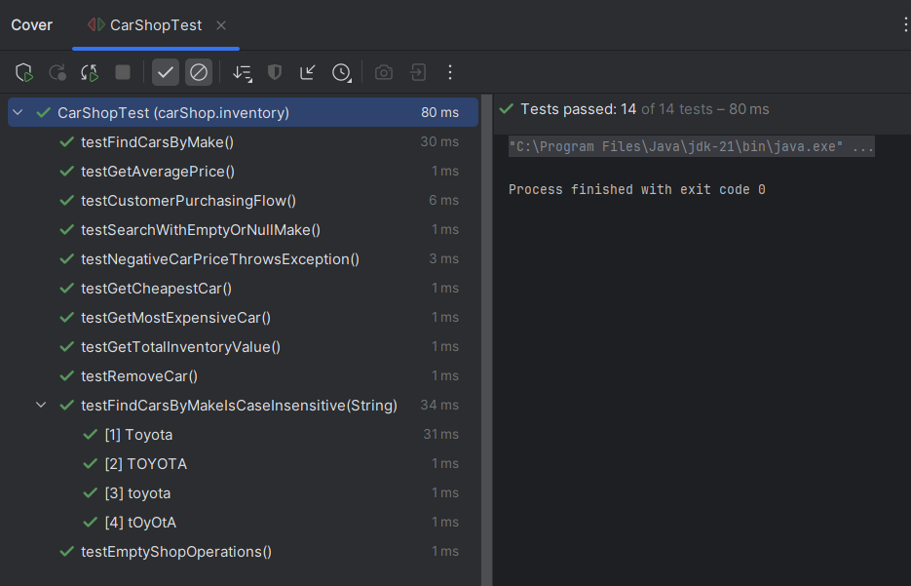

Slide 10
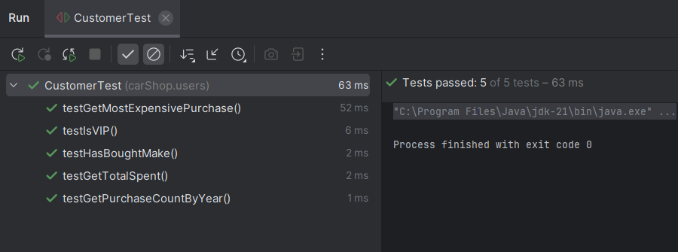
Customer Management Testing(CustomerTest)
Focus
User-centric logic and customer-related operations
CustomerTest.java Highlights
Verified total spent calculations and VIP status designation.
Tested tracking logic for identifying the most expensive purchase.
Validated historical purchase patterns (e.g., counting purchases by year).

Slide 11
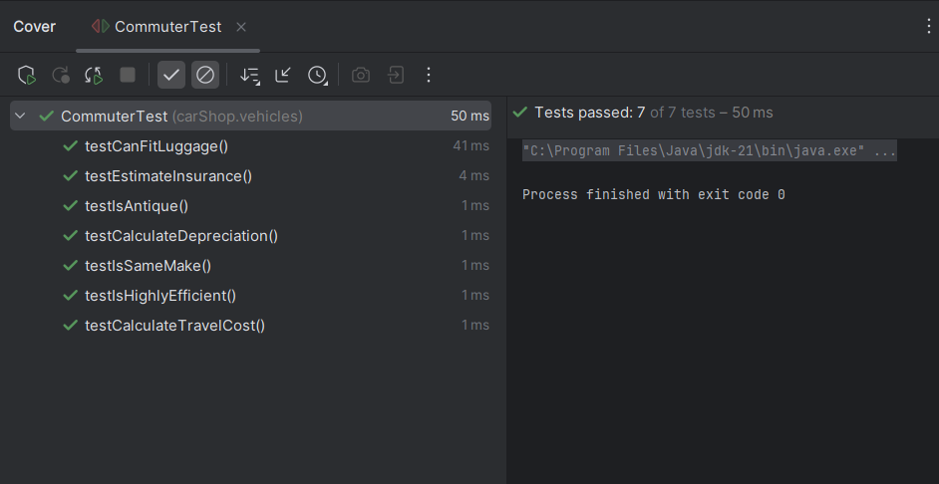
Commuter Vehicle Testing(CommuterTest)
Focus
Business logic and specifications for commuter vehicles.
CommuterTest.java Highlights
Tested financial estimators: depreciation, insurance, and travel costs.
Evaluated practical classifications: luggage capacity and efficiency.
Verified the logic for identifying antique vehicles based on the manufacturing year.

Slide 12
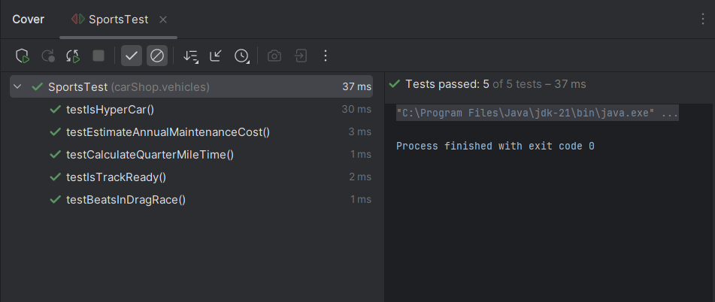
High-Performance Vehicle Testing(SportsTest)
Focus
Distinct attributes of sports and high-performance cars.
SportsTest.java Highlights
Validated performance categorizations (e.g., 'Is Track Ready', 'Is Hypercar').
Tested specific metric estimators like quarter-mile time calculations.
Evaluated comparative logic (e.g., determining drag race winners) and high annual maintenance costs.

Slide 13
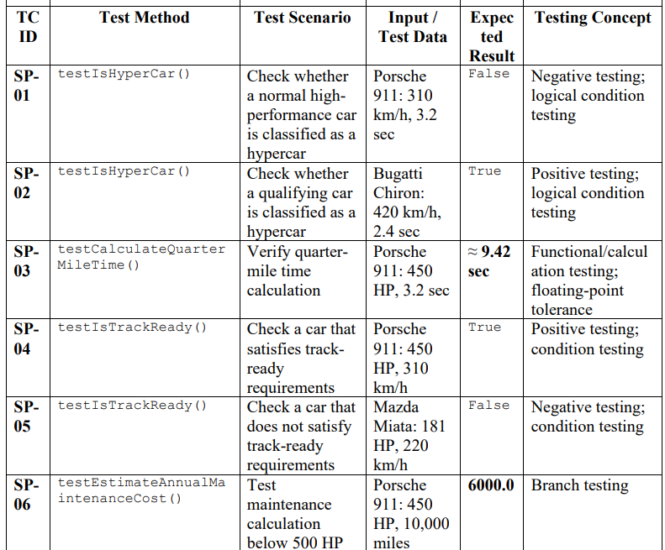
High-Performance Vehicle Testing(SportsTest)
Thank You!

Slide 14
Thank You!

