Slide 1
Impact of Socioeconomic Factors on Student Academic Performance

Slide 2

Submitted To
Md. Al Imran
Senior Lecturer,
Department of Computer Science & Engineering, East West University
Course Title: Statistics for Data Science
Course Code: CSE303
Section: 08
Submitted By
Name: Saima Islam
ID: 2022-1-60-150
Name: Faria Zaman Titly
ID: 2022-1-60-068
Name: Lima Prodhan
ID: 2021-3-60-180
Name: Ferthousi Yesmin Pinky
ID: 2021-3-60-163

Slide 3
Overview
Objective
Data Preprocessing
Exploratory Data Analysis (EDA)
Statistical Hypothesis Testing
Confidence Interval Analysis
Regression Analysis
Robustness Checks
Insights & Recommendations
Conclusion

Slide 4
Objective
Explore the relationship between parental education, reading, writing, and math scores.
Perform hypothesis testing, regression analysis, and bootstrapping for robust confidence intervals.
Understand factors influencing math performance.

Slide 5

Data Preprocessing
Handled missing values
Standardized numerical features (Math, Reading, Writing scores).
Converted categorical variable (parental level of education) to dummy variables.
No missing data found.

Slide 6
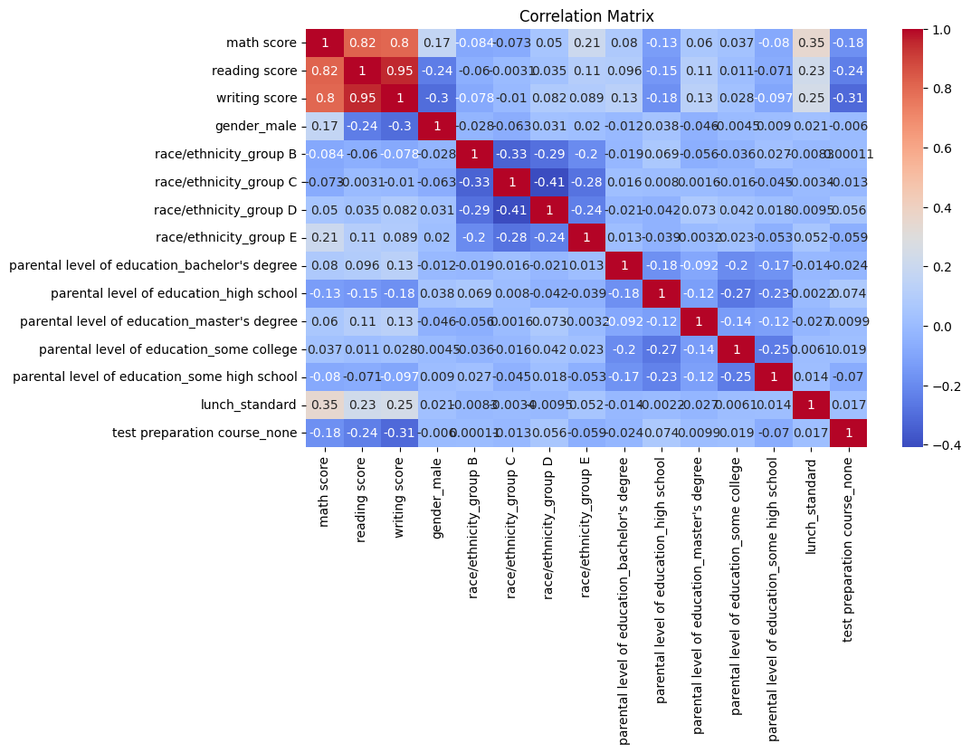
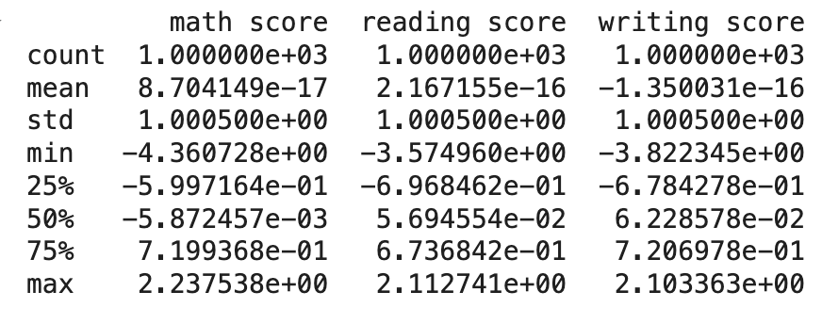
Exploratory Data Analysis
Heatmap for correlations.
Strong correlation between reading, writing, and math scores.
Summary statistics for the dataset.

Slide 7
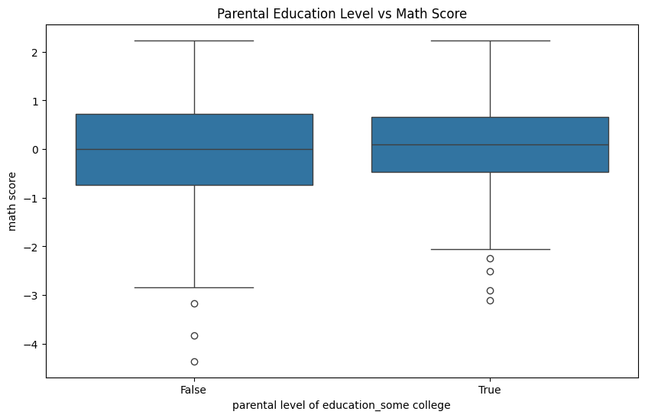
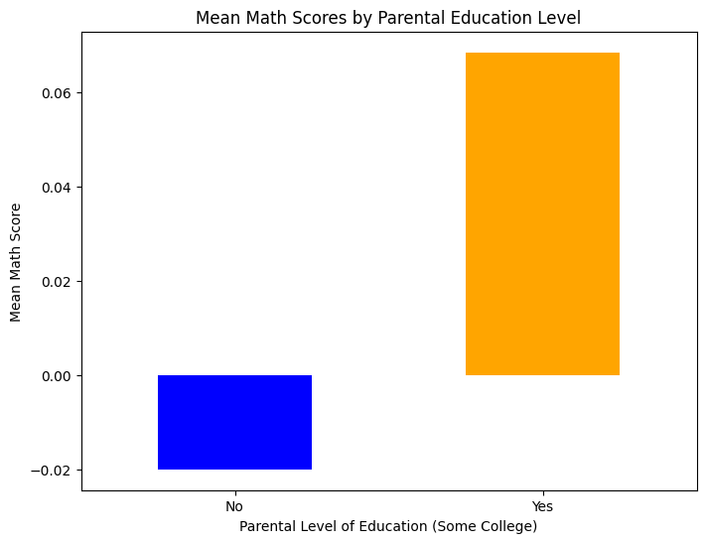
Bar graph comparing mean math scores across parental education groups.
Boxplot for parental education and math scores.

Slide 8
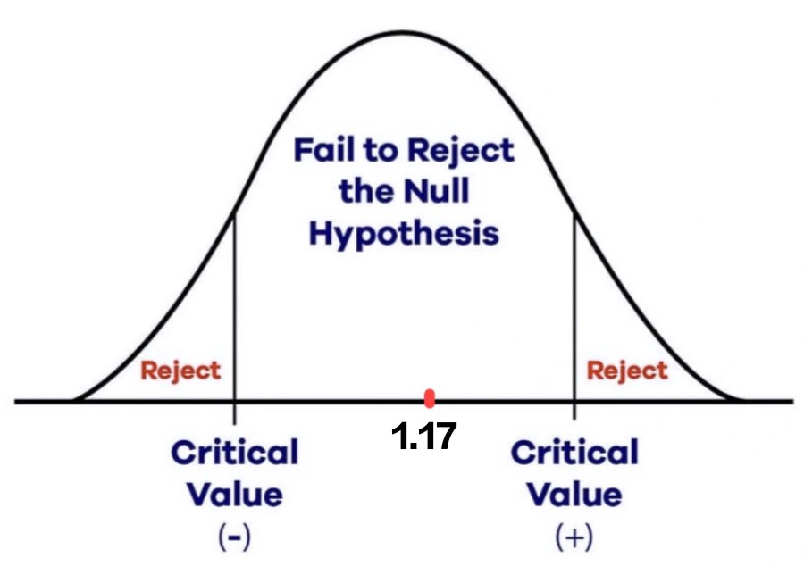
Statistical Hypothesis Testing
Perform the t-test with Scipy (Pseudo Code):
t_stat, p_value = stats.ttest_ind(group1, group2)
print("T-statistic:", t_stat, "P-value:", p_value)
Conclusion
We may not reject the null hypothesis. Parental Education does not have a statistically significant impact on math scores at 5% significance level.
Hypothesis: Does parental education significantly impact math scores?
Null Hypothesis (H₀): There is no difference in math scores based on parental education.
Alternative Hypothesis (H₁): There is a difference in math scores based on parental education.
T-test Results:
T-statistic = 1.17
P-value = 0.242 (24.2% probability)

Slide 9
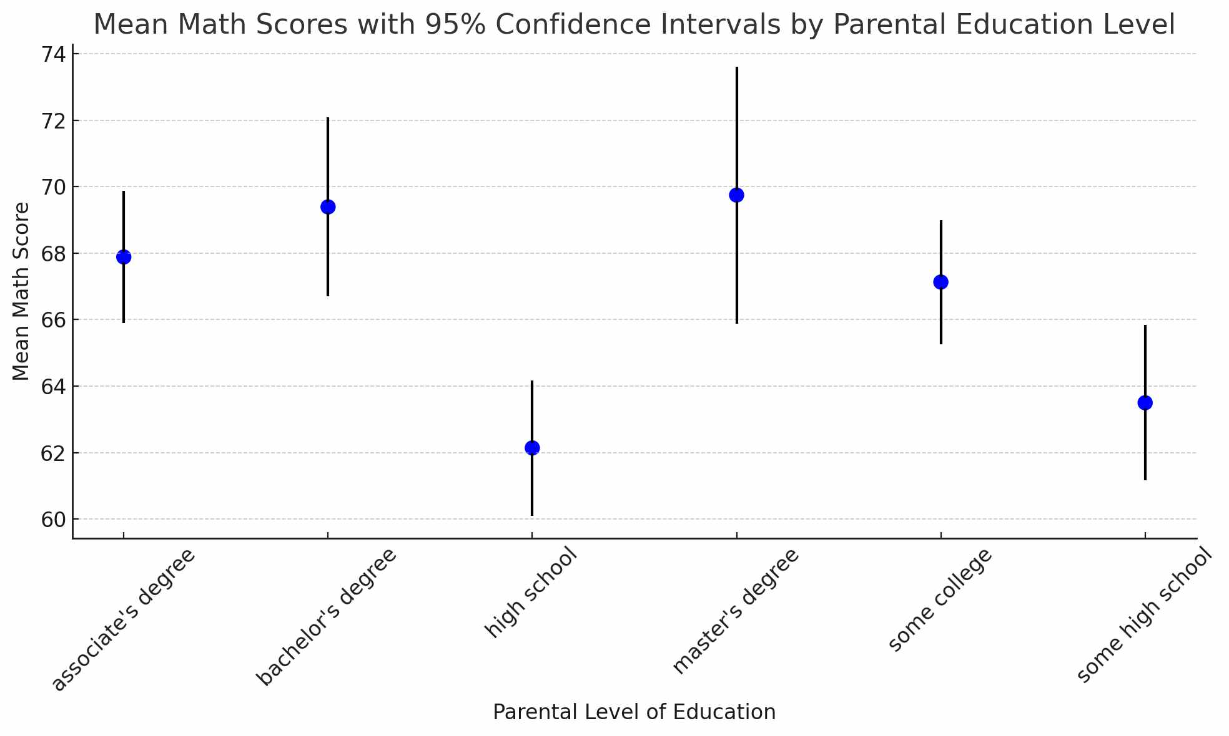
Confidence Interval Analysis
The 95% confidence intervals graph for the mean math scores based
on parental education levels are:
➡ Higher parental education levels (e.g., Master's or Bachelor's) are associated with higher mean math scores compared to lower levels (e.g., High School or Some High School).
➡ Confidence intervals for Master's and Bachelor's degrees overlap, suggesting less certainty about a significant difference between them.
➡ High School and Some High School groups have distinct, lower scores compared to other education levels as their confidence intervals do not overlap significantly with higher education groups.

Slide 10
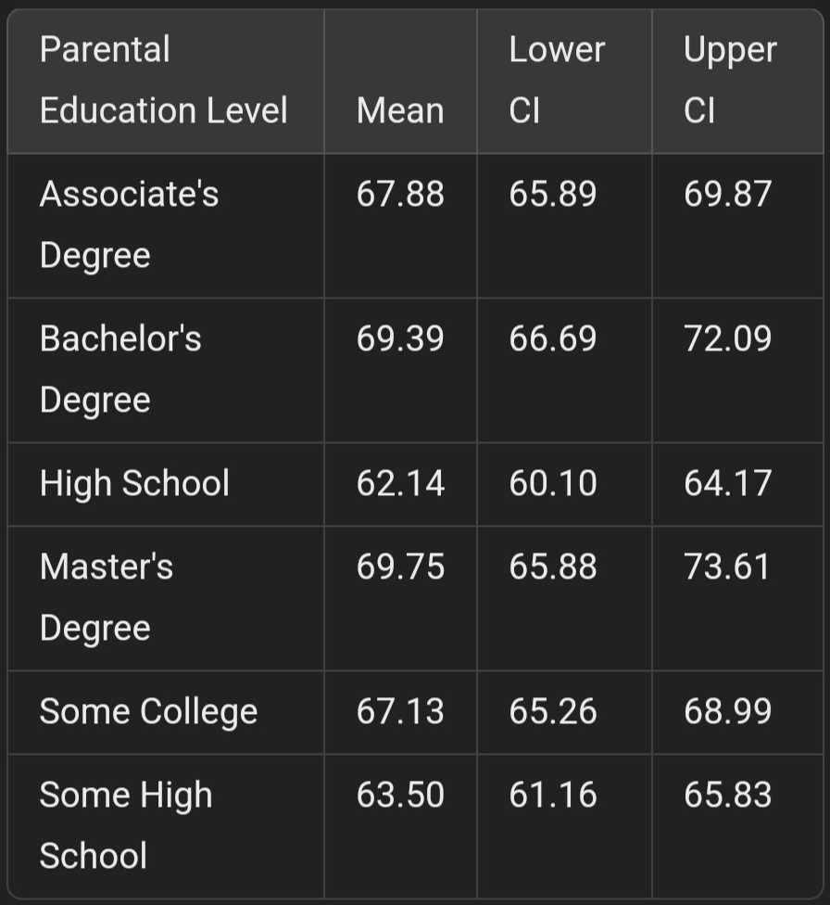
Confidence Interval Analysis
Calculate confidence intervals for key metrics like-
“The mean math score for students with college educated parents is between 80 and 85 with 95% confidence.”
Answer: The 95% confidence intervals for
Associate's Degree: (65.89, 69.87)
Bachelor's Degree: (66.69, 72.09)
High School: (60.10, 64.17)
Master's Degree: (65.88, 73.61)
Some College: (65.27, 68.99)
Some High School: (61.17, 65.83)
Conclusion: From the data, we are 95% confident that the mean math score for students with college educated parents doesn’t fall between 80 and 85.
Using bootstrapping, we computed robust confidence intervals for math scores.

Slide 11
Regression Analysis
Features: Parental education, reading score, writing score.
Response Variable: Math score.
Coefficients
Parental education (some college): 0.086
Reading score: 0.559
Writing score: 0.267
Conclusion
Reading and writing scores are strong predictors of math performance.

Slide 12
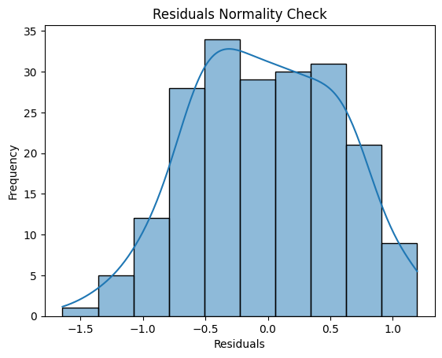
Robustness Checks
Levene's Test for Homogeneity of Variances:
Statistic = 2.645
P-value = 0.104 (No significant difference in variances).
Residuals Normality Check:
Residuals appear approximately normal.
Linearity Check:
Linear relationship between predictors and residuals.

Slide 13

Bootstrapping Confidence Intervals
95% Bootstrap Confidence Interval for Mean Math Score
(-0.06, 0.06)
Suggests a very small effect for parental education on math scores.

Slide 14
Insights & Recommendations
Actionable Insight
Focus on enhancing reading and writing skills to improve math scores.
Parental Education
No significant impact on math scores based on t-test
(p-value = 0.242)
Predictors of Math Scores
Reading and writing scores are stronger predictors of math performance.

Slide 15
Limitations
Focus on Parental Education
Limited Variables
Small Effect Size

Slide 16
Future Scopes
Incorporating Socioeconomic Data
Broader Dataset
Inclusion of Qualitative Data

Slide 17
Conclusion
Parental education level does not significantly affect math scores in this dataset.
Reading and writing scores show strong predictive power for math performance.
Future analyses could include additional features like study time, extracurricular activities, etc.

Slide 18
Thank you!

