Slide 1
Lima Consulting Company
Name: Lima Akter
Roll: 01-022-23
Batch: 022
Lima Consulting
IT consultants , Computer consultants , Software consultants , Business and technology advisors.

Slide 2

Table of Contents
01
02
03
04
Problem & Solution
Skilled Manpower, Data Security, Flaws in Execution, Artificial Intelligence Takeover ect.
Market Analysis and Target
Research marketing and sales strategies and assess brand's relative strengths and weaknesses.
Our Process
Identify the most and least valuable markets.
Develop buyer personas.
Find gaps in the market to fill.
Assess the viability of a product or service.
Improve business strategy.
Our Consultants
IT consultants
Computer consultants
Software consultants
Business and technology advisors

Slide 3
Our Company Summary
Lima Consulting
Tech Consultants analyze existing systems and processes within our own company and our clients' organizations to develop technological strategies and provide solutions. We are responsible for planning and installing hardware and software, and addressing support requests from employees and clients.

Slide 4
Understanding the Problem
Our Product and Services
IT Business
Software
Data
Lack of Qualified IT Personnel. Careless Approach to Online Security · Low IT Workshop Attendance and No Emergency Plan · Unreliable Internet .
Find out a defect in the Software distribution media and or Software function which is inconsistent with the Software Specification.
Data Security . The quantities, characters, or symbols on which operations are performed by a computer, which may be stored and transmitted in the form of electrical signals and recorded on magnetic, optical, or mechanical recording media.

Slide 5
Our Solutions / Services
01
Software
02
Plaining
Custom software development . We use technology and data science to build a comprehensive plan that goes beyond simply "installing a new IT system."
Comprehensive ERP (Enterprise Resource Planning). enterprise performance management. ERP software can be remarkably complex.
Security
Maintainance
03
04
Stronger cybersecurity.
civilian and defense clients to protect information systems and data.
Help with governance, risk, and compliance

Slide 6
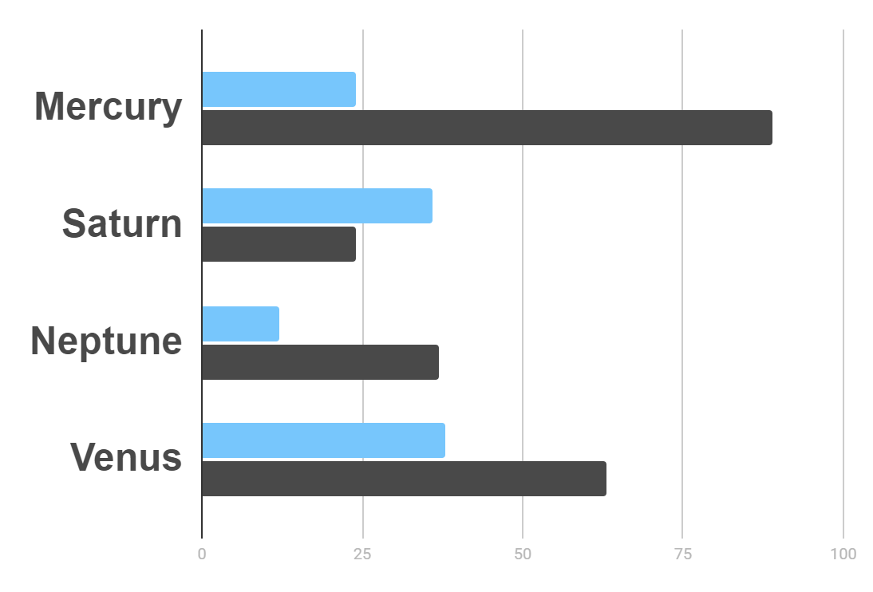
Market Research
Hyperlink
$20K
Gross Revenue in the Sector
10%
45K
Here is the hyperlink added
Sector Growth

Slide 7
Competitor Analysis
Location
Competitors
Capgemini
Deloitte
AOT
Infosys
TATA consulting
Slalom
Here is the Smart art added

Slide 8
Business plan
Architecture planning
offers IT consulting services to create a system and supporting infrastructure.
Strategic planning
Operational assessment
offers IT consulting services to help clients assess their IT needs and formulate plans for system implementation.
offers IT consulting services to assess the IT operating efficiency.
Implementation planning
offers IT consulting services to help clients rollout and test new IT solutions.

Slide 9
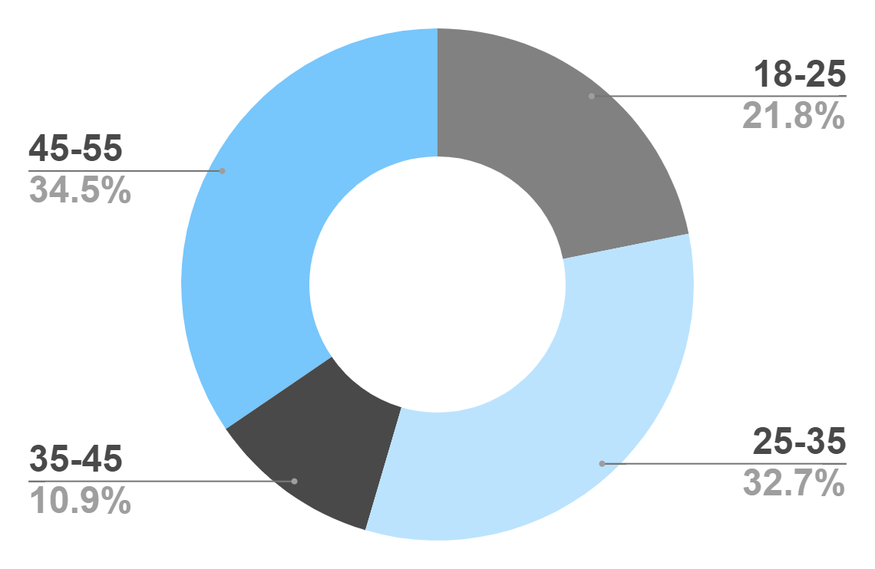
Target
Gender
Age
30%
70%
Interests
Security
Usability
Interface

Slide 10
Our Process
Custom software development
Stronger cybersecurity.
Step 1
Step 2
Step 3
Step 4
Comprehensive ERP (Enterprise Resource Planning).
Help with governance, risk, and compliance

Slide 11
Our Partners
Deloitte
Accenture
Priceaterhouse
Deloitte is the closest IT consulting company to the Lima con
Accenture is the biggest company of them all
Priceaterhouse
is the farthest company from the lima con.
IBM
Capgemini
McKinsey
IBM is the ringed one and a gas giant
Capgemini
being red, Mars is actually a cold place
McKinsey
is the second hIghest earning company from the lima con.

Slide 12
Sales and cost statistics
2024
2025
2026
2027
Goal 1
Improves business processes
Making quality controls
Phase 1
Maximizes any tech opportunities
security consultants.
Phase 2
Performing studies
Reduces costs

Slide 13
…Statistics
 | Vision | Mission | Values
2024 | 0.06 | 0.38 | 0.38
2025 | 0.11 | 0.53 | 0.38
2025 | 95.2 | 9.4 | 1.16

Slide 14
Thank you everyone!

