Slide 1

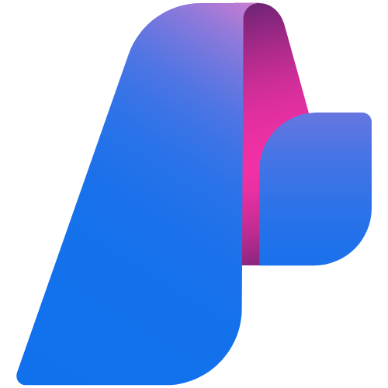
FOUNDRY DATA
INTEGRATION SERIES
Bring Databricks
Genie into Foundry
Session 1 of 4
June 22, 2026
Connect Azure AI Foundry agents to your
Databricks data using the Genie MCP Server
Li Ma
Sr Cloud Solution Architect
Microsoft UK CSU
Azure Databricks Genie
Microsoft Foundry

Slide 2
ABOUT THIS SERIES
Foundry Data Integration Series
June 22
June 29
July 6
July 13
TODAY
NEXT
UPCOMING
UPCOMING
Bring Databricks Genie into Foundry
Bring Fabric Data Agent into Foundry
Fabric MCP + Power BI MCP into Foundry
Integrate Snowflake with Foundry
Real-time data and BI access from within Foundry agents
Securely retrieve data from Snowflake with Foundry agents
Connect Genie to Foundry agents via MCP Server
Integrate Fabric Data Agent as a Foundry knowledge

Slide 3
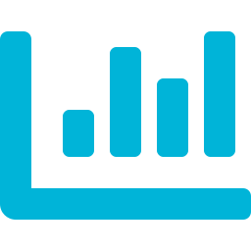



PLATFORM OVERVIEW
What is Databricks Genie?
Natural Language Analytics
Genie Spaces
Genie lets users ask questions about their data in plain English — no SQL required. It translates queries into Databricks SQL automatically.
Curated, governed environments that expose specific tables, metrics, and business context to the Genie AI. Set once, query anywhere.
Unity Catalog Governed
Genie MCP Server (new)
All data access is controlled through Unity Catalog — row-level security, column masking, and audit logging apply automatically.
A Model Context Protocol server that exposes Genie Spaces as tools — enabling external AI agents (like Foundry) to query your Databricks data.

Slide 4
PLATFORM OVERVIEW
What is Microsoft Foundry?
Microsoft Foundry (Azure AI Foundry) is the unified platform for building, orchestrating, and governing AI agents at enterprise scale.
Model Catalogue
Agent Builder
1800+ model catalogue (OpenAI, Meta, Mistral, Databricks DBRX…)
Visual agent builder with multi-step tool orchestration
Built-in evaluation, safety, and observability
MCP-native: connect any data tool as an agent skill
Governed deployment with Azure RBAC, Purview, and Private Link
1800+ models
Visual + code
MCP Tools
Observability
Any data source
Built-in eval

Slide 5

WHY INTEGRATE
Better together: Databricks Genie + Microsoft Foundry
Databricks alone
Foundry alone
Together
Great lakehouse & ML platform
Genie answers data questions
Data platform, not an AI/agent platform
Powerful agent orchestration
Multi-model, multi-tool AI
Needs a data intelligence layer
Foundry agents query live Databricks data naturally
No data movement — governed by Unity Catalog
Full enterprise AI with real data intelligence

Slide 6
Use case 1: Use Genie to run natural language analytics

Slide 7
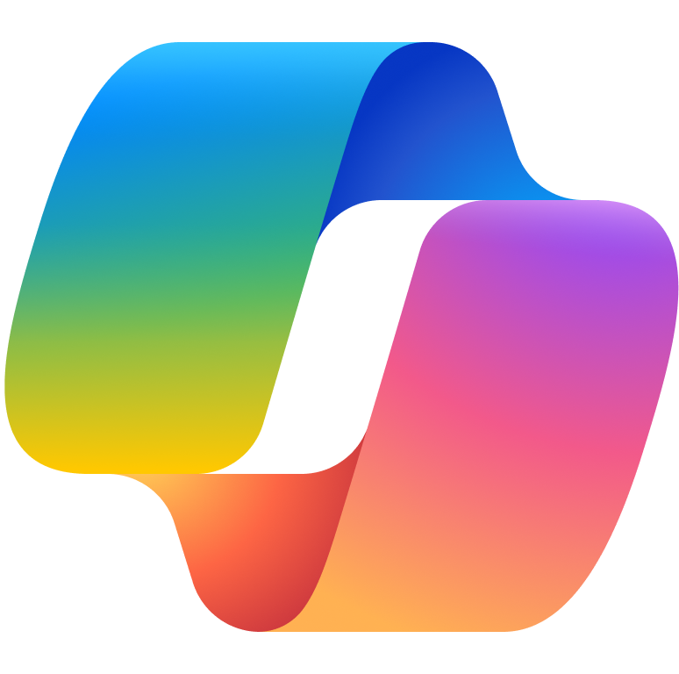



Data Intelligence with Azure Databricks in AI Foundry
Public Preview
Azure AI Foundry - Azure Databricks connection
User
Web App
Copilot
Native Integration: Connect to Azure Databricks AI/BI Genie from Azure AI Foundry
Contextual Answers: Genie agents provide answers grounded in your unique data
Supports Various LLMs: Secure, authenticated data access.
Streamlined Process: Real-time data insights within GenAI apps
Seamless Integration: Simplifies AI agent management with data governance.
Multi-Agent workflows: Leverages Azure AI agents and Genie Spaces for faster insights.
Enhanced Collaboration: Boosts productivity between business and technical users.
Azure AI Foundry
Azure Databricks
Entra ID
Agent to Agent NLQ
Agents
Genie Space
Azure Databricks Unity Catalog
ADLS
Microsoft Purview
AI Developer
Data/ML Engineers
Notes:
The integration between Azure AI Foundry and Azure Databricks transforms how organizations manage data and AI workflows by delivering native integration for seamless connectivity.
With support for various large language models (LLMs), users gain secure, authenticated access to their data, ensuring governance and compliance at every step.
Genie agents provide contextual answers grounded in your unique data, enabling users to perform natural language queries and receive detailed, context-aware responses without needing to understand underlying data structures.
This streamlined process delivers real-time data insights directly within GenAI applications, while multi-agent workflows leverage Azure AI agents and Genie Spaces for faster, more sophisticated analysis.
Seamless integration simplifies AI agent management, and enhanced collaboration boosts productivity between business and technical users.
Ultimately, this approach empowers organizations to make data-driven decisions efficiently, with robust security and accessibility.
Alternate:
The integration between Azure AI Foundry and Azure Databricks revolutionizes the way businesses handle data and AI workflows with the best of both worlds.
By combining Azure Databricks' extensive data processing capabilities with Foundry's advanced AI tools, this integration allows developers to create sophisticated, multi-agent workflows.
Users can perform natural language queries and receive detailed, context-aware responses without needing to understand the underlying data structures.
This integration supports various large language models (LLMs) and ensures secure, authenticated access to data, tailored to each user's permissions.
The result is a streamlined, efficient process for surfacing critical real-time data within Microsoft solutions and other corporate applications, fostering enhanced collaboration between business developers and technical teams.
This innovative approach not only drives productivity but also ensures that data remains secure and accessible, empowering organizations to make data-driven decisions with ease.

Slide 8




VALUE PROPOSITION
Why this matters
Zero data movement
0 copies
Reuse existing investments
Day 1 ready
Genie queries run inside Databricks. Only the result set travels to Foundry — your data never leaves your lakehouse.
No rebuild required. Your Genie Spaces, Unity Catalog governance, and Delta Lake tables work as-is.
AI agents with real data IQ
Live data
Governed & auditable
Compliant
Foundry agents can now answer deep analytical questions — not just retrieve documents — using your live enterprise data.
Every Genie query is logged in Databricks audit logs. Unity Catalog ACLs apply automatically — no new permission model.

Slide 9


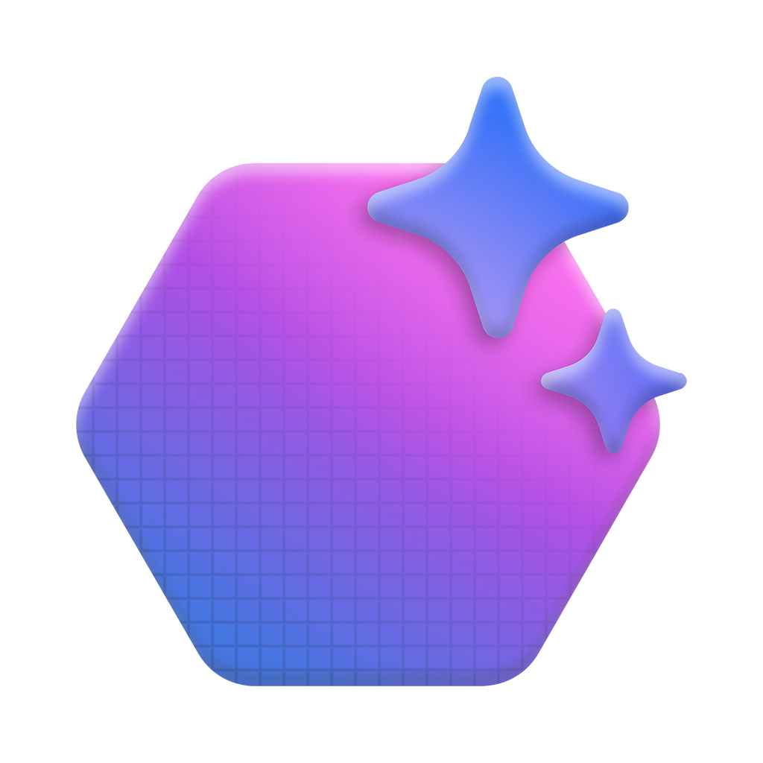





Azure Databricks and AI Foundry
Azure Databricks
Azure AI Foundry
Azure AI Foundry Project
Agent
VS Code
Unity Catalog
Genie Space
LLM
catadb360dev.golddb.nyc_yellow_taxi
Instructions
Open AI Models
Custom Function
ask_genie
Tools
Governed data for AI
Unity Catalog & Genie expose trusted data to AI Foundry.
LLM-driven analytics
Agents use tools and functions to query live data.
Clear responsibility split
Databricks governs data; AI Foundry builds and runs agents

Slide 10
ARCHITECTURE
How Databricks Genie connects to Foundry
Business User
Foundry Agent
Genie MCP
Server
Databricks
Genie Space
Unity Catalog
& Delta Lake
Natural language
question
AI orchestration
& reasoning
MCP protocol
tool endpoint
NL → SQL
translation
Governed data
at rest
NL Query
MCP Call
Genie API
SQL + Results
Key architecture points
No data leaves Databricks — queries execute in place, only results are returned to Foundry
Genie MCP Server runs as a serverless endpoint; no additional infrastructure required
Unity Catalog enforces row/column security automatically — the Foundry agent honours existing ACLs
Notes:
Genie space is a governed semantic workspace that teaches Genie how to answer business questions. Not just tables but the business understanding of the data. . You curate relationships, metrics, business definititions , example questions and trusted SQL patterns. the MCP server exposes Genie Spaces, not individual tables.

Slide 11
SETUP GUIDE
Setting it up in 4 steps
Create a Genie Space in Databricks
Enable the Genie MCP Server endpoint
01
In your Databricks workspace, open Genie and create a new space. Select the Unity Catalog tables you want to expose. Add business context and curated questions.
02
In Databricks workspace settings, enable the Genie MCP Server. Copy the endpoint URL and generate a personal access token (PAT) for authentication.
Add Genie as a tool in Foundry
Build your agent and test
03
In Azure AI Foundry, navigate to your project's Tool Connections. Add a new MCP connection using the Genie endpoint URL and PAT. Name it 'databricks-genie'.
04
Create a Foundry agent and add the Genie tool. Write a system prompt that tells the agent when to use Genie. Test with natural language queries against your data.

Slide 12
Best Practice for Optimizing Genie’s AI Performance
Data Quality is Fundamental
Clear Natural Language
Optimising Genie space configuration
Instructions for Business Context
Example SQL Queries (Structured definitions through SQL are more reliable and maintainable than plain text guidance.)
Custom SQL Functions
Iterative Refinement
Consider pre-materialised views
Curate an effective Genie Space | Databricks on AWS
Enhancing Databricks Genie with Advanced AI Capabi... - Databricks Community - 122152

Slide 13
Limitations
The Genie API enforces a rate limit of five questions per minute when called from Microsoft Foundry.
Design your agent prompts and user experience to avoid rapid sequential queries. If your scenario requires higher throughput, contact your Databricks account team to discuss options.
Genie spaces support up to 30 tables or views.
Prejoin tables into views/metric views if requiring more than 30 tables.

Slide 14
Cost
Microsoft Foundry charges for agent LLM call cost.
Azure Databricks charges for serverless SQL compute when Genie spaces execute queries.

Slide 15
Demo

Slide 16
LIVE DEMO
Ask your Databricks data from a Foundry agent
Demo flow
FOUNDRY AGENT
Show the Genie Space in Databricks — tables, context, and curated questions
Show the MCP Server endpoint enabled in workspace settings
Open Azure AI Foundry — show the Genie tool connection configured
Run the Foundry agent: ask "What were our top 10 products by revenue last quarter?"
Agent invokes Genie → Genie generates SQL → results returned to agent
Agent synthesises a natural language answer with citations back to the data
You : What were our top 10 products by revenue last quarter?
Tool : [Calling databricks-genie tool…]
→ Query: SELECT product, SUM(revenue) FROM sales…
→ Returned 10 rows from Unity Catalog
Agent: The top product was Product A at £4.2M, followed by Product B at £3.8M…
* Sample only — replace with your actual customer data

Slide 17
WHAT'S NEXT
Continue the series & try it yourself
Upcoming sessions in this series
Try it today
Set up a Genie Space on your Databricks workspace
Enable the Genie MCP Server endpoint
Connect it to your Azure AI Foundry project
Share your results in next week's session
June 29
Bring Fabric Data Agent into Foundry
July 6
Fabric MCP + Power BI MCP into Foundry
Use Azure Databricks Genie in Microsoft Foundry - Azure Databricks | Microsoft Learn
Li Ma | lima8@microsoft.com | Foundry Data Integration Series | June 22, 2026

Slide 18
Use case 2: Use Databricks tool to run operational actions

