Slide 1
Final project on figma restaurant design submitted by Halima Idris Haruna
August,2025

Slide 2
Materials use for the design
Html(hyper text markup language)
Css(cascading style sheets)
Internet
Laptop
Images

Slide 3
What are html and css
Html is the standard markup language for documents to be displayed in a web browser
It defines the content and structure of web content
It defines assisted by technologies such as css and javascript
The purpose is for structuring and formatting content on the web

Slide 4
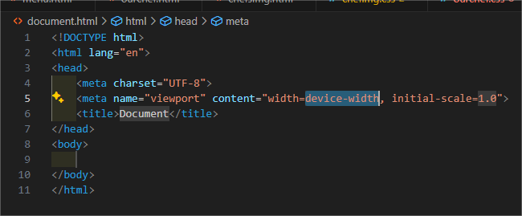
Basic html structure
Html document
Html tags use to define lements such as headings, pargraph, images and link
Examples are <h>, <p>, <img>,<a> etc

Slide 5
Css is use for styling and layout of web pages
Css layout properties are the padding, margin, width, height etc
Topography properties are the font size, font weight, text align, text decoration
Color properties are the color, background-color

Slide 6
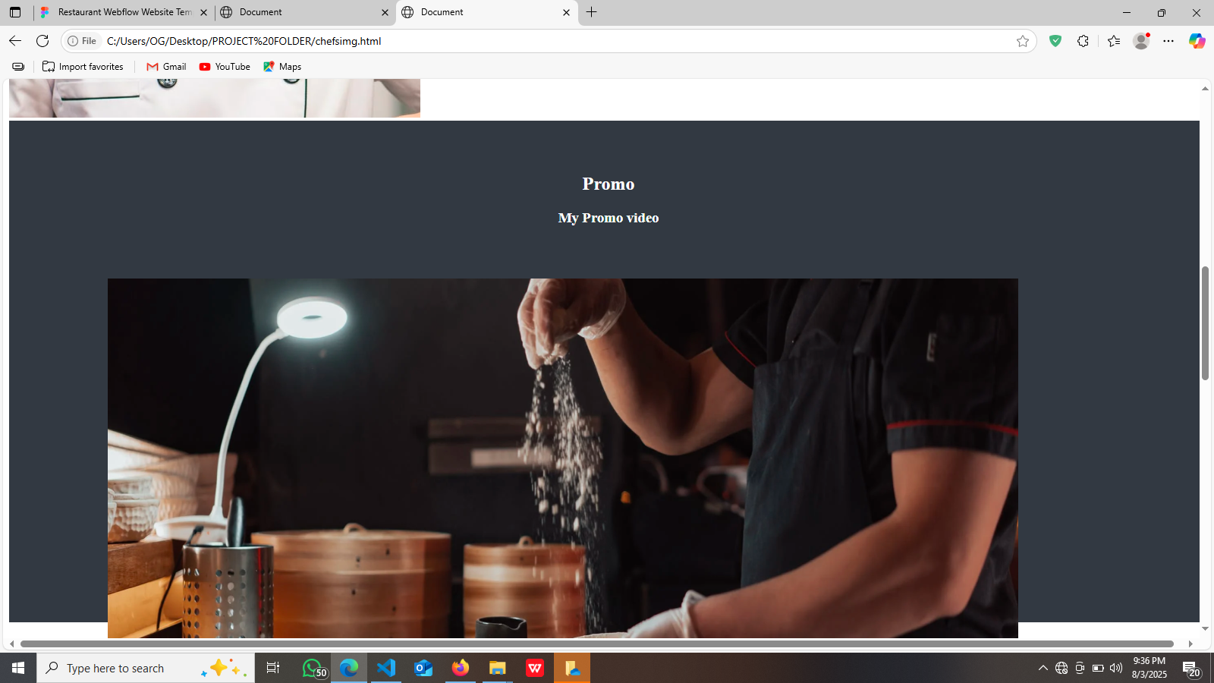

Slide 7
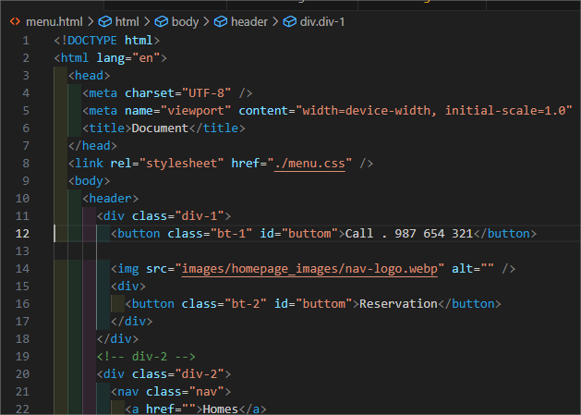

Slide 8
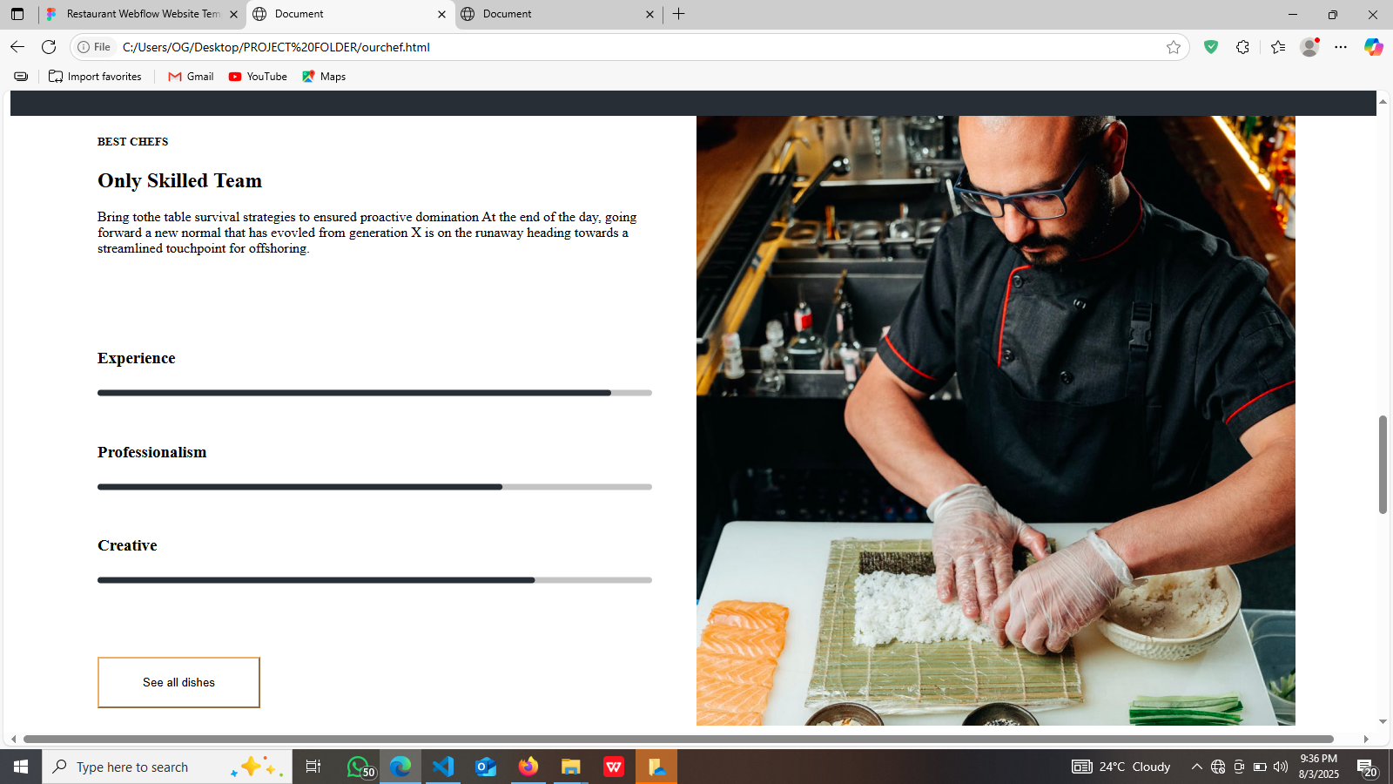
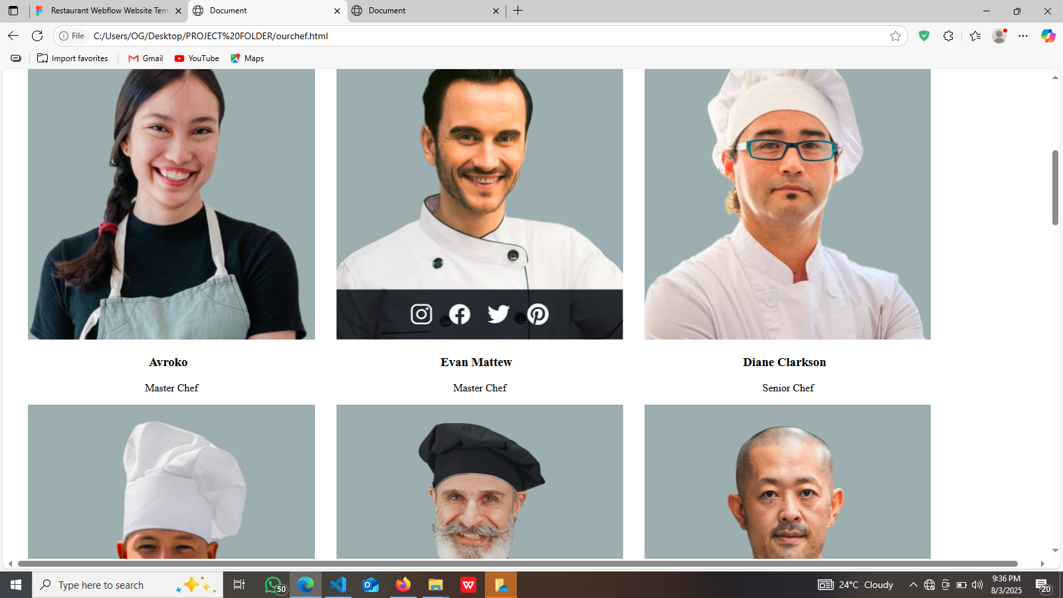
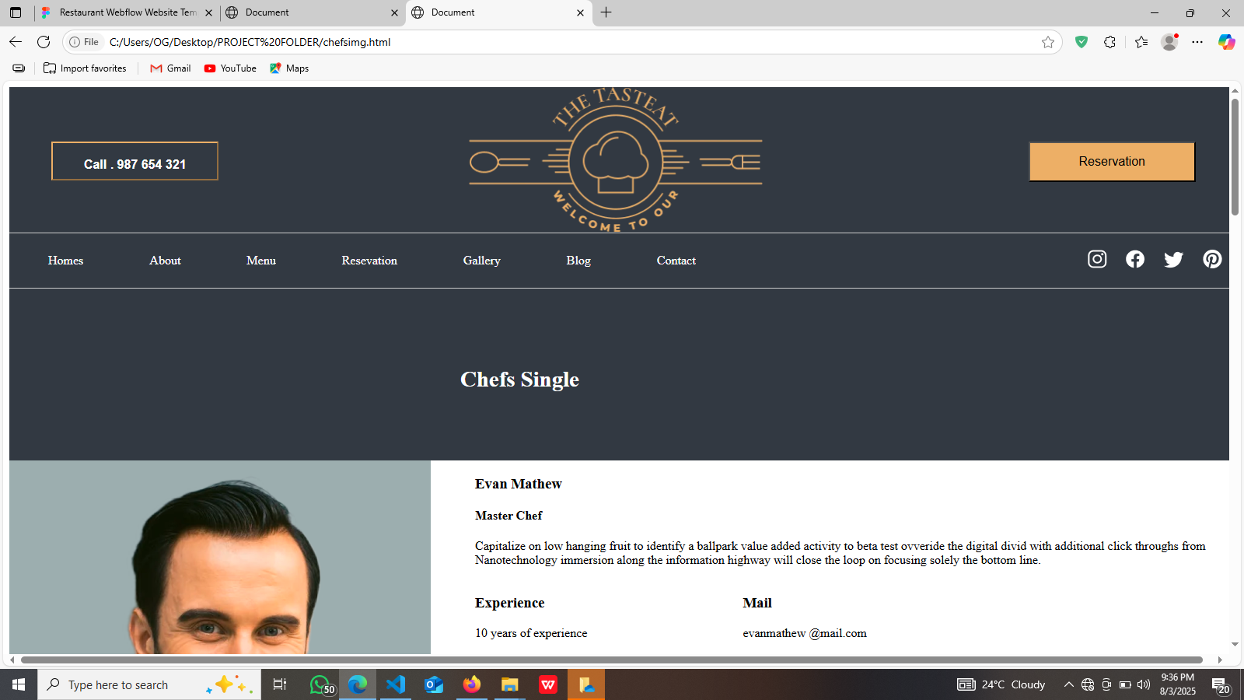

Slide 9
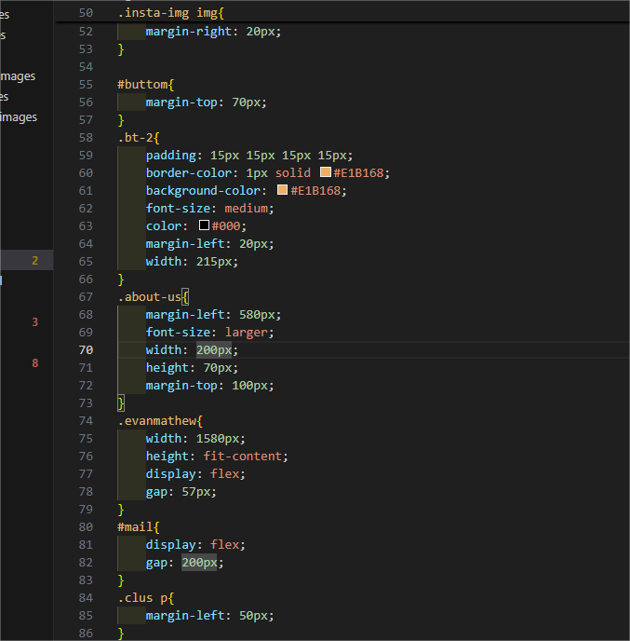

Slide 10
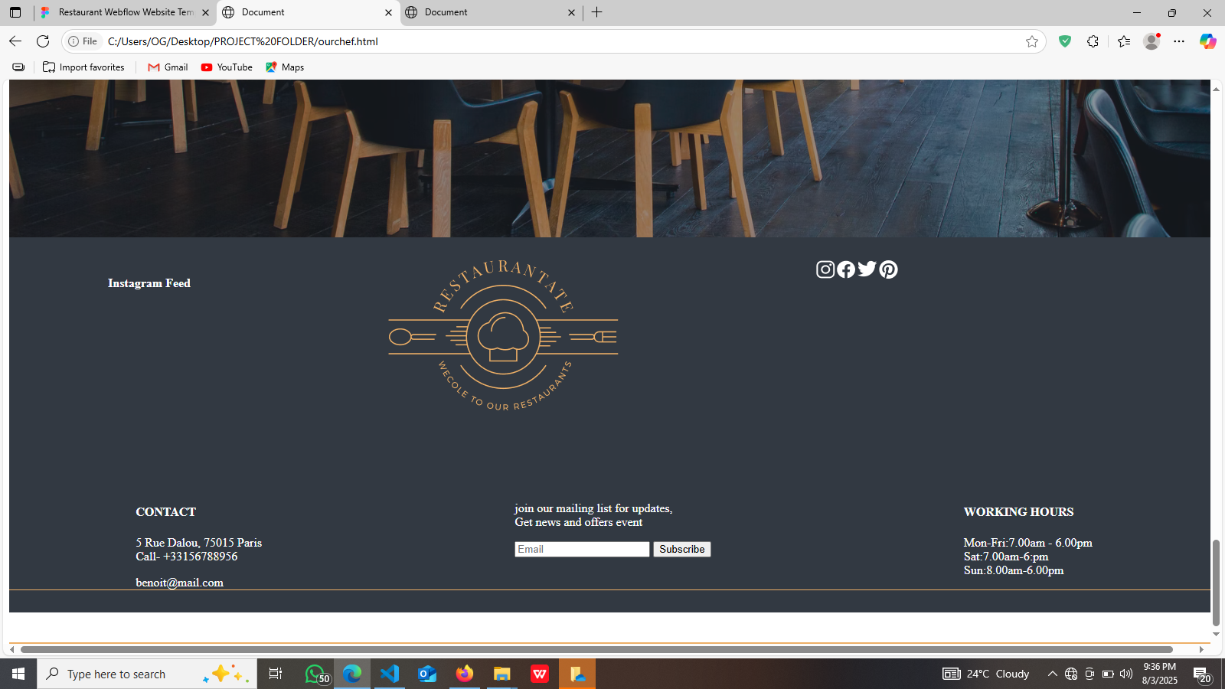

Slide 11
Thank You for listening

