Slide 1
“Mazer”
It’s a Blender add-on

Slide 2
Advantages
Can with just two mouse-clicks wrap 3d-model file into a static gazebo mesh
Not only generates labyrinths, but also allows to modify them
Allows to add other models to labyrinths, so they can be exported as a single mesh

Slide 3
Disadvantages
Blender is needed
For now supports only .stl and .fbx
Blender assets size is different from gazebos
Only three types of “labyrinths” for now

Slide 4
Step 1. Preparation.
Install Blender and add Mazer.py as an add-on

Slide 5
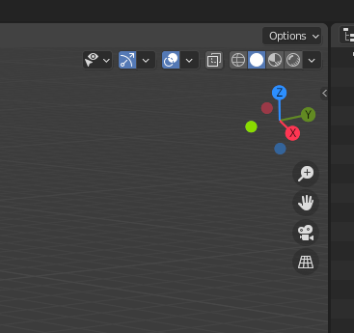
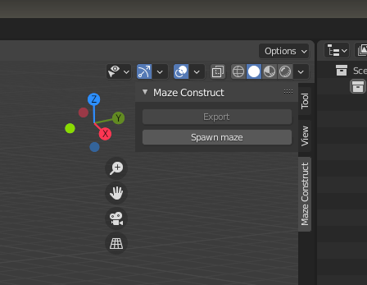
Step 2. Open Mazer
1
2

Slide 6
Step 3. Setup
Press “Spawn maze”
Select “labyrinth” type
Set desirable width and length
Press “OK”

Slide 7
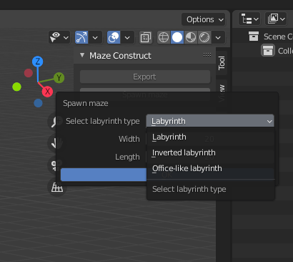
Step 3. Setup
2
3
1
4

Slide 8
Step 4. Edit spawned model
You can:
  move, scale and rotate “labyrinths”
  add 3d-models to the world
  delete/add specific wall in “labyrinths”

Slide 9
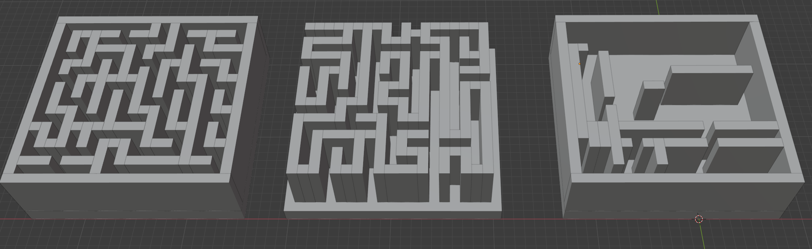
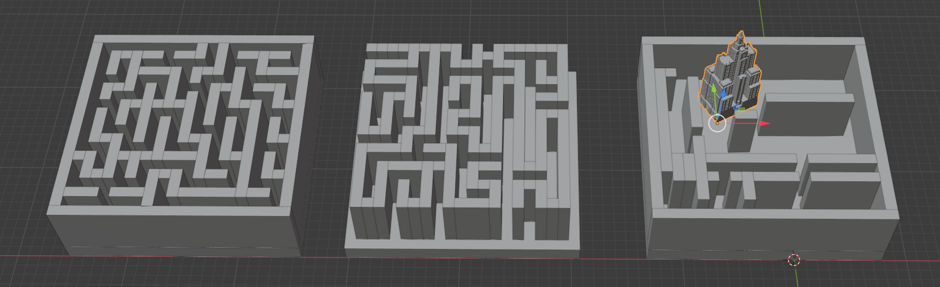
Step 4. Edit spawned model

Slide 10
Step 5. Export as Gazebo mesh
Just press “Export” button on “Mazer” plate and specify mesh location with a name for one

Slide 11
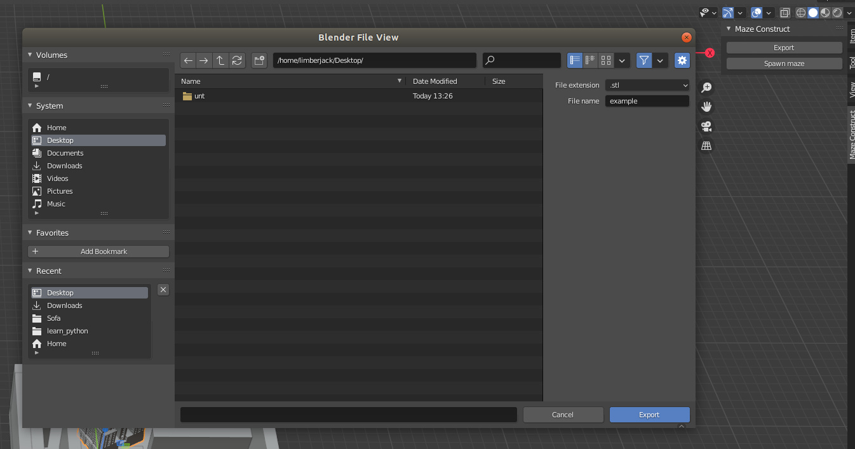
Step 5. Export as Gazebo mesh

Slide 12
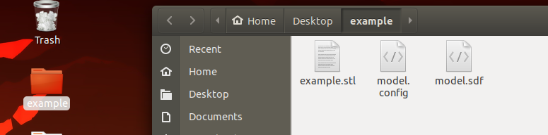
Step 6. Check if mesh was created

Slide 13
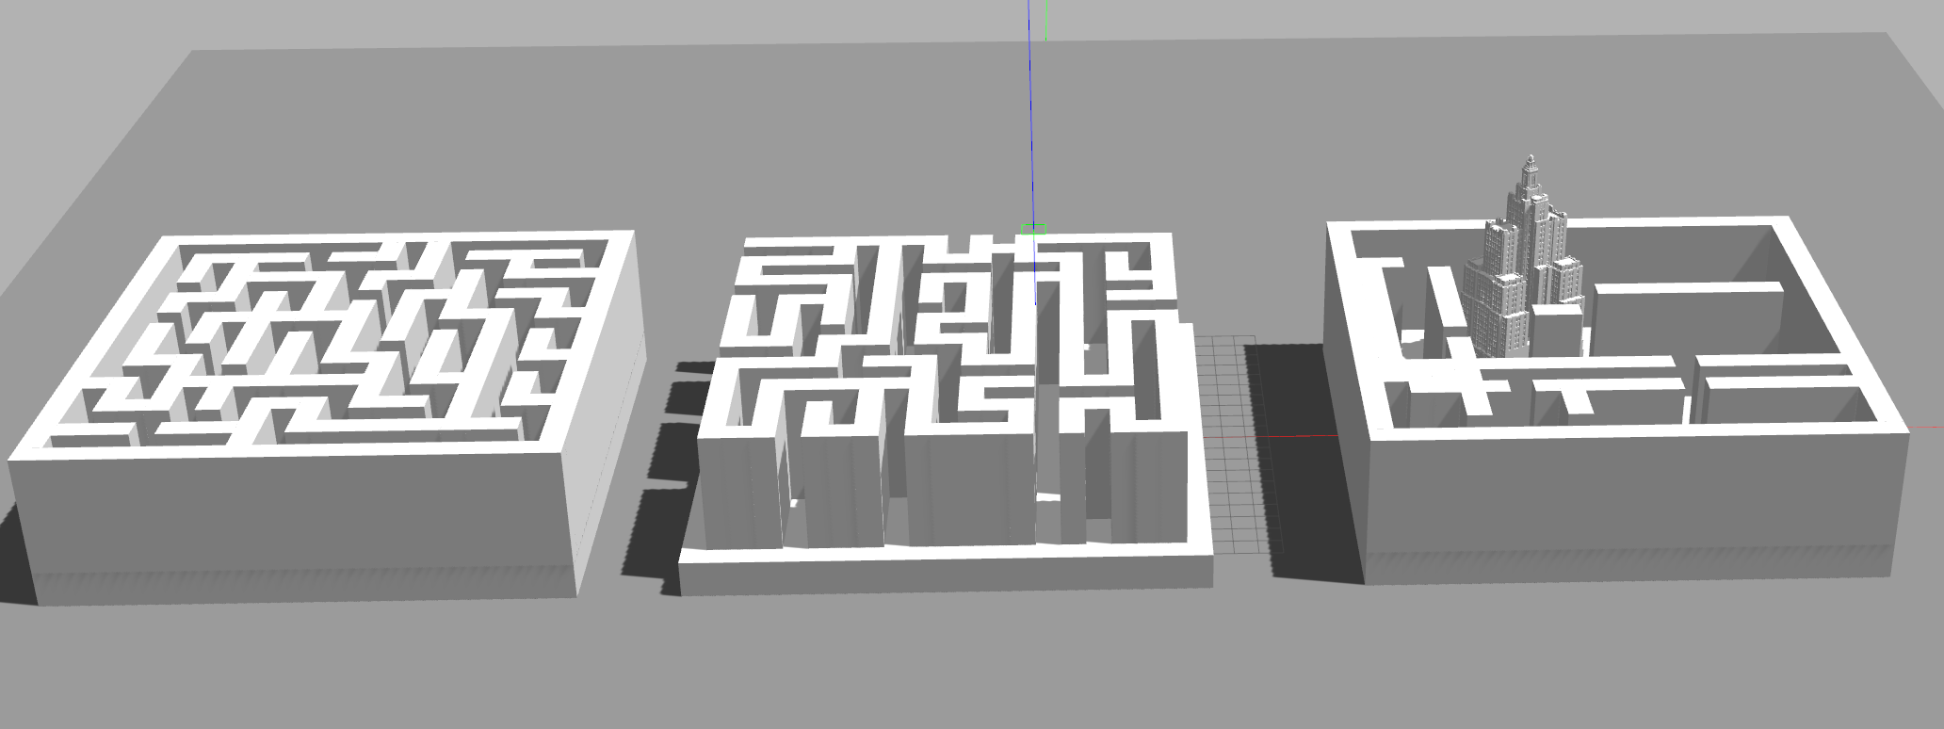
Step 7. Enjoy in Gazebo

