Slide 1
Ad Campaign Optimization using Machine Learning
Liam McCarthy

Slide 2
The Project Objectives
Demonstrate:
How machine learning can be or is applied to predict campaign elements
Notes:
The objective of this project is to demonstrate how machine learning is or can be applied to optimise and predict campaign performance and show how data driven decisions can enhance campaign performance.
Specifically, I have used simulated ad campaign data to replicate the machine learning process in campaigns on a smaller scale

Slide 3
An overview of campaign optimisation
Improving performance for better results
Learn what works, and what doesn’t
Deliver on objectives in the most effective manner
Machine learning takes the guesswork out of it
Notes:
The purpose of campaign optimisation is first and foremost to improve performance - we want to ensure we are delivering optimal results for our use of ad spend.
Optimisation helps to learn what works, and what doesn’t so we can continue to improve performance and applying that to the next campaign, or as running improvements to the current campaign.
We use optimisation to deliver on objectives- from the ad creative being used, to the targeting and even the level of budget being used to get the most effective results we can.
The role machine learning plays in that takes the guesswork out of it to drive real, actionable optimisations based on signals, data and predictive technologies

Slide 4
The process
Data Collection
Feature Engineering
Analysis
Machine Learning
Sourced a Facebook Ads data source from Kaggle. It needed to reflect a real campaign as close as possible
Reviewed the features I needed, calculated additional features and processed the data ready for ML applications
Analysed the data to review relationships, visualise and which variables are most likely to deliver results
Applied machine learning models, evaluated and optimised

Slide 5



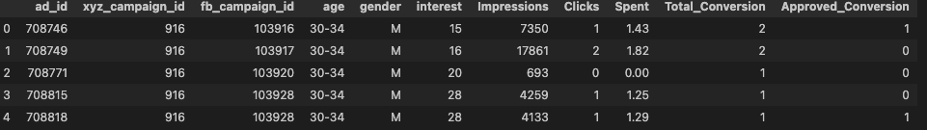
The data
Notes:
I sourced facebook ads data from Kaggle to replicate real campaign data you’d find in an ad platform, downloaded as a csv and read into python pandas.
Within the structure, I needed to identify the target variables and independent variables that would make up the predictions and optimisations.
For the Facebook data, we have impressions (the number of times the ad was seen), clicks (number of clicks on the ad), amount spent, total conversions (we’ll call these leads), and approved conversions (sales). Also featured are targeting features such as age groups, and interest category (coded in this instance).
What I would be looking for here is relationships between the variables, for instance correlation between the number of impressions to the number of conversions, is a particular age bracket or interest group driving higher performance than another, or will increasing spend drive more results.

Slide 6
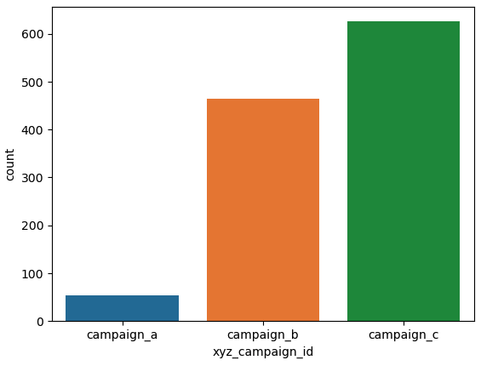
Considerations
Relationships between variables
Scale of data
Accuracy of the target variables
Notes:
Some considerations within this:
The relationships between any of the features might be specific to this dataset and will likely change in a real world situation such as different (or broader) age groups, interest targeting, number of ads or campaigns running or even total budget, and does not represent patterns in other datasets or platforms.
I am working with a one-off data set of 1,143 rows, where a live dataset could be working with significantly higher volume of variables which could alter the outcomes, and have a much larger base to work from with more conversions, higher spends or a greater number of different campaigns and ads.
The data would only be as strong as its source, such as if there were any accuracy errors in tracking conversions or non-human interactions inflating the clicks or impressions (ad fraud detection). The size of the available users in each of the age brackets or gender groups (for example this data set may have only been targeting ages 30-44) may also lead to biases.

Slide 7
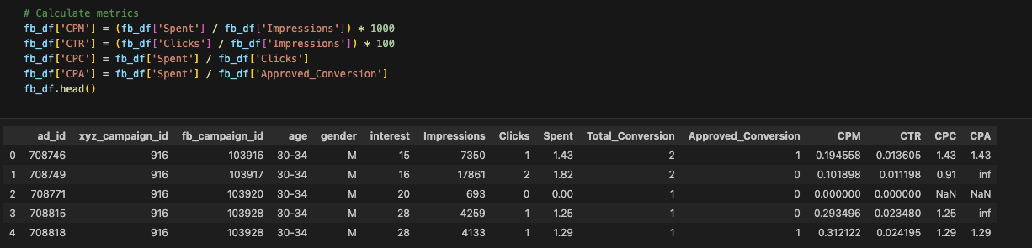
Feature engineering
Calculating additional performance metrics
Replacing NaN and inf values with 0
Identifying the influencing features impacting campaign performance
Notes:
The data didn’t have metrics for cost per click, cost per thousand impression, cost per conversion or click through rate which are key performance indicators for benchmarking and could influence how a campaign performs. These are key variables for optimisation that can indicate a trend or pattern so have been calculated into the data.
I then needed to replace the inf and NaN values for those not divisible by 0 for a clean data source and have a clear view of all the key influencing factors

Slide 8
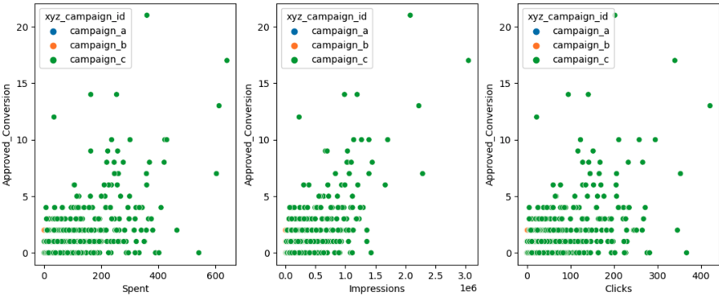
Influencing features
Notes:
The most influencing features for the prediction are the relationships between spend, clicks, impressions and their impact on conversions

Slide 9
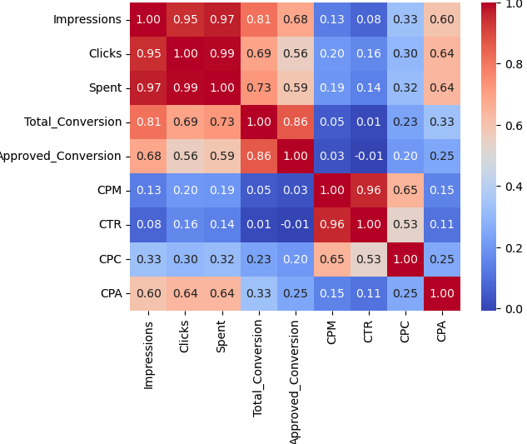
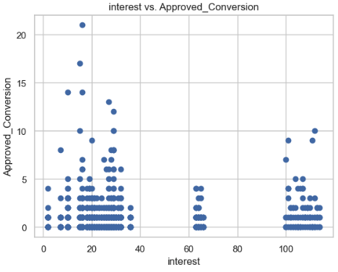
Quick analysis
Notes:
Reviewing and analysing the data
Within this data set, there appears to be a strong correlation between impressions and total conversions as well as a correlation between spend and impressions or clicks
We can also see that all three (impressions, spend, clicks) follow a similar pattern when it comes to delivering approved conversions - which is not unexpected.
I also looked at factors such as age, gender and interest grouping to see if there were any obvious patterns, which surprisingly most of these followed a similar pattern which may or may not have been due to the type of data

Slide 10
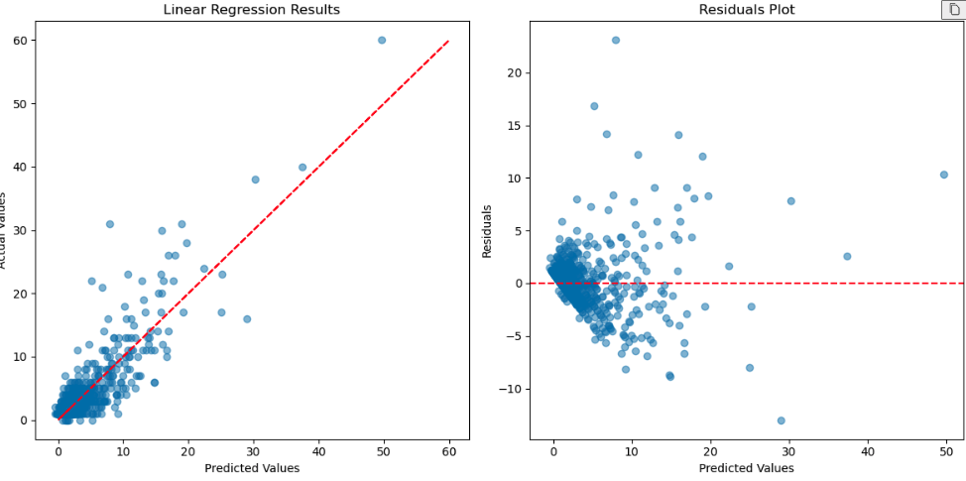
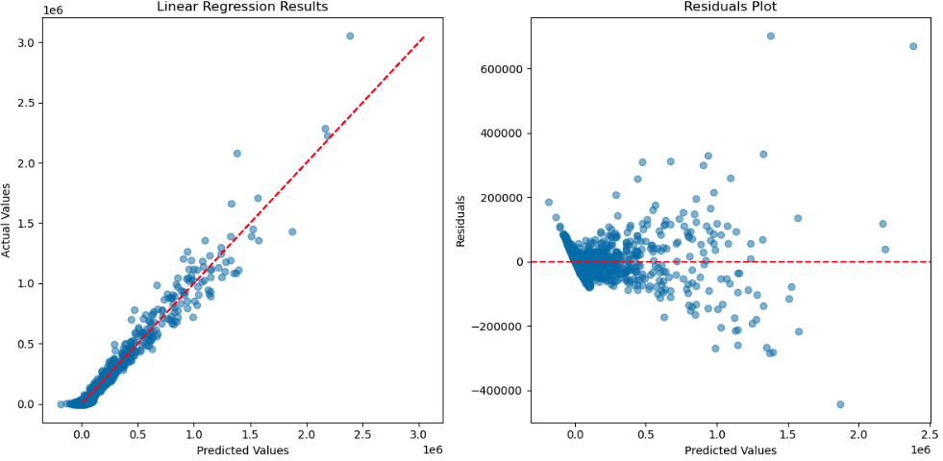
Machine Learning: OLS Regression
Predicting impressions, spend or conversions
Optimising based on scaling budgets and greater eyeballs
Notes:
Used Ordinary Least Squares regression to predict the relationships between the dependant and independent relationships. I have used it to analyse and predict three key data points: impressions and conversions.
In both instances, the clusters are reasonably close to the regression, indicating the predictions are relatively close to the actuals which suggests a strong linear relationship between the variables.
Most interesting though, was that within this data set there was a negative coefficient between spent and total_conversions which would indicate diminishing returns - as the spend becomes higher it will become less efficient at delivering conversions possibly due to ad fatigue or reaching less relevant audiences. There was a positive coefficient with impressions, clicks and CPM though, which indicates as the clicks and impressions increase, the likelihood of conversions does to, though as the cost per click gets higher it will have an impact.
However, when predicting impressions, there was a positive coefficient with spend, indicating as the spend increases so will the impression volume.

Slide 11
Conclusion
Significant amounts of data are needed to deliver effective results
Machine learning can lead to better, data-driven outcomes
Both linear and non-linear relationships need to be taken into consideration
Notes:
There’s a reason platforms tend to use a threshold when it comes to their own machine learning algorithms - a lot of historical data is required. This dataset was a one off export that had no time series or even time frame to work within.
There are a multitude of different applications available for different uses within a marketing campaign. We can use it for precise predictions,as explained here where we can look at potential performance and even forecasting. By using continuous learning across historical data, we can develop patterns and drive accurate modelling to effectively predict future performance in real time or make adjustments in real time. But most importantly, we can make informed business decisions with the tools to have better outcomes.
While clicks, impressions and spend can have a linear relationship to the delivery of conversions, there are also non-linear factors at play such as click through rates, user behaviour and factors outside of spends and eyeballs - particularly when it comes to the creative optimisation.

