Slide 1
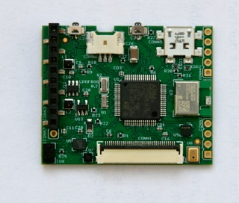
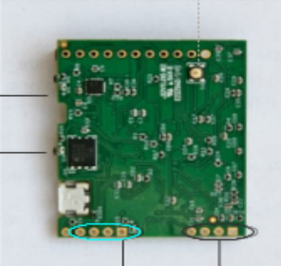
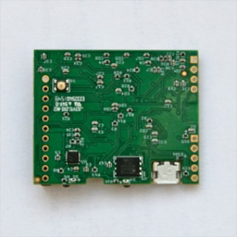
TOP VIEW
OLED Display
Connector
Extension Port
Position 1: digital GPIO (PA6)
Position 2: digital GPIO (PA4)
Position 3: digital GPIO (PA3)
Position 4: digital GPIO (PA2)
Position 5: VCC_LDO (OFF or 3.3V)
Position 6: digital GPIO (PA1)
Position 7: digital GPIO (PA0)
Position 8: GND
Position 9: digital GPIO (PB8)
Position 10: digital GPIO (PB9)
STM32
SWD
interface
#1: VCC
#2: GND
#3: SWCK
#4: SWDIO
#5: external
ON/OFF
USB Connector
ON/OFF
Push-Button Switch
General Purpose
Push-Button Switch
Battery Connector
LED D4
LR VH9F-P2R1-1-Z
RED
Controlled by MCU
LED D1
LA VH9F-Q1R2-24-Z
AMBER
USB charging indicator
(ON if USB power applied)
STM32 SWD interface
BLE Module
SWD interface
Manual reset
push-button switch
BOTTOM VIEW

