Slide 1

Importing Road-Network from OSM into AIMSUN
Satya
PhD Candidate
Intelligent Vehicles and Systems Group
szm888@psu.edu

Slide 2
Open Street Maps
Road networks are imported from OSM
Import only road network in the Region Of Interest
The coordinate system is set automatically as a projected UTM zone using WGS 84
EPSG:32617 is used for I99
Remove unnecessary layers
Remove irrelevant sections
Ensure continuity of sections
https://www.penndot.gov/ProjectAndPrograms/Planning/Maps/Pages/Traffic-Volume.aspx

Slide 3
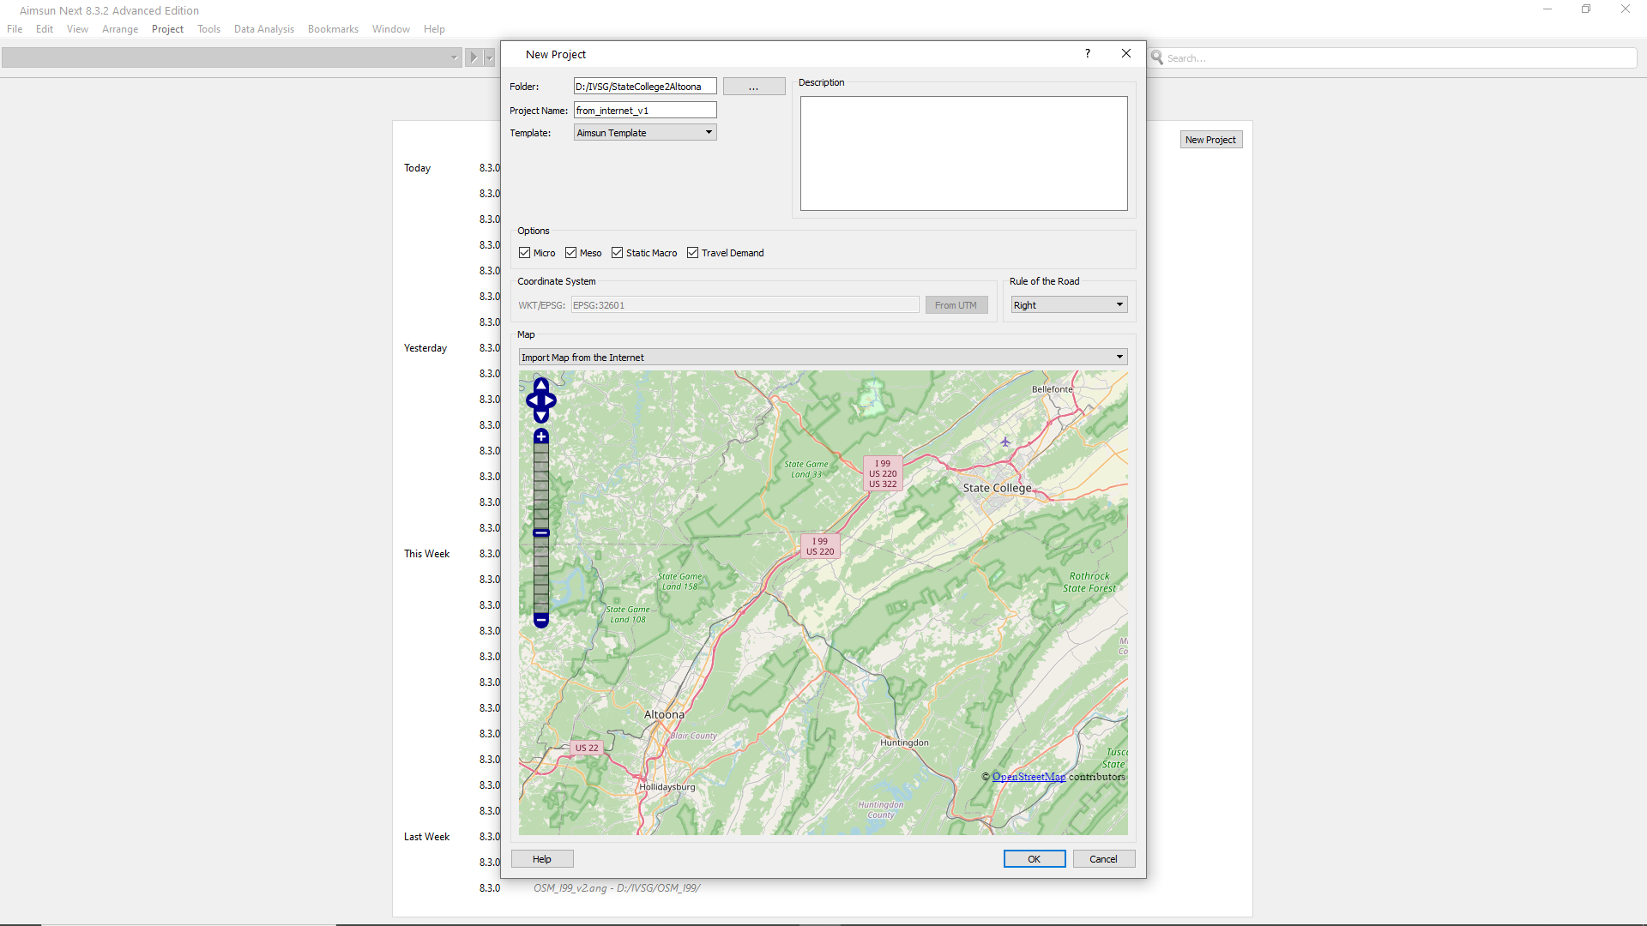
Select the Region Of Interest

Slide 4
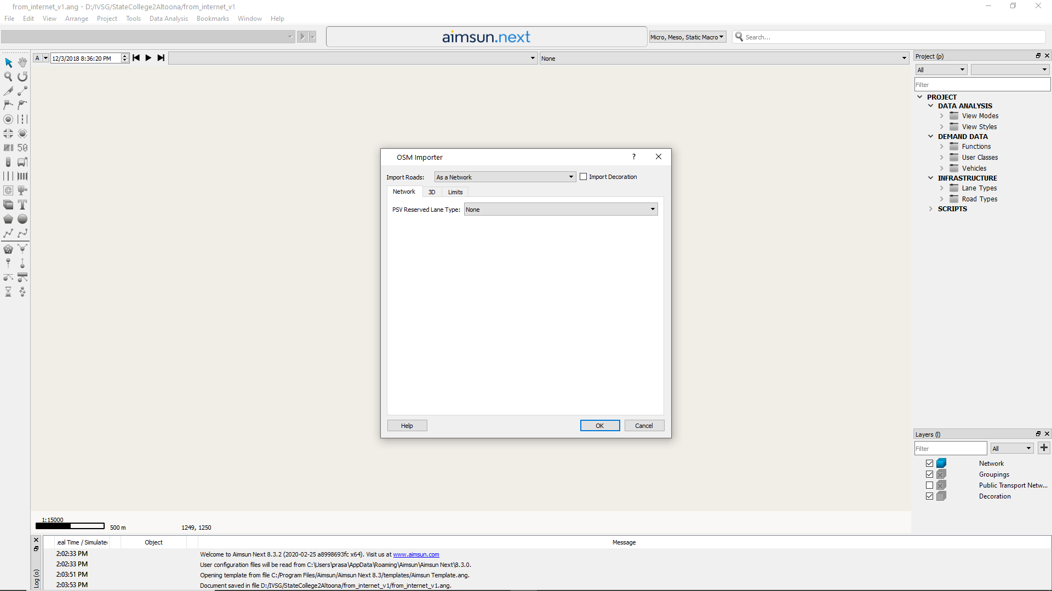
Import only network

Slide 5
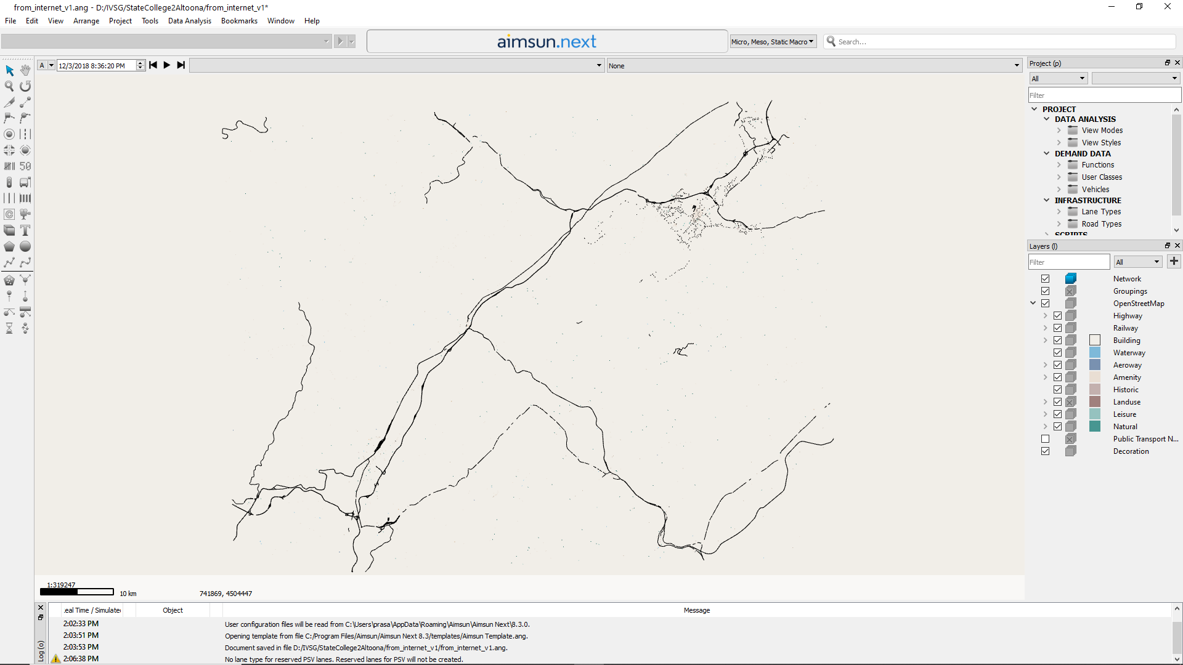
OSM consists of different layers

Slide 6
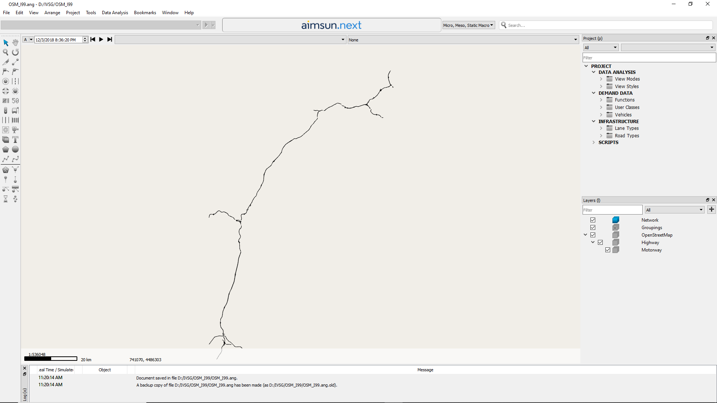
Remove every layer except Highway/Motorway

Slide 7
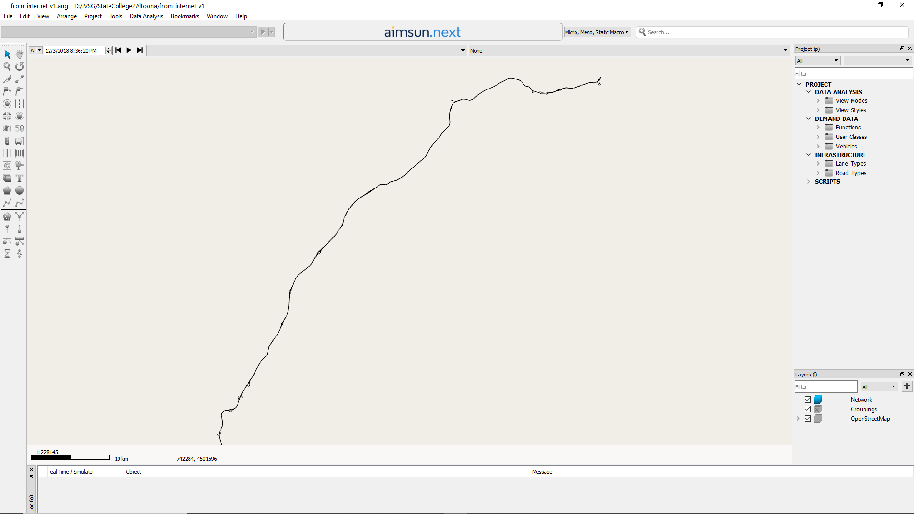
Delete irrelevant sections and Ensure the continuity of remaining sections
State College
Altoona

