Slide 1

ITE441 GROUP 7 LIBRARY ER DIAGRAM
Sopon Moleechat 1801240013
Korakrod Thammajaree 1802190002
Francis Punnawit Bergmans 1901160018

Slide 2

What are the features?
Acquisition Module
is the provision of various types of information resources,
including books, journals, booklets, newspapers, audiovisual materials, digital information databases,
as well as information created by the organization itself to the library for user service. Through a variety
of methods such as purchasing, requesting and accepting donations exchange or subscription

Slide 3
Online Public Access Catalog (OPAC Module)
Online publications search service. That facilitates users to access the information resources they need quickly.
Borrowing service - return Information resources (Circulation Module) Services related to library service users directly,
such as borrowing-back transactions (Check in-Check out), Renewal transactions,
information resource reservation transactions (Hold), demand for collection. Manage fines, etc.

Slide 4
Entity Relations
Relationships between entities base hed relationship borrowed It's a one-to-many relationship. Between the employee entity and the member entity, as one employee may contact more members One member, where only one employee contacts one employee. reception relationship It is a one-to-many relationship between the Employee and Book entity As one employee may accept multiple books. and many books Must be picked up by one employee only. Purchase relationship It is a one-to-many relationship between the Employee and Book purchase order entity This is because one employee may write multiple orders for books. and book orders One bill will only come from one salesperson.

Slide 5
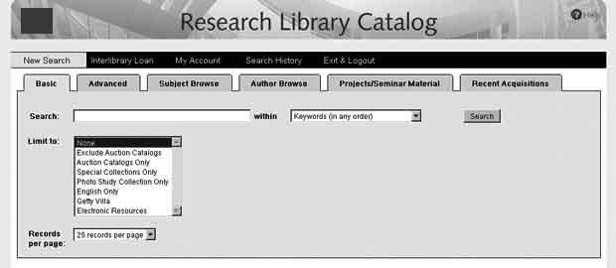
Interface

Slide 6
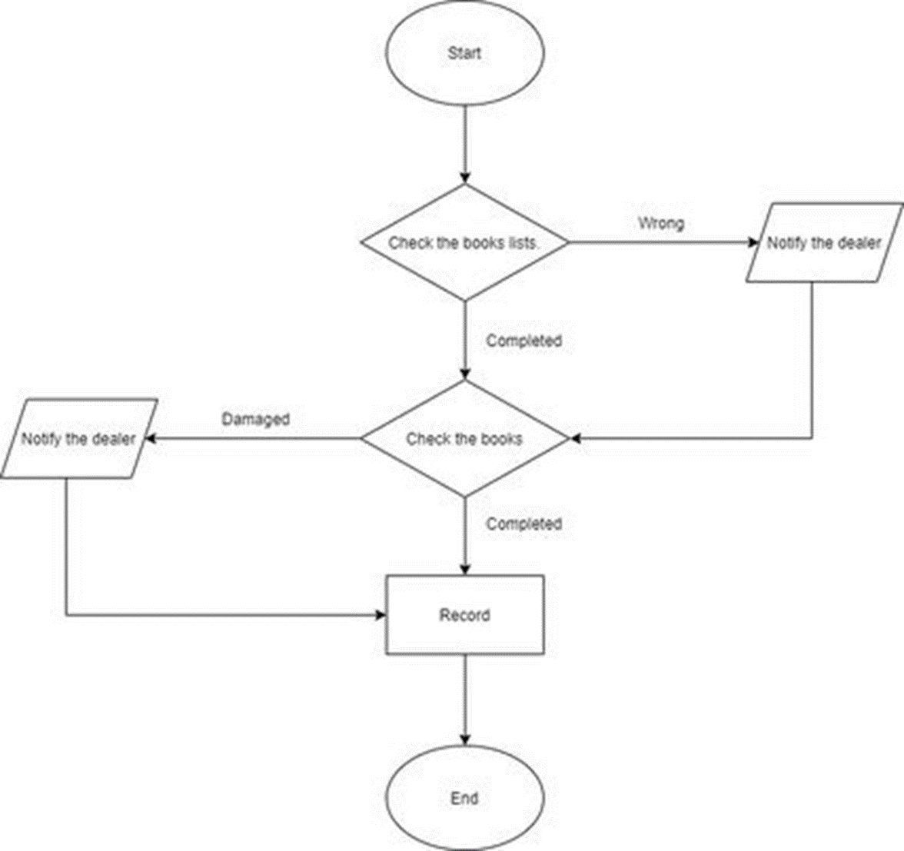
Getting the book

Slide 7
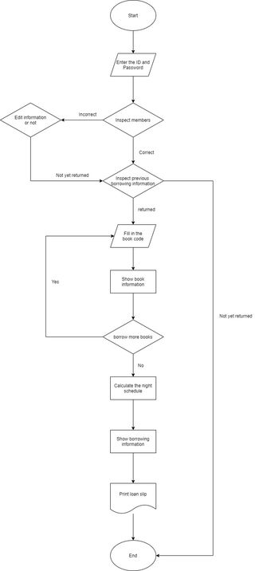
Borrowing

Slide 8
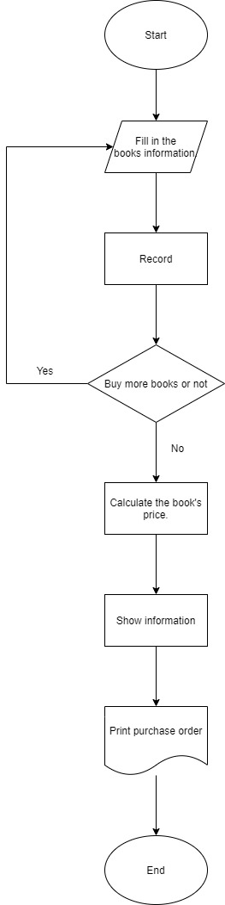
Order

Slide 9
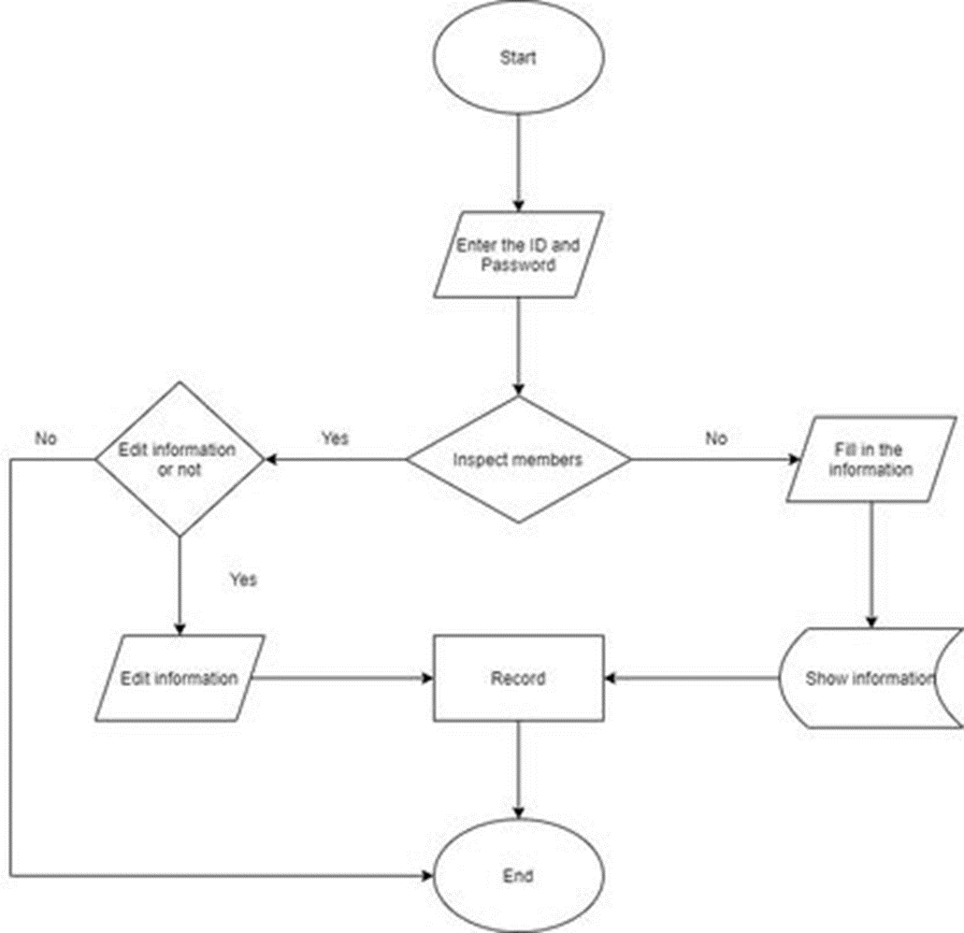
Subscription

Slide 10
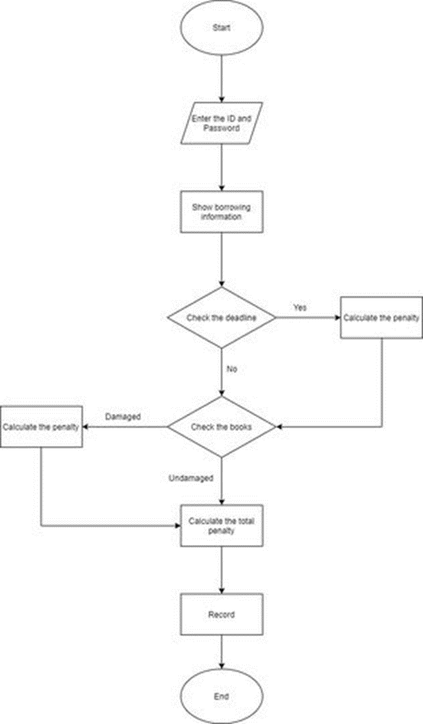
Return

Slide 11
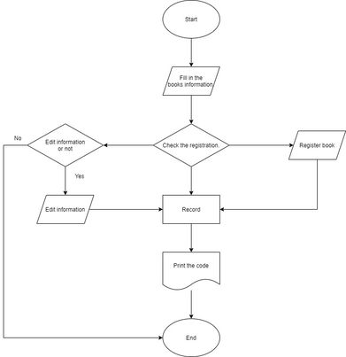
Registration

Slide 12
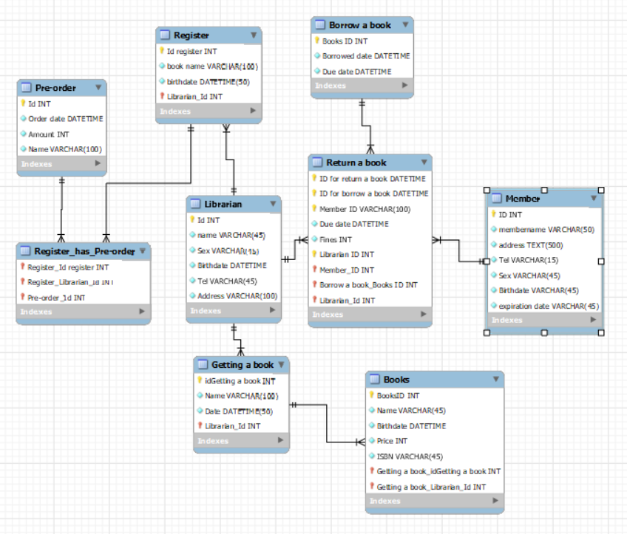
EER diagram

