Slide 1
Virtual Private Network (VPN) Project
IK2206 HT 2016
Kim Hammar
Konstantin Sozinov

Slide 2
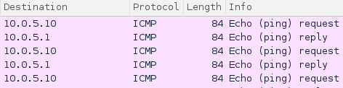
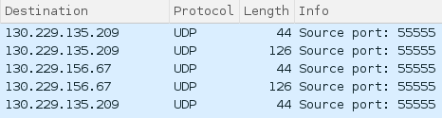
Tunneling Basics
We use TUN/TAP virtual interface to let us attach the miniVPN to the interface and perform tunneling on all packets traversing that interface. Essentially it constitutes as a type of middleware between the physical network interfaces and programs in user space. When tunneling we utilize this intermediate level to encapsulate and decapsulate IP packets and to perform certain security services.
Tunnel-messages are decapsulated by miniVPN and then piped to TUN/TAP Tunneled UDP messages arriving on the to the real physical interface (e.g wlan or eth0). and appear to the application as coming directly from the network.

Slide 3
Things to consider
Why use UDP as transport protocol for the Tunnel?
- UDP can provide better performance. Even if you don’t care about performance and like the idea of an extra layer of reliability with the mechanisms that TCP provides, you are better of using TCP wrapping the packets inside the tunnel than sending the whole tunnel inside TCP. TCP on top of TCP can cause many problems, it was not something that the designers of the protocol had in mind. (http://sites.inka.de/bigred/devel/tcp-tcp.html)
Where to place the tunnel end-points?
- We have examined Host-to-Host, Host-to-Gateway and Gateway-to-Gateway. Really there is no right or wrong here, it depends on the situation. If you trust your internal network Gateway-to-Gateway is an attractive choice since it reduces the amount of configuration necessary compared to number of hosts.

Slide 4
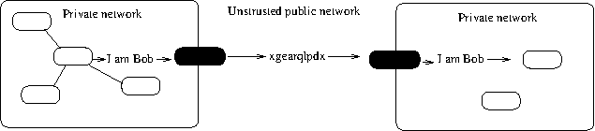
Securing the Tunnel
Confidentiality: Encryption with AES256 (256 bit key, 128 bit IV)
Integrity: Using MAC codes generated with HMAC256
Key exchange: Using a TLS/SSL secure channel for exchanging keys and IV’s.

Slide 5

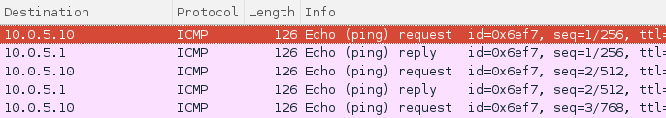
Secure tunnel
Decoding the UDP stream on physical interface to see content that is encapsulated in the tunnel (traffic is ICMP ping).
Encrypted tunnel vs Plaintext tunnel

Slide 6
Things to consider
What ciphers are suitable for this type of tunnel?
Due to performance reasons it is desirable to encrypt bulk data with symmetric ciphers, like AES-256. Exchanging private keys for symmetric encryption is difficult, a common and well-proven solution is to use asymmetric encryption for exchanging keys, like SSL/TLS does.
Should MAC be computed based on cipher or plaintext ?
You could compute MAC on either plaintext or ciphertext. For miniVPN we chose to compute MAC based on the ciphertext, with the reasoning that under the assumption that the cipher have no visual relationship with the plaintext, then the MAC won’t either.
Why is the random number generation important in the miniVPN architecture?
Keys and IV are generated from a random bytestream, an adversary should not be able to predict the Key/IV.

Slide 7
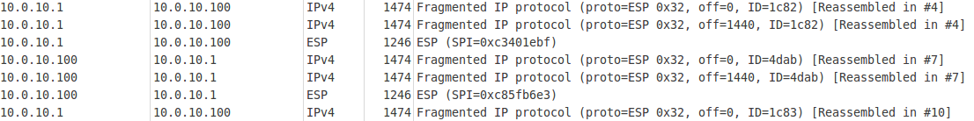
StrongSwan
Configuration: Security is achieved by using the ESP protocol with AES-128 (complies with the Strong Cryptography definition at https://www.pcisecuritystandards.org/pci_security/glossary) and IKEv1 for key exchange.
Wireshark capture:

Slide 8
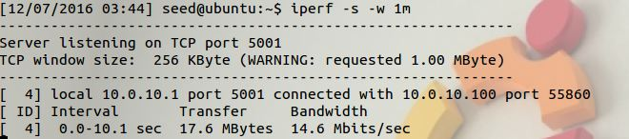
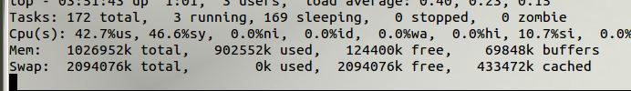
Simple stress testing - Strongswan IP sec
Iperf test with 1 megabyte:
Cpu raised from 0.2% to 42.7% on the server:

Slide 9
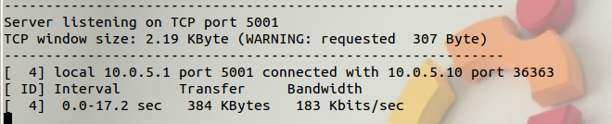
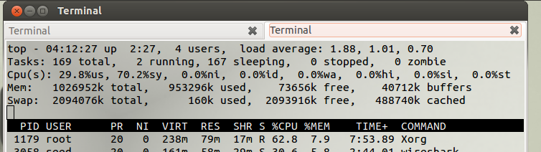
Simple stress testing - miniVPN
Iperf test with 0.3kbyte (Our miniVPN implementation limits window size it can handle due to manual MAC/Encryption):
CPU 30%

Slide 10
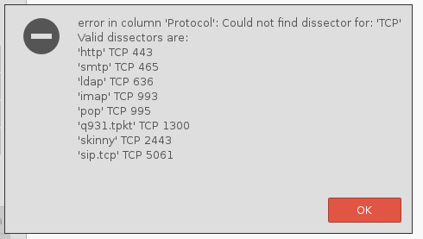
Decrypting traffic from wireshark (Task 3.8.3)
Wireshark only support decryption of certain protocols but not for the secure channel used inour miniVPN solution, i.e TLS/SSL over raw TCP connection.

Slide 11
Conclusions
Setting up your own secure VPN takes many more times longer than using a solution like StrongSwan.
The openSSL library which is open for anyone gives you alot of power at your hands to craft your own secure solutions. In this lab we constructed i miniVPN with a quite ad-hoc architecture (manual decryption/encryption over UDP and TLS/SSL channel for exchanging secrets), in a more serious setting it is probably recommended to use more established architectures.

