Slide 1
Cohen‘s kappa

Slide 2
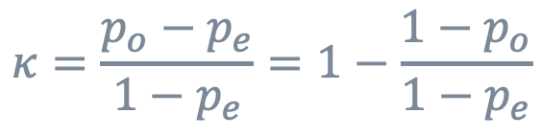
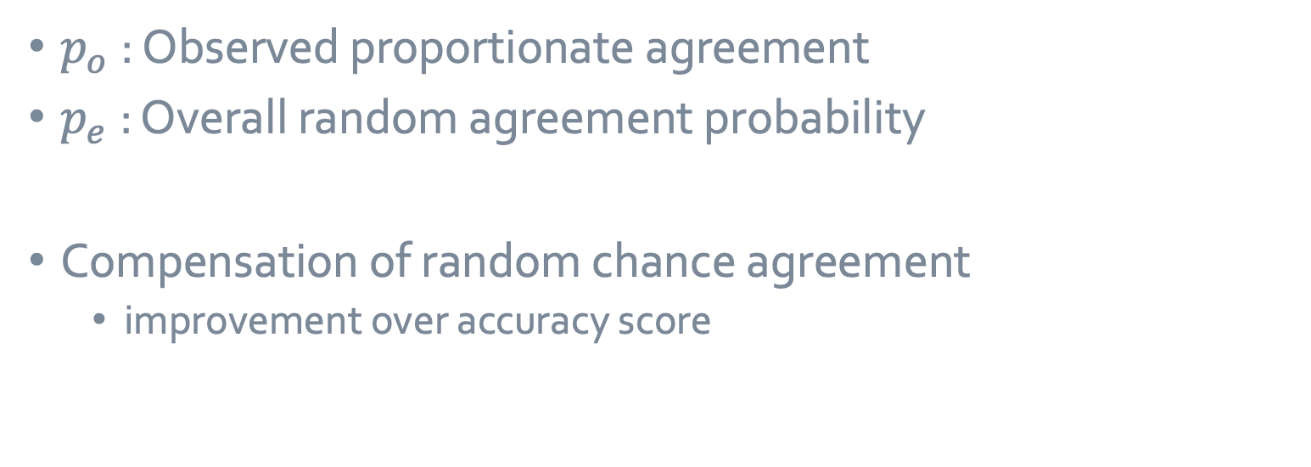
1 unweighted Cohen‘s kappa
$$κ=\frac{p_{o}−p_{e}}{1−p_{e}}=1−\frac{1−p_{o}}{1−p_{e}}$$
$p_{o}$: Observed proportionate agreement
$p_{e}$: Overall random agreement probability
Compensation of random chance agreement
improvement over accuracy score
https://www.datanovia.com/en/lessons/cohens-kappa-in-r-for-two-categorical-variables/
J. Cohen, Educational and Psychological Measurement, 1960, 20, (1), 37-46

Slide 3

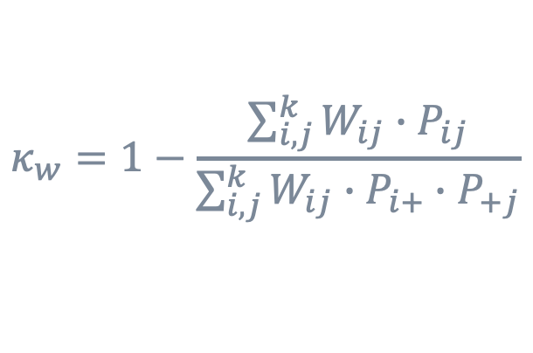
2 weighted kappa
$$κ_{w}=1−\frac{\sum_{i,j}^{k}{W_{ij}∙P_{ij}}}{\sum_{i,j}^{k}{W_{ij}∙P_{i+}∙P_{+j}}}$$
weight matrix W : values from 0 to 1
proportion matrix P : contigency table normed with N
Weight quantifies the deviation from the actual value
For categories in an order
e.g. solubility prediction
difference | Linear weight
0 | 0
1 | 1/3
2 | 2/3
3 | 1
https://www.datanovia.com/en/lessons/weighted-kappa-in-r-for-two-ordinal-variables/

Slide 4
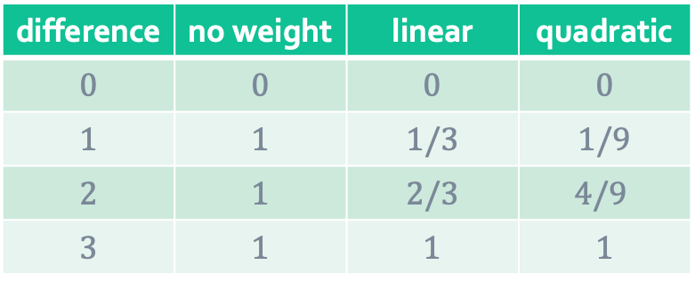
2.1 choosing the weighting system
difference | no weight | linear | quadratic
0 | 0 | 0 | 0
1 | 1 | 1/3 | 1/9
2 | 1 | 2/3 | $$\text{4/9}$$
3 | 1 | 1 | 1
Choice depends on the importance of each category difference
linear: same importance
quadratic: far larger influence of greater deviation

Slide 5
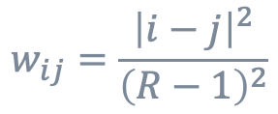
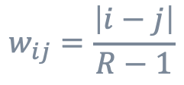
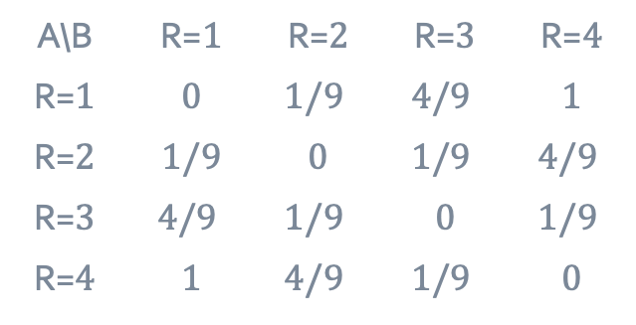
2.2 linear and quadratic weighted kappa
Cicchetti-Alson: linear weighted
$$w_{ij}=\frac{\left|i−j\right|}{R−1}$$
Fleiss-Cohen: quadratic weighted
$$w_{ij}=\frac{{\left|i−j\right|}^{2}}{{\left(R−1\right)}^{2}}$$
Example of linear weights
Example of quadratic weights
A\B | R=1 | R=2 | R=3 | R=4
R=1 | 0 | 1/3 | 2/3 | 1
R=2 | 1/3 | 0 | 1/3 | 2/3
R=3 | 2/3 | 1/3 | 0 | 1/3
R=4 | 1 | 2/3 | 1/3 | 0
A\B | R=1 | R=2 | R=3 | R=4
R=1 | 0 | $$\text{1/9}$$ | $$\text{4/9}$$ | 1
R=2 | 1/9 | 0 | $$\text{1/9}$$ | $$\text{4/9}$$
R=3 | $$\text{4/9}$$ | $$\text{1/9}$$ | 0 | $$\text{1/9}$$
R=4 | 1 | $$\text{4/9}$$ | $$\text{1/9}$$ | 0
https://www.datanovia.com/en/lessons/weighted-kappa-in-r-for-two-ordinal-variables/

Slide 6
Appendix

Slide 7
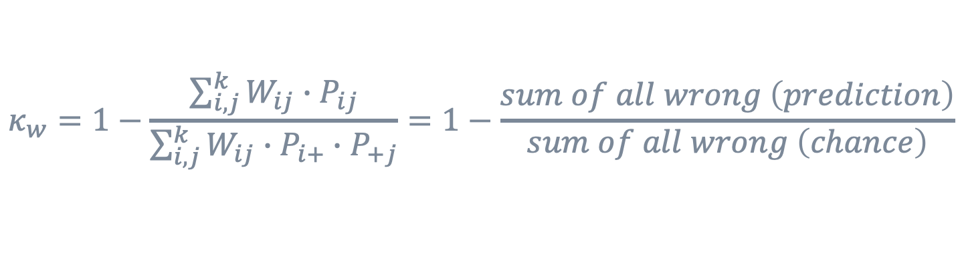
3 semi-mathematical derivation
Unweighted Cohen‘s kappa:
$$κ=\frac{p_{o}−p_{e}}{1−p_{e}}=1−\frac{1−p_{o}}{1−p_{e}}=1−\frac{1−right\left(prediction\right)}{1−right\left(chance\right)}=1−\frac{wrong \left(prediction\right)}{wrong \left(chance\right)}$$
Weighted Cohen‘s kappa with unweighted weight matrix
$$κ_{w}=1−\frac{\sum_{i,j}^{k}{W_{ij}∙P_{ij}}}{\sum_{i,j}^{k}{W_{ij}∙P_{i+}∙P_{+j}}}=1−\frac{sum of all wrong \left(prediction\right)}{sum of all wrong \left(chance\right)}$$

Slide 8
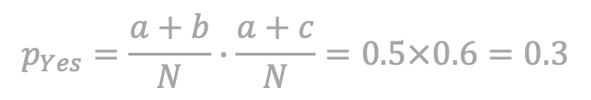
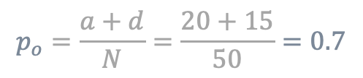
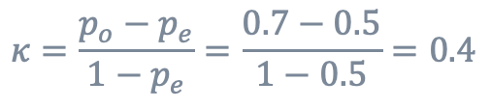

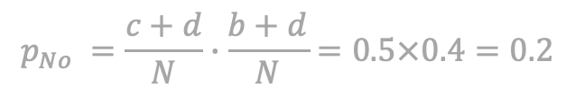
4.1 simple examples, unweighted
Observed proportionate agreement:
$$p_{o}=\frac{a+d}{N}=\frac{20+15}{50}=0.7$$
$$p_{Yes}=\frac{a+b}{N}∙\frac{a+c}{N}=0.5×0.6=0.3$$
A\B | Yes | No
Yes | a = 20 | b = 5
No | c = 10 | d = 15
Overall random agreement probability:
$$p_{No} =\frac{c+d}{N}∙\frac{b+d}{N}=0.5×0.4=0.2$$
$$p_{e}=p_{Yes}+p_{No}=0.3+0.2=0.5$$
Cohen‘s kappa:
$$κ=\frac{p_{o}−p_{e}}{1−p_{e}}=\frac{0.7−0.5}{1−0.5}=0.4$$
https://en.wikipedia.org/wiki/Cohen%27s_kappa

Slide 9
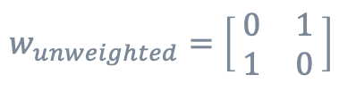
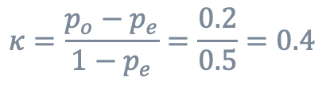
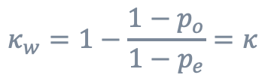
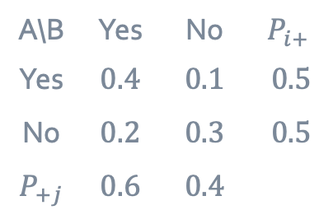
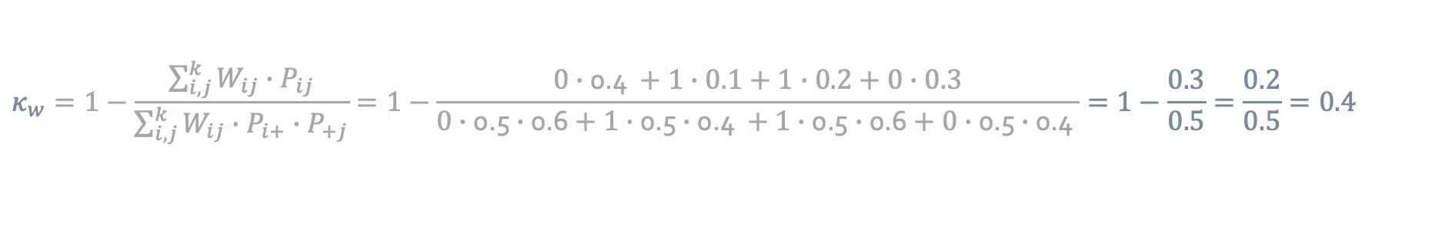
4.2 simple examples, unweighted weight matrix
Percentages normed with total amount N=50
Unweighted cohen‘s kappa:
$$κ=\frac{p_{o}−p_{e}}{1−p_{e}}=\frac{0.2}{0.5}=0.4$$
A\B | Yes | No | $$P_{i+}$$
Yes | 0.4 | 0.1 | 0.5
No | 0.2 | 0.3 | 0.5
$$P_{+j}$$ | 0.6 | 0.4
$$w_{unweighted}=\left[\begin{matrix} 0 & 1 \\ 1 & 0 \end{matrix}\right]$$
$$κ_{w}=1−\frac{\sum_{i,j}^{k}{W_{ij}∙P_{ij}}}{\sum_{i,j}^{k}{W_{ij}∙P_{i+}∙P_{+j}}}=1−\frac{0∙\text{0.4 }+1∙0.1+1∙0.2+0∙0.3}{0∙\text{0.5}∙\text{0.6}+1∙\text{0.5}∙\text{0.4 }+1∙\text{0.5}∙\text{0.6}+0∙\text{0.5}∙\text{0.4 }}=1−\frac{0.3}{0.5}=\frac{0.2}{0.5}=0.4$$
$$κ_{w}=1−\frac{1−p_{o}}{1−p_{e}}=κ$$

