Slide 1
How to edit “getNLDAS__simple.R”
Since the there are often changes in the URL…
By : Patricia Tran
Code from: Hilary Dugan
Sent by: Robert Ladwig

Slide 2
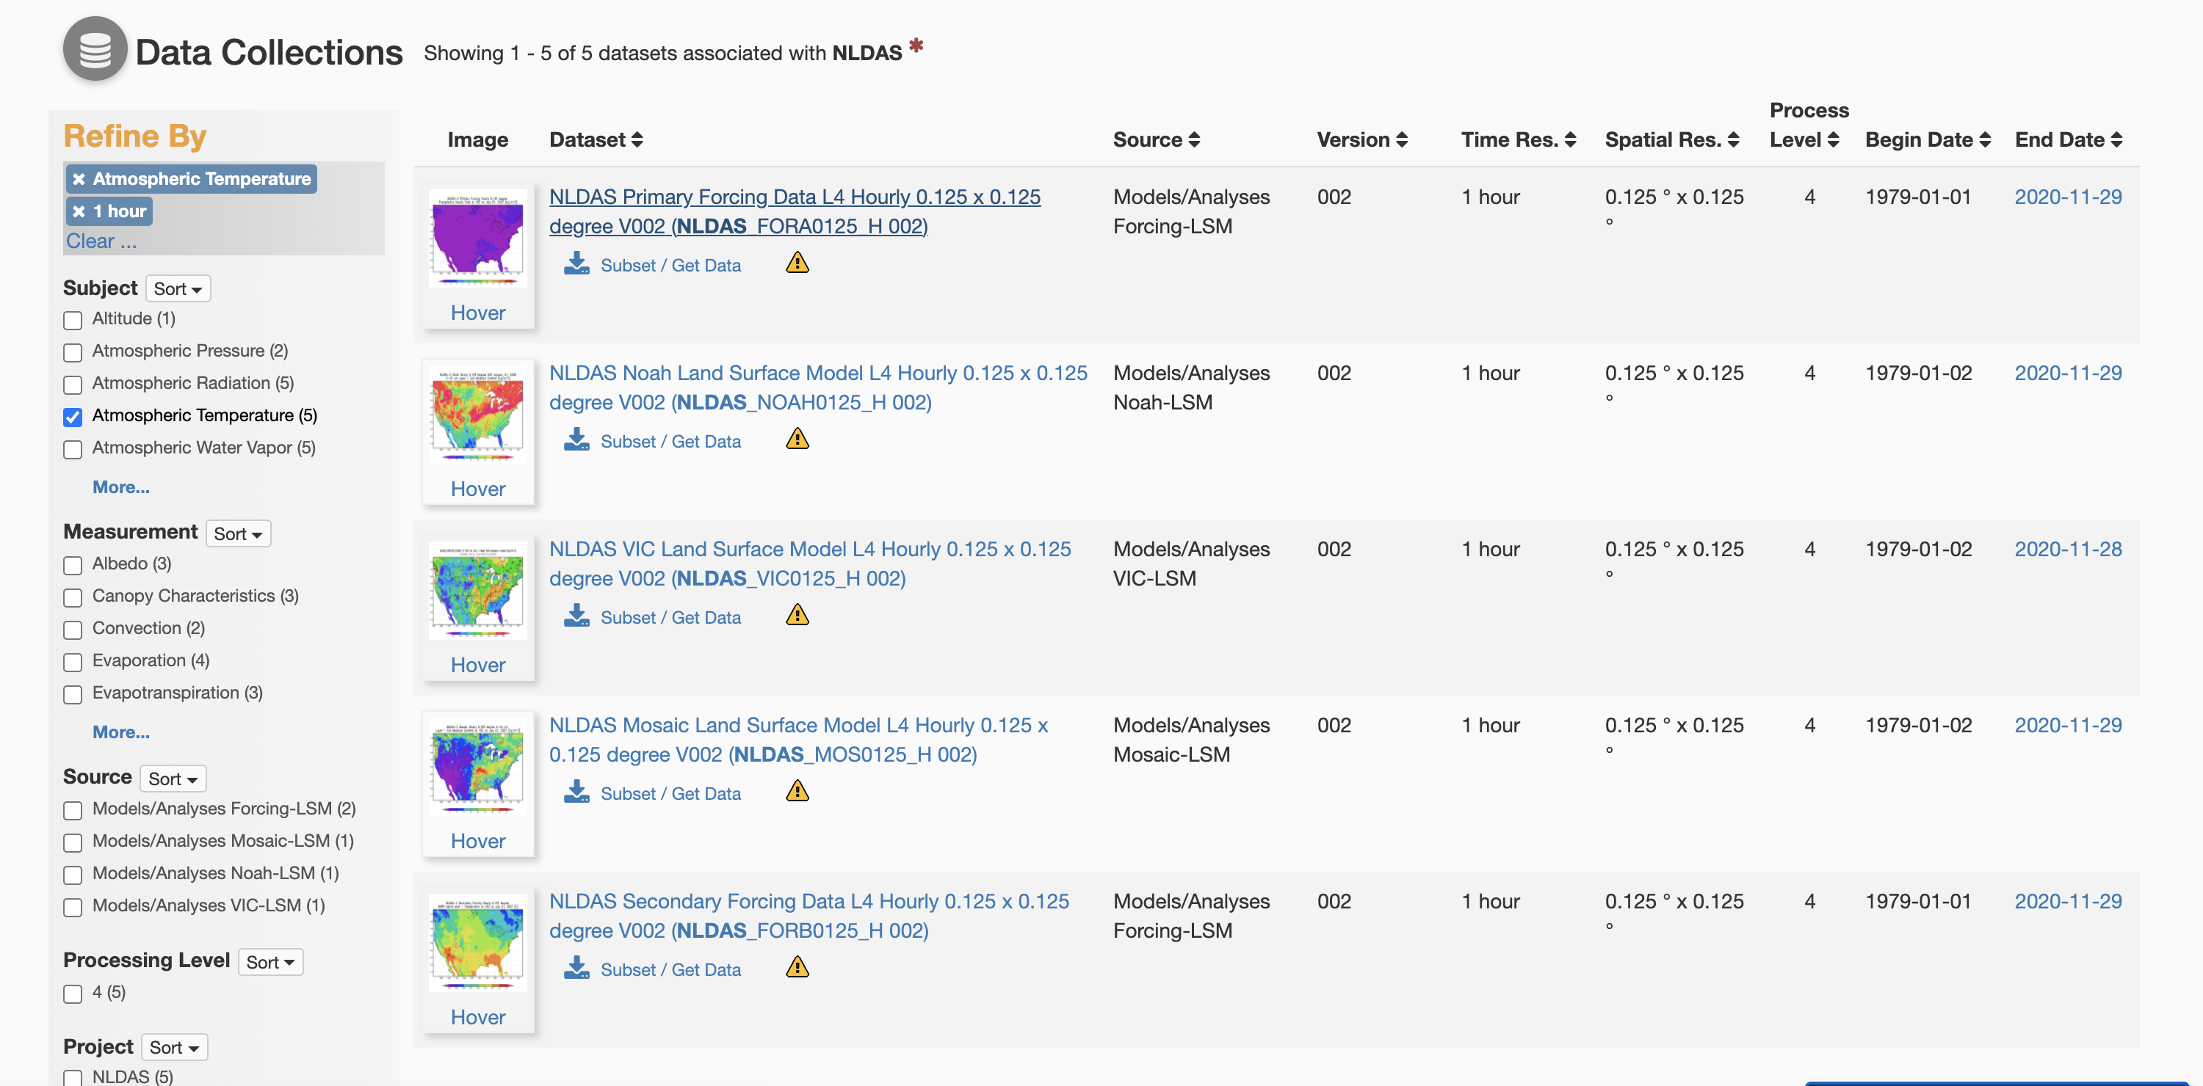
https://disc.gsfc.nasa.gov/datasets?keywords=NLDAS&page=1
I chose atmospheric temperature, and the first dataset

Slide 3
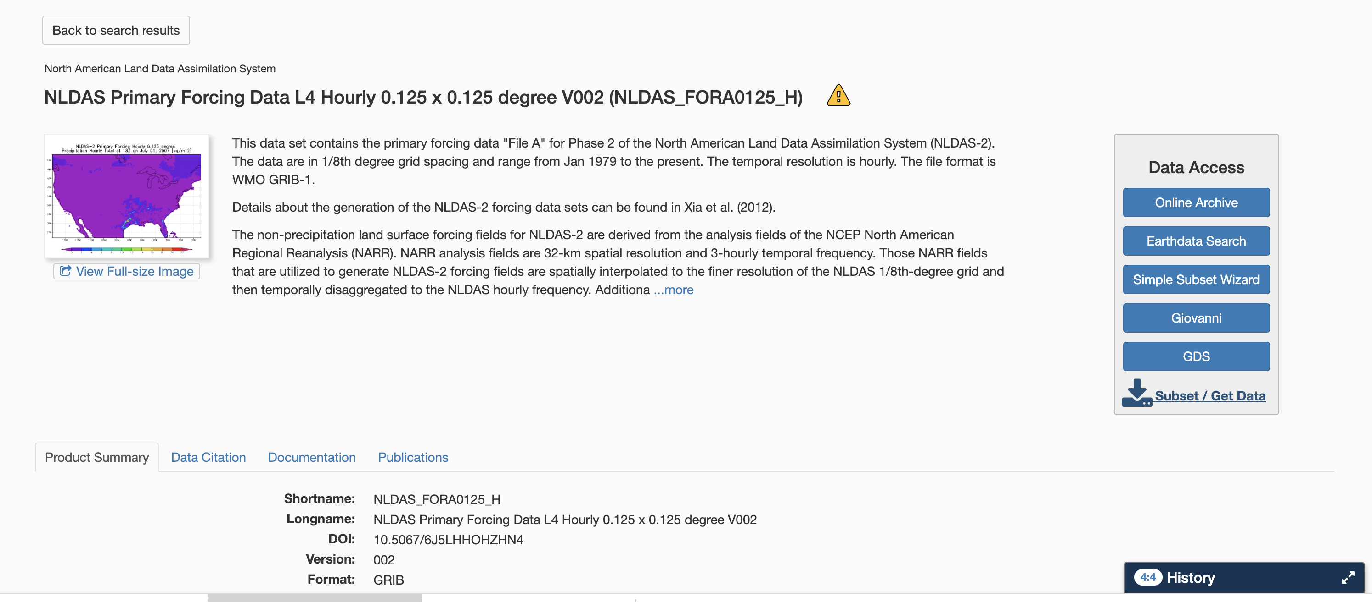
After clicking on the dataset click Subset/Get data

Slide 4
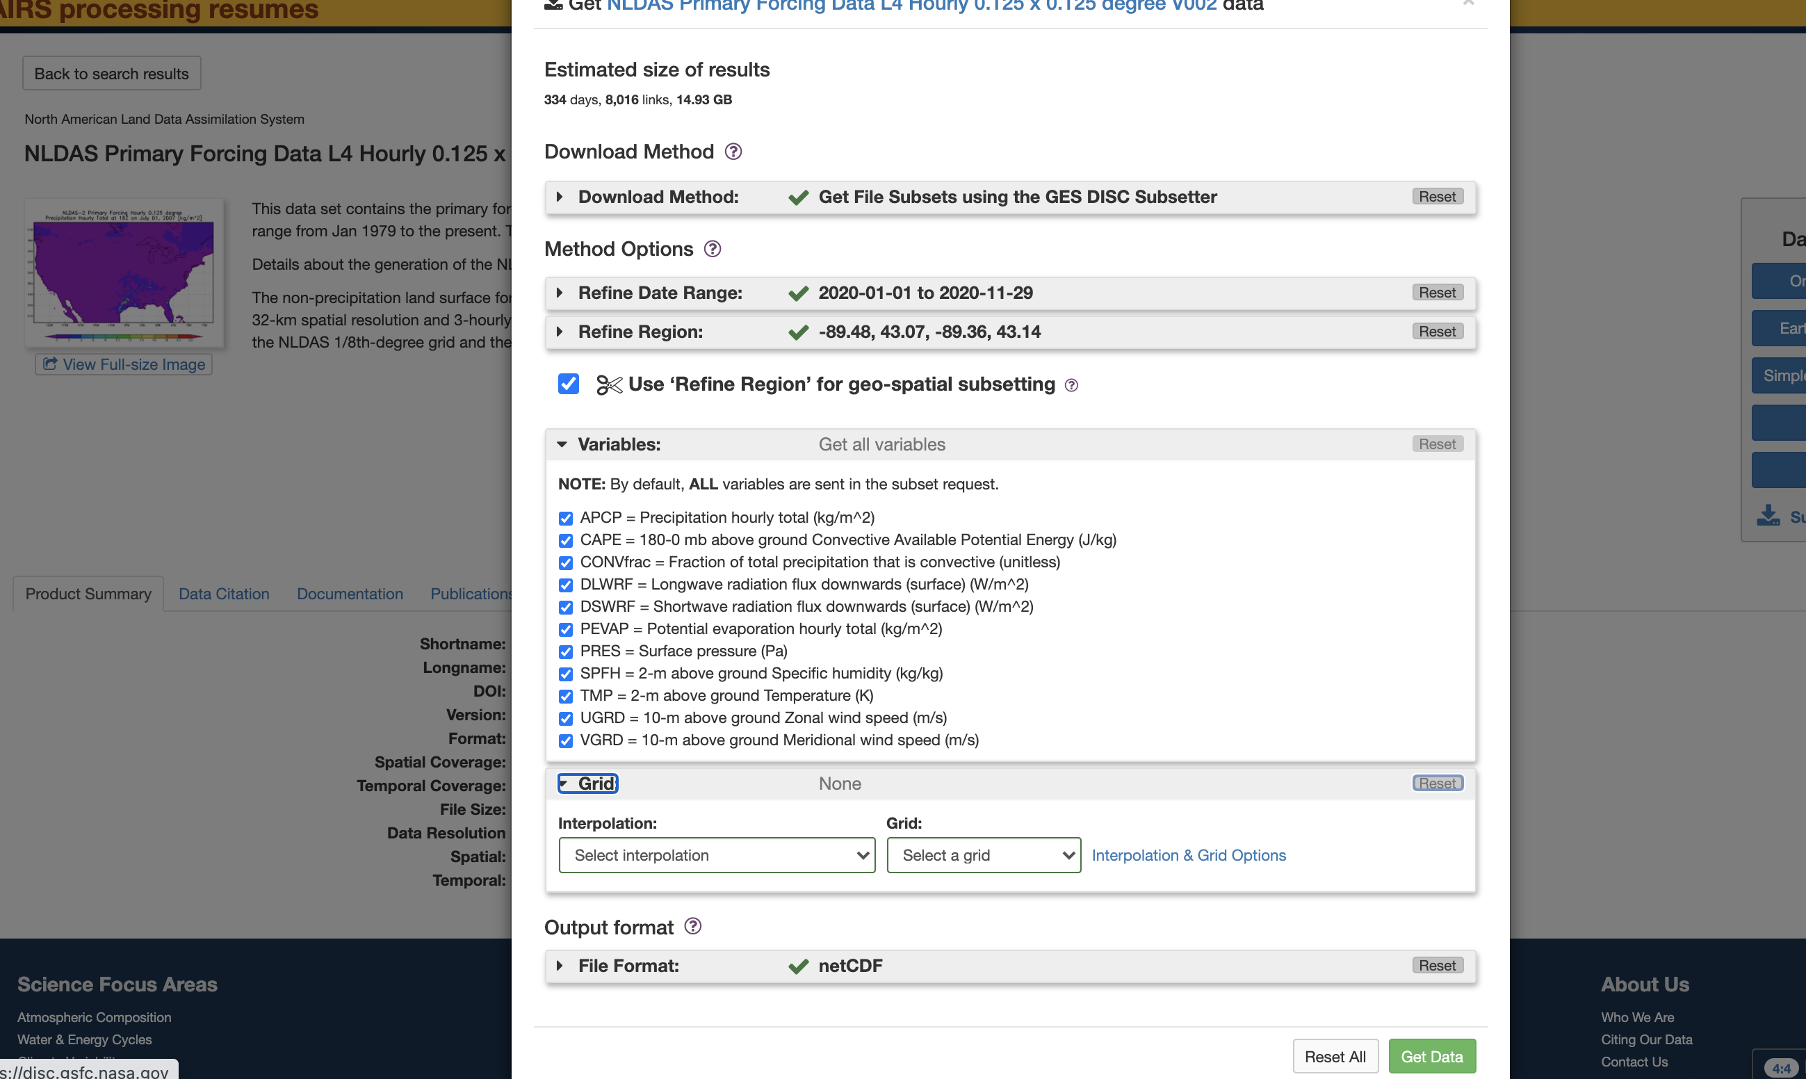
Choose the following settings (use the dropdown menu), then click the green Get Data Button

Slide 5
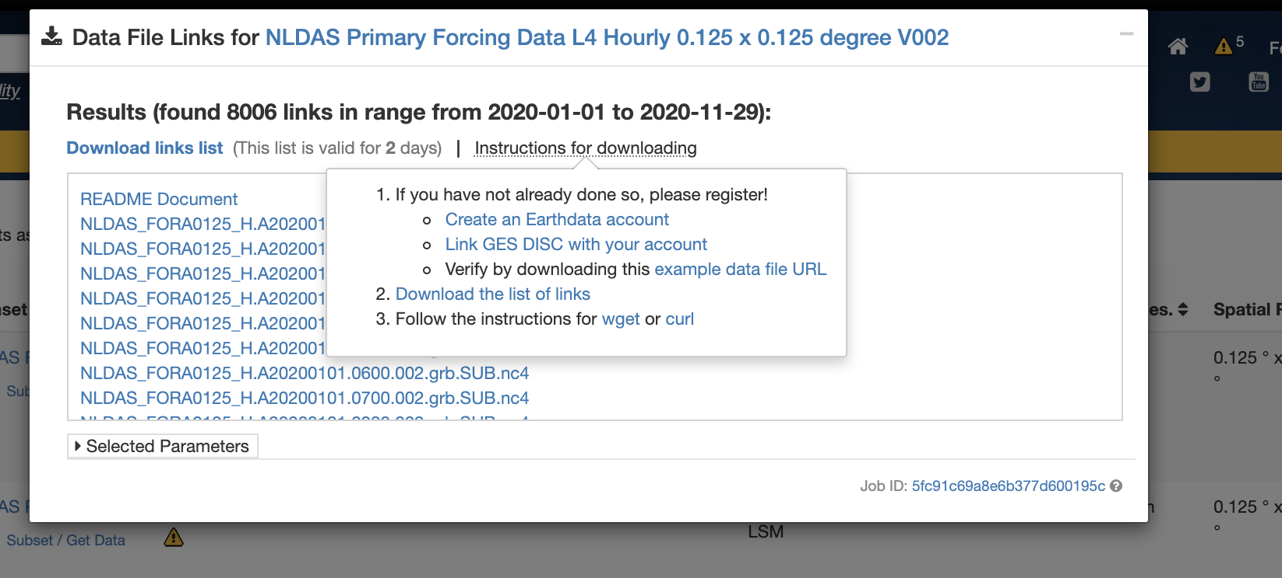
Before trying to edit the R code be surer to follow the instructions here in point 1 and 2 to set up your account

Slide 6
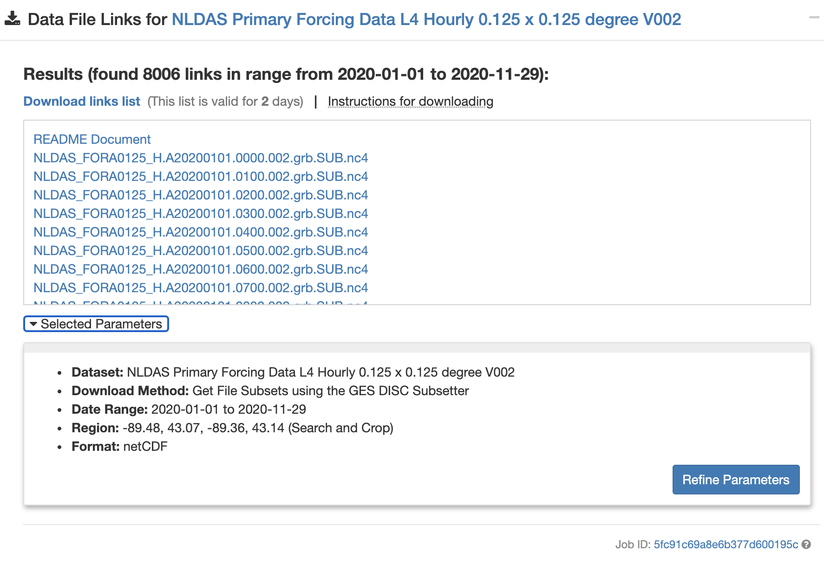
There will be a popup menu, click “Download links list”

Slide 7
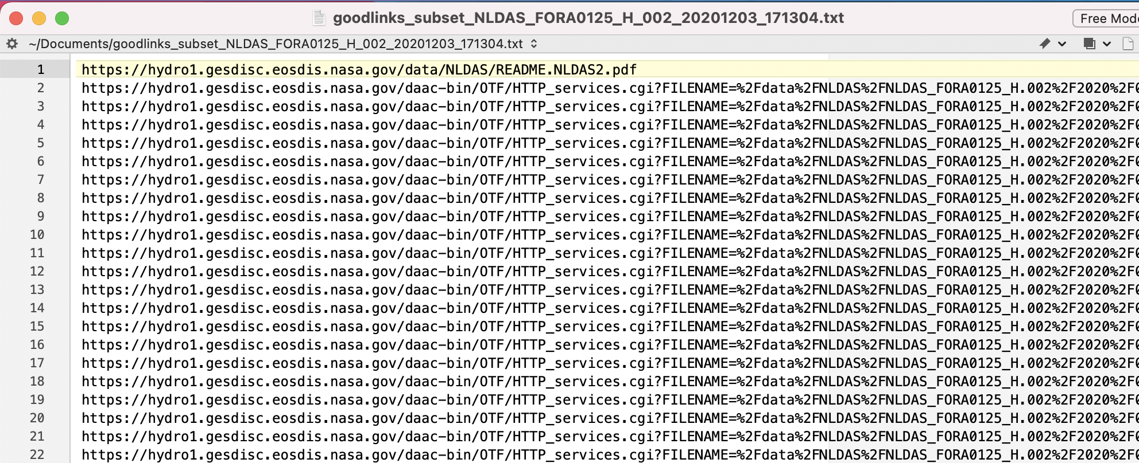
It will be a text file with a bunch of URL links

Slide 8
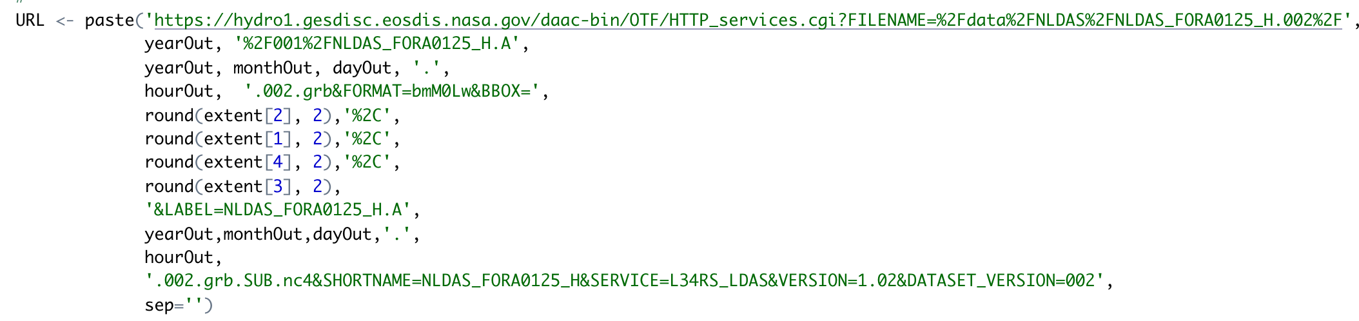
Take a look at one of the URL from your downloaded file
Edit the R code accordingly in the chunk URL <- {}
Example in the text file downloaded:
https://hydro1.gesdisc.eosdis.nasa.gov/daac-bin/OTF/HTTP_services.cgi?FILENAME=%2Fdata%2FNLDAS%2FNLDAS_FORA0125_H.002%2F2020%2F001%2FNLDAS_FORA0125_H.A20200101.0000.002.grb&FORMAT=bmM0Lw&BBOX=43.07%2C-89.48%2C43.14%2C-89.36&LABEL=NLDAS_FORA0125_H.A20200101.0000.002.grb.SUB.nc4&SHORTNAME=NLDAS_FORA0125_H&SERVICE=L34RS_LDAS&VERSION=1.02&DATASET_VERSION=002
R code with the changes:
Variables in the Rcode:
yearOut
monthOut
dayOut
hourOut
Extent[1]
Extent[2]
Extent[3]
Extent[4]
You might need to round your extent variable

