Slide 1

Interacting with Git

Slide 2



A new language for tracking files
Copy
Paste
Save
Save As
Open
Undo
Clone
Pull request
Sync
Branch
Commit
Publish

Slide 3

Git Framework
Git is a framework for tracking incremental changes to files (especially text), and ensuring that those changes don’t conflict.
Git is also many other things.
SLIDE 3

Slide 4
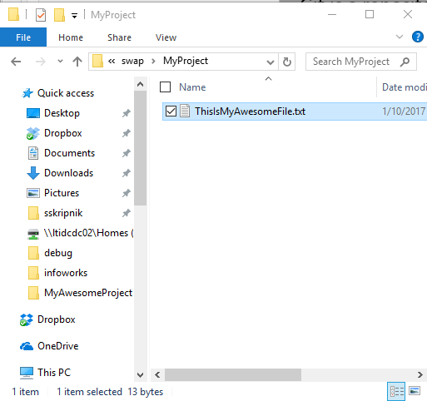
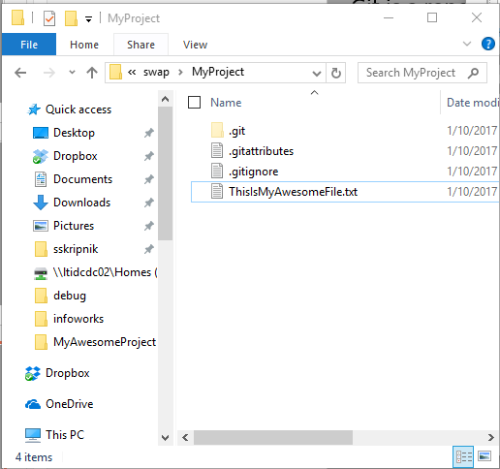
Git Framework
Repository: A collection of files used for a single project in Git. A Windows folder that uses Git is a repository. A repository contains all past versions of a folder.
Boring, old Windows folder
Exciting Git repository!
SLIDE 4

Slide 5
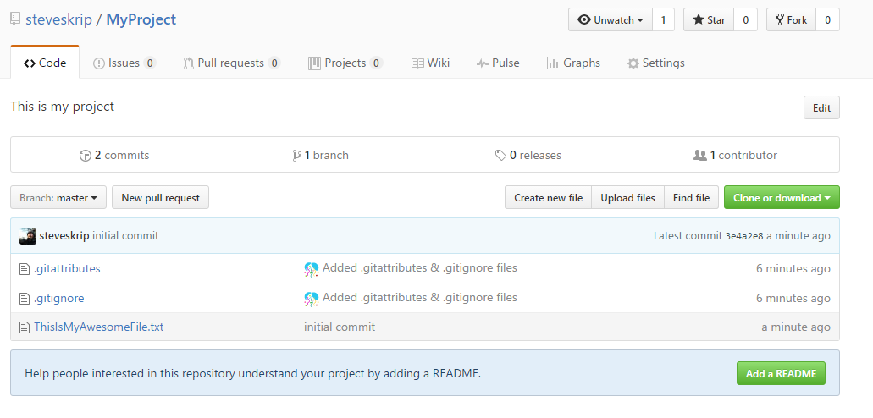
Git Framework
Local Repository: The repository saved on your computer.
Remote Repository: The shared repository saved on a server somewhere (like GitHub).
Local Git repository
Remote Git repository
SLIDE 5

Slide 6
Git Framework
Local Repository: The repository saved on your computer.
Remote Repository: The shared repository saved on a server somewhere. GitHub or others (BitBucket, somewhere on a LimnoTech server)
Local Git repository
Remote Git repository
SLIDE 6

Slide 7
Clone a Repository
Clone: Copy a Git repository from remote to local. You get the whole history of all of the files in the repository. Each snapshot in history is a commit.
Commit 1
Commit 2
Commit 3
Commit 4
(current state)
Commit 1
Commit 2
Commit 3
Commit 4
(current state)
Remote
Local
You can make changes to your local repository without affecting the remote repository. You’ll sync them later.
SLIDE 7
Notes:
Using GitHub Desktop. Could also use command line.

Slide 8
[Clone Demo]
Open GitHub Desktop and login if you haven’t already
Go to github.com
Login
Search for LimnoTech
Click on LimnoTech/SuperAwesomeProject
Click Clone > Open in Desktop
Appears on the left
Right click and go to Explorer View.
Show how you can see everything that’s happened in the past. Show that explorer just shows latest.
SLIDE 8
Notes:
Using GitHub Desktop. Could also use command line.

Slide 9
Branch
Branch: Create a new environment where you can try out new things without affecting the master branch.
Master
Branch
SLIDE 9
Notes:
Using GitHub Desktop. Could also use command line.

Slide 10
[Branch Demo]
Click branch icon
Type in name of new branch
Branch from Master
Click OK
SLIDE 10
Notes:
Using GitHub Desktop. Could also use command line.

Slide 11
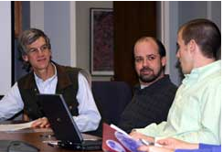
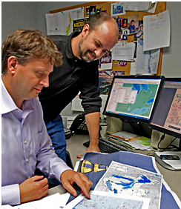
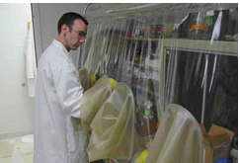
Do actual work!
SLIDE 11
Notes:
Using GitHub Desktop. Could also use command line.

Slide 12
Commit changes
Commit: Save the latest snapshot of your project to the repository. Always leave a note!
Master
Branch
New commit
SLIDE 12
Notes:
Using GitHub Desktop. Could also use command line.

