Slide 1

Git and GitHub Basics

Slide 2



Some new vocabulary words
Copy
Paste
Save
Save As
Open
Undo
Clone
Pull request
Sync
Branch
Commit

Slide 3
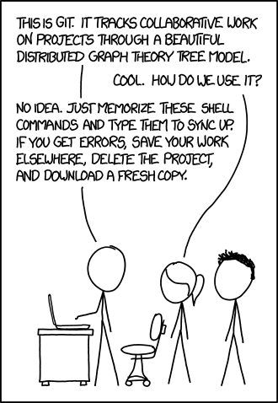

Git Framework
Source: xkcd.com
SLIDE 3

Slide 4
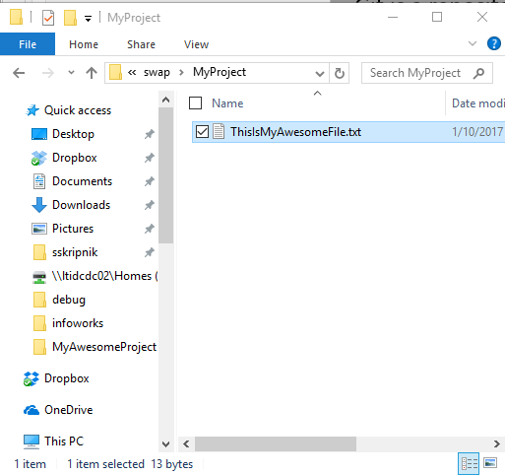
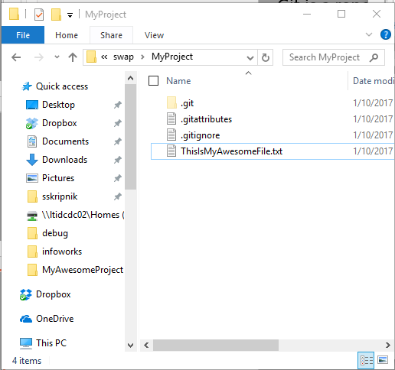
Git Framework
Repository: A collection of files used for a single project in Git. A Windows folder that uses Git is a repository. A repository contains all past versions of a folder.
Boring, old Windows folder
Exciting Git repository!
SLIDE 4

Slide 5
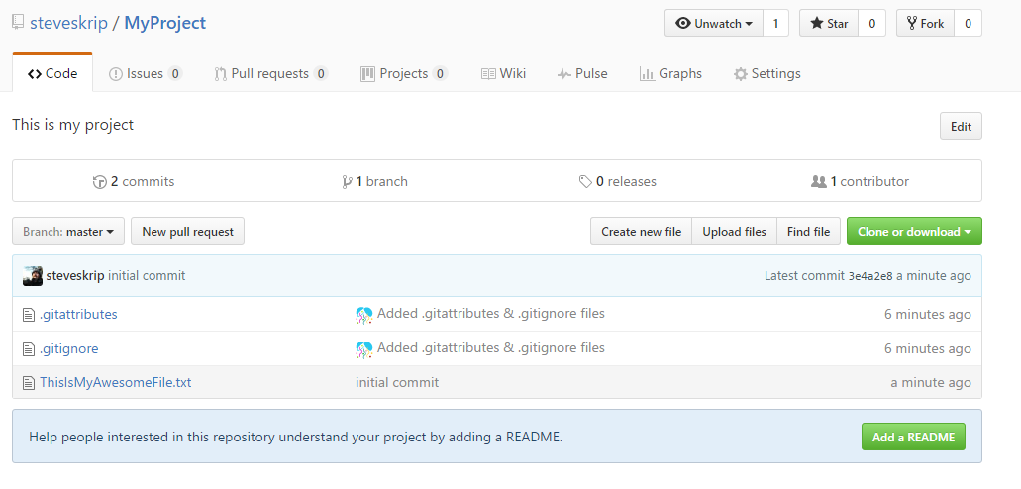
Git Framework
Local Repository: The repository saved on your computer.
Remote Repository: The shared repository saved on a server somewhere. GitHub or others (Bitbucket, somewhere on a LimnoTech server)
Local Git repository
Remote Git repository
SLIDE 5

Slide 6
Clone a Repository
Clone: Copy a Git repository from remote to local. You get the whole history of all of the files in the repository. Each snapshot in history is a commit.
Commit 1
Commit 2
Commit 3
Commit 4
(current state)
Commit 1
Commit 2
Commit 3
Commit 4
(current state)
Remote
Local
You can make changes to your local repository without affecting the remote repository. You’ll sync them later.
SLIDE 6
Notes:
Using GitHub Desktop. Could also use command line.

Slide 7
[Clone Demo]
Open GitHub Desktop and login if you haven’t already
Go to github.com
Login
Search for LimnoTech
Click on LimnoTech/SuperAwesomeProject
Click Clone > Open in Desktop
Appears on the left
Right click and go to Explorer View.
Show how you can see everything that’s happened in the past. Show that explorer just shows latest.
SLIDE 7
Notes:
Using GitHub Desktop. Could also use command line.

Slide 8
Branch
Branch: Create a new environment where you can try out new things without affecting the master branch. Other people may continue working on the Master branch. If you screw up, you can always go back to the master. Branches are cheap! Branch early and often.
Master
Branch
SLIDE 8
Notes:
Using GitHub Desktop. Could also use command line.

Slide 9
[Branch Demo]
Click branch icon
Type in name of new branch
Branch from Master
Click OK
SLIDE 9
Notes:
Using GitHub Desktop. Could also use command line.

Slide 10
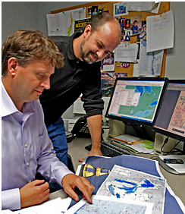
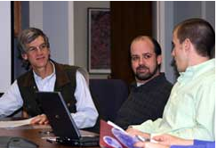
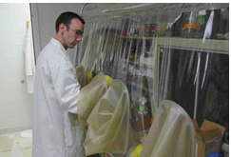
Do actual work!
Add a file, change something, add something…
For the demo, try adding a new text file to the directory
SLIDE 10
Notes:
Using GitHub Desktop. Could also use command line.

Slide 11
Commit changes
Commit: Save the latest snapshot of your project to the repository. Always leave a note!
Master
Branch
New commit
SLIDE 11
Notes:
Using GitHub Desktop. Could also use command line.

Slide 12
[commit demo]
Click Changes (should have a dot indicating a change)
Changes are listed
Note the changes briefly
Click Commit to [branch name]
SLIDE 12
Notes:
Using GitHub Desktop. Could also use command line.

Slide 13
Publish and Sync
Sync your changes to GitHub
Publish your branch to GitHub
SLIDE 13
Notes:
Using GitHub Desktop. Could also use command line.

Slide 14
Pull Request
Pull Request: Merge the changes from a branch to the master and sync it with GitHub. Use a Pull Request to submit your changes to the project that you want everybody to have access to.
Master
Branch
Pull Request
Pull Requests can cause conflicts, but GitHub makes it relatively easy to resolve them.
Different than sync. Pull requests begin a collaborative effort to merge work.
SLIDE 14
Notes:
Using GitHub Desktop. Could also use command line.

Slide 15
[pull request demo]
Click Pull Request in Desktop
Make sure you are merging to Master
Leave a note
Check to see if there will be issues. If there will be issues, you’ll need to resolve them later in GitHub. (We won’t have time to go into this).
Click Send Pull Request.
Go into GitHub and see what we’ve done.
SLIDE 15
Notes:
Using GitHub Desktop. Could also use command line.

Slide 16
Other Terms
.gitignore file: list of files that you do not want Git to track (model output files, compiled files, other binary files).
Push/Pull/Checkout: GitHub desktop does these commands under the hood when you sync, publish or change branches.
Fork: Very similar to clone.
SLIDE 16
Notes:
Using GitHub Desktop. Could also use command line.

Slide 17
Git and GitHub at LimnoTech

Slide 18
Individual Projects
Git and GitHub are great tools to track individual text-based work.
Revert back to previous versions anytime
Keep collections of files in sync
Easy to bring new people in on project
Commits are self-documenting
SLIDE 18
Notes:
Using GitHub Desktop. Could also use command line.

Slide 19
Your own coding projects
Git is designed for this!
Make it a habit to start a Git repository when you start a coding project
Various editors/IDEs have Git and GitHub integration
R Studio
Visual Studio Code
IntelliJ/JetBrains
Many more…
SLIDE 19
Notes:
Using GitHub Desktop. Could also use command line.

Slide 20
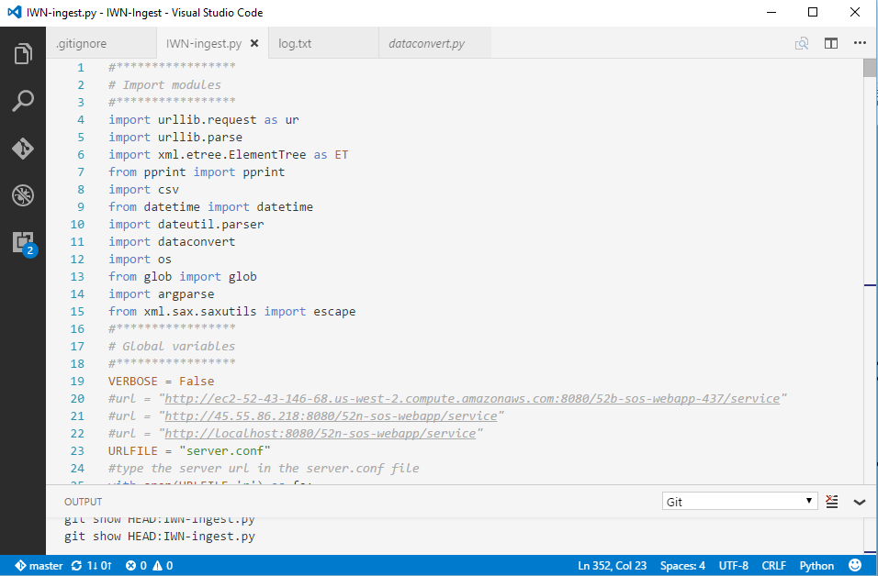
Your own coding projects
SLIDE 20
Notes:
Using GitHub Desktop. Could also use command line.

Slide 21
Your own coding projects
Git is designed for this!
Make it a habit to start a Git repository when you start a coding project
Various editors/IDEs have Git and GitHub integration
R Studio
Microsoft Visual Code
IntelliJ/JetBrains
Many more…
SLIDE 21
Notes:
Using GitHub Desktop. Could also use command line.

Slide 22
Model scenario management
Many models have text input files
Manage input files in Git
Use command line and checkout command to open a previous commit
Can use GitHub to compare previous commits to track down differences in model input files
See https://github.com/LimnoTech/bloomingdale-git/compare for an example
Be sure to use the .gitignore file to list any types of files you do not want to track (calibration data, input data, output files)
SLIDE 22
Notes:
Using GitHub Desktop. Could also use command line.

Slide 23
Collaboration
GitHub is designed to prevent conflicts when working on the same repository as somebody else.
It’s very easy to go from a personal project to a collaboration project.
You can clone, edit, and submit pull requests for many, many open source projects.
SLIDE 23
Notes:
Using GitHub Desktop. Could also use command line.

Slide 24
Git without GitHub
GitHub is a remote server for hosting Git repositories.
You can use Git without GitHub.
SLIDE 24
Notes:
Using GitHub Desktop. Could also use command line.

Slide 25
Homework

Slide 26
Homework
Clone the https://github.com/LimnoTech/Forum-GitHub remote repository using GitHub Desktop
Open and login to GitHub Desktop
In your browser, go to the remote repository and click Clone > Open in Desktop
Create a new branch in Desktop
Add something to the project
Add your own file
Add a question to the FAQ in Readme.md or answer somebody else’s question
Fix a typo
Submit a Pull Request
See your changes on the master branch once the pull request is approved
SLIDE 26
Notes:
Using GitHub Desktop. Could also use command line.

