Slide 1

An Intro to Git & GitHub for Version Control & Collaboration
A Hands-on Forum Presentation to LimnoTech Staff
By Anthony Aufdenkampe & Steve Skripnik

Slide 2
1. What is version control and why should I use it?

Slide 3
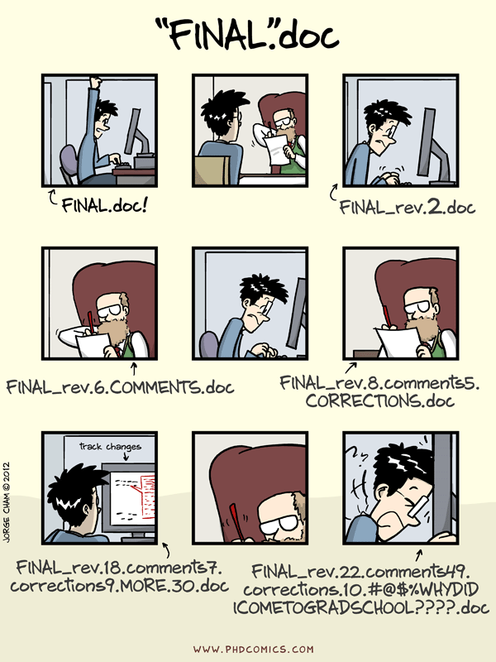

SLIDE 3
Notes:
From: http://swcarpentry.github.io/git-novice/01-basics/

Slide 4

Version Control
SLIDE 4
Notes:
Using GitHub Desktop. Could also use command line.

Slide 5
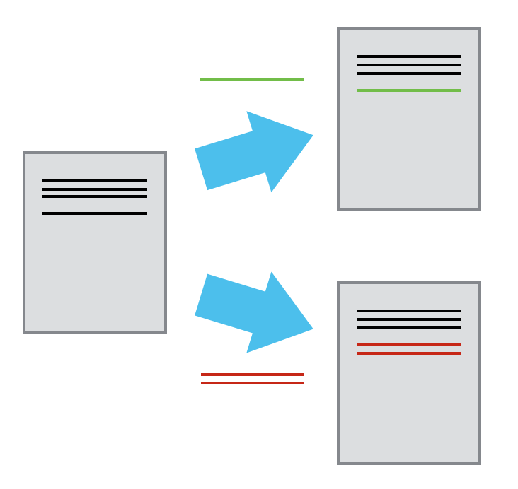
Version Control
SLIDE 5
Notes:
Using GitHub Desktop. Could also use command line.

Slide 6
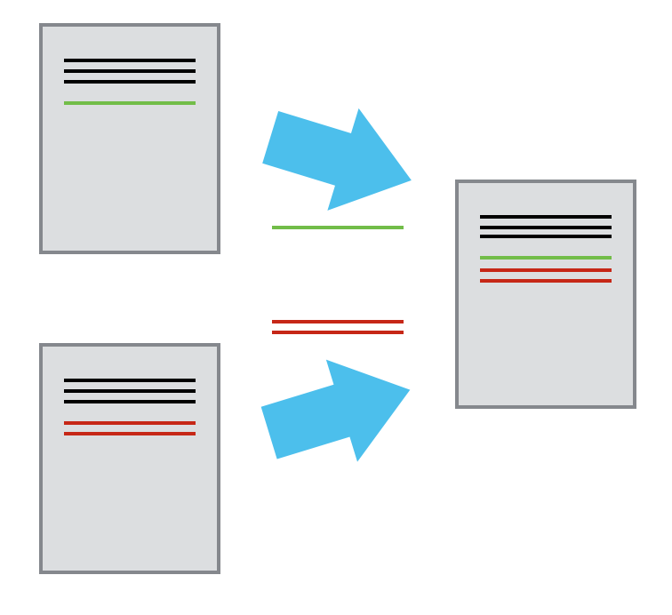
Version Control
SLIDE 6
Notes:
Using GitHub Desktop. Could also use command line.

Slide 7
Version Control
A complete long-term change history of every file in the selected file-tree
Branching and merging.
Traceability.
SLIDE 7
Notes:
Using GitHub Desktop. Could also use command line.

Slide 8
Git
The most widely used modern version control system in the world today
Developed by Linus Torvalds in 2005
Other Modern Version Control Systems:
Mercurial
Older Version Control System
Controled Versioning System (CVS)
Subversion (SVN)
SLIDE 8
Notes:
Using GitHub Desktop. Could also use command line.

Slide 9
GitHub
A web-based Git repository hosting service
Also: BitBucket, GitLab
Additional collaboration features
bug tracking
feature requests
task management
wikis and web pages for every project.
Social Networking
Free Plans for public repositories
paid plans for private repositories
SLIDE 9
Notes:
Using GitHub Desktop. Could also use command line.

