Slide 1

Interacting with Git

Slide 2



A new language for tracking files
Copy
Paste
Save
Save As
Open
Undo
Clone
Pull request
Sync
Branch
Commit

Slide 3
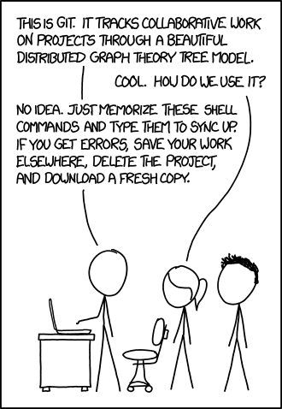

Git Framework
Source: xkcd.com
SLIDE 3

Slide 4
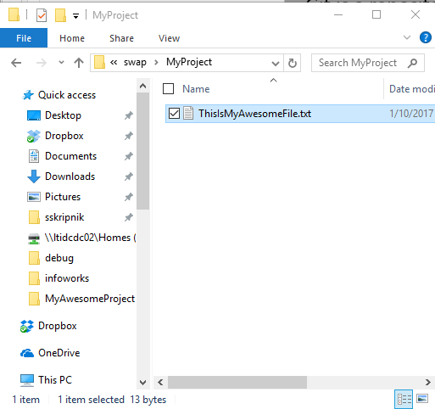
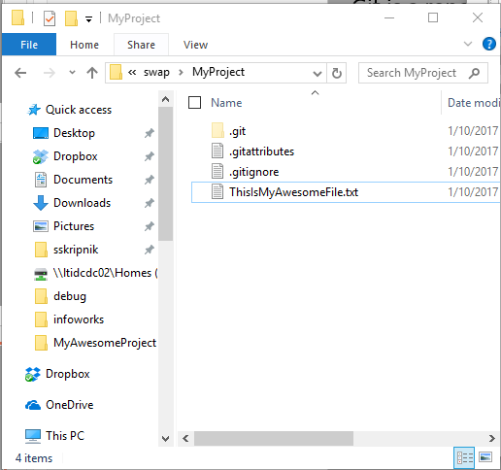
Git Framework
Repository: A collection of files used for a single project in Git. A Windows folder that uses Git is a repository. A repository contains all past versions of a folder.
Boring, old Windows folder
Exciting Git repository!
SLIDE 4

Slide 5
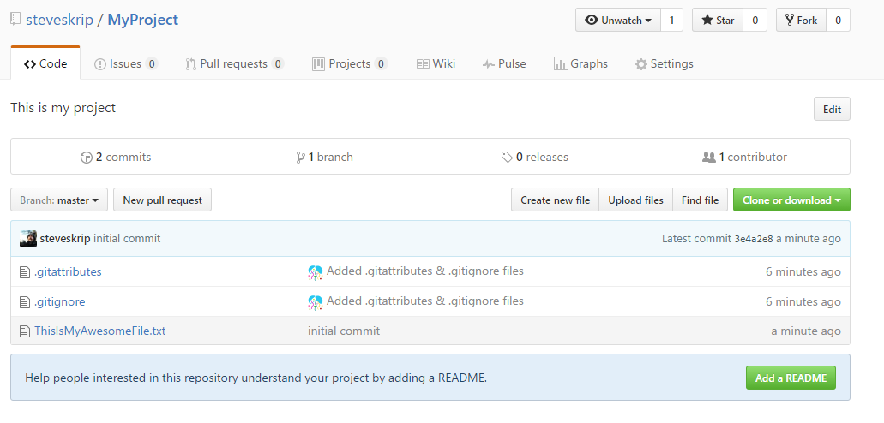
Git Framework
Local Repository: The repository saved on your computer.
Remote Repository: The shared repository saved on a server somewhere (like GitHub).
Local Git repository
Remote Git repository
SLIDE 5

Slide 6
Git Framework
Local Repository: The repository saved on your computer.
Remote Repository: The shared repository saved on a server somewhere. GitHub or others (BitBucket, somewhere on a LimnoTech server)
Local Git repository
Remote Git repository
SLIDE 6

Slide 7
Clone a Repository
Clone: Copy a Git repository from remote to local. You get the whole history of all of the files in the repository. Each snapshot in history is a commit.
Commit 1
Commit 2
Commit 3
Commit 4
(current state)
Commit 1
Commit 2
Commit 3
Commit 4
(current state)
Remote
Local
You can make changes to your local repository without affecting the remote repository. You’ll sync them later.
SLIDE 7
Notes:
Using GitHub Desktop. Could also use command line.

Slide 8
[Clone Demo]
Open GitHub Desktop and login if you haven’t already
Go to github.com
Login
Search for LimnoTech
Click on LimnoTech/SuperAwesomeProject
Click Clone > Open in Desktop
Appears on the left
Right click and go to Explorer View.
Show how you can see everything that’s happened in the past. Show that explorer just shows latest.
SLIDE 8
Notes:
Using GitHub Desktop. Could also use command line.

Slide 9
Branch
Branch: Create a new environment where you can try out new things without affecting the master branch. Other people may continue working on the Master branch. If you screw up, you can always go back to the master. Branches are cheap! Branch early and often.
Master
Branch
SLIDE 9
Notes:
Using GitHub Desktop. Could also use command line.

Slide 10
[Branch Demo]
Click branch icon
Type in name of new branch
Branch from Master
Click OK
SLIDE 10
Notes:
Using GitHub Desktop. Could also use command line.

Slide 11


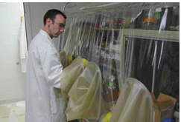
Do actual work!
Add a file, change something, add something…
For the demo, try adding a new text file to the directory
SLIDE 11
Notes:
Using GitHub Desktop. Could also use command line.

Slide 12
Commit changes
Commit: Save the latest snapshot of your project to the repository. Always leave a note!
Master
Branch
New commit
SLIDE 12
Notes:
Using GitHub Desktop. Could also use command line.

Slide 13
[commit demo]
Click Changes (should have a dot indicating a change)
Changes are listed
Note the changes briefly
Click Commit to [branch name]
SLIDE 13
Notes:
Using GitHub Desktop. Could also use command line.

Slide 14
Publish and Sync
Sync your changes to GitHub
Publish your branch to GitHub
SLIDE 14
Notes:
Using GitHub Desktop. Could also use command line.

Slide 15
Pull Request
Pull Request: Merge the changes from a branch to the master and sync it with GitHub. Use a Pull Request to submit your changes to the project that you want everybody to have access to.
Master
Branch
Pull Request
Pull Requests can cause conflicts, but GitHub makes it relatively easy to resolve them.
Different than sync. Pull requests begin a collaborative effort to merge work.
SLIDE 15
Notes:
Using GitHub Desktop. Could also use command line.

Slide 16
[pull request demo]
Click Pull Request in Desktop
Make sure you are merging to Master
Leave a note
Check to see if there will be issues. If there will be issues, you’ll need to resolve them later in GitHub. (We won’t have time to go into this).
Click Send Pull Request.
Go into GitHub and see what we’ve done.
SLIDE 16
Notes:
Using GitHub Desktop. Could also use command line.

Slide 17
Other Terms
.gitignore file: list of files that you do not want Git to track (model output files, compiled files, other binary files).
Push/Pull/Checkout: GitHub desktop does these commands under the hood when you sync, publish or change branches.
Fork: Very similar to clone.
Spoon: Kitchen utensil.
SLIDE 17
Notes:
Using GitHub Desktop. Could also use command line.

