Slide 1

An Intro to Git & GitHub for Version Control & Collaboration
GitHub Training for ERDC-EL: August 30-31, 2021
Anthony Aufdenkampe
Content from:
Steve Skripnik
Many others …
Notes:
It is easy to get lost in the alphabet soup of data science tools that are available and provide incredible power to help us make sense out of data.
We can easily forget that often the biggest challenge is gathering all the relevant data and organizing it for analysis.

Slide 2
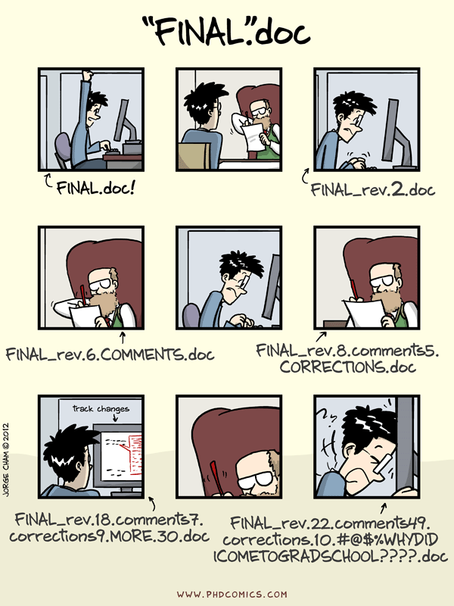
What is version control and why should I use it?

Slide 3
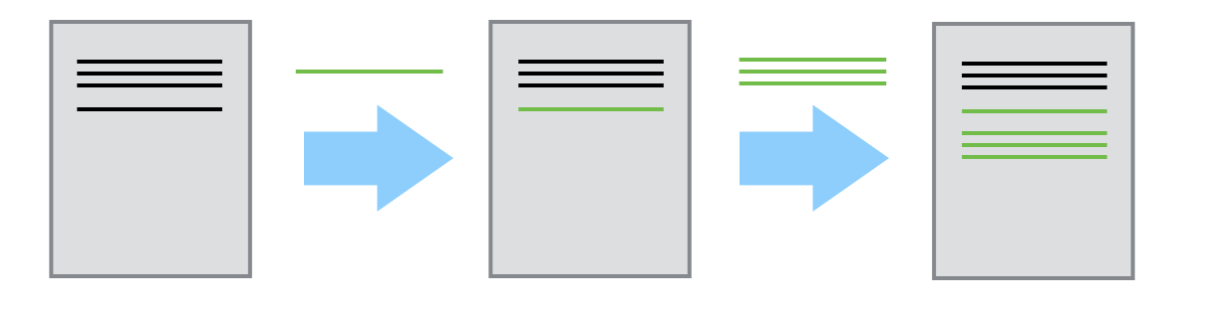
Version Control
Notes:
Using GitHub Desktop. Could also use command line.

Slide 4
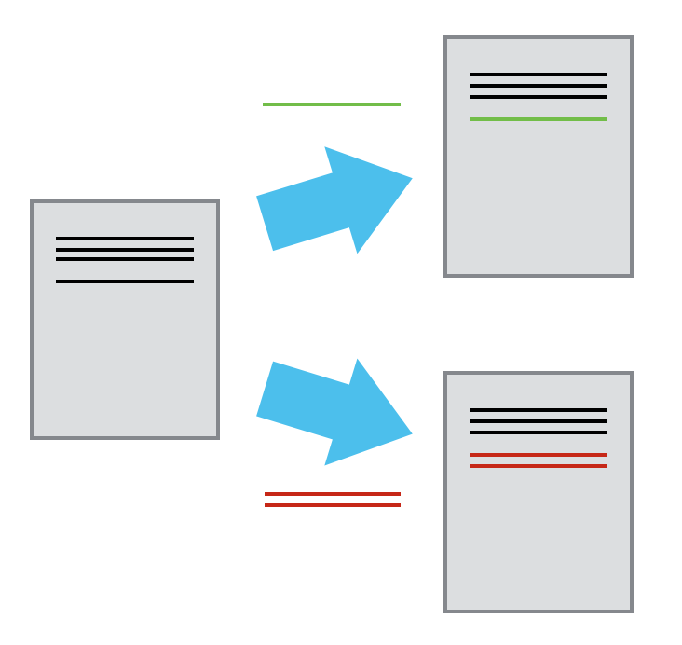
Version Control
Notes:
Using GitHub Desktop. Could also use command line.

Slide 5
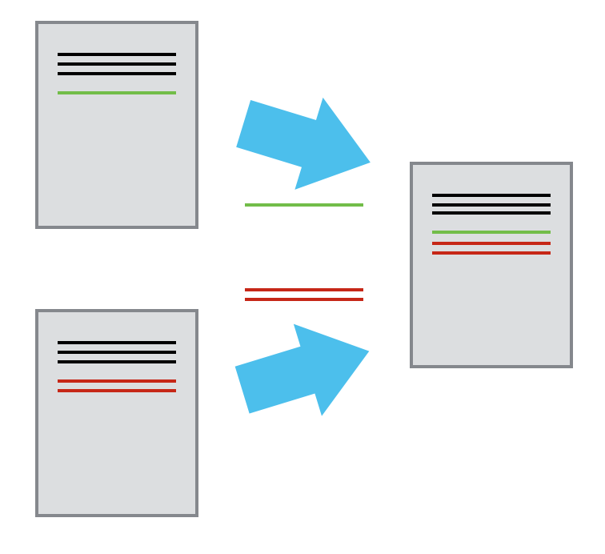
Version Control
Notes:
Using GitHub Desktop. Could also use command line.

Slide 6
Version Control
A complete long-term change history of every file in the selected file-tree
Branching and merging.
Traceability.
A complete long-term change history of every file in the selected file-tree
Branching and merging.
Traceability.
Notes:
Using GitHub Desktop. Could also use command line.

Slide 7
Git
The most widely used modern version control system in the world today
Developed by Linus Torvalds in 2005
Other Modern Version Control Systems:
Mercurial
Older Version Control System
Controlled Versioning System (CVS)
Subversion (SVN)
Notes:
Using GitHub Desktop. Could also use command line.

Slide 8
GitHub
A web-based Git repository hosting service
Also: BitBucket, GitLab
Additional collaboration features
bug tracking
feature requests
task management
wikis and web pages for every project.
Social Networking
Free Plans for public repositories
paid plans for private repositories
Notes:
Using GitHub Desktop. Could also use command line.

Slide 9
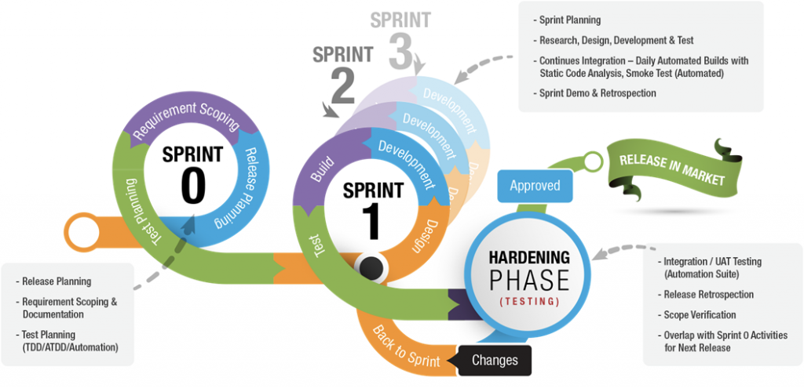
Agile Methodology and Scum Cycles
RELEASE to USERS

Slide 10
Git and GitHub Basics

Slide 11

Some new vocabulary words
Copy
Paste
Save
Save As
Open
Undo
Clone
Pull request
Sync
Branch
Commit

Slide 12
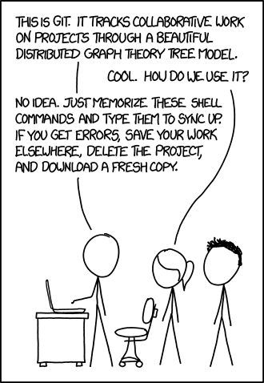
Git Framework

Slide 13
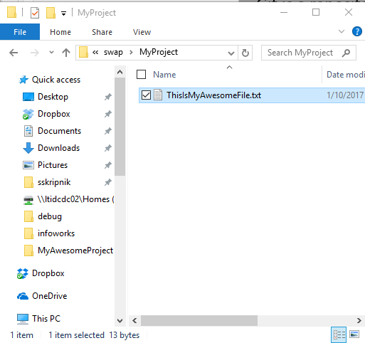
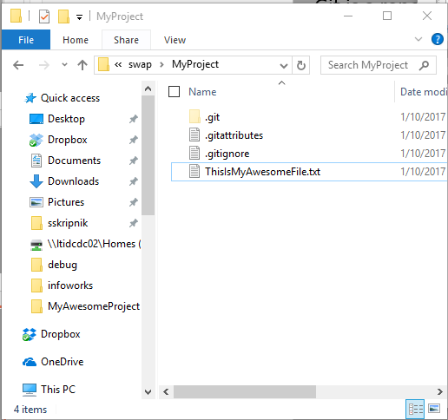
Git Framework
Repository: A collection of files used for a single project in Git. A Windows folder that uses Git is a repository. A repository contains all past versions of a folder.
Boring, old Windows folder
Exciting Git repository!

Slide 14
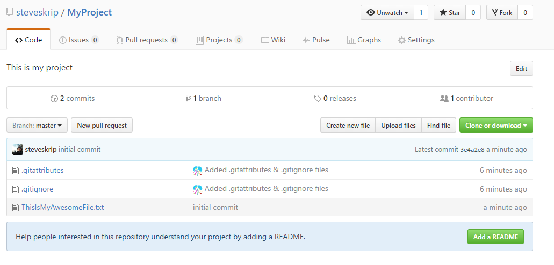
Git Framework
Local Repository: The repository saved on your computer.
Remote Repository: The shared repository saved on a server somewhere. GitHub or others (Bitbucket, somewhere on a LimnoTech server)
Local Git repository
Remote Git repository

Slide 15
Clone a Repository
Clone: Copy a Git repository from remote to local. You get the whole history of all of the files in the repository. Each snapshot in history is a commit.
Commit 1
Commit 2
Commit 3
Commit 4
(current state)
Commit 1
Commit 2
Commit 3
Commit 4
(current state)
Remote
Local
You can make changes to your local repository without affecting the remote repository. You’ll sync them later.
Notes:
Using GitHub Desktop. Could also use command line.

Slide 16
[Clone Demo]
Open GitHub Desktop and login if you haven’t already
Go to github.com
Login
Search for LimnoTech
Click on LimnoTech/SuperAwesomeProject
Click Clone > Open in Desktop
Appears on the left
Right click and go to Explorer View.
Show how you can see everything that’s happened in the past. Show that explorer just shows latest.
Notes:
Using GitHub Desktop. Could also use command line.

Slide 17
Branch
Branch: Create a new environment where you can try out new things without affecting the master branch. Other people may continue working on the Master branch. If you screw up, you can always go back to the master. Branches are cheap! Branch early and often.
Master
Branch
Notes:
Using GitHub Desktop. Could also use command line.

Slide 18
[Branch Demo]
Click branch icon
Type in name of new branch
Branch from Master
Click OK
Notes:
Using GitHub Desktop. Could also use command line.

Slide 19


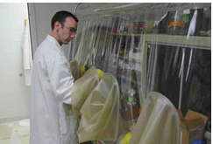
Do actual work!
Add a file, change something, add something…
For the demo, try adding a new text file to the directory
Notes:
Using GitHub Desktop. Could also use command line.

Slide 20
Commit changes
Commit: Save the latest snapshot of your project to the repository. Always leave a note!
Master
Branch
New commit
Notes:
Using GitHub Desktop. Could also use command line.

Slide 21
[commit demo]
Click Changes (should have a dot indicating a change)
Changes are listed
Note the changes briefly
Click Commit to [branch name]
Notes:
Using GitHub Desktop. Could also use command line.

Slide 22
Publish and Sync
Sync your changes to GitHub
Publish your branch to GitHub
Notes:
Using GitHub Desktop. Could also use command line.

Slide 23
Pull Request
Pull Request: Merge the changes from a branch to the master and sync it with GitHub. Use a Pull Request to submit your changes to the project that you want everybody to have access to.
Master
Branch
Pull Request
Pull Requests can cause conflicts, but GitHub makes it relatively easy to resolve them.
Different than sync. Pull requests begin a collaborative effort to merge work.
Notes:
Using GitHub Desktop. Could also use command line.

Slide 24
[pull request demo]
Click Pull Request in Desktop
Make sure you are merging to Master
Leave a note
Check to see if there will be issues. If there will be issues, you’ll need to resolve them later in GitHub. (We won’t have time to go into this).
Click Send Pull Request.
Go into GitHub and see what we’ve done.
Notes:
Using GitHub Desktop. Could also use command line.

Slide 25
Other Terms
.gitignore file: list of files that you do not want Git to track (model output files, compiled files, other binary files).
Push/Pull/Checkout: GitHub desktop does these commands under the hood when you sync, publish or change branches.
Fork: Very similar to clone.
Notes:
Using GitHub Desktop. Could also use command line.

Slide 26
Workflows with Git and GitHub

Slide 27
Individual Projects
Git and GitHub are great tools to track individual text-based work.
Revert back to previous versions anytime
Keep collections of files in sync
Easy to bring new people in on project
Commits are self-documenting
Notes:
Using GitHub Desktop. Could also use command line.

Slide 28
Your own coding projects
Git is designed for this!
Make it a habit to start a Git repository when you start a coding project
Various editors/IDEs have Git and GitHub integration
R Studio
Visual Studio Code
IntelliJ/JetBrains
Many more…
Notes:
Using GitHub Desktop. Could also use command line.

Slide 29
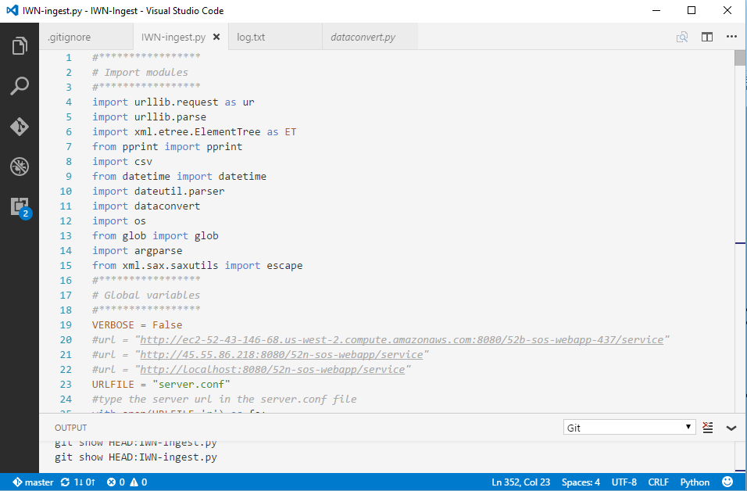
Your own coding projects
Notes:
Using GitHub Desktop. Could also use command line.

Slide 30
Your own coding projects
Git is designed for this!
Make it a habit to start a Git repository when you start a coding project
Various editors/IDEs have Git and GitHub integration
R Studio
Microsoft Visual Code
IntelliJ/JetBrains
Many more…
Notes:
Using GitHub Desktop. Could also use command line.

Slide 31
Model scenario management
Many models have text input files
Manage input files in Git
Use command line and checkout command to open a previous commit
Can use GitHub to compare previous commits to track down differences in model input files
See https://github.com/LimnoTech/bloomingdale-git/compare for an example
Be sure to use the .gitignore file to list any types of files you do not want to track (calibration data, input data, output files)
Notes:
Using GitHub Desktop. Could also use command line.

Slide 32
Collaboration
GitHub is designed to prevent conflicts when working on the same repository as somebody else.
It’s very easy to go from a personal project to a collaboration project.
You can clone, edit, and submit pull requests for many, many open source projects.
Notes:
Using GitHub Desktop. Could also use command line.

Slide 33
Git without GitHub
GitHub is a remote server for hosting Git repositories.
You can use Git without GitHub.
Notes:
Using GitHub Desktop. Could also use command line.

Slide 34
Homework

Slide 35
Thank You

Slide 37
Homework
Clone the https://github.com/LimnoTech/Forum-GitHub remote repository using GitHub Desktop
Open and login to GitHub Desktop
In your browser, go to the remote repository and click Clone > Open in Desktop
Create a new branch in Desktop
Add something to the project
Add your own file
Add a question to the FAQ in Readme.md or answer somebody else’s question
Fix a typo
Submit a Pull Request
See your changes on the master branch once the pull request is approved
Notes:
Using GitHub Desktop. Could also use command line.

