Slide 1

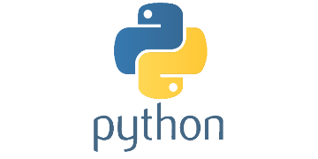
Data Analysis and Python
LimnoTech 2 day course
April 23-24, 2018

Slide 2
Get GitHub Repository
https://github.com/LimnoTech
Click on Python-Data-Analysis-Course
Clone repository or download the zip file

Slide 3
Agenda
Day 1
What is Python?
Basic Python syntax
Under the Hood
Anaconda Introduction
Python Editor Choices
HANDS ON Jupyter Notebook
Data Analysis Choices
Day 2
Data Analysis in Python
Pandas Basics
HANDS ON Intro to Pandas
Matplotlib Basics
HANDS ON Intro to Matplotlib
HANDS ON Start-to-finish exercise
Other Python modules, projects, and workflows

Slide 4
Setting Expectations
We have 3 hours
I am not an expert
Most of this is based on my personal experience, so please speak up if you’ve had a different experience
Learning and retaining requires additional work
Create excuses to use what you’ve learned
There is a WIDE range of backgrounds and experience levels here. Please participate!

Slide 5
Intros

Slide 6
My Goals
Give you the tools you need to fearlessly decide to use Python, if appropriate, and get started on a project.
Show you where to look for or who to ask for more information
Make sure the tools we choose aren’t limiting our ability
Keep the community going after this course
Any others?

Slide 7


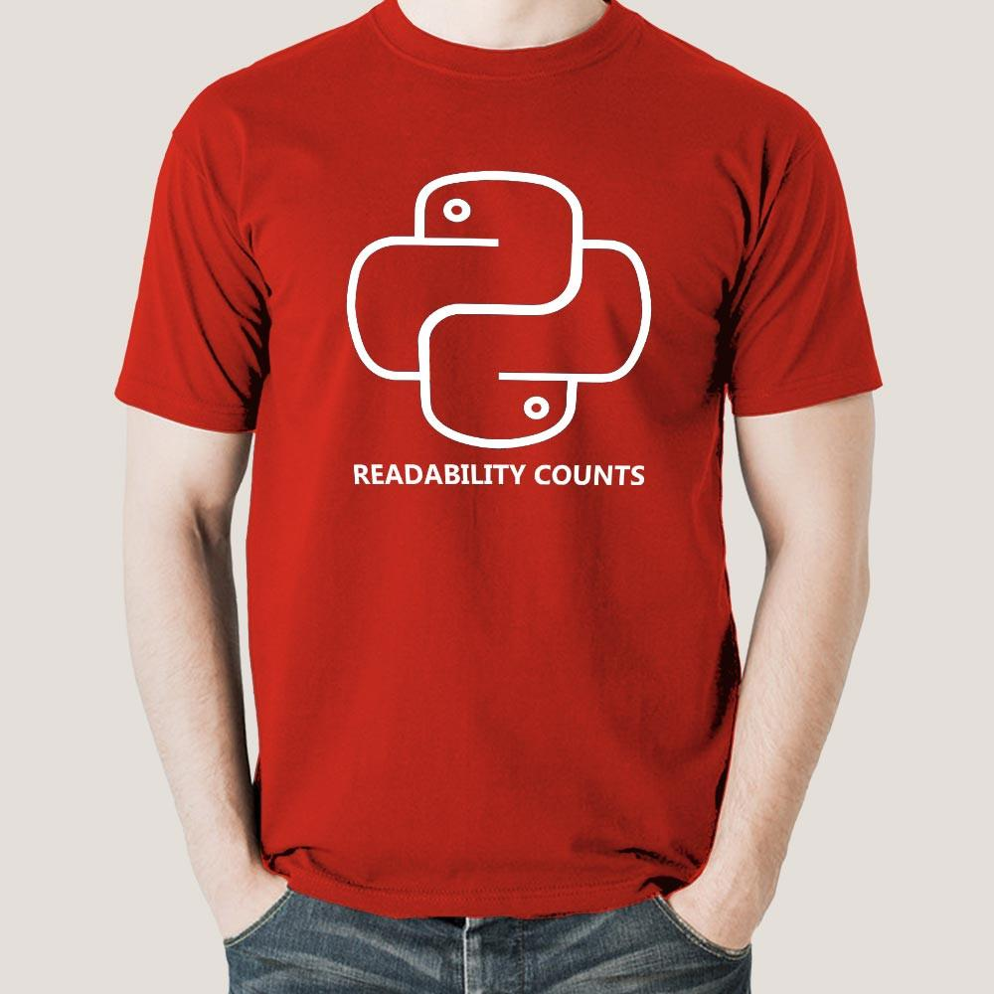
Programming Language Stereotypes
FORTRAN
C++
Java
Visual Basic
R
Python

Slide 8
What is Python?
Open source general-purpose programming language
Object oriented or functional
Easy to interface with other programming languages
Great interactive environment
Kitchen Sink

Slide 9
What is Python?
Not as fast as a fully compiled language
Dynamically typed
No need to define variables or types
Python guesses, and is usually right
Object Oriented
Functional
Very flexible – Pro and Con
A HUGE user community and library support

Slide 10
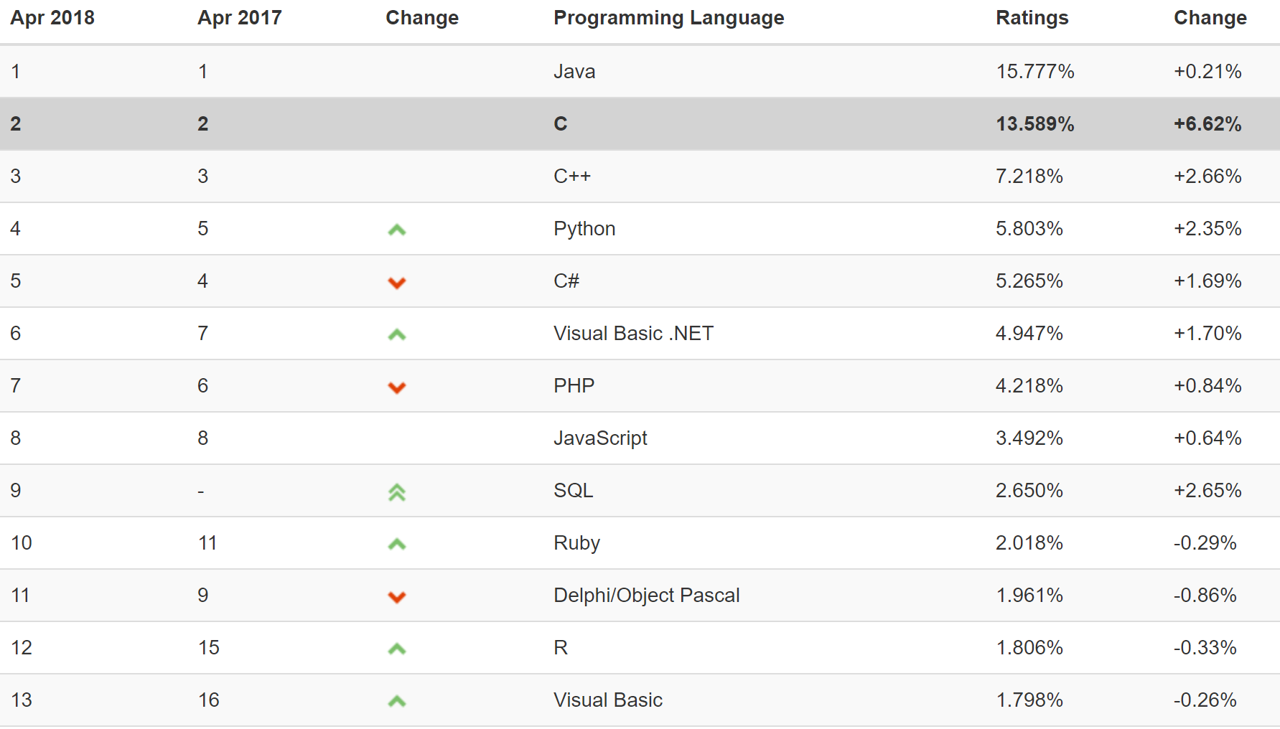
Programming Language Popularity

Slide 11






Where is Python?

Slide 12
What can I use Python for?
Reading/parsing files
Web development
Visualizations
Database interface
Web scraping
Interacting with ArcGIS and other software
Web APIs
…will go over some of these later tomorrow. Most applications already have libraries developed

Slide 13
Python syntax in 5 minutes
No time to go into detail – check out https://learnxinyminutes.com/docs/python3/

Slide 14
Python syntax in 5 minutes
No ; at the end of a line. Indentation is important. Use 4 spaces, NOT TABS. Set your editor to turn the tab key into 4 spaces.
Asignment uses = and comparison uses ==
a = 4
if a==True: Do Something
+ - * / % are as expected
+ also used to concatenate strings “he” + “llo” = “hello”
/ does exact division in Python 3 (Not in Python 2).
5/2 = 2 (Python 2)
5/2 = 2.5 (Python 3)
Basic printing uses print(“print me”)

Slide 15
Python syntax in 5 minutes
Variables don’t need to be declared
Python figures out the variable types on its own
Strings can use “hello” or ‘hello’
“Mr. O’neill went to the store” is OK
Comments start with #
Names are case sensitive and cannot start with a number

Slide 16
Python in 5 minutes
Number
5
3.4
String
“Hello”
List
a = [4,5,6,’apple’,3,2]
a[1] = 5
Tuple – a list that can’t be changed
a = (4,5,6,7,’a’,’pizza’)
a[2] = 6
Dictionary
room_num = {‘john’: 425, ‘tom’:212}
room_num[‘john’] returns 425

Slide 17
Python in 5 minutes
Standard Library
print
print(“hello”)
simple math
a = 5 + 5
read and write
(we’ll use Pandas to read and write files)
for loops
for i in [‘hello’,’goodbye’]:
print(i)

Slide 18
Python in 5 minutes
Powerful for loops – loop over anything
for i in range(5):
print(i)
list = [‘a’,’b’]
for i,j in enumerate(list):
print(i,j)
dict = {‘a’:159,
‘b’:300}
for k,v in dict.items():
print(k,v)
0
1
2
3
4
5
0 a
1 b
a 159
b 300b

Slide 19
Python in 5 Minutes
Modules are added at the beginning of a script.
We’ll be using pandas, matplotlib, numpy, and some other packages
You can name them something convenient to type less
import pandas as pd
import matplotlib.pyplot as plt
import numpy as np
from datetime import datetime as dt
To use a function or method from an imported module, append it with a dot.
np.pi() = 3.1415…
plt.plot([1,2,3],[4,5,6]) plots a graph

Slide 20
Typical Python Program
Import modules
Define global variables
(Define functions or classes)
Run the program
import pandas as pd
file = ‘samplefile.xls’
dataframe = pd.read_excel(file)
dataframe.plot()

Slide 21
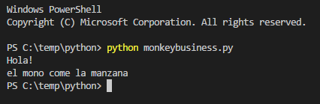
Behind the Scenes
monkeybusiness.py
print(“Hola!”)
print(“el mono come la manzana”)
You can type this in any text editor. Some are more helpful than others
C:\> python monkeybusiness.py
If you installed Anaconda correctly, this will work anywhere
Python checks your file for obvious mistakes and compiles it to bytecode, then immediately runs it.

Slide 22
Behind the Scenes
Python code typically run from command line or within editor
No separate linking, compiling steps
After running Python once, it creates a .pyc file that contains compiled code. You can ignore it.
If you run the code again, it will automatically find the compiled file, if it is identical to your code.
Other tools, such a “pdb” to debug code
Type “pdb [file].py” at command line

Slide 23
Behind the Scenes
Anaconda installs a completely separate Python installation
Adds PATH to point “python” to Anaconda instead of system installation
Can also invoke Anaconda python by starting “anaconda prompt” from Windows start menu.

Slide 24
Why Anaconda?
Package management
Keep packages and dependencies working together
Easily update packages
Separate from system python
Isolated
Distribute programs
Without Anaconda, package management nightmare

Slide 25
How can I use Python?
type python at command prompt to bring up an interactive shell
type ipython at the command prompt to bring up a more helpful interactive shell!
Write a program and save it as a *.py file. Run it on the command prompt by typing python *.py
Use an editor with python integrated into it, such as PyCharm, Spyder, Microsoft Visual Code, etc. IDLE is not recommended.
Use jupyter notebooks. Type jupyter notebook to begin.

Slide 26
What do I use?
Shell
Personally, rarely used
Jupyter Notebook
Personally, mostly used
Share with others
Editor
Developing full application
Organize multiple files
Testing things out
Debugging
Interact with data and document work
Robust debugging and variable tracking

Slide 27
Suggested Editors (Windows)
Lightweight – Good for quick, one off scripts
Microsoft Visual Code
Sublime Text
Notepad++
Atom
Vim/Emacs
Full IDE – Full development environment
PyCharm – full development IDE, handle many files and assets
Spyder – like MATLAB or Rstudio
Unique – Good for prototyping, and quick scripts
Jupyter Notebook

Slide 28
What to look for
Syntax highlighting
Auto-indentation
4 spaces! No tabs!
Auto completion
Something you’re comfortable with

Slide 29
Jupyter Notebook
A web-based python editor
Automatic syntax highlighting, indentation, and tab completion
Shows inputs and outputs
Can be used to document an entire project
Go to any directory and type jupyter notebook

Slide 30
Try out Jupyter Notebooks
Open command line in the following folder on your computer
C:\...\Python-Data-Analysis-Course\notebooks
Type jupyter notebook
Open the Python Basics notebook
After that, feel free to try spyder or ipython

Slide 31
What do we mean by data analysis?
Monitoring data
Model pre- and post- processing
Streaming data streams
Time series data
What else?

Slide 32
What tools do we use to do this?
Excel
Access
Custom programs
Other databases
R
Python

Slide 33
Adoption
Doing what you’re used to
Doing something new
Effort →
Usage
Progression of Project →
Notes:
Any new methodology requires activation energy. Our goal is to only have this activation energy take place once, as a company.
Dividends will pay off down the road

Slide 34
Case Study
HORROR
STORY
You are compiling and analyzing flow data from a network of sewer meters.
Date | Time | Location | Flow
You receive 15 csv files, 2 text files, a pdf, and an Excel spreadsheet with “flow data”
What do you do with it?
What’s different if you are expecting the same batch of data every month?

Slide 35
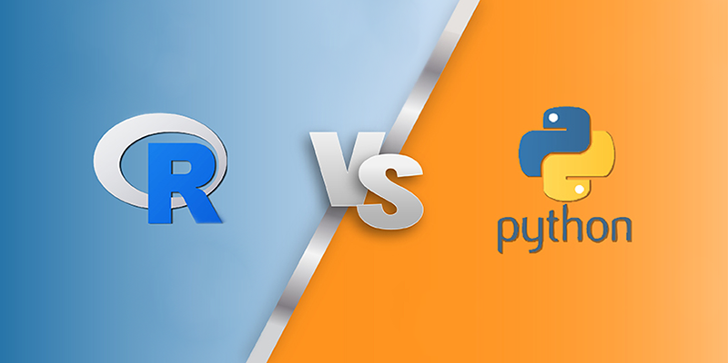

Slide 36
R
Programming language created by statisticians and mathematicians
Huge library of statistical and modeling functions
Great graphics support
Wide user community
Python
Programming language named after Monty Python
More general purpose than R
Can be used for much more than data analysis
Great graphics support
With Pandas, puts it on a level playing field with R for data analysis
Wide user community

Slide 37
The other tool…Excel
Used by consultants
Great user interface
Everybody has it
Shallow learning curve
Unstructured
Non-linear setup
Great for prototyping and one-off calcs
Not most efficient for repetitive work
Limited graphical capabilities

Slide 38
Adoption
Doing what you’re used to
Doing something new
Effort →
Usage
Progression of Project →
Notes:
Any new methodology requires activation energy. Our goal is to only have this activation energy take place once, as a company.
Dividends will pay off down the road

Slide 39
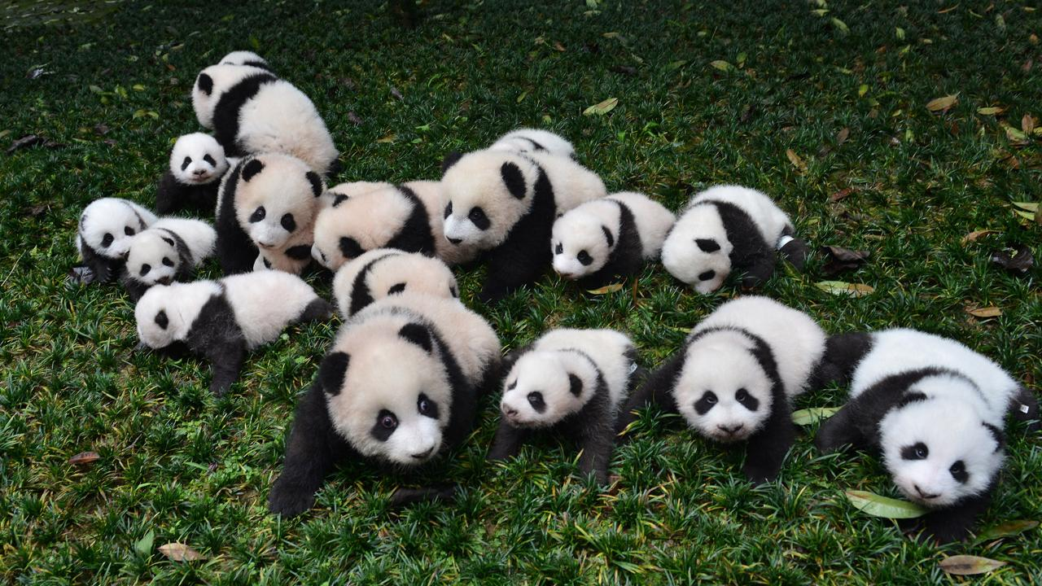
Python’s Data Analysis Modules
Numpy
Introduced matrix math
import numpy as np
Matplotlib
Introduced easy 2D plotting, similar to MATLAB
import matplotlib.pyplot as plt
Pandas
Introduced dataframes, copied from R
import pandas as pd
These modules put Python on the same playing field as R for data analysis

Slide 40
Typical Workflow
Clean up and organize data
Excel for irregular data
Import data into Pandas dataframe
Do something to the data
Analyze
Calculate
Summarize
Visualize
Explore
Export data or visualization to text file, Excel, website

