Slide 1


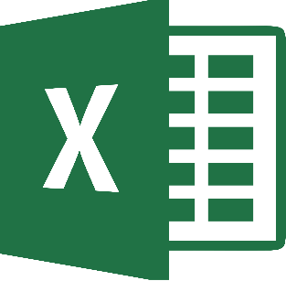





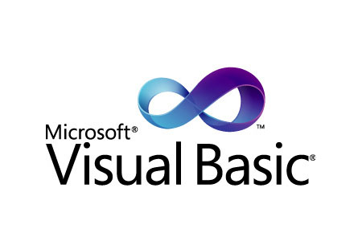
Ja-FORT-C++

Slide 2
Programming Languages
Ja-FORT-C++

Slide 3
Programming Languages
Ja-FORT-C++

