Slide 1


Data Analysis in Python
Day 2 of 2
April 24, 2018

Slide 2
Get GitHub Repository
https://github.com/LimnoTech
Click on Python-Data-Analysis-Course
Clone repository or download the zip file

Slide 3
Agenda
Day 1
What is Python?
Basic Python syntax
Under the Hood
Anaconda Introduction
Python Editor Choices
HANDS ON Jupyter Notebook
Data Analysis Choices
Day 2
Data Analysis in Python
Pandas Basics
HANDS ON Intro to Pandas
Matplotlib Basics
HANDS ON Intro to Matplotlib
HANDS ON Start-to-finish exercise
Other Python modules and projects

Slide 4
Setting Expectations
We have 1.5 hours to cover what I’ve seen advertised as a 6-week course
I am not an expert
Most of this is based on my personal experience, so please speak up if you’ve had a different experience
Learning and retaining requires additional work
Create excuses to use what you’ve learned
There is a WIDE range of backgrounds and experience levels here. Please participate!

Slide 5
My Goals
Give you the tools you need to fearlessly decide to use Python, if appropriate, and get started on a project.
Show you where to look for or who to ask for more information
Make sure the tools we choose aren’t limiting our ability
Keep the community going after this course
Any others?

Slide 6
What can I use Python for?
Reading/parsing files
Web development
Visualizations
Database interface
Web scraping
Interacting with ArcGIS and other software
Web APIs
…will go over some of these later tomorrow. Most applications already have libraries developed

Slide 7
Python vs. R (my personal view)
Don’t throw stones at me!
Python is a full featured, powerful programming language that happens to have great data analysis tools (that are mostly based on R).
R is a data analysis tool that has grown to incorporate so many other things that it has become a full featured programming language.

Slide 8
Python syntax in 5 minutes
No time to go into detail – check out https://learnxinyminutes.com/docs/python3/

Slide 9
Python syntax in 5 minutes
No ; at the end of a line. Indentation is important. Use 4 spaces, NOT TABS. Set your editor to turn the tab key into 4 spaces.
Asignment uses = and comparison uses ==
a = 4
if a==True: Do Something
+ - * / % are as expected
+ also used to concatenate strings “he” + “llo” = “hello”
/ does exact division in Python 3 (Not in Python 2).
5/2 = 2 (Python 2)
5/2 = 2.5 (Python 3)
Basic printing uses print(“print me”)

Slide 10
Python syntax in 5 minutes
Variables don’t need to be declared
Python figures out the variable types on its own
Strings can use “hello” or ‘hello’
“Mr. O’neill went to the store” is OK
Comments start with #
Names are case sensitive and cannot start with a number

Slide 11
Python in 5 minutes
Number
5
3.4
String
“Hello”
List
a = [4,5,6,’apple’,3,2]
a[1] = 5
Tuple – a list that can’t be changed
a = (4,5,6,7,’a’,’pizza’)
a[2] = 6
Dictionary
room_num = {‘john’: 425, ‘tom’:212}
room_num[‘john’] returns 425

Slide 12
Python in 5 minutes
Standard Library
print
print(“hello”)
simple math
a = 5 + 5
read and write
(we’ll use Pandas to read and write files)
for loops
for i in [‘hello’,’goodbye’]:
print(i)

Slide 13
Python in 5 minutes
Powerful for loops – loop over anything
for i in range(5):
print(i)
list = [‘a’,’b’]
for i,j in enumerate(list):
print(i,j)
dict = {‘a’:159,
‘b’:300}
for k,v in dict.items():
print(k,v)
0
1
2
3
4
5
0 a
1 b
a 159
b 300

Slide 14
Python in 5 Minutes
Modules are added at the beginning of a script.
We’ll be using pandas, matplotlib, numpy, and some other packages
You can name them something convenient to type less
import pandas as pd
import matplotlib.pyplot as plt
import numpy as np
from datetime import datetime as dt
To use a function or method from an imported module, append it with a dot.
np.pi() = 3.1415…
plt.plot([1,2,3],[4,5,6]) plots a graph

Slide 15
Typical Python Program
Import modules
Define global variables
(Define functions or classes)
Run the program
import pandas as pd
file = ‘samplefile.xls’
dataframe = pd.read_excel(file)
dataframe.plot()

Slide 16
Suggested Editors (Windows)
Lightweight – Good for quick, one off scripts
Microsoft Visual Code
Sublime Text
Notepad++
Atom
Vim/Emacs
Full IDE – Full development environment
PyCharm – full development IDE, handle many files and assets
Spyder – like MATLAB or Rstudio
Unique – Good for prototyping, and quick scripts
Jupyter Notebook

Slide 17
What to look for
Syntax highlighting
Auto-indentation
4 spaces! No tabs!
Auto completion
Something you’re comfortable with

Slide 18
Jupyter Notebook
A web-based python editor
Automatic syntax highlighting, indentation, and tab completion
Shows inputs and outputs
Can be used to document an entire project
Go to any directory and type jupyter notebook

Slide 19

Python’s Data Analysis Modules
Numpy
Introduced matrix math
import numpy as np
Matplotlib
Introduced easy 2D plotting, similar to MATLAB
import matplotlib.pyplot as plt
Pandas
Introduced dataframes, copied from R
import pandas as pd
These modules put Python on the same playing field as R for data analysis

Slide 20
Typical Workflow
Clean up and organize data
Excel for irregular data
Import data into Pandas dataframe
Do something to the data
Analyze
Calculate
Summarize
Visualize
Explore
Export data or visualization to text file, Excel, website

Slide 21
Pandas
pandas is a Python package providing fast, flexible, and expressive data structures designed to make working with “relational” or “labeled” data both easy and intuitive. It aims to be the fundamental high-level building block for doing practical, real world data analysis in Python. Additionally, it has the broader goal of becoming the most powerful and flexible open source data analysis / manipulation tool available in any language. It is already well on its way toward this goal.

Slide 22
Why will this make my life easier?
Easy handling of missing data (represented as NaN) in floating point as well as non-floating point data
Size mutability: columns can be inserted and deleted from DataFrame and higher dimensional objects
Automatic and explicit data alignment: objects can be explicitly aligned to a set of labels, or the user can simply ignore the labels and let Series, DataFrame, etc. automatically align the data for you in computations
Powerful, flexible group by functionality to perform split-apply-combine operations on data sets, for both aggregating and transforming data
Make it easy to convert ragged, differently-indexed data in other Python and NumPy data structures into DataFrame objects
Intelligent label-based slicing, fancy indexing, and subsetting of large data sets
Intuitive merging and joining data sets
Flexible reshaping and pivoting of data sets
Hierarchical labeling of axes (possible to have multiple labels per tick)
Robust IO tools for loading data from flat files (CSV and delimited), Excel files, databases, and saving / loading data from the ultrafast HDF5 format
Time series-specific functionality: date range generation and frequency conversion, moving window statistics, moving window linear regressions, date shifting and lagging, etc.

Slide 23
Series and DataFrames
Series: 1-D array – data with an index (or not)
DataFrame: multi-D array with an index (or not). Made up of multiple Series.

Slide 24
Data I/O
Import pandas
Import pandas as pd
Read data or create data
df = pd.read_excel(‘file’)
See documentation for many ways to modify this
Pandas will guess at unknowns (it does a decent job)
Pandas will parse dates very well
Set it and forget it. It’s worth it.
If you have problems reading a CSV file, it’s probably Excel’s fault
df = pd.DataFrame([1,2,3,4],index=[‘a’,’b’,’c’,’d’])
Do something to it
Anything at all
Write data
df.to_xxx(‘outfile’) OR to a database:
df.to_sql(‘tablename’,con=enginename) #requires one other line of code above

Slide 25
Common read parameters
df = pd.read_table([file name], param1=x, param2=x) read_csv read_json read_excel
sheet_name = name or number of Excel sheet
header = row number of header row
skiprows = number of rows to skip at the top
index_col = number of column to use as a row index
names = list of manually defined column names
usecols = list of column numbers to use (don’t waste time reading data you don’t need)
parse_dates = True|False Pandas tries to parse dates into datetime objects. Very useful and well done, but slow. Can also hard code date converter.
See documentation for more….
Specialized functions for: csv, json, html, clipboard, excel, hdf, feather, parquet, msgpack, stata, sas, pickle, sql, gbq. read_table is most general.

Slide 26
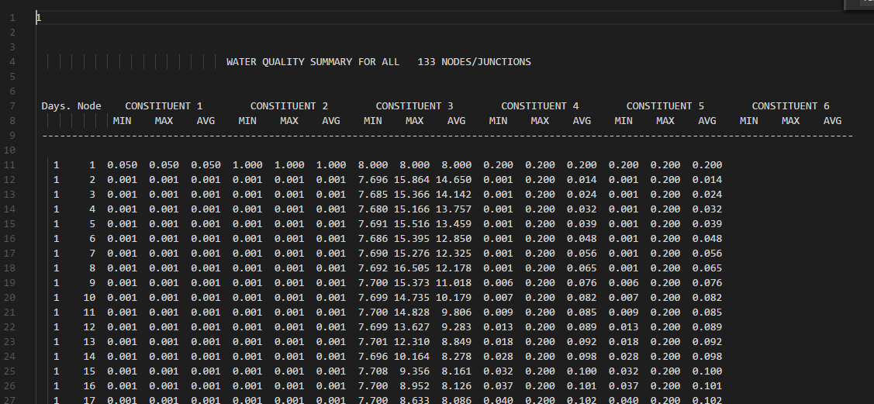
Sample read function
df = pd.read_table(jsmfile, delim_whitespace=True, skiprows=10, usecols=[0,1,15], skip_blank_lines=False, header=None, names=["days", "node", "RawEC"])
jsmfile:

Slide 27
df = pd.read_excel(‘pathtodata.xlsx’,index_col=0)
read_table
read_sql
read_csv…
df[‘Series1’] = [1 9
2 6
…
7 3000]
DataFrame “df”
df[‘Series1’].max() = 8500
Index | Series1 | Series2 | Series3 | Series4
1 | 9 | Yes | mg/m3 | Bladensburg
2 | 6 | No | mg/m3 | Benning Road
3 | 6 | No | mg/m3 | Ana PA Ave
4 | 8500 | Yes | mpn/100ml | Bladensburg
5 | 1120 | No | mpn/100ml | Benning Road
6 | 4100 | Yes | mpn/100ml | Ana PA Ave
7 | 3000 | No | mpn/100ml | Upstream Rockcreek
df[‘Series1’].sum() = 16741
df2 = df[df[‘Series2’]==“Yes”]=
df[T,F,F,T,F,T,F]=
Index | Series1 | Series2 | Series3 | Series4
1 | 9 | Yes | mg/m3 | Bladensburg
4 | 8500 | Yes | mpn/100ml | Bladensburg
6 | 4100 | Yes | mpn/100ml | Ana PA Ave
df[df[‘Series2’]==“Yes”][‘Series1’].sum()=
[9,8500,4100].sum()= 12609
df2.to_excel(‘pathto_output.xlsx’)
to_json
to_sql
to_csv…

Slide 28
Useful pandas functions
See Cheat Sheet in folder

Slide 29
Subset Observations
df.head(5) #Display the first 5 rows
df.tail(5) #Display the last 5 rows
df.sample(frac=0.5) #Randomly select half of the rows
df.describe() #Display basic stats
Slice data
iloc for numerical indices, loc for named indices
df.iloc[10:20,2:3] #Display rows 10-20, columns 2-3 (0 index)
df.iloc[:,2:3] #Display all rows, columns 2-3
df.loc[:,’C’] #Display column C Same as df[‘C’]
df[’C’] = df[’A’] #Copy column A as column C

Slide 30
Doing stuff to data
df[’C’] = df[’A’] * 0.4536
Apply an operation to a column
Can also use apply for a complicated function
df[’C’] = df[’A’].apply(np.log)
Take the log of everything in column C.
def myfunction(x):
return x+x-x*x/35+22
df[’C’] = df[’A’].apply(myfunction)
Do complicated math

Slide 31
Demo number 1

Slide 32
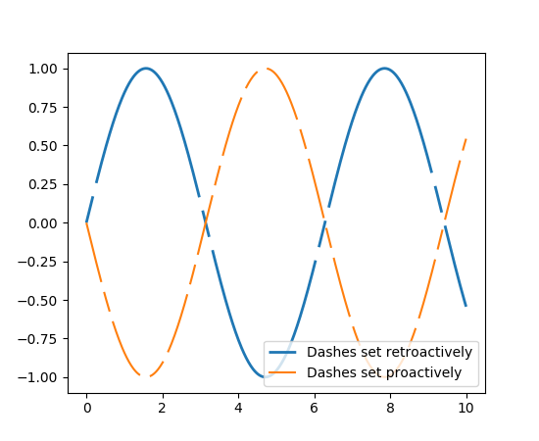
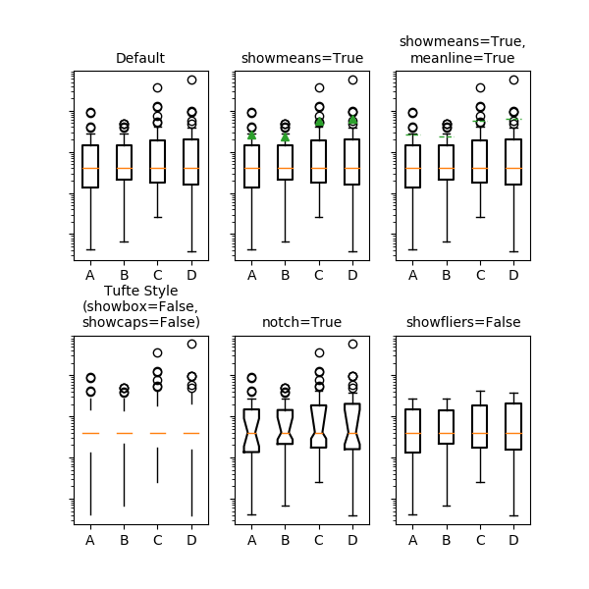
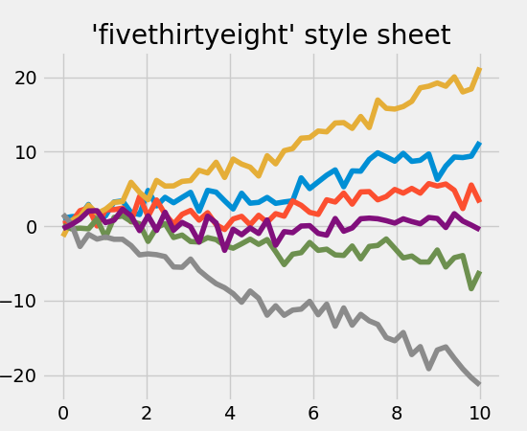
Intro to Matplotlib
If you’ve plotted in MATLAB, this will be familiar
Matplotlib is incorporated in jupyter notebooks for interactive plotting
Use another editor to export to high quality .png

Slide 33
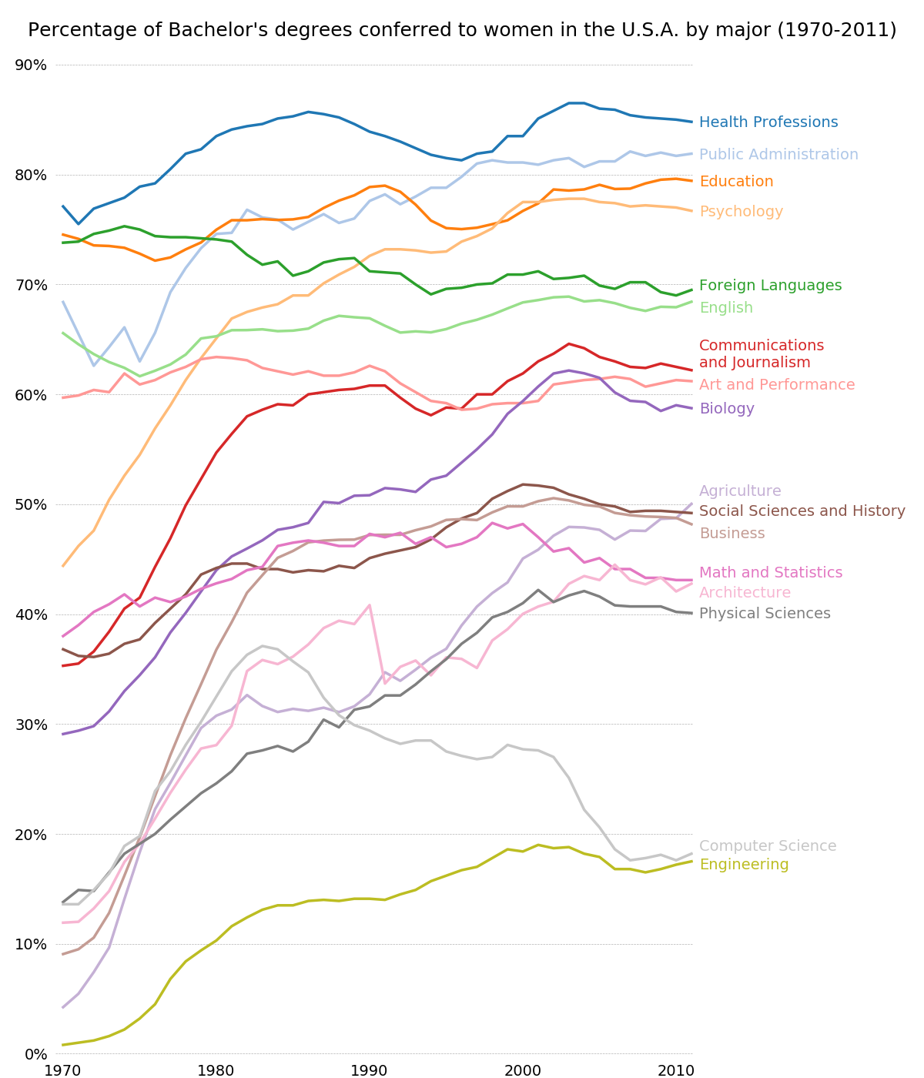
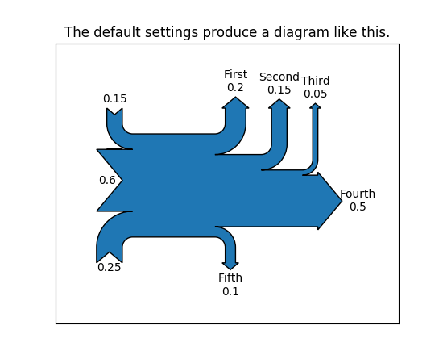
Intro to Matplotlib
Go to https://matplotlib.org/gallery.html for great starting points.
Find a plot that is similar to what you want to do and make modifications.

Slide 34
Non-static graphics
Other packages are better for animations, non-static graphics, and web-based graphics
Bokeh
Plotly
Geoplotlib
Seaborn
ggplot (for you R pros – ported ggplot package)

Slide 35
All Matplotlib Plots Follow the Same Recipe
#Import Modules
import matplotlib.pyplot as plt
import pandas as pd
#Import Data
df = pd.read_excel("Output_data/df_daily.xlsx",index_col=0)

Slide 36
Matplotlib Recipe
Step 1. Create a figure. A figure is a single page with 1 or more plots on it.
Step 2. Create an axis. This is a single "plot".
Step 3. Draw your plot. Basic function is plot(xdata,ydata,...other optional parameters)
See https://matplotlib.org/api/_as_gen/matplotlib.pyplot.plot.html
Step 4. Personalize it!
This is where you’ll spend the most time getting your plot to look the way you want it to look. Nearly infinite ways to customize a plot
Step 5: Output it! Or View it.
fig = plt.figure(figsize=(11,8))
#The 1,1,1 is a short cut for a page layout. 1 plot vertically on page, 1 plot horizontally on page, and this is the first one.
ax = fig.add_subplot(1,1,1)
x = df.index
y1 = df["Precip_in"]
l1 = ax.plot(x,y1) #you can add MANY MANY MANY parameters here to parameterize your plot
ax.set_title("Daily Rainfall at DCA")
ax.set_ylabel("Date")
ax.set_xlabel("Rainfall, in")
ax.grid()
plt.tight_layout() #Makes the plot fill the page and fix spacing
plt.savefig("Output_data/dailyrain.png",dpi=600)
#plt.show()

Slide 37
Demos

Slide 38
Other Standard Python Libraries
glob selects files based on wildcard characters
common usage:
a = glob(“*.csv”) will produce a list of paths to every file in the current directory that matches *.csv.
re regular expressions
os interact with the operating system and paths
datetime very useful datetime objects. Time zones. Time math.

Slide 39
More Python Packages
Requests Interact with web services
json Parse json files easily
ElementTree Parse xml and other structured data
BeautifulSoup HTML and web scraping
Django Full-featured web framework
Flask Smaller, nimbler web framework
Jekyll Even smaller static website generator from markdown
NetCDF4 API for NetCDF4 C library
PySWMM Interact with SWMM models
SQLAlchemy Intuitive database connections. Nearly database agnostic.

Slide 40
Some examples

