Slide 1
Aircraft Analysis from Aviation Accident Data

Slide 2
Overview
Brief intro to the aviation industry
The aviation industry is a vital component of the global economy, facilitating fast and efficient transportation of people and goods across long distances.
Purpose of the analysis
To support our company's strategic entry into the aviation industry by analyzing historical accident data focusing on aircraft types, flight phases, and contributing factors in order to uncover key safety risks and provide actionable insights that will guide operational planning and risk management decisions.

Slide 3
Business Understanding
As part of its diversification strategy, our company is expanding into the aviation sector specifically the operation of aircraft for both commercial and private use.
By analyzing aviation accident records, this project aims to uncover patterns related to accident frequency, flight phases, and fatality rates. These insights will directly support the Head of the Aviation Division in identifying safer and more reliable aircraft for purchase.

Slide 4
Business Understanding
Key Business Questions
Which aircraft types historically had the highest and lowest number of accidents?
During which phases of flight are accidents most likely to occur?
Which aircraft types are associated with the highest number of fatalities?
How does the purpose of flight impact accident rates?
What data-supported recommendations can be made to minimize risk when selecting aircraft?

Slide 5
Data Analysis
The goal of the analysis was to discover important trends and safety insights by examining different aspects of aviation accidents, such as aircraft type, flight phase, fatalities, and purpose of flight. Key visualizations in the next slides.

Slide 6
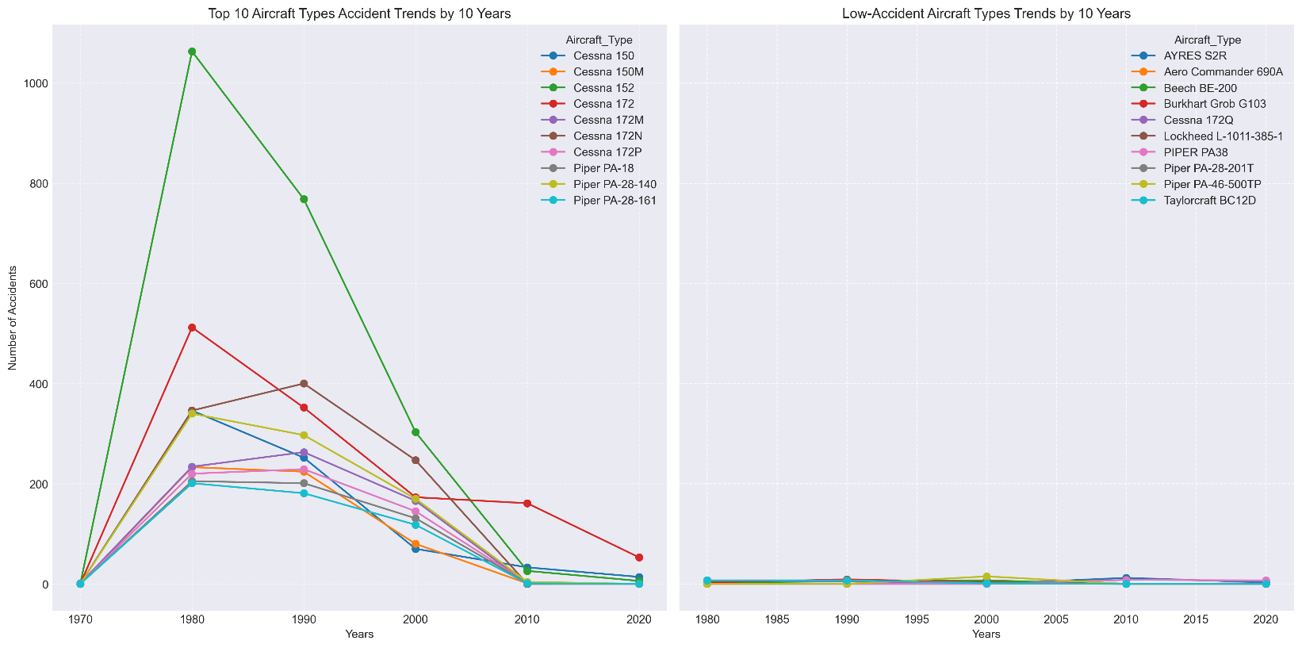
Data Analysis (Accident Trends Over Time)
Cessna aircrafts have the most accidents recorded with high accidents recorded between 1970 and 2000

Slide 7
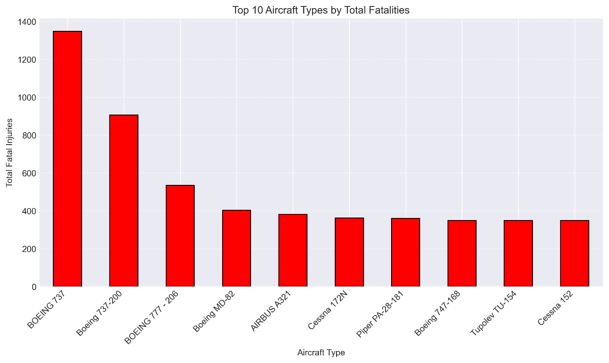
Data Analysis (Fatalities by Aircraft Type)
The chart shows which aircraft types are deadliest based on total fatalities, even if they didn’t crash often.
The analysis showed that the Boeing 737 and Boeing 737-200 accounted for the highest number of fatalities across all aircraft types in the dataset.

Slide 8
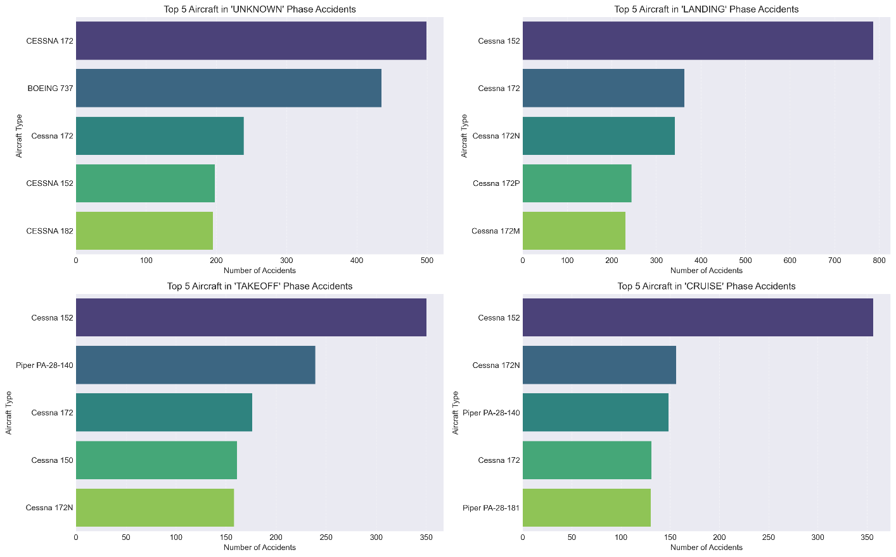
Data Analysis (Accidents by Phase of Flight)
Landing, takeoff, and cruise phases account for most of the accidents

Slide 9
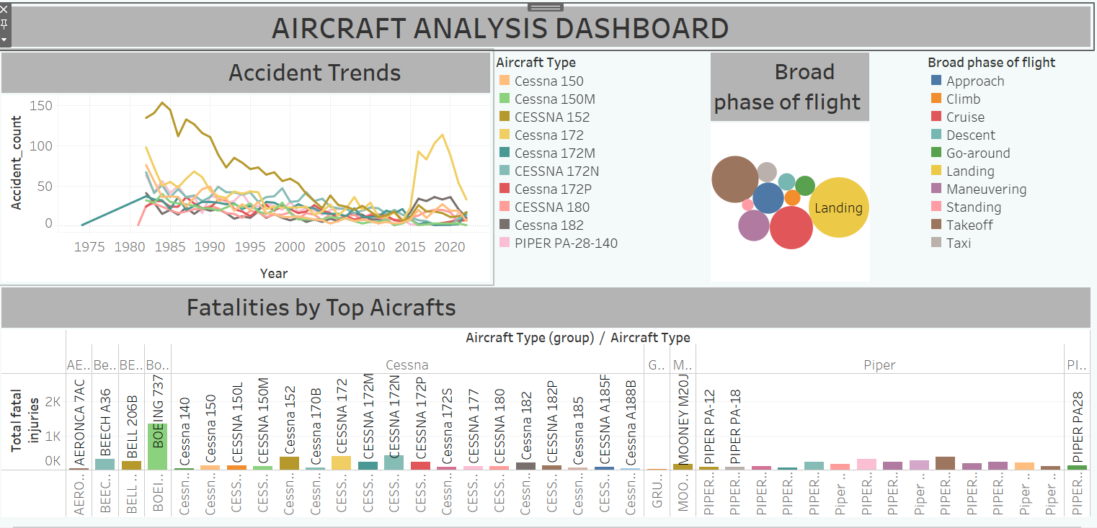
Data Analysis (Interactive Dashboard)

Slide 10
Business Recommendations
The analysis of aircraft accident trends, fatality rates, and flight purposes leads to the following strategic recommendations:
Enter the Commercial Aviation Sector, focusing on executive and corporate operations, where safety performance is more favorable.
Avoid High-Incident Aircraft such as the Cessna 152 and Cessna 172, which show a higher frequency of accidents.
Prioritize multi-engine Aircraft with low incident rates and strong safety records, especially during critical phases like takeoff and landing.
Start with Smaller, Safer Jets to minimize operational risk and gain industry experience.
Scale Gradually while maintaining a safety-first approach, positioning the company as a reliable and responsible aviation provider.

Slide 11
Next Steps
To support a safe and informed market entry, the following steps are recommended:
Conduct a Detailed Aircraft Evaluation Shortlist low-incident, multi-engine jets aligned with executive and corporate needs.
Engage Regulatory and Safety Experts Ensure compliance with national and international aviation safety standards.
Recruit Skilled Personnel and Pilots Focus on pilots with strong safety records and experience in corporate aviation.
Develop a Safety-First Operational Plan Include scenario-based training, emergency protocols, and phased onboarding of aircraft.
Continue Data-Driven Monitoring Integrate ongoing analytics into operations to refine strategy and manage risk.

Slide 12
Aircraft Analysis from Aviation Accident Data

