Slide 1

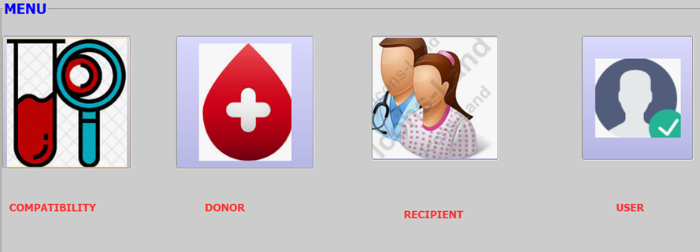
SIMPLE BLOOD TRANSFUSION MANAGEMENT SOFTWARE.
A software program to connect patients, Donors and Transfusion managers
Vincent Limo

Slide 2
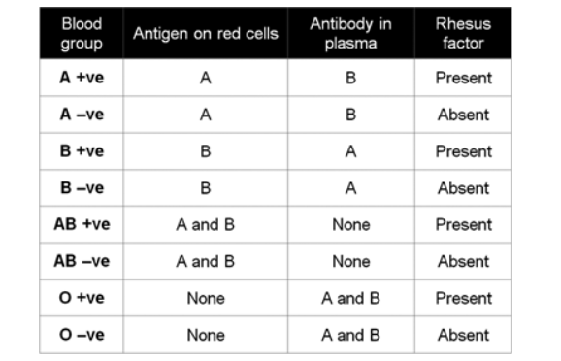
About Blood
Body fluid in human that transport oxygen, nutrients, wastes and cells
Contains
Blood Group ( A, B AB …)
Rhesus Factor ( with (+) Without (-)
Antigen ( a, b… )
Biologically, Blood Group, Antigens and Antibodies determined compatibility of blood during transfusion.

Slide 3
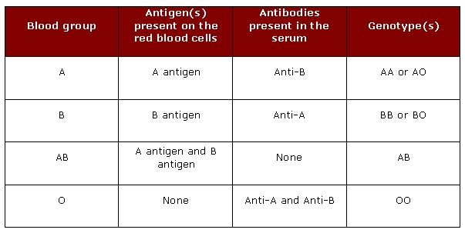
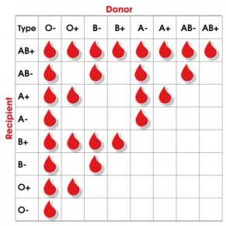
COMPATIBILITY
  Everyone has an ABO blood type (A, B, AB, or O) and an Rh factor (positive or negative)
  A and B genes are dominant and O is recessive (AA = A blood group)
  During transfusion, their should never be agglutination

Slide 4
Program
Audience / Market
Development environment
Primarily for:
Hospitals, Blood Trasnfusins agencies and Health units
Also useful for:
- Learning pursposes
Java Netbeans and SQLite

Slide 5
Program: How its works
The program;
Allows users to sign in, sign up and update, view and delete donors and recipient information.
allows Donors and recipient to add their information
Users can check blood compatibility of all/available donors for one and only one recipient
Users can add other users as well.

Slide 6
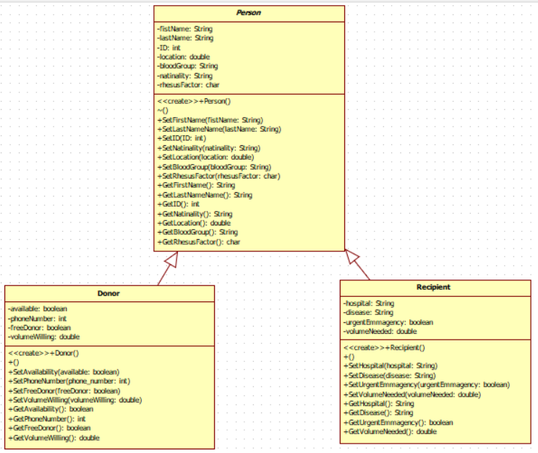
Program: Pre-Implementation classes

Slide 7
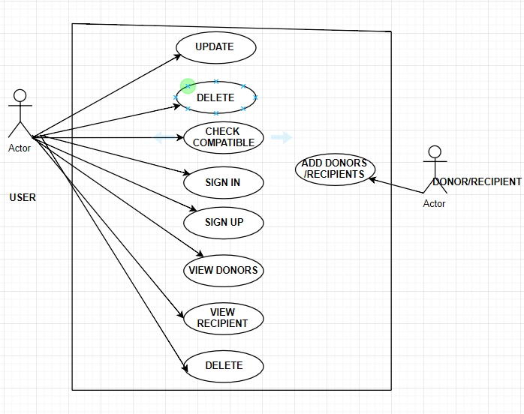
Program: Use Case Diagram.

Slide 8
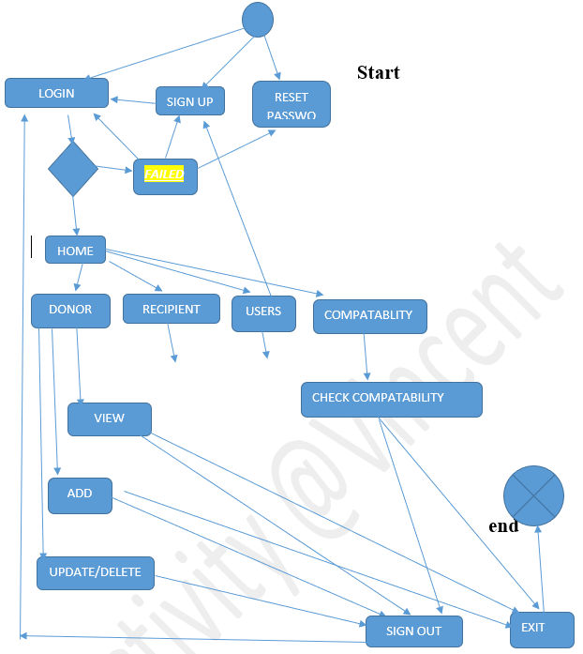
Program: Activity Diagram.

Slide 9
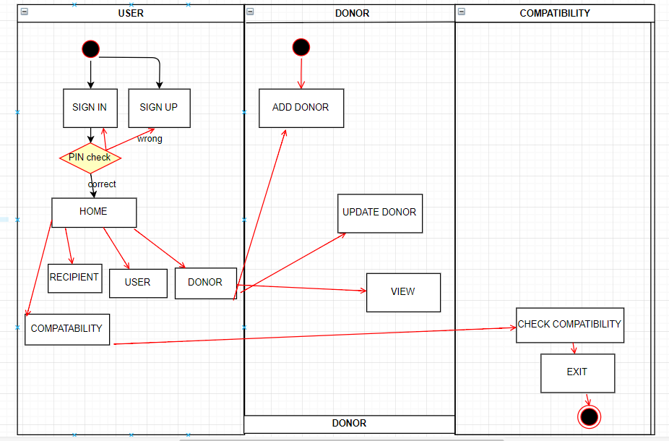
Program: Sequence diagram.

Slide 10

GUI, design and Analysis
Java is so secure
Use of Combo box reduces typing error
Used of Jtattoo jar makes user interface so attractive
Attractive and illustrative icons
ID’s and procedures/Steps prevents mistakes

Slide 11
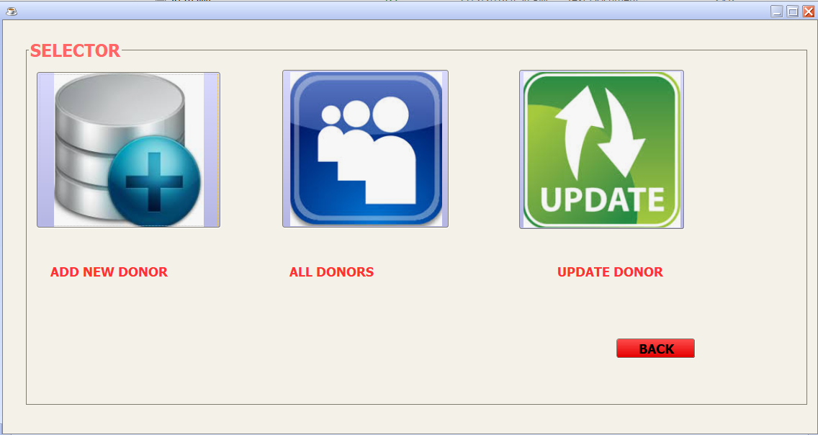
Thank You.

