Slide 1

Presentation Topic : Internet Control Message Protocol
Course Title: Data Communication
Course Code : ICT-3101
Presented By
Limon Hasan
ID: IT-24041
Department of Information and
Communication Technology
MBSTU
Supervised By
Dr. Nazrul Islam
Associate Professor,
Department of Information and
Communication Technology ,
MBSTU

Slide 2
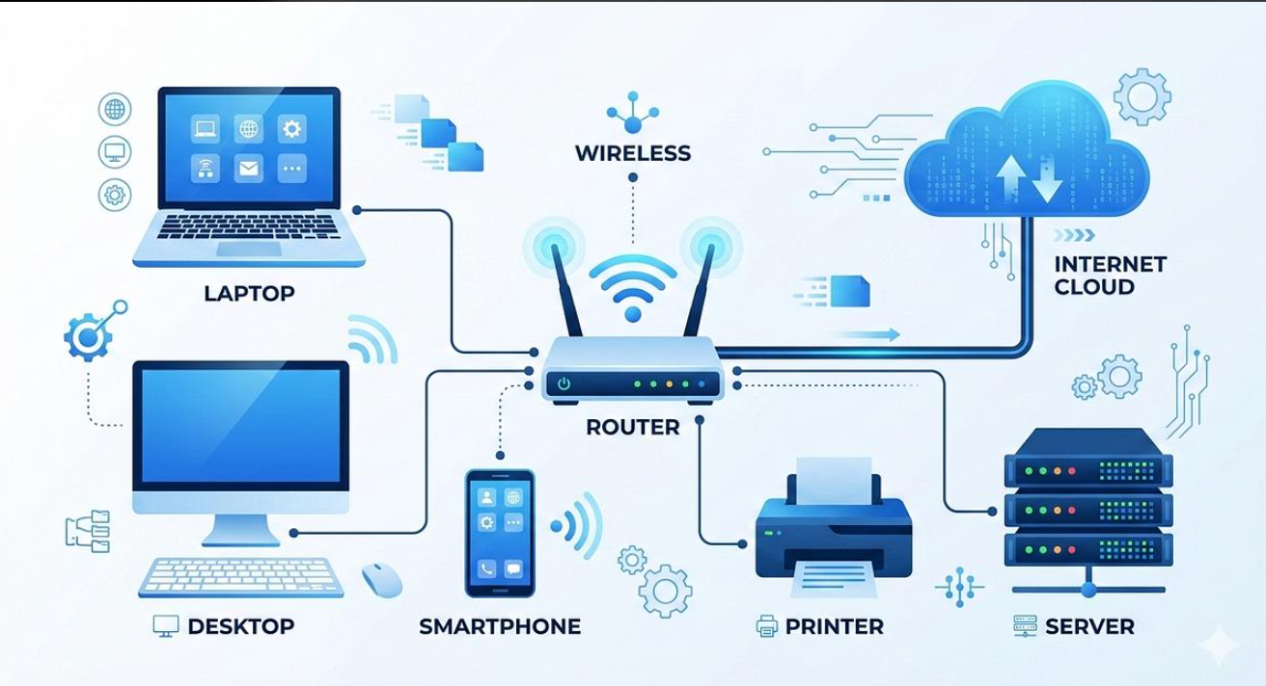
Introduction to ICMP
• ICMP stands for Internet Control Message Protocol.
• It is an important protocol in the TCP/IP protocol suite.
• It is mainly used for reporting network errors and diagnostic information.
• ICMP helps devices communicate information about network problems.
• It plays an important role in network troubleshooting.

Slide 3
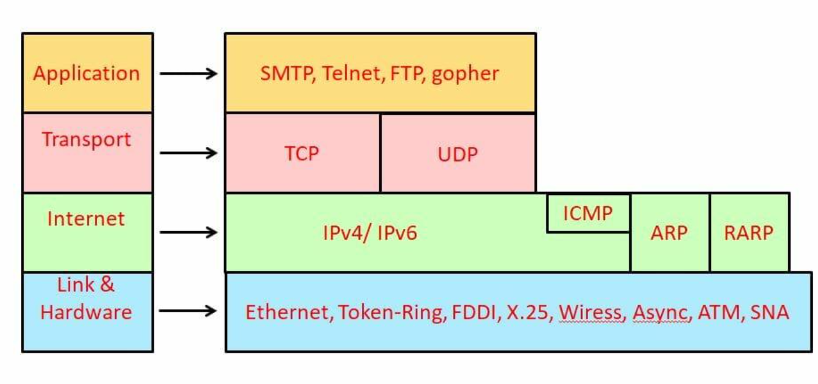
What is ICMP?
• ICMP is a network-layer control protocol.
• It works alongside the Internet Protocol (IP).
• It is used to send control and error-reporting messages.
• ICMP does not transmit application data like TCP or UDP.
• It helps identify communication problems between network devices.

Slide 4
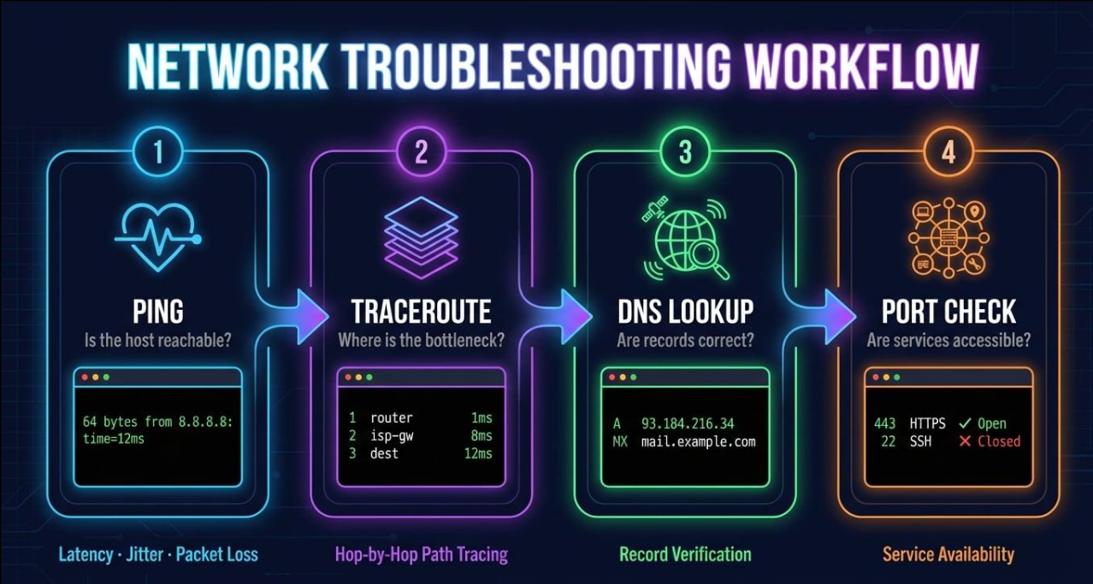
Why is ICMP Used?
1. Error Reporting:
Reports problems during packet delivery.
2. Connectivity Testing:
Checks whether a destination device is reachable.
3. Network Troubleshooting:
Helps identify network communication problems.
4. Diagnostic Information:
Provides information about network errors.
5. Response Time Measurement:
Helps measure network response time using tools like Ping.

Slide 5
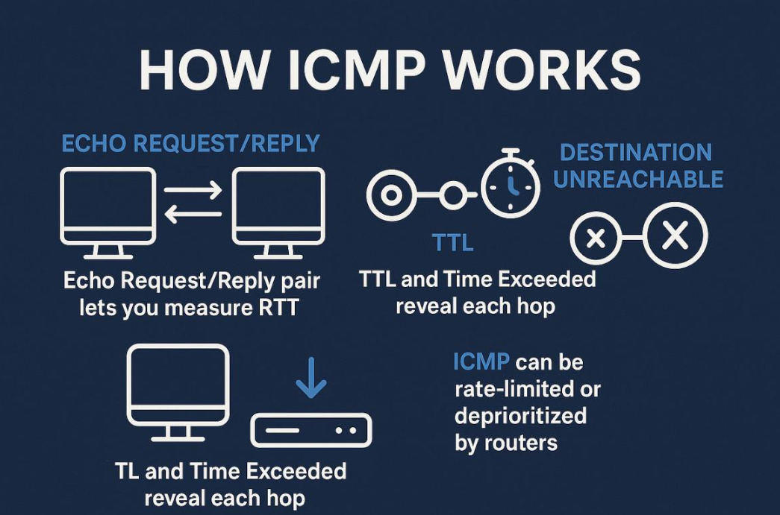
How Does ICMP Work?
1. A source device sends an IP packet to a destination.
2. The packet travels through the network.
3. If a network error occurs, an ICMP message may be generated.
4. The ICMP message is sent back to the source device.
5. The source device receives the message and identifies the problem.

Slide 6
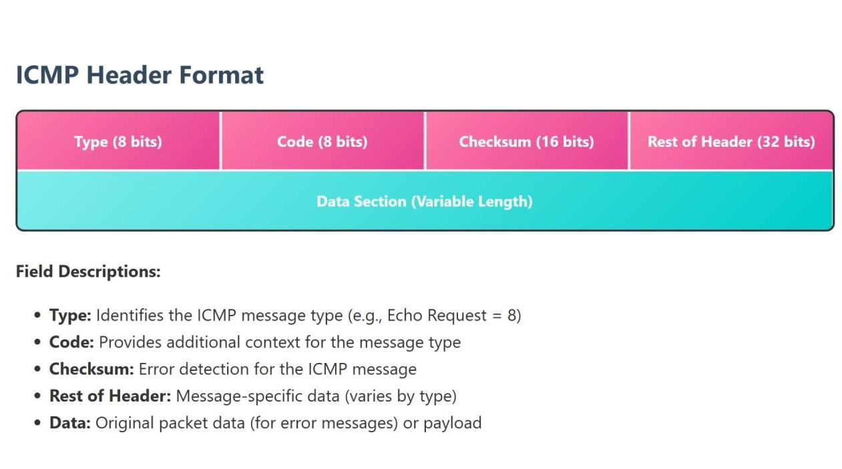
ICMP Message Format
An ICMP message consists of the following fields:
1. Type:
Identifies the type of ICMP message.
2. Code:
Provides additional information about the message.
3. Checksum:
Used to detect errors in the ICMP message.
4. Rest of Header:
Contains additional information depending on the message type.
5. Data:
Contains message-specific information.

Slide 7
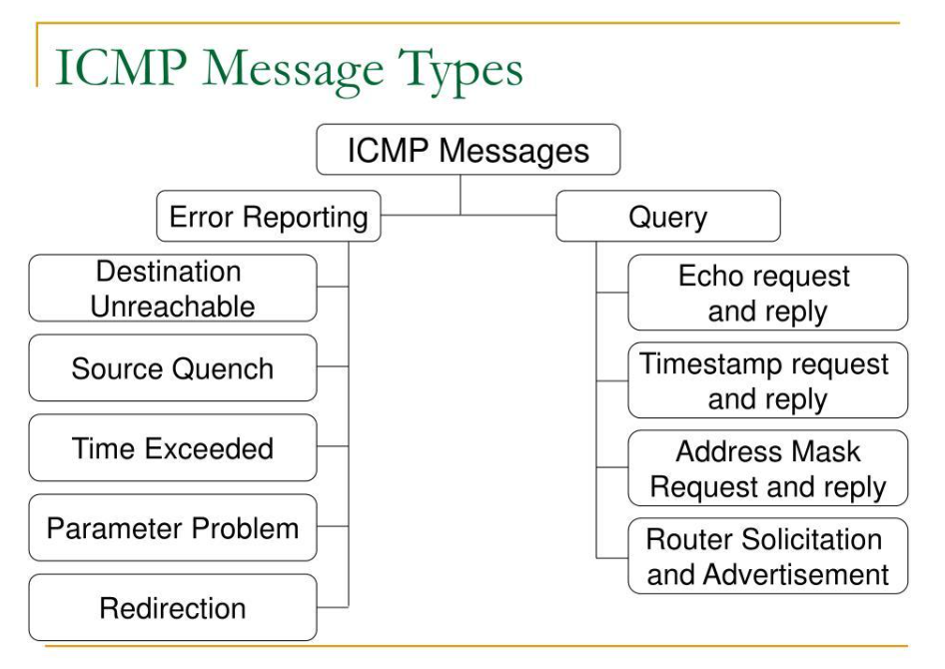
Types of ICMP Messages
ICMP messages are mainly divided into two categories:
1. Error-Reporting Messages:
• Destination Unreachable
• Time Exceeded
• Redirect
• Parameter Problem
2. Query and Informational Messages:
• Echo Request
• Echo Reply
These messages help monitor and diagnose network communication.

Slide 8
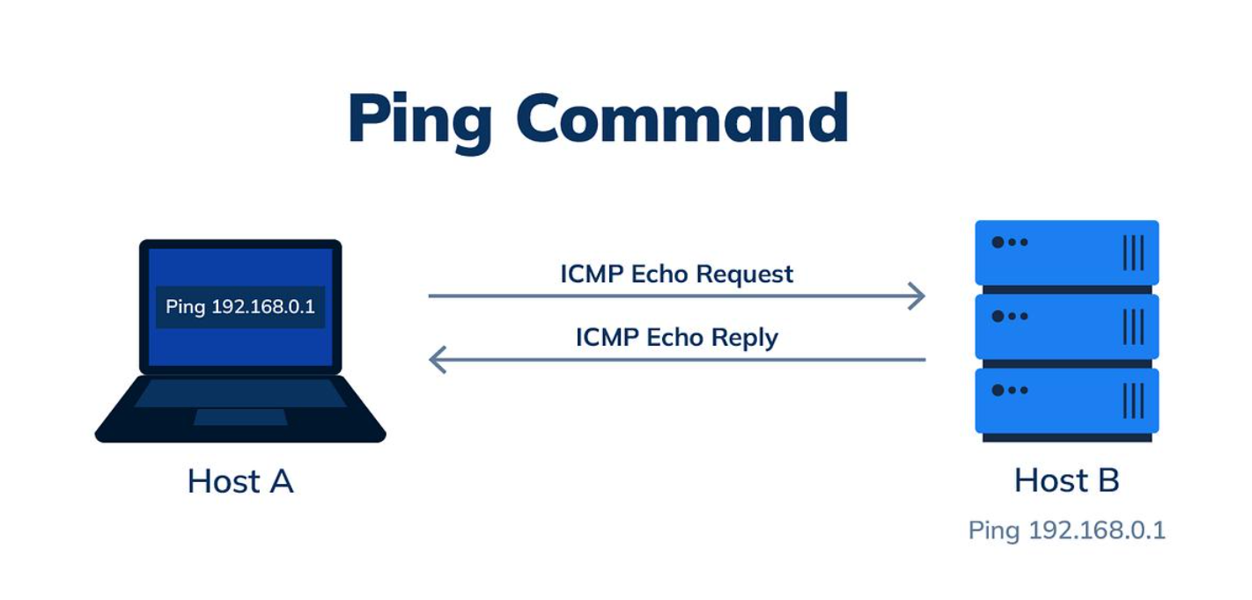
ICMP Echo Request and Echo Reply
• Echo Request:
A message sent by the source
device to check connectivity.
• Echo Reply:
A response sent by the destination device after receiving an Echo Request.
• These messages are used by the Ping command.
• They help determine whether a destination device is reachable.

Slide 9
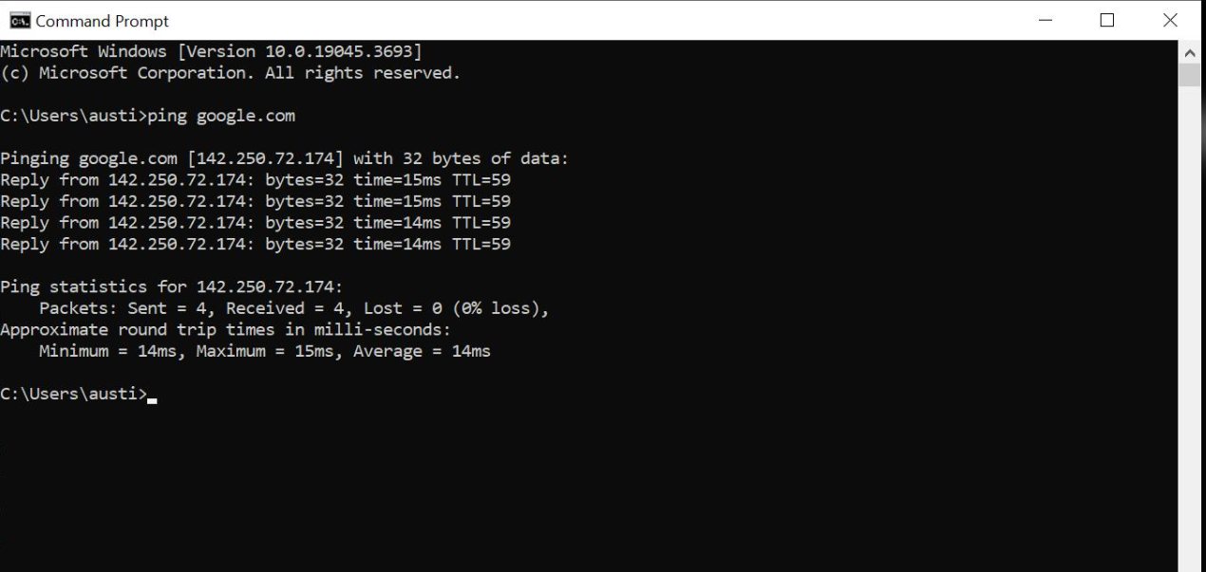
Practical Example – Ping Command
The Ping command is used to test network connectivity.
Example Command:
ping 8.8.8.8
Possible Output:
Reply from 8.8.8.8
Reply from 8.8.8.8
Reply from 8.8.8.8
Reply from 8.8.8.8
Explanation:
• Each reply indicates that the destination responded.
• Time shows the response time.
• TTL represents Time To Live.

Slide 10
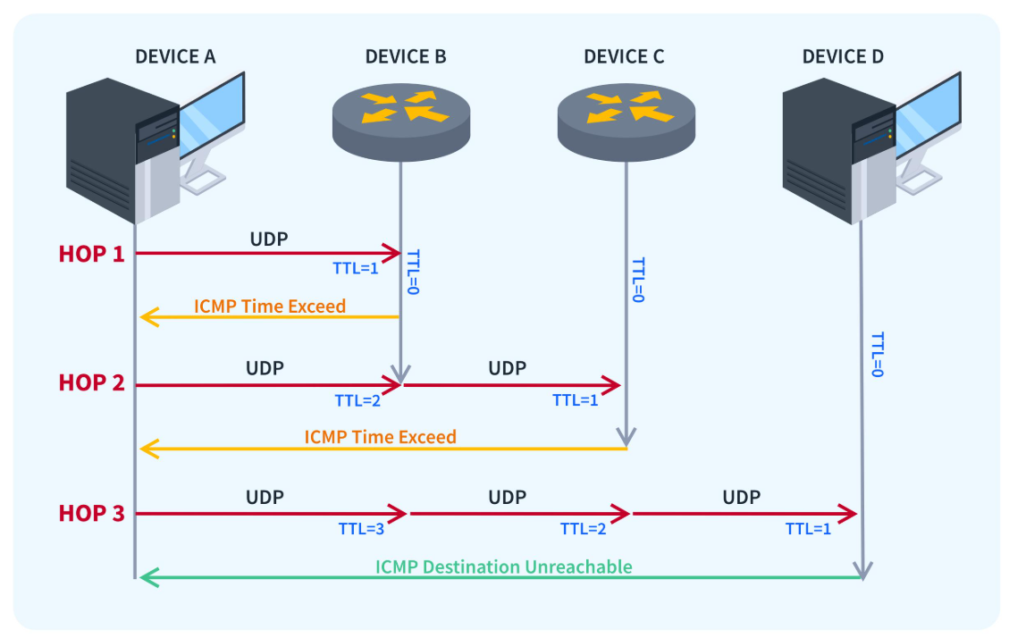
ICMP Error Messages
1. Destination Unreachable:
Indicates that a packet cannot reach its destination.
2. Time Exceeded:
Indicates that a packet's Time To Live (TTL) has
expired.
3. Redirect:
Informs a host about a better route to a destination.
4. Parameter Problem:
Indicates an error in the IP header.

Slide 11
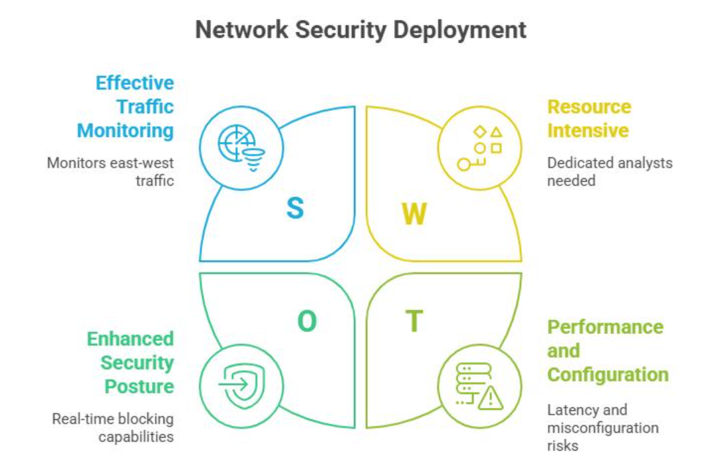
Advantages and Limitations of ICMP
• Helps identify network errors.
• Supports network troubleshooting.
• Tests network connectivity.
• Provides useful diagnostic information.
• Helps measure network response time.
• ICMP messages may be blocked by firewalls.
• Does not guarantee application availability.
• Can be misused in certain network attacks.
• Some devices may ignore ICMP requests.
• It does not provide reliable data delivery.

Slide 12

Conclusion
• ICMP is an important protocol in the TCP/IP suite.
• It helps report network errors and diagnostic information.
• The Ping command uses ICMP Echo Request and Echo Reply.
• ICMP plays an important role in network troubleshooting.
• It helps network administrators identify connectivity problems.
THANK YOU

